Slide 1
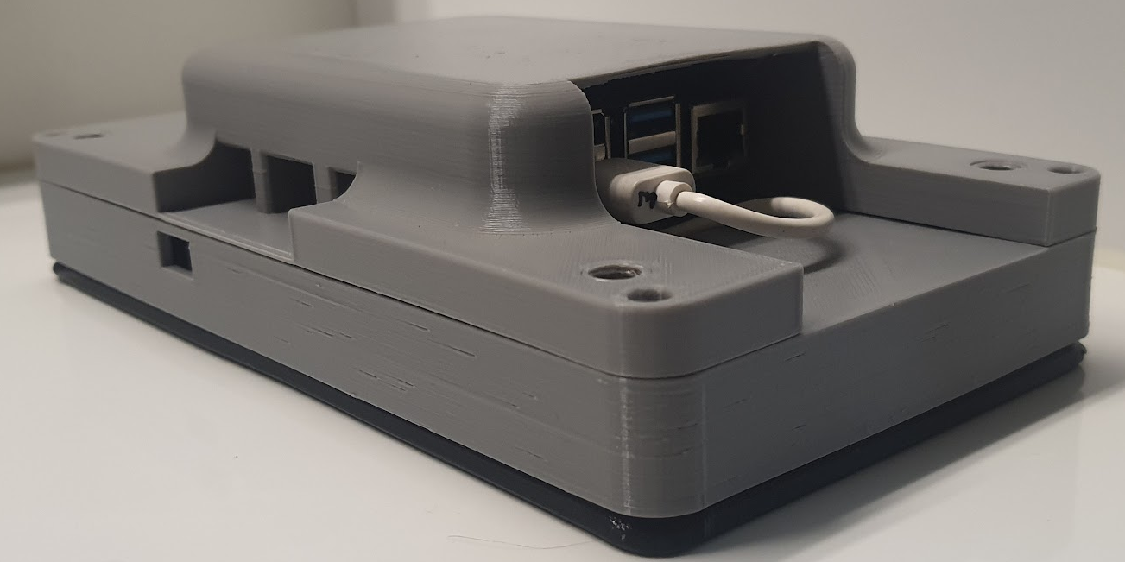
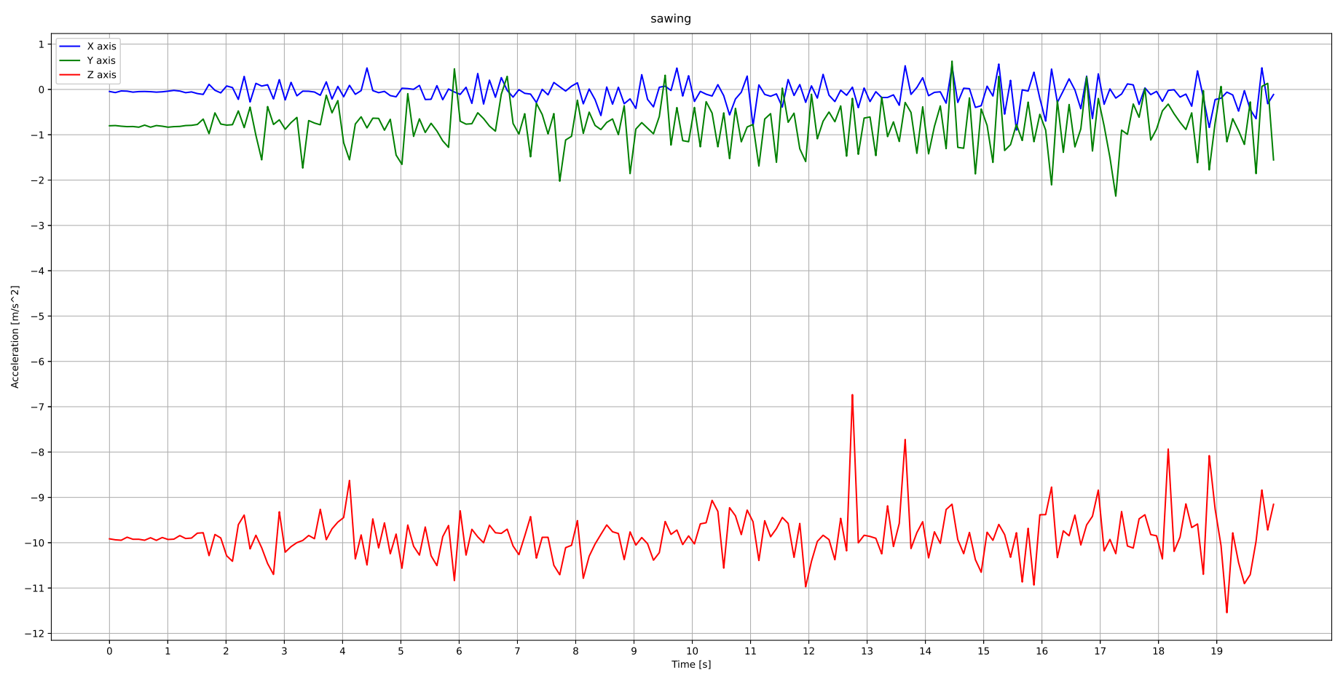
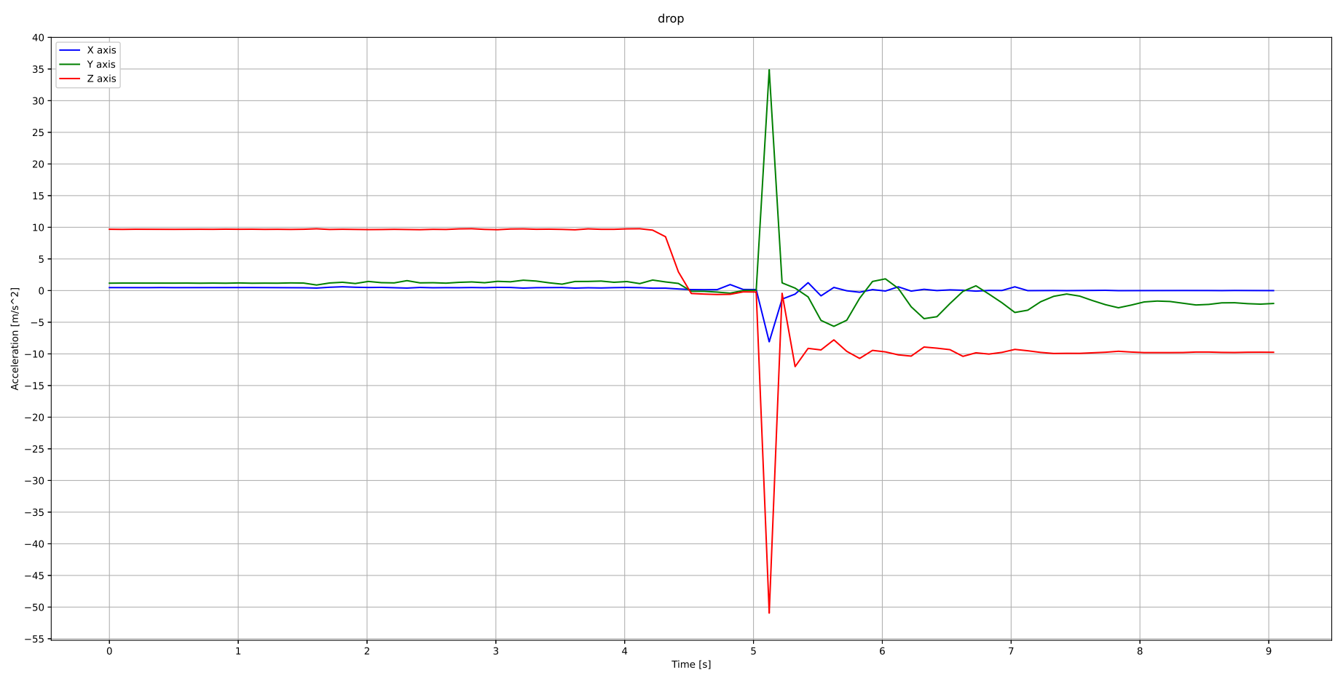
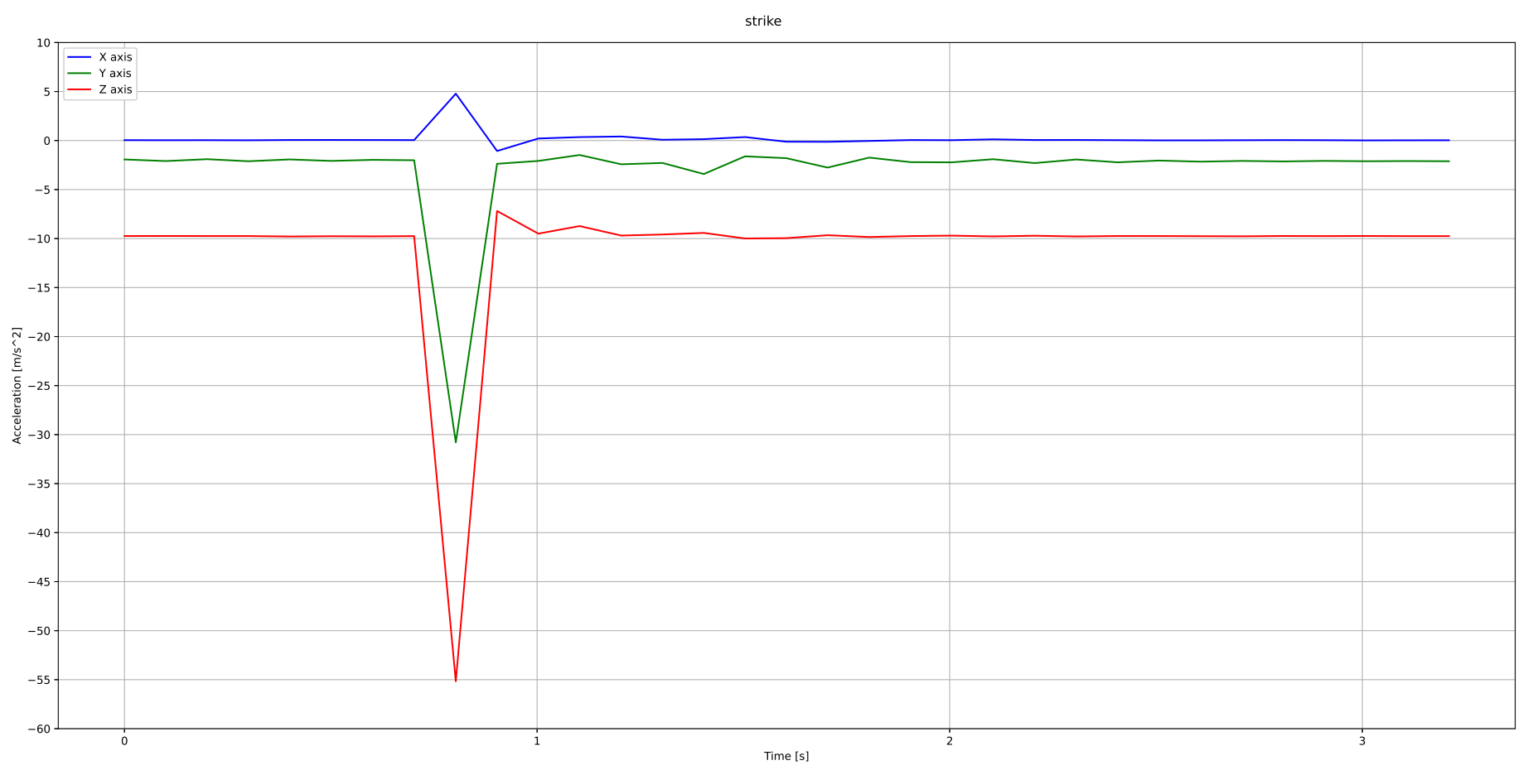
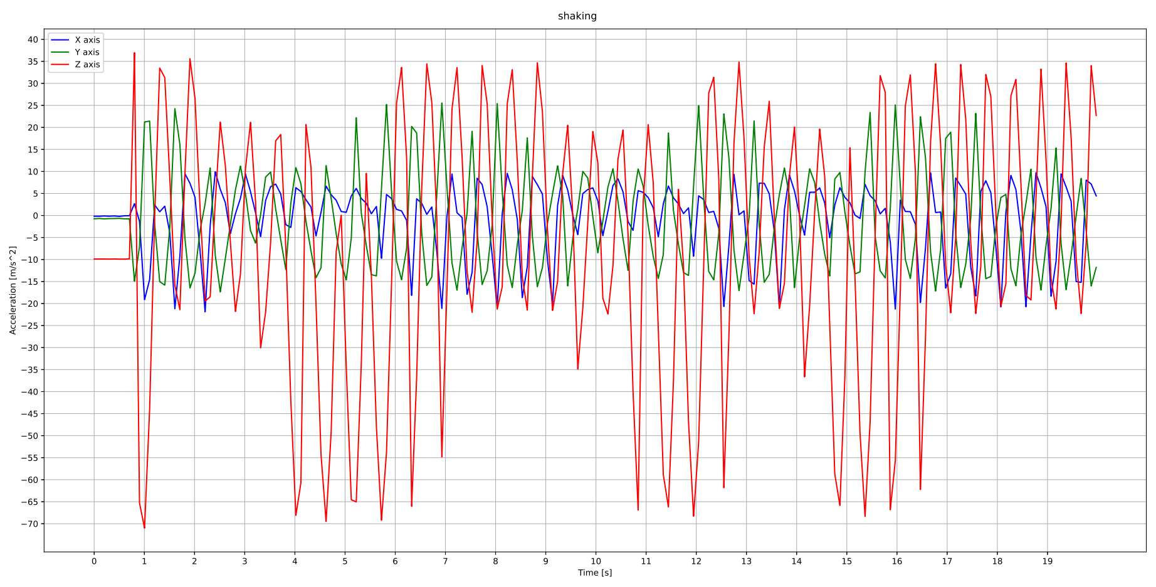

Securing the MediColCox a study on how accelerometers can detect intrusion
Lars Birger Bergmål
BO23EH-07
Data Gathering
Sawing
the handheld system implementing the accelerometer, used in this study to gather the acceleration data.
The acceleration of sawing on the system with a hack saw is not very visible, so a simple amplitude criteria may not be enough for this. However gathering the amplitude of the variation of acceleration can still detect the sawing due to the low levels of background noise.
Dropping
Striking
The acceleration of dropping the system is clearly visible by the sensor and can be detected using a simple amplitude criteria.
The acceleration of striking the system is almost as visible as dropping the system. In this case both the plain amplitude criteria and the amplitude of variation of acceleration criteria is sufficient to detect.
Shaking
Conclusion:
Modern accelerometers are a cheap and sufficient method for detecting intrusion attempt events on a system.
It is can be too sensitive at times.
Utilizing pattern recognition algorithms and/or complementary data sampling methods, to filter the data, can very plausibly differentiate intrusion attempt events from regular use events.
The acceleration of shaking the system is so visible that during events such as an earthquake it will most likely trigger a false alarms.
Recording the time of the event can be useful data for geologists tracking seismic movement.

