Slide 1

2D Image
Coordinates
Intrinsic properties
(Optical Centre, scaling)
Extrinsic properties
(Camera Rotation
and translation)
3D World
Coordinates

Slide 2


M is the Projection Matrix
C is the Camera Centre
to be estimated

Slide 3
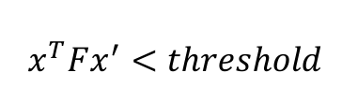
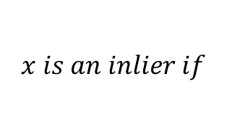
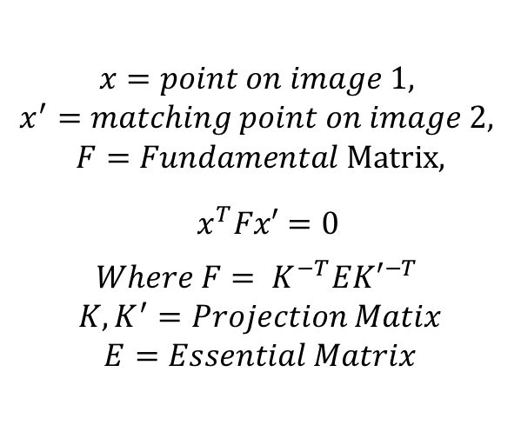
$$x=point on image 1,$$
$$x^{′}=matching point on image 2,$$
$$F=Fundamental Matrix,$$
$${ x}^{T}Fx′=0$$
$$Where F= K^{−T}E{K′}^{−T}$$
$$K, K^{′}=Projection Matix$$
$$E=Essential Matrix$$
$$x is an inlier if$$
$${ x}^{T}Fx^{′}<threshold$$

Slide 4

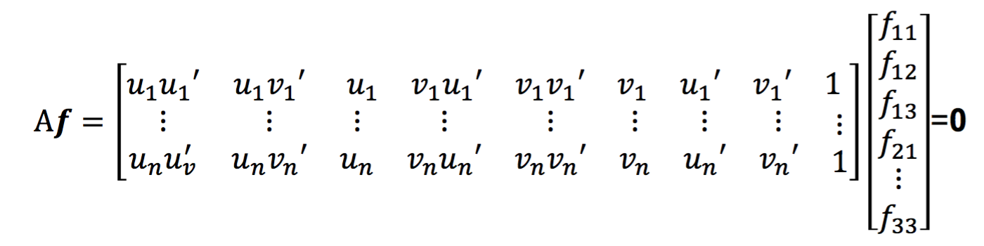
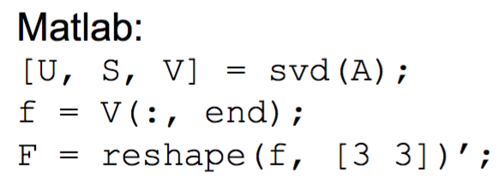
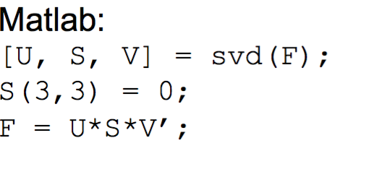
Solve f from Af = 0 using SVD
Resolve det(F) = 0 constraint using SVD

Slide 5


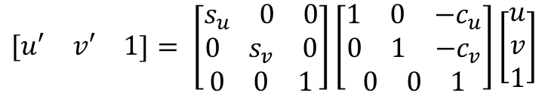
$$\begin{matrix}[u′ & v′ & 1\end{matrix}]= \left[\begin{aligned}\begin{aligned}\begin{matrix}s_{u} & 0 & 0\end{matrix} \\ \begin{matrix}0 & s_{v} & 0\end{matrix}\end{aligned} \\ \begin{matrix}0 & 0 & 1\end{matrix}\end{aligned}\right]\left[\begin{aligned}\begin{aligned}\begin{matrix}1 & 0 & {−c}_{u}\end{matrix} \\ \begin{matrix}0 & 1 & {−c}_{v}\end{matrix}\end{aligned} \\ \begin{matrix}0 & 0 & 1\end{matrix}\end{aligned}\right]\left[\begin{matrix}u \\ v \\ 1\end{matrix}\right]$$
Normalized
coordinates
$s_{u}$ = variance of u
$s_{v}$ = variance of v
$c_{u}$= mean of u
$c_{v}$ = mean of v
Un-normalized
coordinates

Slide 6
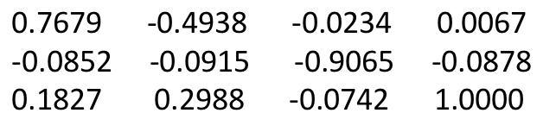
$$\text{0.7679 -0.4938 -0.0234 0.0067 } \\ \text{-0.0852 -0.0915 -0.9065 -0.0878 } \\ \text{0.1827 0.2988 -0.0742 1.0000 }$$
-0.0000 -0.0000 0.0008 -0.0000 -0.0000 0.0016 0.0002 -0.0007 -1.2410

