Slide 1

Texas Food Deserts
A food desert is an area that lacks access to affordable and fresh fruits, vegetables, whole grains, and dairy items. We chose to study their occurrence in three urban areas: Austin, Dallas, and Laredo, Texas.
This phenomenon impacts low-income areas where residents are less likely to have access to transportation and are more negatively affected by supermarket distance than residents who reside in wealthier areas
Lynn Leifker
Kellye Rennell

Slide 2
Texas Food Deserts
The available data is aggregated by zip code. We wanted to research smaller neighborhoods. We decided that to use elementary schools as markers for the center points in these neighborhoods.
Title 1 schools receive federal funding for low-income families and the federal government provides public annual reporting on the poverty level within the schools. We made Title 1 elementary schools our starting points.
Lynn Leifker
Kellye Rennell

Slide 3
Data Resources
U.S. Department of Education
Google Geolocation API
Google Nearby Search API
Google Distance Matrix

Slide 4

Data Exploration & Clean Up Outline
From the U.S. Department of Education, we were able to retrieve data for Title 1 schools in each of our cities and their respective poverty levels for 2018. This came in PDF form, which required conversion and cleaning.
Next we found the geographic coordinates of the schools using the Google geocode API.

Slide 5
Data Exploration & Clean Up Outline
We started our grocery store search in Austin.
We used Google’s nearby search to find all of the grocery stores in Austin.
The rationale was that it would take one API pull to gather all grocery stores in Austin into one dataset and therefore save us time later.
Unfortunately, this did not turn out to be the case.

Slide 6
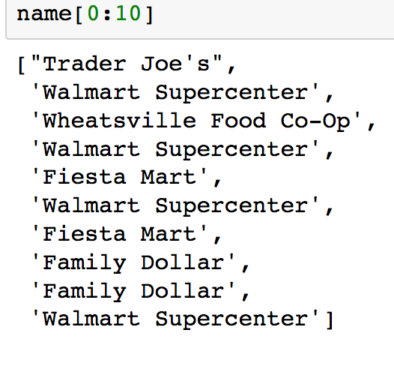
Data Exploration & Clean Up Outline
Our initial API pull by keywords “supermarket” and “grocery” showed something weird was happening…
H-E-B and Randalls were missing. We had to do separate API pulls for those chains.

Slide 7
Data Exploration & Clean Up Outline
In our list of Austin stores, we discovered that we had stores that did not meet the eligibility requirement of offering fresh fruits and vegetables. Family Dollar, for example, appeared repeatedly. We had to remove these.
Additionally, we had many duplicate H-E-B and Randalls listings. Often a store and its bakery and pharmacy were all listed separately and with different geocoordinates.

Slide 8
Data Exploration & Clean Up Outline
Once we had a clean list of stores, it was time to match stores to schools.
We did this using a brute force method algorithm, matching every school to every store and finding the closest match.
The key to doing this was using the geopy library. It finds the distance between two sets of coordinates. We set up a loop to 1) run the coordinates through geopy, and 2) use the outputted distance the closest store for each school.
This was surprisingly fast – it only took a few seconds to run.

Slide 9
Data Exploration & Clean Up Outline
The output produced index numbers for the schools and their corresponding stores. We had to run another loop to pull the correct stores and schools together into their own dataframe.
It felt like there had to be a better way to go about this.
For Dallas, we tried using the Google nearby API to find stores near a given school. This had the same problem as in Austin – it ignored chains like Tom Thumb and Albertsons while returning Family Dollar and other grocery stores.

Slide 10
Data Exploration & Clean Up Outline
We finally gave up on using API pulls and got the rest of our data for Dallas by looking up a school on Google maps and finding the nearest grocery store.
We do not recommend doing this. We were novices who didn’t understand when to bail and start a new project!
The final step was to get driving distances between school and store from the Google Distance Matrix API.

Slide 11
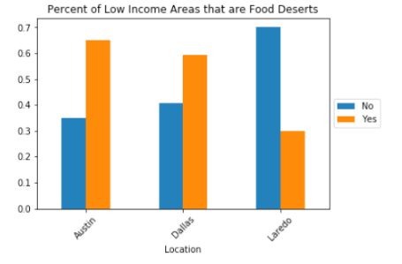
Questions we asked:
If you live in a poor neighborhood, how likely are you to also live in a food desert?

Slide 12
Findings - Percent of poor neighborhoods in Food Deserts
We found that the likelihood that a neighborhood is located in a food desert varies signiﬁcantly based on which city is being studied.
In Austin, 65% of Title 1 schools are in food deserts, and 35% are not.
Dallas has a slightly lower rate — 59% of Title 1 schools are in food deserts, while 41% are not.

Slide 13
Findings - Percent of poor neighborhoods in Food Deserts
Laredo proves to be surprising outlier in this group. Although its Title 1 schools have the greatest poverty rate of the three cities, it has the lowest occurrence of food deserts: only 30% of Title 1 schools are in a food desert.
The overall likelihood that any given neighborhood across the three cities is in a food desert is 58%.

Slide 14
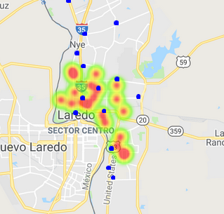
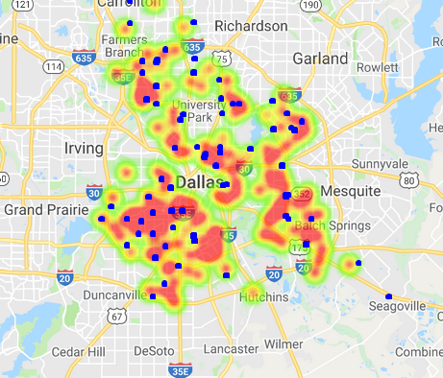
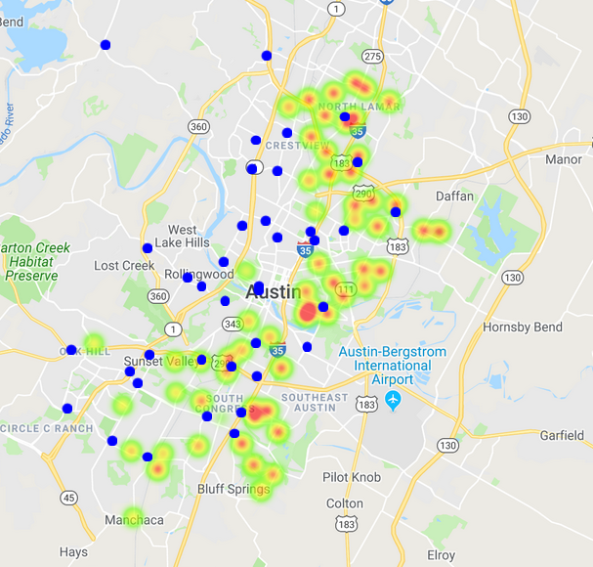
Is there a difference among the major cities in the severity of this phenomenon?
The heat maps below give an illustration of how dispersed grocery stores are within neighborhoods with Title 1 schools. The heat map shows where Title 1 schools are located, and darker red corresponds to greater poverty within a school. The blue squares represent locations of grocery stores.
Laredo
Dallas
Austin

Slide 15
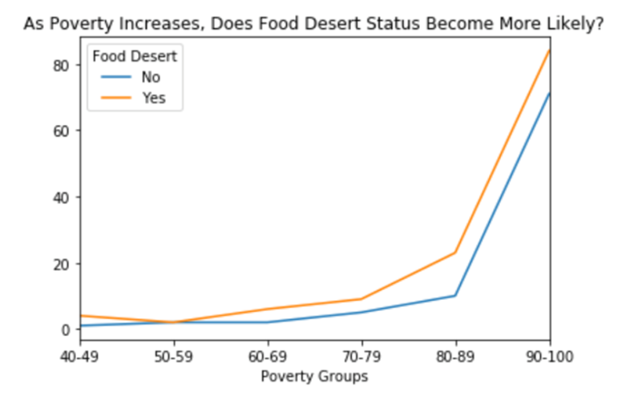
Does the likelihood of living in a food desert increase as poverty increases?
The proportion of Title 1 schools within poverty groups that are in a food desert stays fairly steady across all groups.

Slide 16
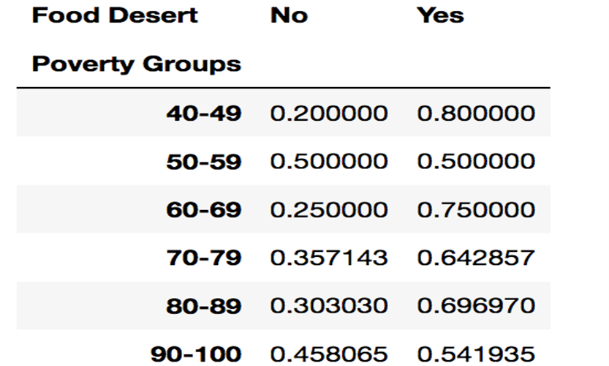
Does the likelihood of living in a food desert increase as poverty increases?
In the 50-59% poverty range, the proportion 50-50.
The range where food deserts are proportionally highest is the 60-69% range—75% of schools are in food deserts.
Strangely, the second-to-lowest proportion of food deserts occurs in the 90-100% poverty range. Of those schools, 54% are in food deserts and 46% are not.

Slide 17
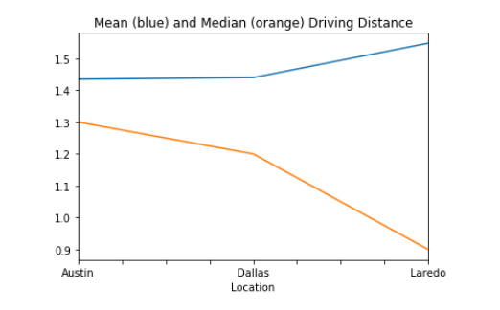
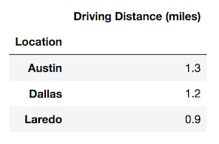
What is the average distance a person in any given neighborhood has to drive to the nearest grocery store?
Median distance us the more reliable metric for average driving distance
Laredo’s median shows that on average a Title 1 school is not in a food desert
- As seen below, the variance between mean and median driving distance can be extreme in some cities

Slide 18
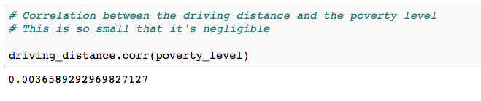
Does driving distance correlate to the level of poverty in a neighborhood?
No!
The correlation coeﬃcient between poverty level and driving distance is 0.003. This means there is no relationship whatsoever between an increase in poverty level and increase in driving distance.

Slide 19
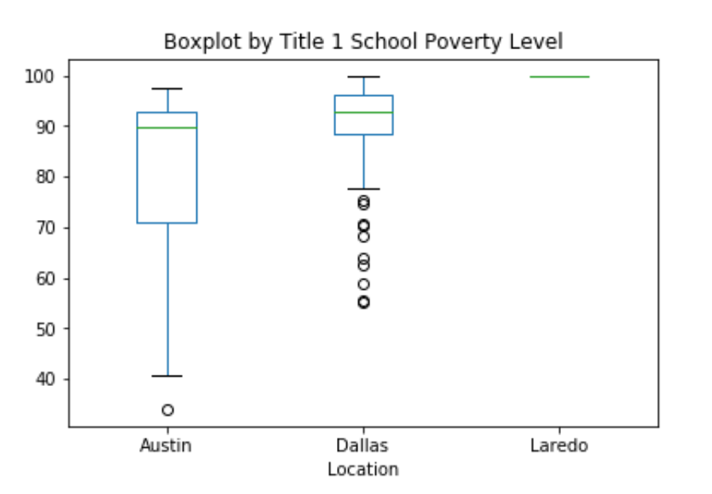
Surprising Insights
The poverty disparity in Title 1 schools among the cities was unexpected
Looking at this boxplot, you can see that Austin has the greatest spread in IQR and the lowest median poverty level.
Dallas’ lowest poverty level is 55%, but this and every other level up to 75% is an outlier. - - Laredo has no spread at all. Every one of its 20 Title 1 schools has a poverty level of 100%!<

Slide 20
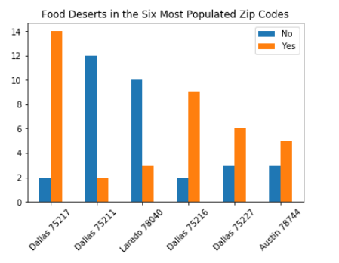
Surprising Insights
We expected all poor areas to be in food deserts, but this turned out not to be the case.
Laredo’s Title 1 schools were all at 100% poverty level, and yet Laredo has the smallest proportion of food deserts

Slide 21
Surprising Insights
The proportion of schools in a food desert can be radically diﬀerent from zip code to zip code, even within the same city.
In Dallas, the two zip codes containing the most Title 1 schools are completely opposite in food desert status: in 75217, 14 of 16 schools are in a food desert, while in 75211, only 2 of 14 are in a food desert.

Slide 22
Conclusion
Urban neighborhoods in the two large cities we studied tended to be located in food deserts.
Austin had the greatest likelihood, at 65%, and this may be a result of the rapid population growth of the city over the last decade. It may be that housing growth has outpaced commercial building, leading to a drop in available space for grocery stores as the number of people needing housing grows.

Slide 23
Conclusion
In the smaller city of Laredo, the low likelihood of living in a food desert (30%) despite also living in the highest poverty of the three cities is diﬃcult to explain.
Perhaps its population is more densely clustered than in the bigger cities, while still leaving space in an urban area for grocery stores to be built.

Slide 24
Challenges
A team member dropped out early in the process, so it was up to the two of us to create and develop this project
We underestimated the amount of time and labor involved with cleaning the data sets – it worked out to at least 60 hours.
We were technical novices, so we were learning as we went

Slide 25
Questions for Future Study
Are there correlations between the racial and ethnic makeup of a given neighborhood and its food desert status?
What are the relative health outcomes for these neighborhoods whose poverty level is similar but whose food desert status is radically diﬀerent?

