Slide 1
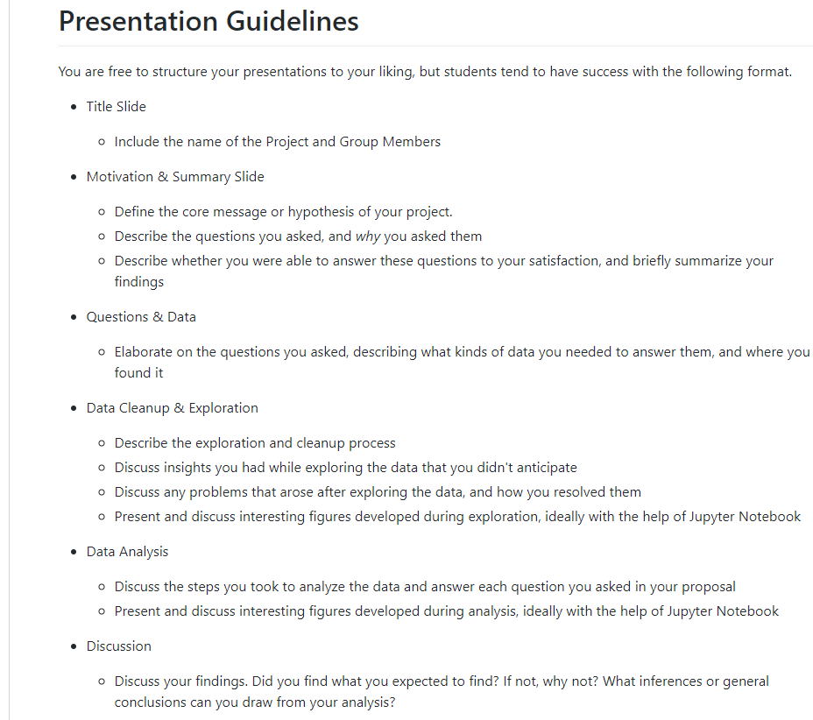

Slide 2

Texas Food Deserts
Lynn Leifker
Kellye Rennell
Blake Rosenhagen

Slide 3

Motivation & Summary
core message or hypothesis of your project.
Describe the questions you asked, and why you asked them
Describe whether you were able to answer these questions to your satisfaction, and briefly summarize your findings

Slide 4

Questions & Data

Slide 5
Questions & Data
Elaborate on the resources used for data
Description of what kind of data was needed in order for the questions to be answered

Slide 6
Visualization Placeholder Slide

Slide 7
Visualization Placeholder Slide

Slide 8
Data Cleanup & Exploration

Slide 9
Data Cleanup & Exploration
Describe the exploration and cleanup process
Discuss insights you had while exploring the data that you didn't anticipate
Discuss any problems that arose after exploring the data, and how you resolved them
Present and discuss interesting figures developed during exploration, ideally with the help of Jupyter Notebook

Slide 10
Data Analysis

Slide 11
Data Analysis Steps
Discuss the steps you took to analyze the data and answer each question you asked in your proposal
Present and discuss interesting figures developed during analysis, ideally with the help of Jupyter Notebook

Slide 12
Visualization Placeholder Slide

Slide 13
Visualization Placeholder Slide

Slide 14
Discussion

Slide 15
Team Findings
Discussion of findings
Did we find what we expected to find?
What inferences or general conclusions can we draw from our analysis

Slide 16
Visualization Placeholder Slide

Slide 17
Visualization Placeholder Slide

Slide 18
Post Mortem

Slide 19
Challenges & More Insight
Discuss any difficulties that arose, and how you dealt with them
Discuss any additional questions that came up, but which you didn't have time to answer: What would you research next, if you had two more weeks?

