Slide 1
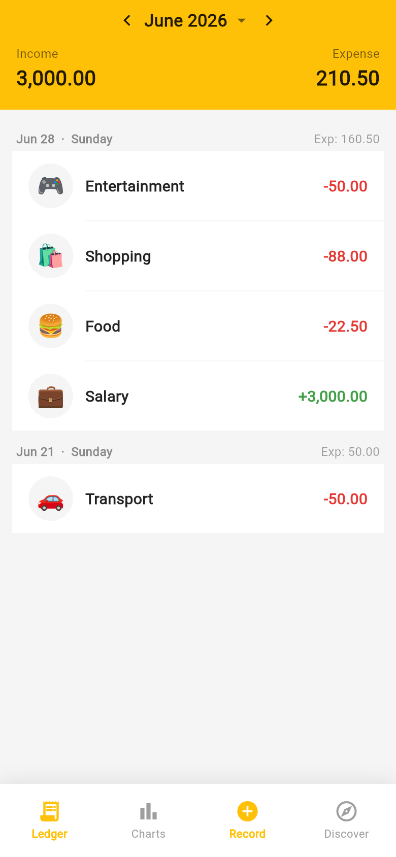
My Wallet
Personal Expense Tracker
A cross-platform CRUD mobile app built with Flutter & Firebase
DES3113 — Mobile App Design & Development · Project Pitch
Team of 5 · Lecturer: Dr. Ahmad Wiraputra bin Selamat · 2026
Ledger

Slide 2
The Problem
Where does my money actually go?
Small, frequent purchases are easy to forget and quickly add up. Most finance apps are cluttered, ad-heavy, or hide the basics behind a paywall.
🧾
Hard to track
Daily cash spending slips through the cracks.
🧩
Too complex
Existing apps are bloated and confusing.
💾
No backup
Records trapped on one phone — lost if it's gone.
📉
No insight
Spending patterns and budgets aren't obvious.

Slide 3
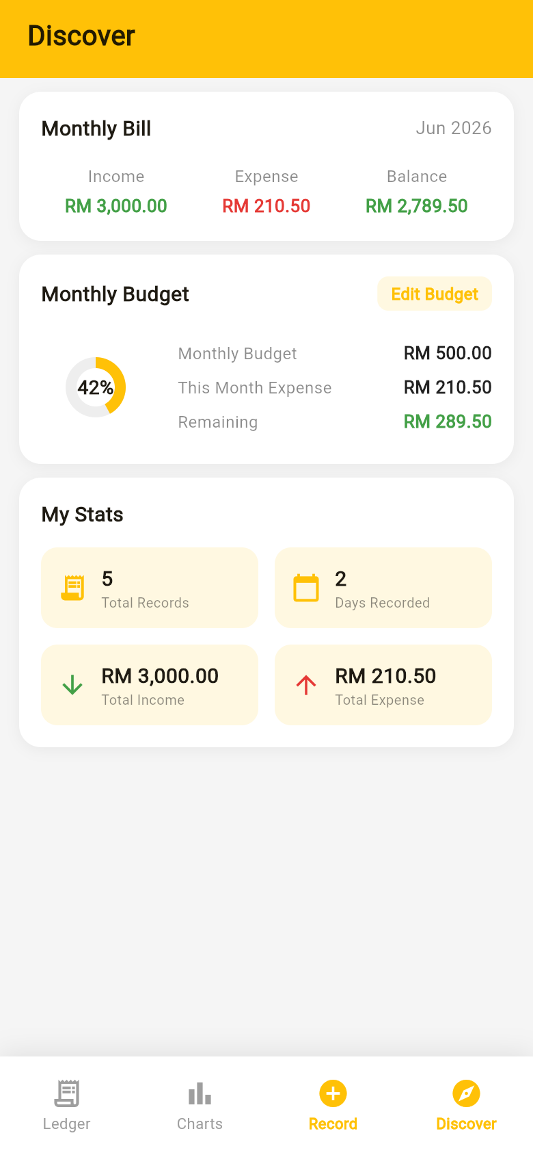
The Solution
A fast, simple, cloud-backed ledger
My Wallet lets you record income and expenses in seconds, browse them by day and month, see spending trends, and stay on budget — with every record stored safely in the cloud and synced in realtime.
✓
Record a transaction in just a few taps
✓
Browse by day, switch between months
✓
Charts and category breakdown
✓
Monthly budget tracking
Budget & Stats
✓
Realtime cloud sync with Firebase

Slide 4
Key Features
🧾
Smart Ledger
Transactions grouped by day with monthly totals.
➕
Quick Record
Custom keypad, category grid, date & note.
📊
Charts
Week / Month / Year trend + category breakdown.
🎯
Budget
Set a monthly limit; track remaining balance.
📈
Statistics
Lifetime income, expense, balance & activity.
☁️
Cloud Database
Stored in Cloud Firestore, synced in realtime.

Slide 5
CRUD at the Core
Every requirement maps to a real feature, all driven by one Provider.
C
R
U
D
Create
Read
Update
Delete
Add a record via the keypad, category grid, date picker and note.
Browse the Ledger grouped by day; open any record in Detail.
Edit a record — the Add screen reopens pre-filled.
Remove a record with a confirm dialog, or clear all.

Slide 6
Architecture
A clean, layered design — the UI never touches storage directly.
UI Layer Ledger · Charts · Record · Discover · Add / Edit
Why it works
• Single source of truth
• UI rebuilds on change
• Logic easy to test
• Realtime cloud sync
↓ context.watch / read
State Layer TransactionProvider (ChangeNotifier) — CRUD, totals, budget
↓ toMap / fromMap
Model Layer Transaction · Category · TransactionType
↓ snapshots / set / delete
Storage Layer Cloud Firestore (realtime NoSQL database)

Slide 7
Technology Stack
Flutter
Cross-platform UI toolkit (Material 3)
Dart
Application language (SDK ^3.11)
firebase_core
Firebase initialisation
cloud_firestore
Realtime cloud database (CRUD)
provider
ChangeNotifier state management
intl · uuid
Formatting & unique IDs
flutter_test
Unit & widget testing
Git + GitHub
Version control & collaboration

Slide 8
State & Persistence
Provider as the single source of truth
TransactionProvider extends ChangeNotifier. Each CRUD method mutates the list, saves to storage, then calls notifyListeners() so every watching widget rebuilds automatically.
Cloud persistence
Each transaction is a document in Cloud Firestore. A realtime snapshot listener streams changes back, so the UI updates instantly across devices.
// Realtime read
_txCol.snapshots().listen((snap) {
_transactions = snap.docs
.map((d) =>
Transaction.fromMap(d.data()))
.toList();
notifyListeners();
});
// Create / Update
await _txCol.doc(t.id).set(t.toMap());
// Delete
await _txCol.doc(id).delete();

Slide 9
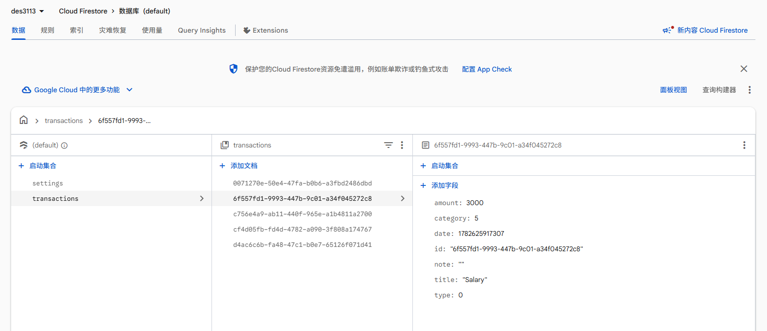
Cloud Database — Firebase
Every record is a document in Cloud Firestore — created, updated and deleted in realtime.
🔄
Realtime sync
Cloud Firestore · project des3113-7d1fe · transactions collection
App · Ledger
transactions — one document per record; Create/Update via set(), Delete via delete().
Fields — amount · category · type · date · title · note, mirroring the model.

Slide 10
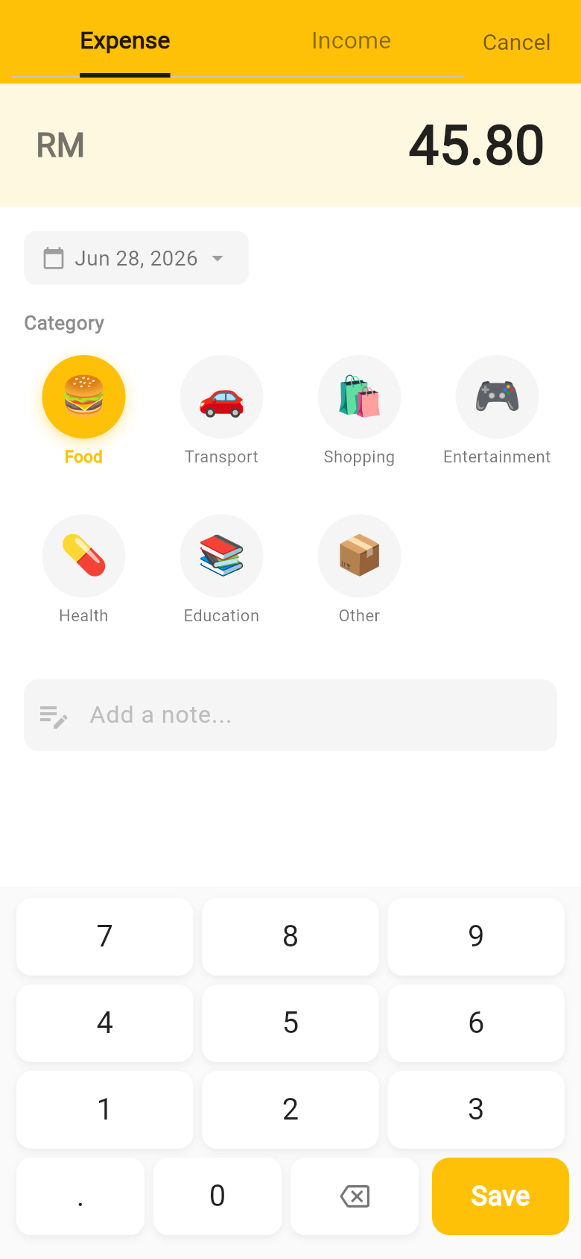
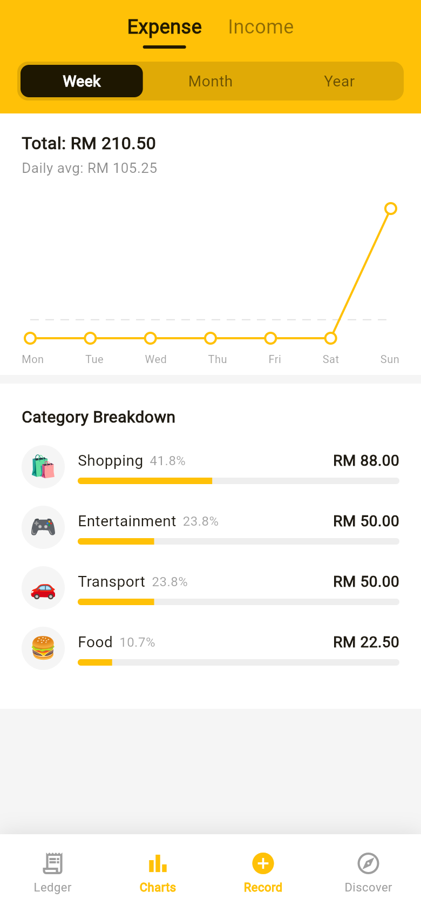
UI / UX Design
Material 3 · amber brand colour · familiar daily-ledger layout.
Ledger
Add Record
Charts
Discover

Slide 11
Testing
What we tested
12 / 12
✓
Unit — Model
Serialisation round-trips, copyWith, category labels.
automated tests passing
✓
Unit — Provider
CRUD + budget on an in-memory test database.
✓
Widget
App builds and the bottom navigation renders.
✓
Manual
9 flows incl. data appearing live in the Firebase console.

Slide 12
Team & Contributions
1
Sazit Ul Islam
Project lead · State management & data model
2
Nur Aisyatul Najwa binti Mohamad Nasir
UI/UX · Ledger & Detail screens
3
Nurfatin Aqilah binti Zolkifli
Add/Edit & Charts screens
4
Shi Kaiyan
Discover screen · Firebase & testing
5
Mst Samiya Haque Kotha
Documentation, report & presentation
Every member contributed across design, development, testing & docs. Source managed with Git + GitHub.

Slide 13
Challenges & What's Next
Challenges we solved
Future enhancements
✓
Keeping UI in sync → single Provider
→
User accounts (Firebase Auth)
✓
Cloud data → Firestore + realtime listener
→
Firestore security rules
→
Export to CSV / PDF
✓
Trend chart → custom CustomPainter
→
Recurring bills & reminders
✓
Valid input → keypad guard rules
→
Dark mode & multi-currency

Slide 14
Thank You
My Wallet — Personal Expense Tracker
Built with Flutter · Firebase · Cloud Firestore
Questions · github.com/LBBT-God/expense-tracker

