Slide 1

Loughrea BADMINTON
BY -: Om, Rai and Rishon
Notes:
Introduction and points to cover

Slide 2

Past and future
Loughrea Badminton Club has long been a prominent club for people who are keenly interested in the sport of badminton.
The success of the club is reflected in its steady growth and its reach to a wider range of people.
We have received numerous requests to establish a more professional system that meets the needs and expectations of our enthusiastic members.
We are delighted to expand our reach to a broader audience with your continued support.
The club aims to share the love of the game and to fuel the spirit of those who are passionate about competing.

Slide 3
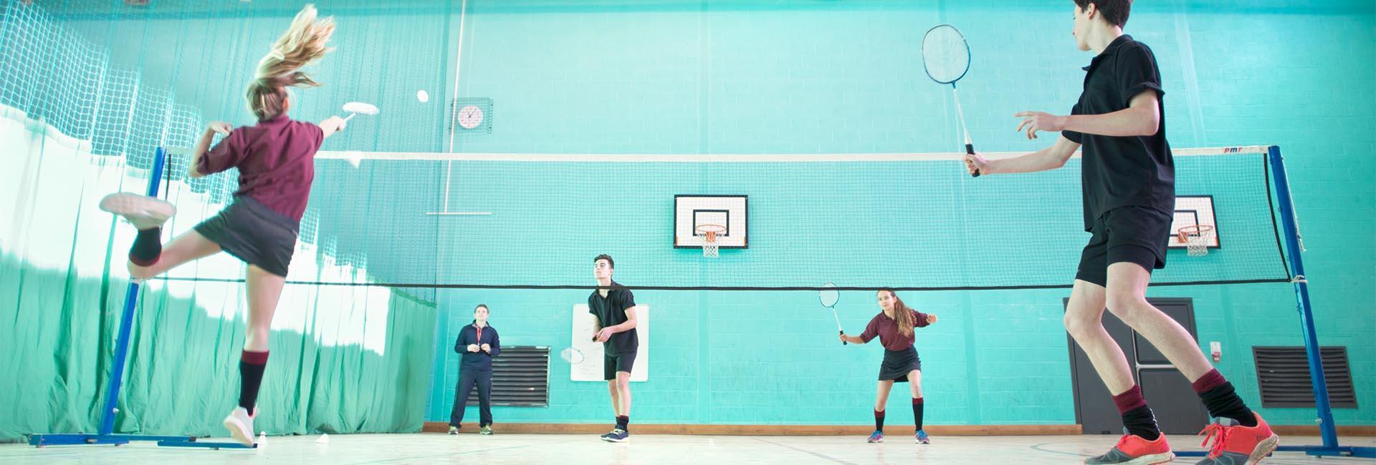
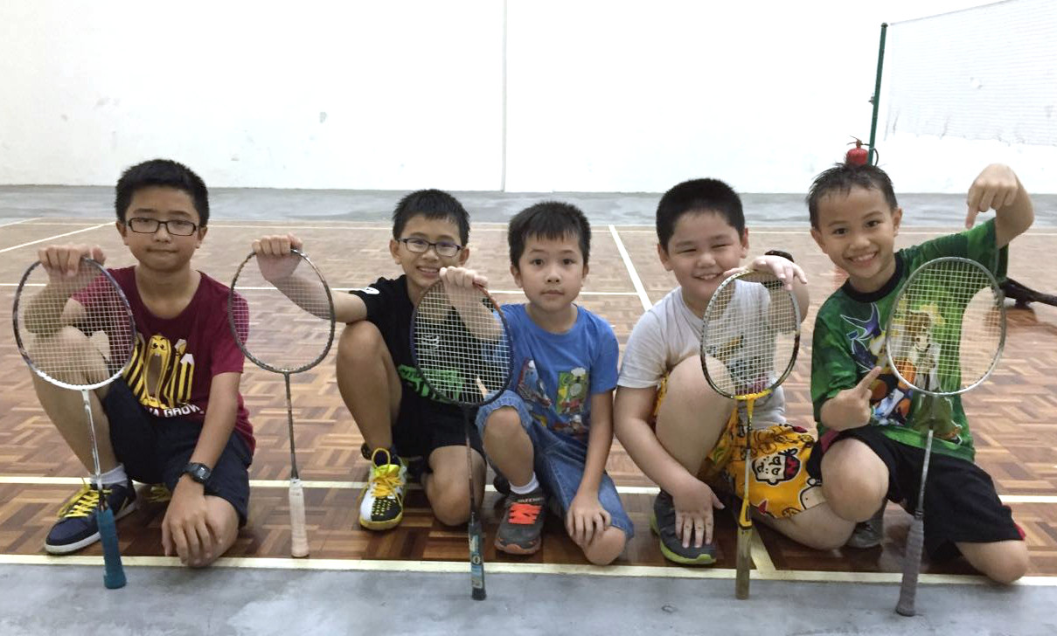
Plans for the club
Hosting Competitions
Kids Badminton Program
Coaching sessions on Thursday
Building a tightly knit community for badminton in Loughrea

Slide 4
ROI
Benefits you have in sponsoring the club
-: Your brand gets recognized to all range of audience
-: It will appear on our jerseys; posters and every social media post we do
-: A positive image will be the outcome as your supports the community people and their clubs.

Slide 5
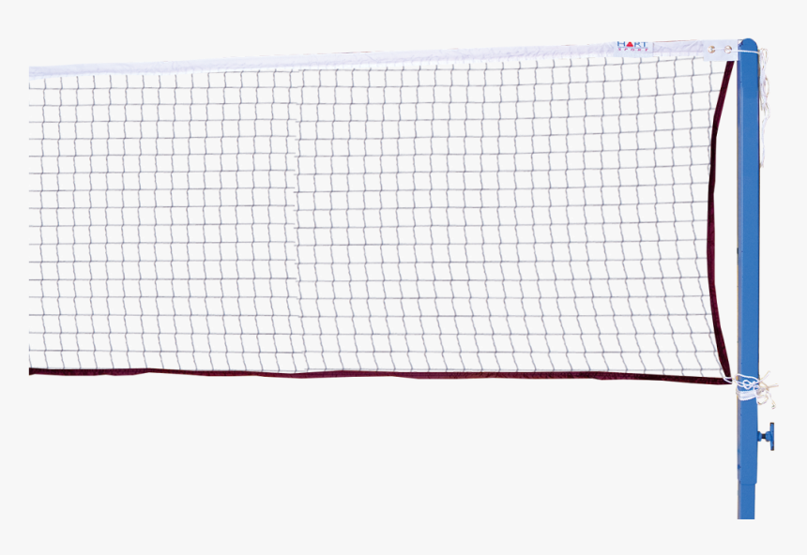
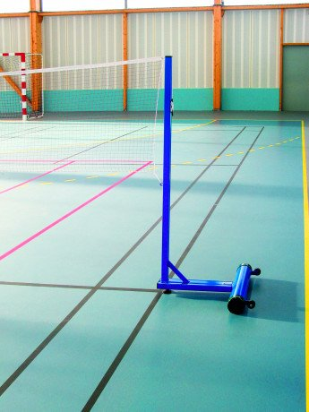
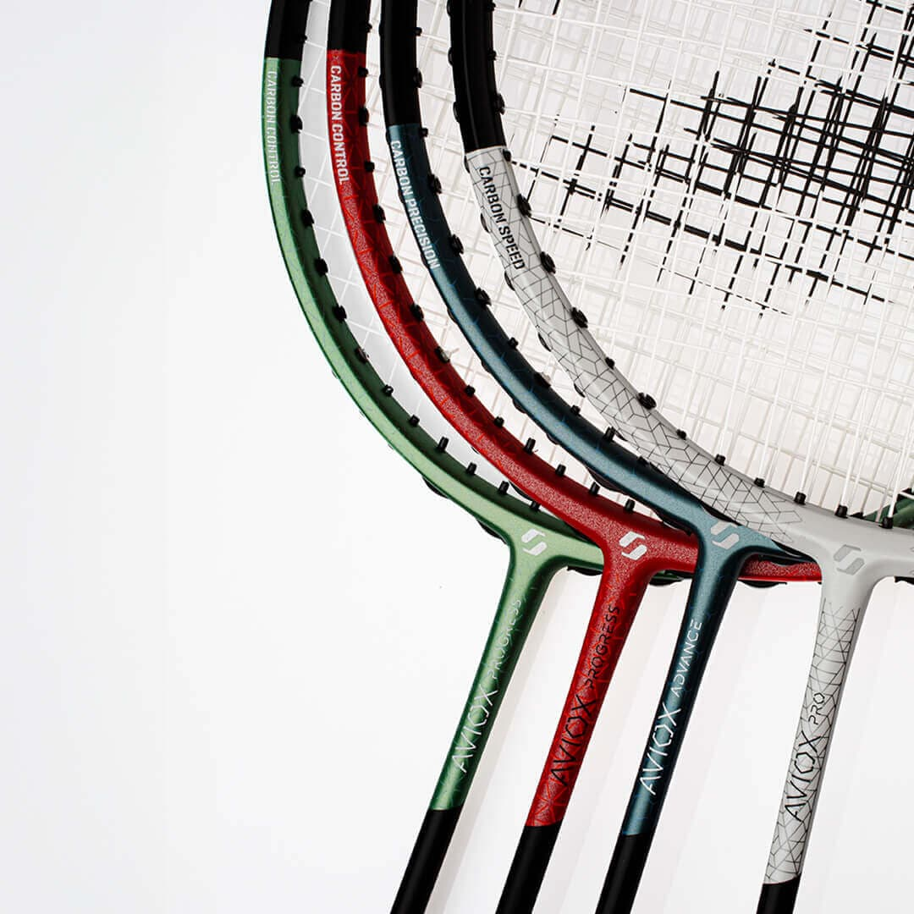
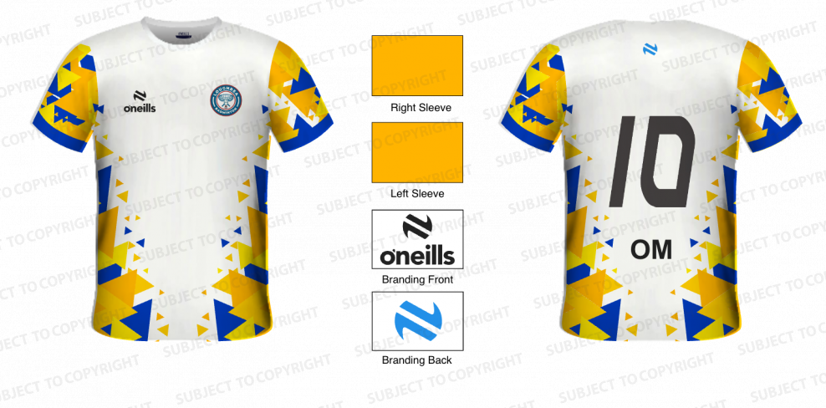
Logistics required
Poles (Approx – 900) Covered
Nets (Approx – 120) Covered
Jerseys (Approx – 25 to 30 each)
Racquet (Approx – 500 )
Shuttles (Approx – 350 for 3 months)

Slide 6


ARE you willing to?

