Slide 1
NEMS planning
LBHB Lab Meeting
June 14, 2017

Slide 2
Next month
Stephen’s schedule next month
Out June 19-29
Back 29-30
Out again July 3-14
Back Monday July 17
Skype (svdavid1), Google Hangout?
Surgery
Implant SPF animal for Jesyin pilots.
MRB surgery suit closed, IACUC has approved use of Knight Inst. suite on LBRB 1st floor.
Need card key access, need to schedule with Elizabeth Le and Traci Schaller

Slide 3

NEMS – Neural Encoding Model System
$$r_{i}\left(t\right)=h_{i}\left[S\left(t\right)\right]$$
Time-varying response as a function of the incoming stimulus:
Wu et al. 2006; Thorson & David 2015

Slide 4
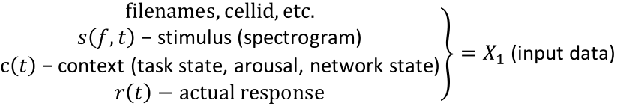

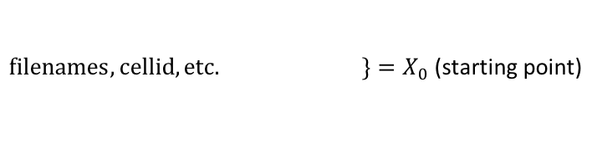
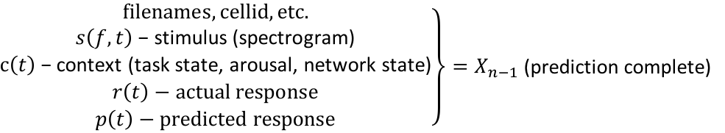
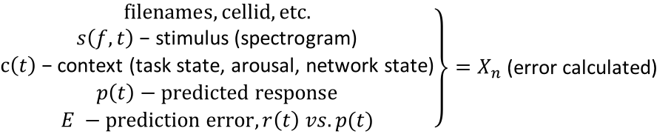

Core – the model engine
Basic model:
$$s\left(f,t\right), c\left(t\right) \underset{→}{H\left(∙,θ\right)}r(t)$$
“Engine”:
$$X_{0}\underset{→}{f_{1}(θ_{1})}X_{1}\underset{→}{f_{2}(θ_{2})}⋯\underset{→}{f_{N}(θ_{N})}X_{N}$$
$\left.filenames, cellid, etc. \right\}=X_{0}$ (starting point)
Load module – or make this pre-processing?
Special step pre-process
$\left.\begin{matrix}filenames, cellid, etc. \\ s\left(f,t\right)\text{ − }\text{stimulus}\text{ (}\text{spectrogram}\text{)} \\ \begin{aligned}c\left(t\right)\text{ − }\text{context}\text{ (}\text{task} \text{state}\text{, }\text{arousal}\text{, }\text{network} \text{state}\text{)} \\ r\left(t\right)−actual response\end{aligned}\end{matrix}\right\}=X_{1}$ (input data)
Filter module(s) – require free parameters (𝛉)
$\left.\begin{matrix}filenames, cellid, etc. \\ s\left(f,t\right)\text{ − }\text{stimulus}\text{ (}\text{spectrogram}\text{)} \\ \begin{aligned}c\left(t\right)\text{ − }\text{context}\text{ (}\text{task} \text{state}\text{, }\text{arousal}\text{, }\text{network} \text{state}\text{)} \\ r\left(t\right)−actual response \\ p\left(t\right)−predicted response\end{aligned}\end{matrix}\right\}=X_{n−1}$ (prediction complete)
Error calculation module(s)
$\left.\begin{matrix}filenames, cellid, etc. \\ s\left(f,t\right)\text{ − }\text{stimulus}\text{ (}\text{spectrogram}\text{)} \\ \begin{aligned}c\left(t\right)\text{ − }\text{context}\text{ (}\text{task} \text{state}\text{, }\text{arousal}\text{, }\text{network} \text{state}\text{)} \\ p\left(t\right)−predicted response \\ E −prediction error, r\left(t\right) vs. p(t)\end{aligned}\end{matrix}\right\}=X_{n}$ (error calculated)

Slide 5

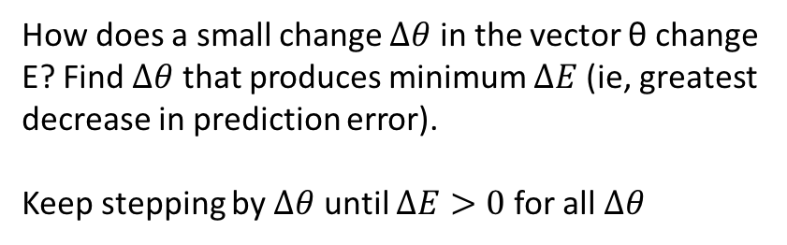
Core – the fitter
Basic model:
$$s\left(f,t\right), c\left(t\right) \underset{→}{H\left(∙,θ\right)}r(t)$$
Engine:
$$X_{0}\underset{→}{f_{1}(θ_{1})}X_{1}\underset{→}{f_{2}(θ_{2})}⋯\underset{→}{f_{N}(θ_{N})}X_{N}$$
Fitter: Choose values of θ for which the engine produces the minimum prediction error.
$E={\left\langle {\left(r\left(t\right) −p(t)\right)}^{2}\right\rangle }_{t}$ = (average square difference between response and prediction)
Gradient :
$$\frac{∆E}{∆θ}$$
How does a small change $∆θ$ in the vector θ change E? Find $∆θ$ that produces minimum $∆E$ (ie, greatest decrease in prediction error).
Keep stepping by $∆θ$ until $∆E>0$ for all $∆θ$

Slide 6
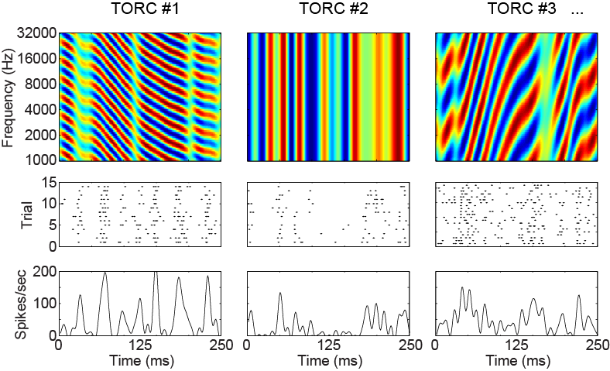
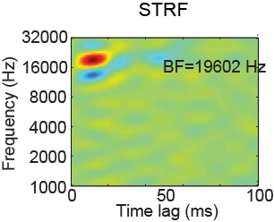
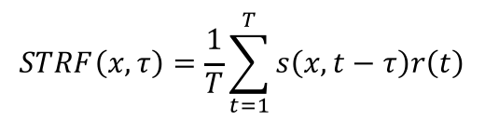
Linear STRF engine requires three modules
…
+
+
+
+
+
…
Spike-triggered average
$$STRF\left(x,τ\right)=\frac{1}{T}\sum_{t=1}^{T}{s\left(x,t−τ\right)r\left(t\right)}$$
Load
FIR
MSE

Slide 7
model_name / keyword sequences
Model_name = “key1_key2_..._keyN”
Fitting: execute sequence key1, then key2, … then keyN
keyX is a function that can do anything, eg:
Add one or more modules to stack
Set parameters or hyperparameters
Run a fit algorithm
Eg: fb18ch100_lognn_wcg03_adp1pc_ap3z1_siglog100_fit05c
fb18ch100 – load 18 channel spectrogram, 100 Hz sampling rate
lognn – perform compression on spectrogram (1 free parm)
wcg03 – Gaussian spectral weighting to three channesl (6 free parms)
adp1pc– synaptic depression or facilitation for each of the (three) channels (3 free parms)
ap3z1– FIR pole-zero filter (4 free parms)
siglog100 – logistic sigmoid (5 free parms)
fit05c – iterative coordinate descent until 𝛥E < 10^-6

Slide 8
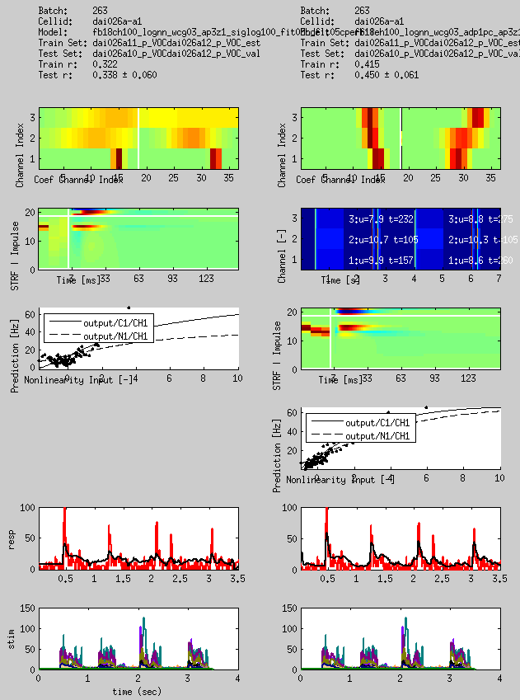
Core – visualization
Spectral filter parameters
Synaptic depression parameters
FIR filter parameters
Static nonlinearity input vs. output
Predicted vs. actual response

Slide 9
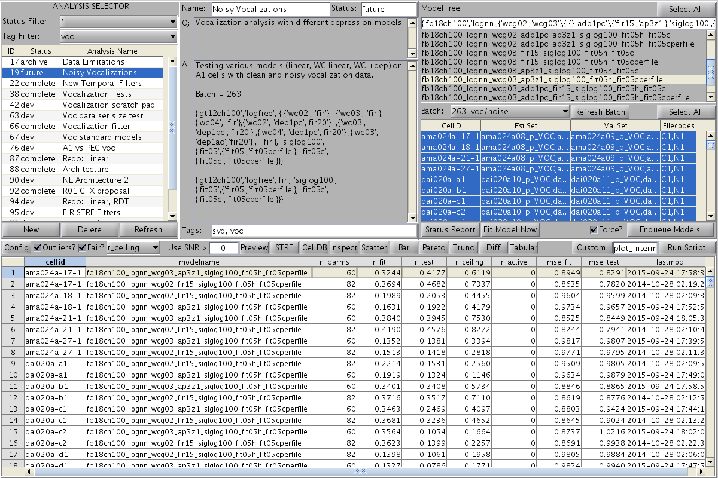
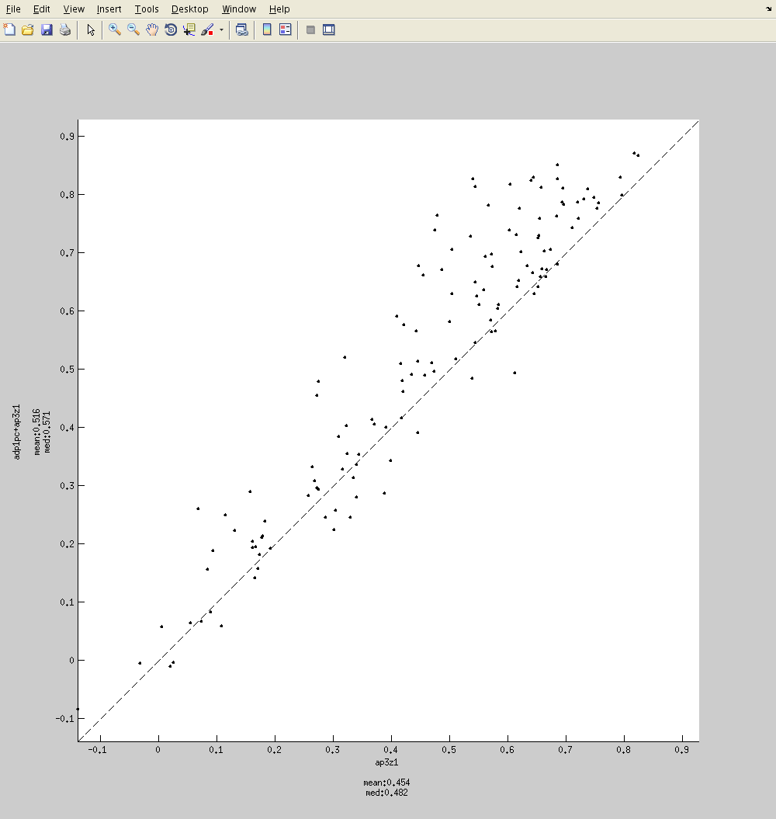
Core - browser

Slide 10
NEMS – all the parts

Slide 11
Near-term to-dos
Model engine
Standard module format
Integrate contextual variables (behavior state, pupil)
Nested cross-validation
Fitter
Simple gradient descent
Iterative fitters
Integrate with fancy fitters (eg, theano)
Web-based model & results browser, fit launcher
Communicate data file information, pre-processing to fitter
Model visualization tool (narf_modelpane)
Link to cluster for fitting large datasets
User specific batches, data sets
Data upload/management
Core utilities for loading, plotting data and talking to celldb
loadspikeraster – kind of replaced by
dbgetscellfile
raster_plot
Etc? What would be useful to make it worth doing analysis in Python?

Slide 12
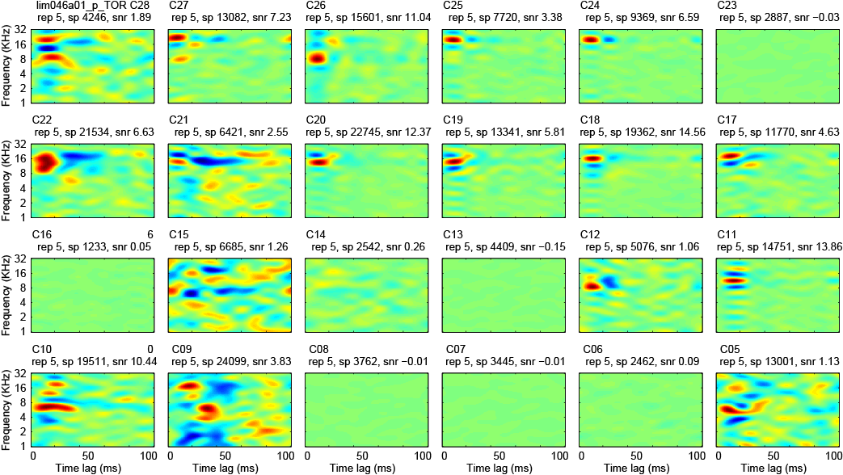
A bunch of FIR matrices for A1 TORC STRFs
STRFs for 24 channels recorded simultaneously in A1/AAF using a fixed array of platinum-iridium electrodes.

