Slide 1
TORC STRF demo

Slide 2
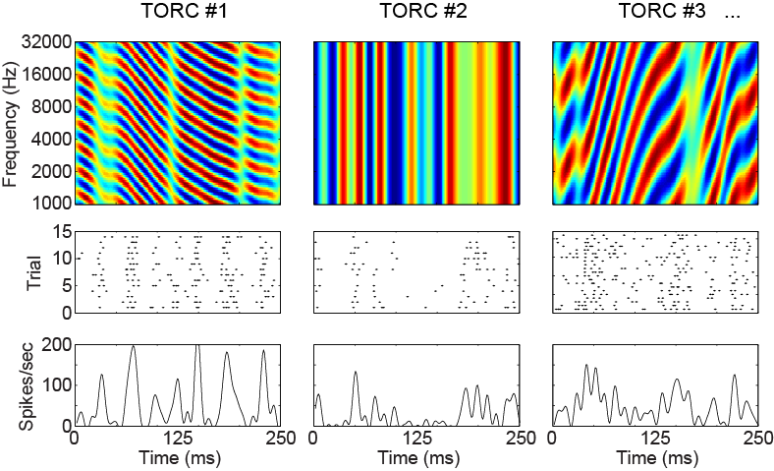
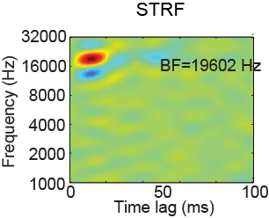
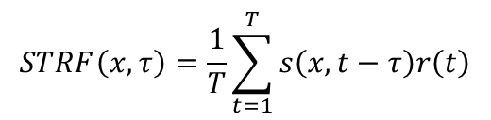
…
+
+
+
+
+
…
Spike-triggered average
$$STRF\left(x,τ\right)=\frac{1}{T}\sum_{t=1}^{T}{s\left(x,t−τ\right)r\left(t\right)}$$

Slide 3
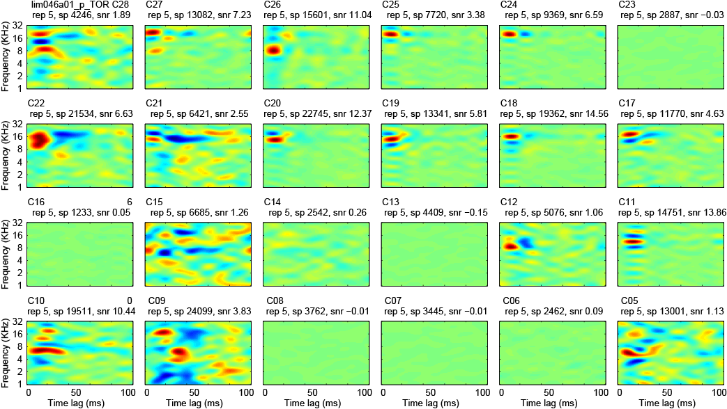
A snapshot of auditory cortex
STRFs for 24 channels recorded simultaneously in A1/AAF using a fixed array of platinum-iridium electrodes.

