Slide 1

Introduction to Command Line
Oct 9, 2019
Research Computing
Services

Slide 2
Instructor:
Alper Kinaci, PhD
Sr. Computational Specialist
akinaci@northwestern.edu

Slide 3
Command Line: Why?
Skip GUI
Minimal data
Fast remote access
Responsive
Automation
Central control
A platform for more-advanced applications
Analysis tools
Fast non-GUI analysis of massive data

Slide 4
You will learn
Navigate files and directories
Find where you are; find what where
Work with files and directories
Copy, create, move files and/or folders
Pipes and filters
Combine commands to do awesome things
Finding things
In the files; in the directories

Slide 5
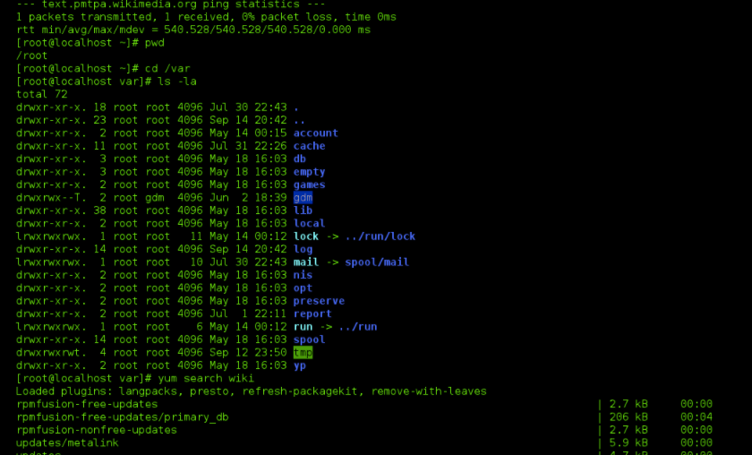

Designed for efficiency
NOT
Designed for ease of use:

Slide 6
Where you will see it?
Older (way way older) computers
Linux
Unix
HPC
Remote servers

Slide 7
Resources
Windows users: install gitbash: https://workshops.rcs.northwestern.edu/install/bash/
Here's the reference material for the workshop: http://swcarpentry.github.io/shell-novice/

Slide 8

Getting Started
Launch terminal
Let the fun begin!
Workshop materials:
https://github.com/nuitrcs/commandlineworkshop.git

Slide 9
Topic 1 of 4: Navigate files and directories

Slide 10
Questions
How can I move around on my computer?
How can I see what files and directories I have?
How can I specify the location of a file or directory on my computer?

Slide 11
Objectives
Navigate the file system
Explain files, directories and paths
Translate absolute path into a relative path and vice versa
Demonstrate the use of tab completion and its advantages

Slide 12
Topic 1: What did we learn?
A file system is organized in a directory tree composed of folders and files
cd (change directory), ls (list), pwd (print working directory) commands
The difference between absolute and relative paths
Most commands take options (flags) which begin with a “-”

Slide 13
Command Line: warming up
Capitalization matters
ls –r vs. ls –R
ls vs. Ls
man ls
ls –help
Most often I use google!!
Go over the commands in the lecture; ask to work on problems
Tab completion
Key points

Slide 14
Topic 2 of 4: Working with files and directories

Slide 15
Questions
How can I create, copy, and delete files and directories?
How can I edit files?

Slide 16
Objectives
Delete, copy and move specified files and/or directories
Create a directories
Create files using an editor or by copying and renaming existing files

Slide 17
Good Names for Files & Directories
Don’t use whitespace (“my work”)
Don’t begin the name with a dash “-”
Don’t begin the name with a “.” unless you mean it
Use letters, numbers, “-”, “.”, “_”

Slide 18
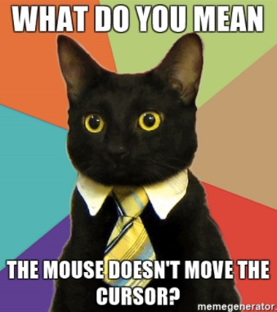
text editor: nano
type “nano <filename>” this will open the named file for editing or create it if it doesn’t exist
type your text: the mouse will not move the cursor - navigate with the arrow keys
save and quit: commands are on the bottom of the screen - the “^” stands for “control”

Slide 19
Topic 2: What did we learn?
cp (copy), mv (move), rm (remove), mkdir (make directory) and touch commands
Deleting with rm is irreversible, use responsibly
Editing a text file with Nano command line editor

Slide 20
Questions
How can I do more with less typing? Any shortcuts?
How can I combine existing commands to do new things?

Slide 21
Objectives
Wildcards, do more with less
Redirect a command's output to a file
Construct command pipelines with two or more stages to filter data
Learn how to exit a process

Slide 22
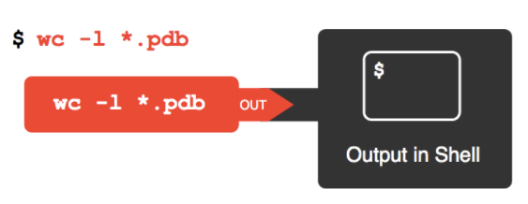

Slide 23
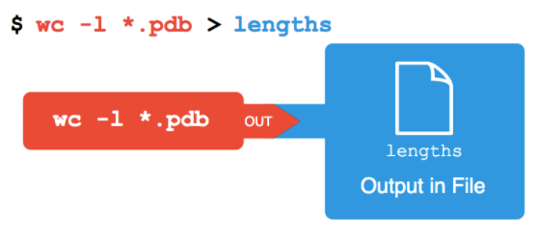

Slide 24
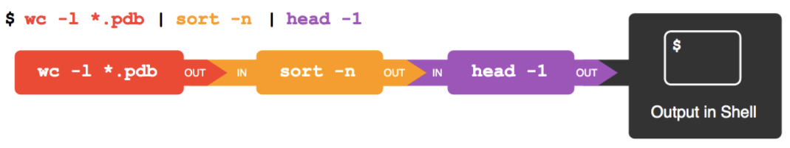

Slide 25
Topic 3: What did we learn?
How to match single and multiple characters with wildcards
Creating or modifying files with different types of output redirection
Pipelining many commands and filter data progressively
Lots of new commands

Slide 26
Topic 4 of 4: Finding Things

Slide 27
Questions
How can I find files?
How can I find things in files?

Slide 28
Objectives
Use grep to select lines from text files that match simple patterns.
Use find to find files whose names match simple patterns.
Use the output of one command as the command-line argument(s) to another command.

Slide 29
Topic 4: What did we learn?
Finding patterns in files according to some search parameters
Searching files and folders
Using a command’s output as the argument of another command

Slide 30
Research Computing Services
https://github.com/nuitrcs/commandlineworkshop.git

