Slide 1

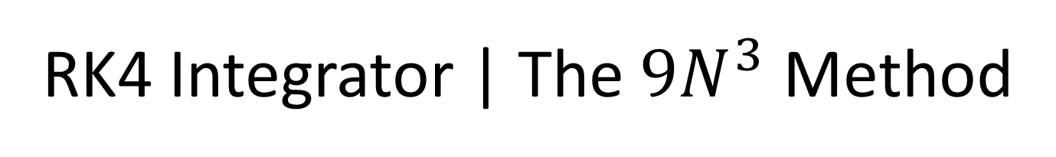
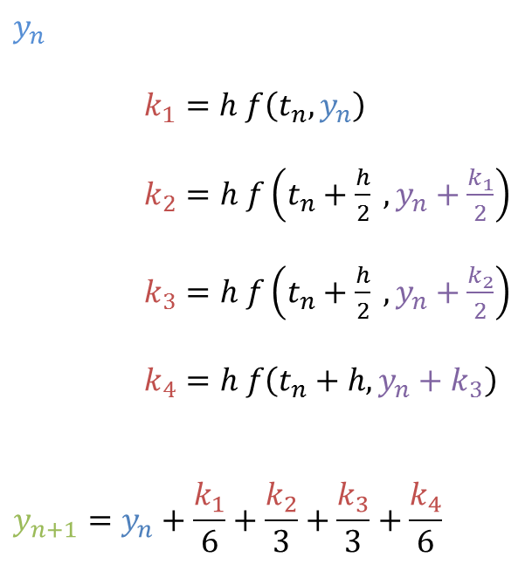
RK4 Integrator | The $9N^{3}$ Method
$$y_{n}$$
$k_{1}=h f\left(t_{n}, y_{n}\right)$
$k_{2}=h f\left(t_{n}+\frac{h}{2} ,y_{n}+\frac{k_{1}}{2}\right)$
$k_{3}=h f\left(t_{n}+\frac{h}{2} ,y_{n}+\frac{k_{2}}{2}\right)$
$k_{4}=h f\left(t_{n}+h, y_{n}+k_{3}\right)$
$$y_{n+1}=y_{n}+\frac{k_{1}}{6}+\frac{k_{2}}{3}+\frac{k_{3}}{3}+\frac{k_{4}}{6}$$

Slide 2

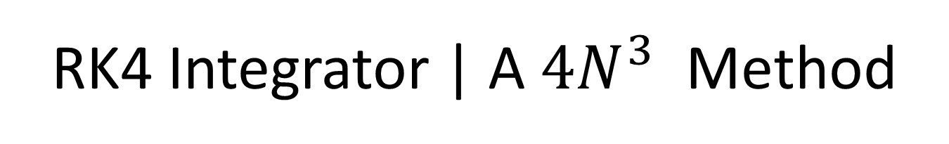



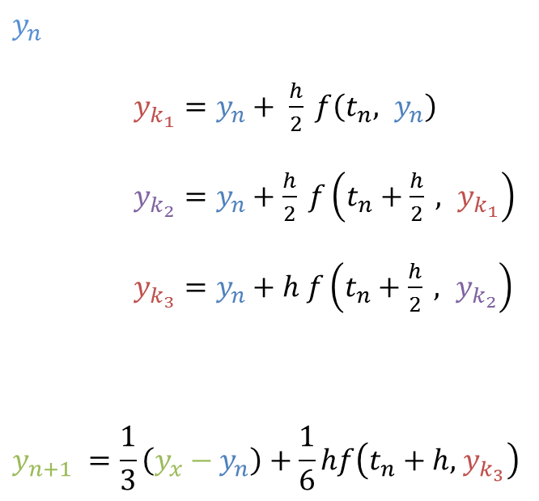
RK4 Integrator | A $4N^{3}$ Method
$$y_{n}$$
$y_{k_{1}}=y_{n}+ \frac{h}{2} f\left(t_{n}, y_{n}\right)$
$y_{k_{2}}=y_{n}+\frac{h}{2} f\left(t_{n}+\frac{h}{2} , y_{k_{1}}\right)$
$y_{k_{3}}=y_{n}+h f\left(t_{n}+\frac{h}{2} , y_{k_{2}}\right)$
$$y_{n+1} =\frac{1}{3}\left(y_{x}−y_{n}\right)+\frac{1}{6}hf\left(t_{n}+h, { y}_{k_{3}}\right)$$
$$y_{x}=0$$
$$y_{x}+=y_{k_{1}}$$
$$y_{x}+=2y_{k_{2}}$$
$$y_{x}+=y_{k_{3}}$$

Slide 3
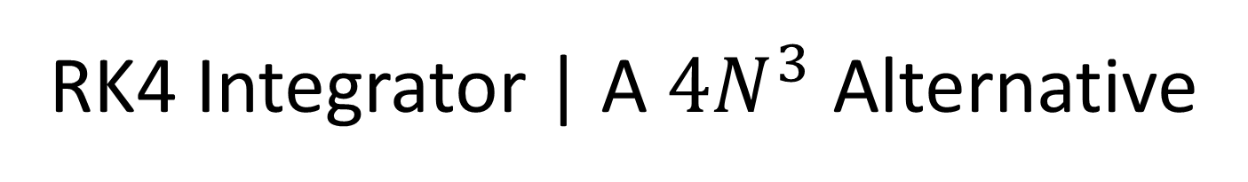
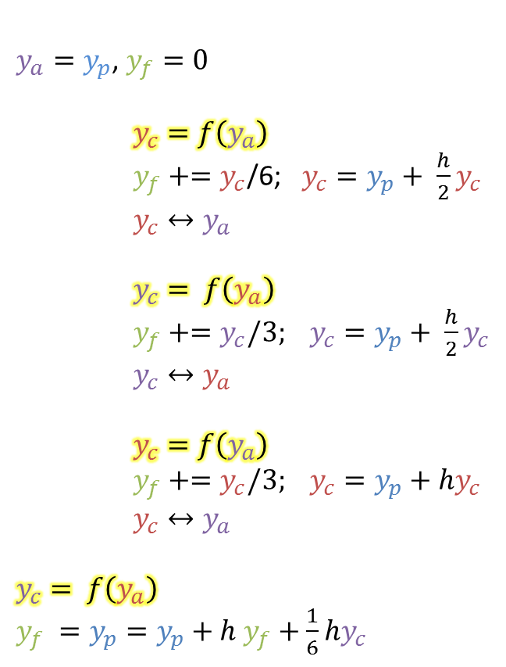
RK4 Integrator | A $4N^{3}$ Alternative
Given a starting $y_{p}$, the RK4 class only needs highlighted steps computed externally:
$y_{a}=y_{p}$, $y_{f}=0$
$y_{c}=f\left(y_{a}\right)$
$y_{f}+=y_{c}$/6; $y_{c}=y_{p}+ \frac{h}{2}y_{c}$
$y_{c}↔y_{a}$
$y_{c}= f\left(y_{a}\right)$
$y_{f}+=y_{c}/3; y_{c}=y_{p}+ \frac{h}{2}y_{c}$
$y_{c}↔y_{a}$
$y_{c}=f\left(y_{a}\right)$
$y_{f}+=y_{c}/3; y_{c}=y_{p}+hy_{c}$
$y_{c}↔y_{a}$
$$y_{c}= f\left(y_{a}\right)$$
$y_{f} =y_{p}=y_{p}+h y_{f}+\frac{1}{6}hy_{c}$
Step initialization
stepInit()
K1 Calculation
RKEvolve()
K1 Finalization
K1Finalize()
K2 Calculation
RKEvolve()
K2 Finalization
K2Finalize()
K3 Calculation
RKEvolve()
K3 Finalization
K3Finalize()
K4 Calculation
RKEvolve()
K4 Finalization
K4Finalize()

Slide 4
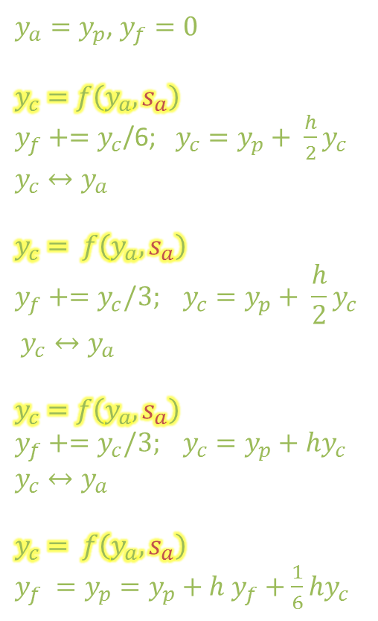
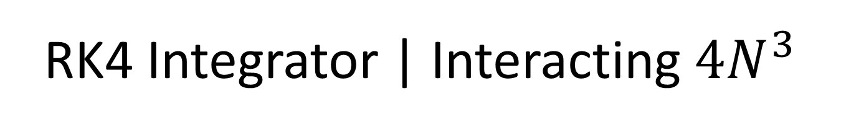


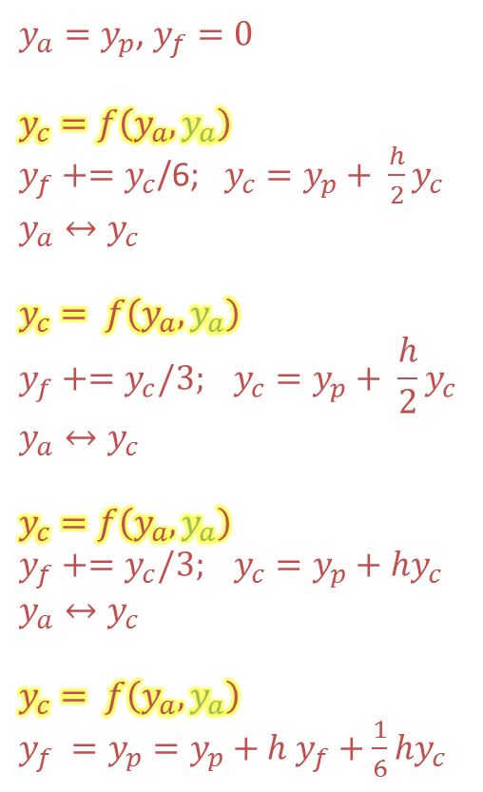
RK4 Integrator | Interacting $4N^{3}$
$y_{a}=y_{p}$, $y_{f}=0$
$$y_{c}=f\left(y_{a},s_{a}\right)$$
$y_{f}+=y_{c}$/6; $y_{c}=y_{p}+ \frac{h}{2}y_{c}$
$$y_{c}↔y_{a}$$
$$y_{c}= f\left(y_{a},s_{a}\right)$$
$$y_{f}+=y_{c}/3; y_{c}=y_{p}+ \frac{h}{2}y_{c}$$
$$y_{c}↔y_{a}$$
$$y_{c}=f\left(y_{a},s_{a}\right)$$
$$y_{f}+=y_{c}/3; y_{c}=y_{p}+hy_{c}$$
$$y_{c}↔y_{a}$$
$$y_{c}= f\left(y_{a},s_{a}\right)$$
$y_{f} =y_{p}=y_{p}+h y_{f}+\frac{1}{6}hy_{c}$
$y_{a}=y_{p}$, $y_{f}=0$
$$y_{c}=f\left(y_{a},y_{a}\right)$$
$y_{f}+=y_{c}$/6; $y_{c}=y_{p}+ \frac{h}{2}y_{c}$
$$y_{a}↔y_{c}$$
$$y_{c}= f\left(y_{a},y_{a}\right)$$
$$y_{f}+=y_{c}/3; y_{c}=y_{p}+ \frac{h}{2}y_{c}$$
$$y_{a}↔y_{c}$$
$$y_{c}=f\left(y_{a},y_{a}\right)$$
$$y_{f}+=y_{c}/3; y_{c}=y_{p}+hy_{c}$$
$$y_{a}↔y_{c}$$
$$y_{c}= f\left(y_{a},y_{a}\right)$$
$y_{f} =y_{p}=y_{p}+h y_{f}+\frac{1}{6}hy_{c}$
Compute $s_{a}$ from $y_{a}$ for $f$, use $y_{a}$ for $f$
Compute $s_{a}$ from $y_{a}$ for $f$, use $y_{a}$ for $f$
Compute $s_{a}$ from $y_{a}$ for $f$, use $y_{a}$ for $f$
Compute $s_{a}$ from $y_{a}$ for $f$, use $y_{a}$ for $f$

Slide 5
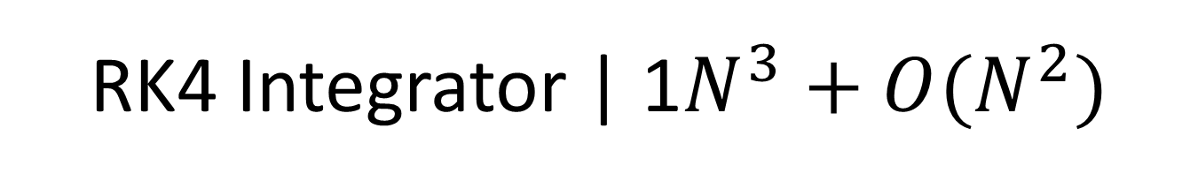

RK4 Integrator | 1$N^{3}+O(N^{2})$
The “wedge” integrator
Use previous RK4 method, but calculate values only on a 2D “wedge”
Gives a 9x memory reduction over a $9N^{3}$ integrator. This is important for low-RAM environments, such as GPUs.
arXiv:1310.2948

