Slide 1
How to Use UPSimulator
UPS Team
2018/11/24

Slide 2
UPSimulator Operating Environment
UPSimulator is built on Java, so only java environment is needed:
Java SE 8+

Slide 3
Describe Your Model
Two kinds of files can be used to describe your model:
Membrane class files
Optional.
One membrane class is a membrane template with objects, rules, properties and sub-membranes.
Environment file
Necessary.
Describe the whole structure of your model.
You also can describe the whole model (including membrane classes) in this file.
The suffix of two kinds of files can be “.txt”, or other suffix, even without suffix.

Slide 4
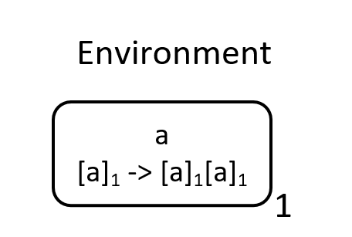
Describe Your Model
For the model described in the picture, several descriptions can be used to describe it in UPLanguage.
Description 1:
File: m.txt
Membrane M{//membrane class
Object a^1;
Rule r1=a->divide({a},{a});
}
File: e1.txt
Environment{//environment
Membrane M 1;
}

Slide 5
Describe Your Model
For the model described in the picture, several descriptions can be used to describe it in UPLanguage.
Description 2:
File: e2.txt
Membrane M{//membrane class
Object a^1;
Rule r1=a->divide({a},{a});
}
Environment{//environment
Membrane M 1;
}

Slide 6
Describe Your Model
For the model described in the picture, several descriptions can be used to describe it in UPLanguage.
Description 3:
File: e3.txt
Membrane M{//membrane class
Rule r1=a->divide({a},{a});
}
Environment{//environment
Membrane M 1{Object a^1;}
}

Slide 7
Describe Your Model
For the model described in the picture, several descriptions can be used to describe it in UPLanguage.
Description 4:
File: e4.txt
Environment{//environment
Membrane 1{
Object a^1;
Rule r1=a->divide({a},{a});
}
}

Slide 8
Start UPSimulator
To run UPSimulator, you can:
Double click the “UPSimulator.jar”, if “.jar” files have been linked to Java.
Or, use the following command in the directory of UPSimulator.jar:
java –jar ./UPSimulator.jar

Slide 9
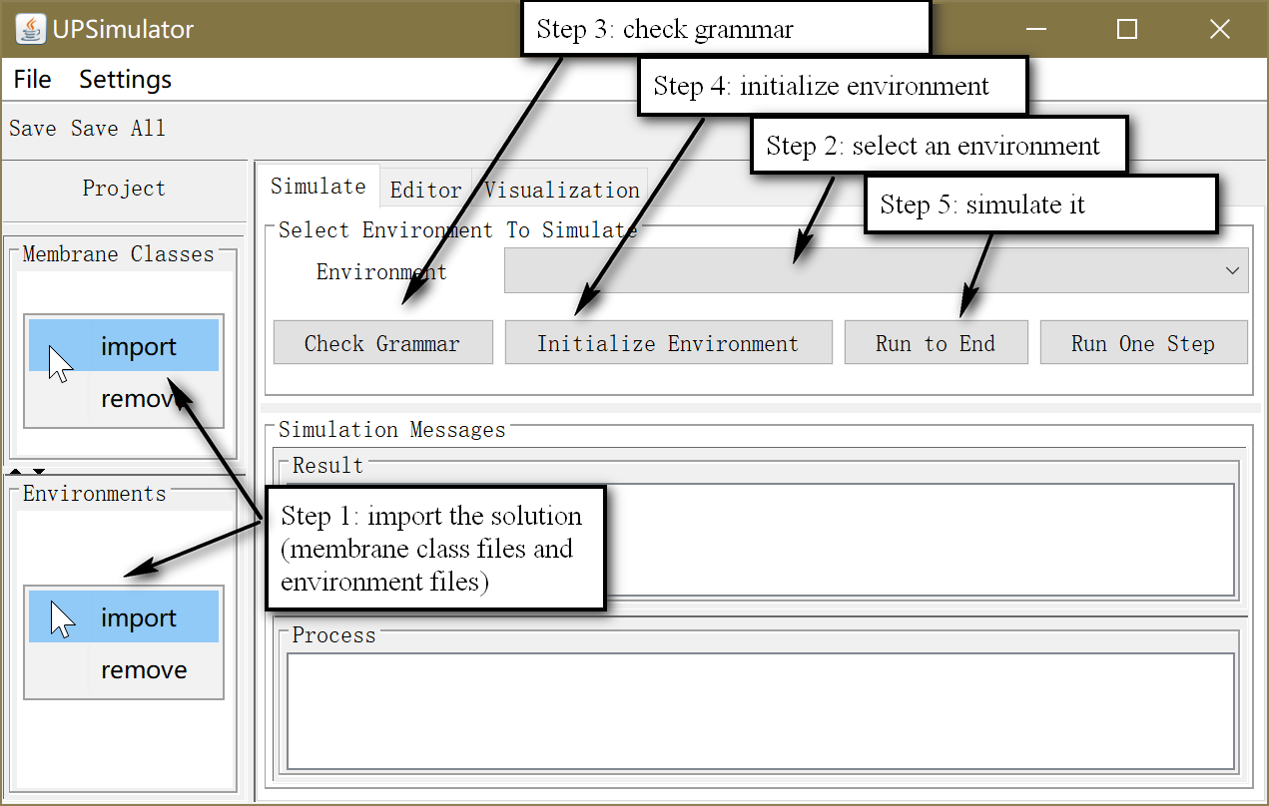
Simulate Your Model
Here we still use the model before as an example:
Choose one of the four descriptions before, and save to file(s).
And then follow the steps in the picture.
Important: The model we used will
never stop, so in step 5, just click
the “Run One Step” button.

Slide 10
More Examples
More examples
can be found in the directory examples
in website of UPSimulator ( https://github.com/quancs/UPSimulator )

Slide 11

Any more questions about UPSimulator
Visit the Home Page
Visit the Wiki Page
Download UPSimulator
Look Up the Grammar of UPLanguage
Contact Us
Notes:
在“幻灯片放映”模式下，选择箭头访问相应链接。

