Slide 1
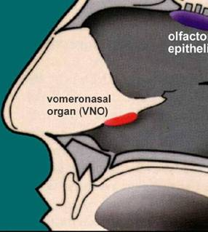
The Mammalian Olfactory System
Olfactory epithelium human: 1 cm² per nostril (5 x 10⁷ cells) dog: ~25 cm² per nostril, highly reticulated
Even Humans can distinguish >10,000 individual scents.
~500 semi-specific receptors: 2% of mammalian genome!
Olfactory receptors are GPCRs, receptor structure speculative, but probably metalloprotein. Wang, Luthey-Schulten, Suslick, PNAS 2003, 100, 3035.
olfactory epithelium

Slide 2
Artificial Olfaction: Chemical Sensing
Uses: ▪ Non-invasive medical diagnosis ▪ Dosimetry of Toxic Industrial Chemicals (TICs) ▪ 1st Responders: Fires, chemical spills, … ▪ Security screening ▪ Rapid Bacterial Identification ▪ Personal hygiene ▪ Food and drug spoilage ▪ Process control …
Problem: Current Technology is not sensitive, not portable, or not cheap.

Slide 3
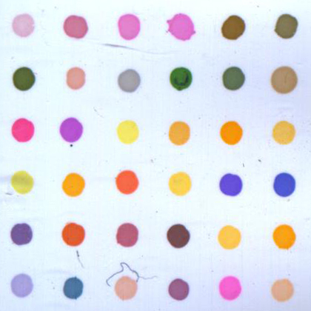
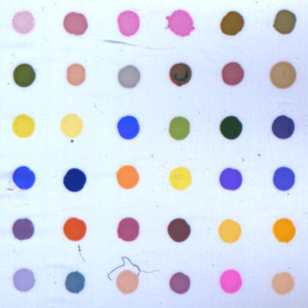

Colorimetric Array Detector
Printed array of chemically responsive dyes.
Digitally image before & after exposure & subtract.
Difference Map is a “molecular fingerprint”: a unique 108-dimensional vector (36 ΔR, ΔG, ΔB).
Before Exposure
After Exposure
Difference Map
(center avg. 300 pixels)
The dyes that change color
most in this example are
boxed in gray.
|R_{after}- R_{before}|, |G_{after}- G_{before}|, |B_{after}- B_{before}|
ammonia

Slide 4
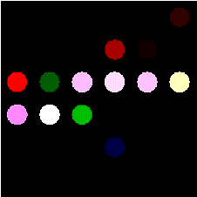
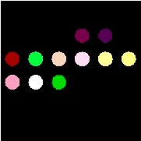
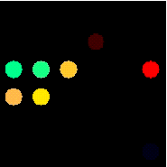

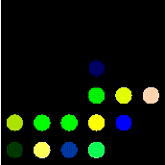

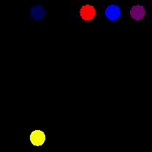
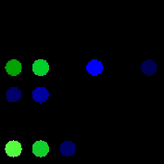

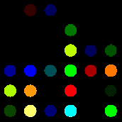
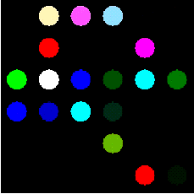

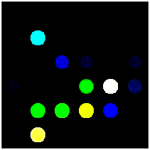
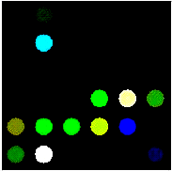

Before Exposure
After Exposure
Difference Map
 | |R_{after}- R_{before}|, | |G_{after}- G_{before}|, | |B_{after}- B_{before}|
dye1 | -0.814 | -0.652 | -0.264
dye2 | -0.806 | -0.099 | -1.429
…
dye36 | 0.991 | -1.038 | 0.823
A
The dyes that change color
most in this example are
boxed in gray.
ammonia
C
decylamine
decylamine
decylamine
decylamine
decylamine
sec
sec
sec
sec
-
-
-
-
Bu
Bu
Bu
Bu
amine
amine
amine
amine
aniline
aniline
aniline
aniline
2
2
2
2
-
-
-
-
picoline
picoline
picoline
picoline
acetic acid
acetic acid
acetic acid
2
acetic acid
2
2
2
hexanethiol
hexanethiol
hexanethiol
hexanethiol
benzylthiol
benzylthiol
benzylthiol
benzylthiol
ethanol
ethanol
ethanol
ethanol
pentanol
pentanol
pentanol
pentanol
CF
CF
CF
CF
CO
CO
CO
CO
H
H
H
3
H
3
3
3
2
2
2
2
Sec-Bu₂amine
PhMe
PhMe
PhMe
PhMe
phospine
phospine
phospine
phospine
Bu
Bu
Bu
Bu
phosphine
phosphine
phosphine
phosphine
hexanal
hexanal
hexanal
hexanal
benzaldehyde
benzaldehyde
benzaldehyde
benzaldehyde
1
1
1
1
-
-
-
-
octene
octene
octene
2
octene
2
2
2
3
3
3
3
B

