Slide 1


Improving processes for Agile Delivery
BMK Lakshminarayanan

Slide 2
DevOps movement
From practitioners, by practitioners
Not a product, specification, job title
An experience-based movement
Decentralized and open to all
Not usually driven from the top down
Improves organization efficiency and effectiveness

Slide 3




“Operation” is the Business

Slide 4
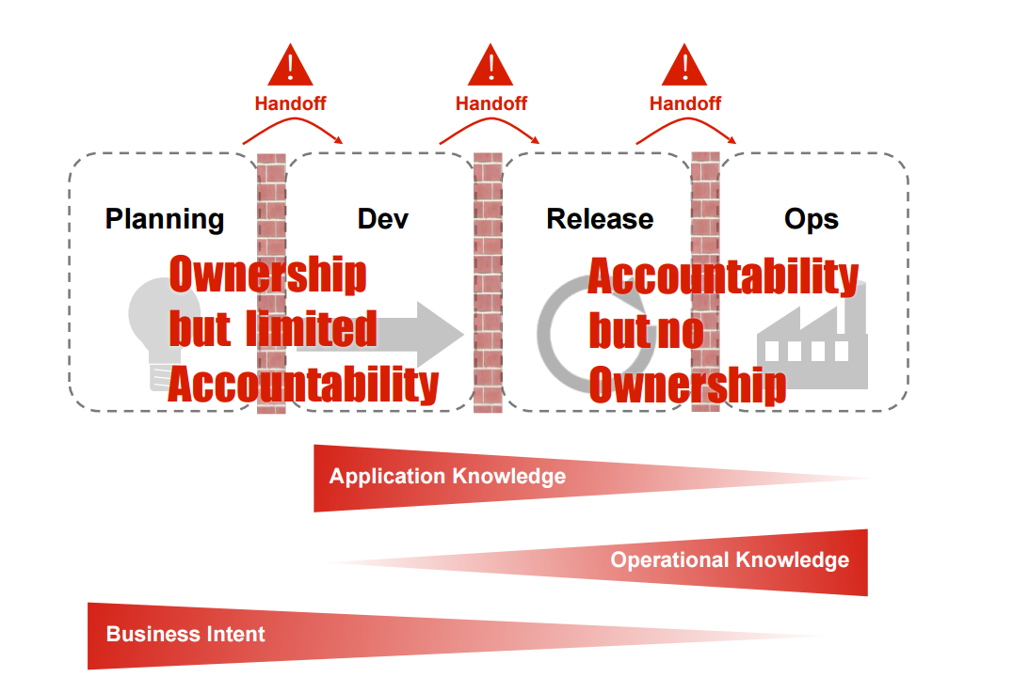
Silos are #1 enemy of throughput and quality
-Damon Edwards

Slide 5
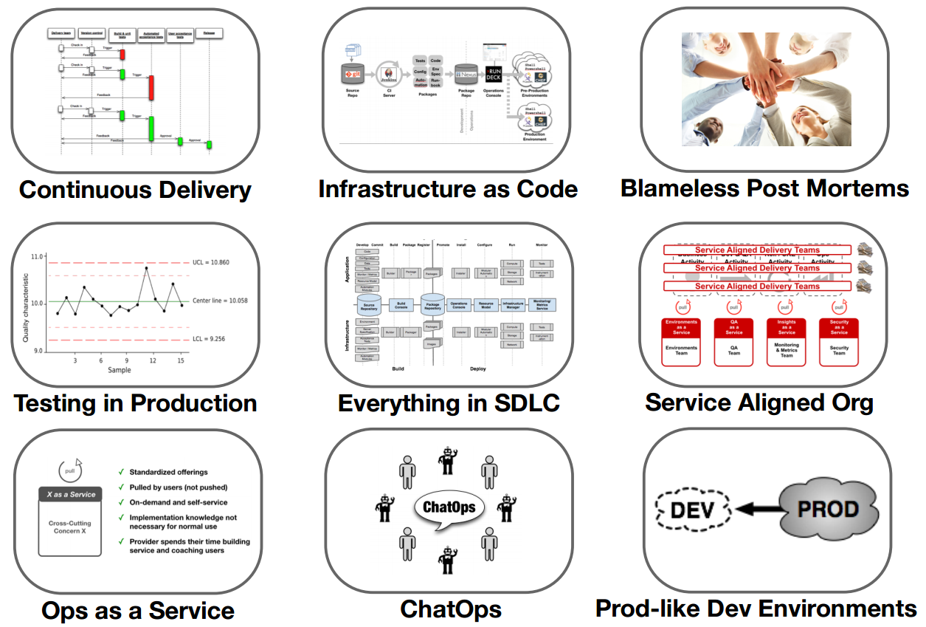

Slide 6
DevOps @ Bnz
Self-service offering | Provision your own Dev, Test boxes
Application performance monitoring | Run, Monitor, Manage, Learn
Microservices and Containers | Immutable Infrastructures
Infrastructure automation and PaaS offerings | 3 days to 30 minutes
Squads, Tribes | Co-located cross functional teams
Automated Deployments| 2 Hours to 20 seconds
DevSecOps| Shifting left

Slide 7
Resources
“Continuous Delivery” workshop by Jez Humble in Auckland 30th June
DevOpsDays NZ conference | follow us @devopsdaysnz
Wellington Enterprise DevOps meetup
https://devopsnz.slack.com/
https://12factor.net/
Building Microservices by Sam Newman
#devops

