Slide 1


Banking On Containers:
Need for Speed
BMK Lakshminarayanan
Solutions Architect
Notes:
Introductions:
Introduce title; Understand the need for speed; Time to market;
Golf-course to Production; Flow, pipeline, feedback loops

Slide 2
150+ Years in Banking for New Zealand
Bank of New Zealand is one of New Zealand's largest banks and has been operating continuously in the country since the first office was opened in Auckland in October 1861 followed shortly after by the first branch in Dunedin in December 1861

Slide 3




“Operation” is the Business

Slide 4
Challenges and Opportunities
Consistency
Application Build
Deployments
Scaling
Health Management
Notes:
It is all DevOps; Wake up everyone in the enterprise; Having great capabilities in organization it terms of platform
You do not have time and resources in your reach to do the best for given context; Speed compromises quality, quality compromises cost; cost compromises scope;

Slide 5
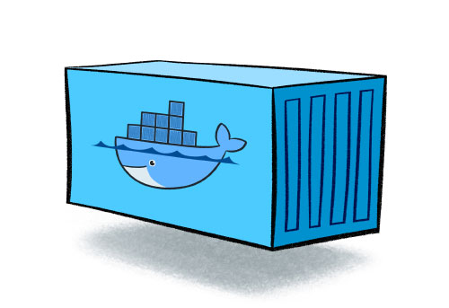
Containers are game changers

Slide 6
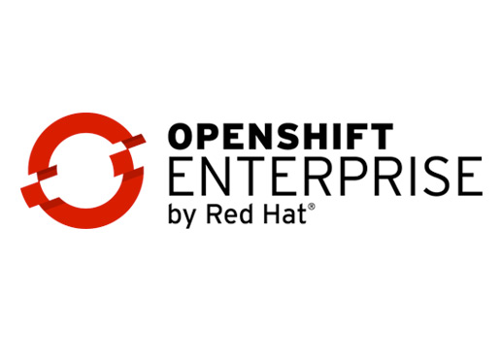
Notes:
Even if you have containerized platform it is not easy; Every organization has their own challenges.
Red Hat OpenShift Container Platform is the first and only hybrid cloud solution delivering enterprise-grade Kubernetes and Linux containers, based on Red Hat Enterprise Linux, the world’s leading enterprise Linux platform.

Slide 7
New (real) Challenges
Notes:
We are monitoring the standard endpoints and processes based on https://github.com/redhat-cop/openshift-playbooks/blob/master/playbooks/operationalizing/monitoring_guide.adoc
We have built some custom monitoring scripts to help monitor and alert on capacity and performance issues.
docker-registery-monitor which does a pull and push to the docker registry every 5 minutes .
persistent-volume-monitor which checks how many persistent volumes we have left that can be used
build-max-pod-monitor this monitors our openshift builder nodes to make sure we are not hitting the max pods for the builder nodes
app-max-pod-monitor this will make sure we are not hitting max pods for our compute nodes
docker-pool-monitor to monitor the docker pool's on the openshift nodes, to ensure we are not going to run out of disk for the docker thin pools
cert monitor, we have a script that runs once every day to check that none of the certs are due to expire in the next month
We have standard OS monitoring on all the nodes (and masters) CPU, mem swap etc.
security
We use cloudforms which scans all of the openshift servers using openscap and reporting on which container images have high severity security CVE's. I think we need to do more in this space (intergrating some scanning into the pipelines)
logging
Currently using elastic search, fluentd and kibana (EFK), but we are working on migrating this to splunk. We have found ELK to be not as reliable.
pipeline
The pipelines are expanding, there are new pipelines being built every day, and having a well-documented pattern is crucial. We are using Jenkins with the openshift plugin, and using a jenkinsfile. This allows us to use ephemeral jenkins.
When the pipelines are working well, things are great. However our current pattern seems to be quite fiddley and complicated where it's getting rather difficult to support.
Playbooks
OpenShift playbooks do:
In a nutshell
Ensures OpenShift projects are kept consistent with the source of truth (Git). This reduces the amount of human intervention and therefore human error at deployment time.
In detail
Executed before deploying to a given environment
Downloads the latest configuration from Git and:
Updates BuildConfig
Updates DeploymentConfig
Updates Service
Updates Route
Creates Imagestreams
Updates Secrets
Updates Configmaps
This is especially handy for a developer who needs to update a configuration property for their project. All they need to do is ensure that source control is updated with the new values and automation takes care of the rest.

Slide 8
New Challenges
Enterprise – Integrating with governance and security
Monitoring
Services & Application logs
Monolith to Microservices
Building PaaS / Cloud native applications
Notes:
We are monitoring the standard endpoints and processes based on https://github.com/redhat-cop/openshift-playbooks/blob/master/playbooks/operationalizing/monitoring_guide.adoc
We have built some custom monitoring scripts to help monitor and alert on capacity and performance issues.
docker-registery-monitor which does a pull and push to the docker registry every 5 minutes .
persistent-volume-monitor which checks how many persistent volumes we have left that can be used
build-max-pod-monitor this monitors our openshift builder nodes to make sure we are not hitting the max pods for the builder nodes
app-max-pod-monitor this will make sure we are not hitting max pods for our compute nodes
docker-pool-monitor to monitor the docker pool's on the openshift nodes, to ensure we are not going to run out of disk for the docker thin pools
cert monitor, we have a script that runs once every day to check that none of the certs are due to expire in the next month
We have standard OS monitoring on all the nodes (and masters) CPU, mem swap etc.
security
We use cloudforms which scans all of the openshift servers using openscap and reporting on which container images have high severity security CVE's. I think we need to do more in this space (intergrating some scanning into the pipelines)
logging
Currently using elastic search, fluentd and kibana (EFK), but we are working on migrating this to splunk. We have found ELK to be not as reliable.
pipeline
The pipelines are expanding, there are new pipelines being built every day, and having a well-documented pattern is crucial. We are using Jenkins with the openshift plugin, and using a jenkinsfile. This allows us to use ephemeral jenkins.
When the pipelines are working well, things are great. However our current pattern seems to be quite fiddley and complicated where it's getting rather difficult to support.
Playbooks
OpenShift playbooks do:
In a nutshell
Ensures OpenShift projects are kept consistent with the source of truth (Git). This reduces the amount of human intervention and therefore human error at deployment time.
In detail
Executed before deploying to a given environment
Downloads the latest configuration from Git and:
Updates BuildConfig
Updates DeploymentConfig
Updates Service
Updates Route
Creates Imagestreams
Updates Secrets
Updates Configmaps
This is especially handy for a developer who needs to update a configuration property for their project. All they need to do is ensure that source control is updated with the new values and automation takes care of the rest.

Slide 9
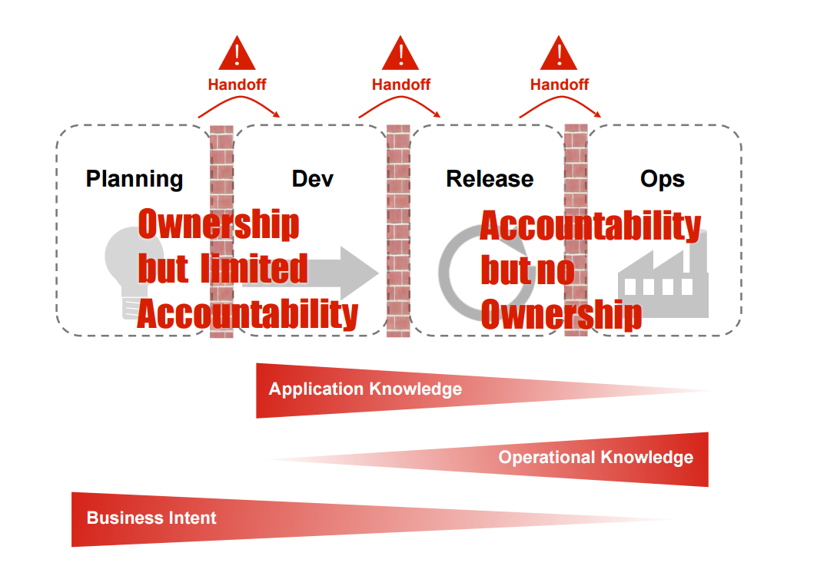
Silos are #1 enemy of throughput and quality
-Damon Edwards

Slide 10
DevOps @ Bnz
Self-service offering | Provision your own Dev, Test boxes
Application performance monitoring | Run, Monitor, Manage, Learn
Microservices and Containers | Immutable Infrastructures
Infrastructure automation and PaaS offerings | 3 days to 30 minutes
Squads, Tribes | Co-located cross functional teams
Automated Deployments| 2 Hours to 20 seconds
DevSecOps| Shifting left

Slide 11
Resources
https://blog.openshift.com/
DevOpsDays NZ conference | follow us @devopsdaysnz
Wellington Enterprise DevOps meetup and OpenShift meetup
https://devopsnz.slack.com/
https://12factor.net/
Building Microservices by Sam Newman
#devops

