Slide 1
VEL 113F Final Project
Luke Peterson

Slide 2
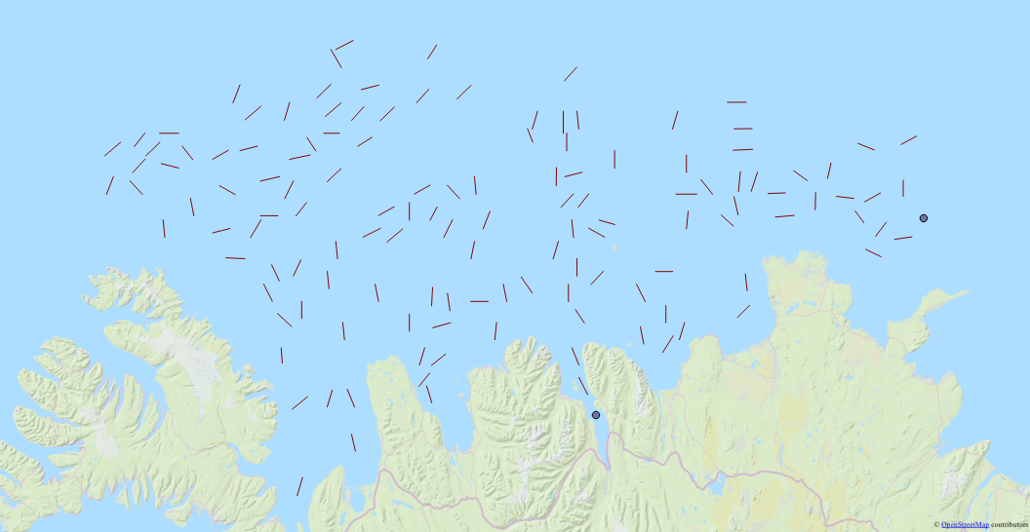
Traveling Salesman Problem
Notes:
Estimating Fish population
Must sail through each line (132 total)
Direction matters!
Start and End signified with points

Slide 3
Objective
“Shortest path”
  Include current
  Include landmass
  Does not include wind
  Does not include slower travel during trawling
  Assumes points on flat coordinate plane
Actual PI is only useful for comparison

Slide 4
Challenges
Wind Direction
Ocean Currents
Land
Notes:
Wind direction cannot be accurately predicted in Iceland

Slide 5
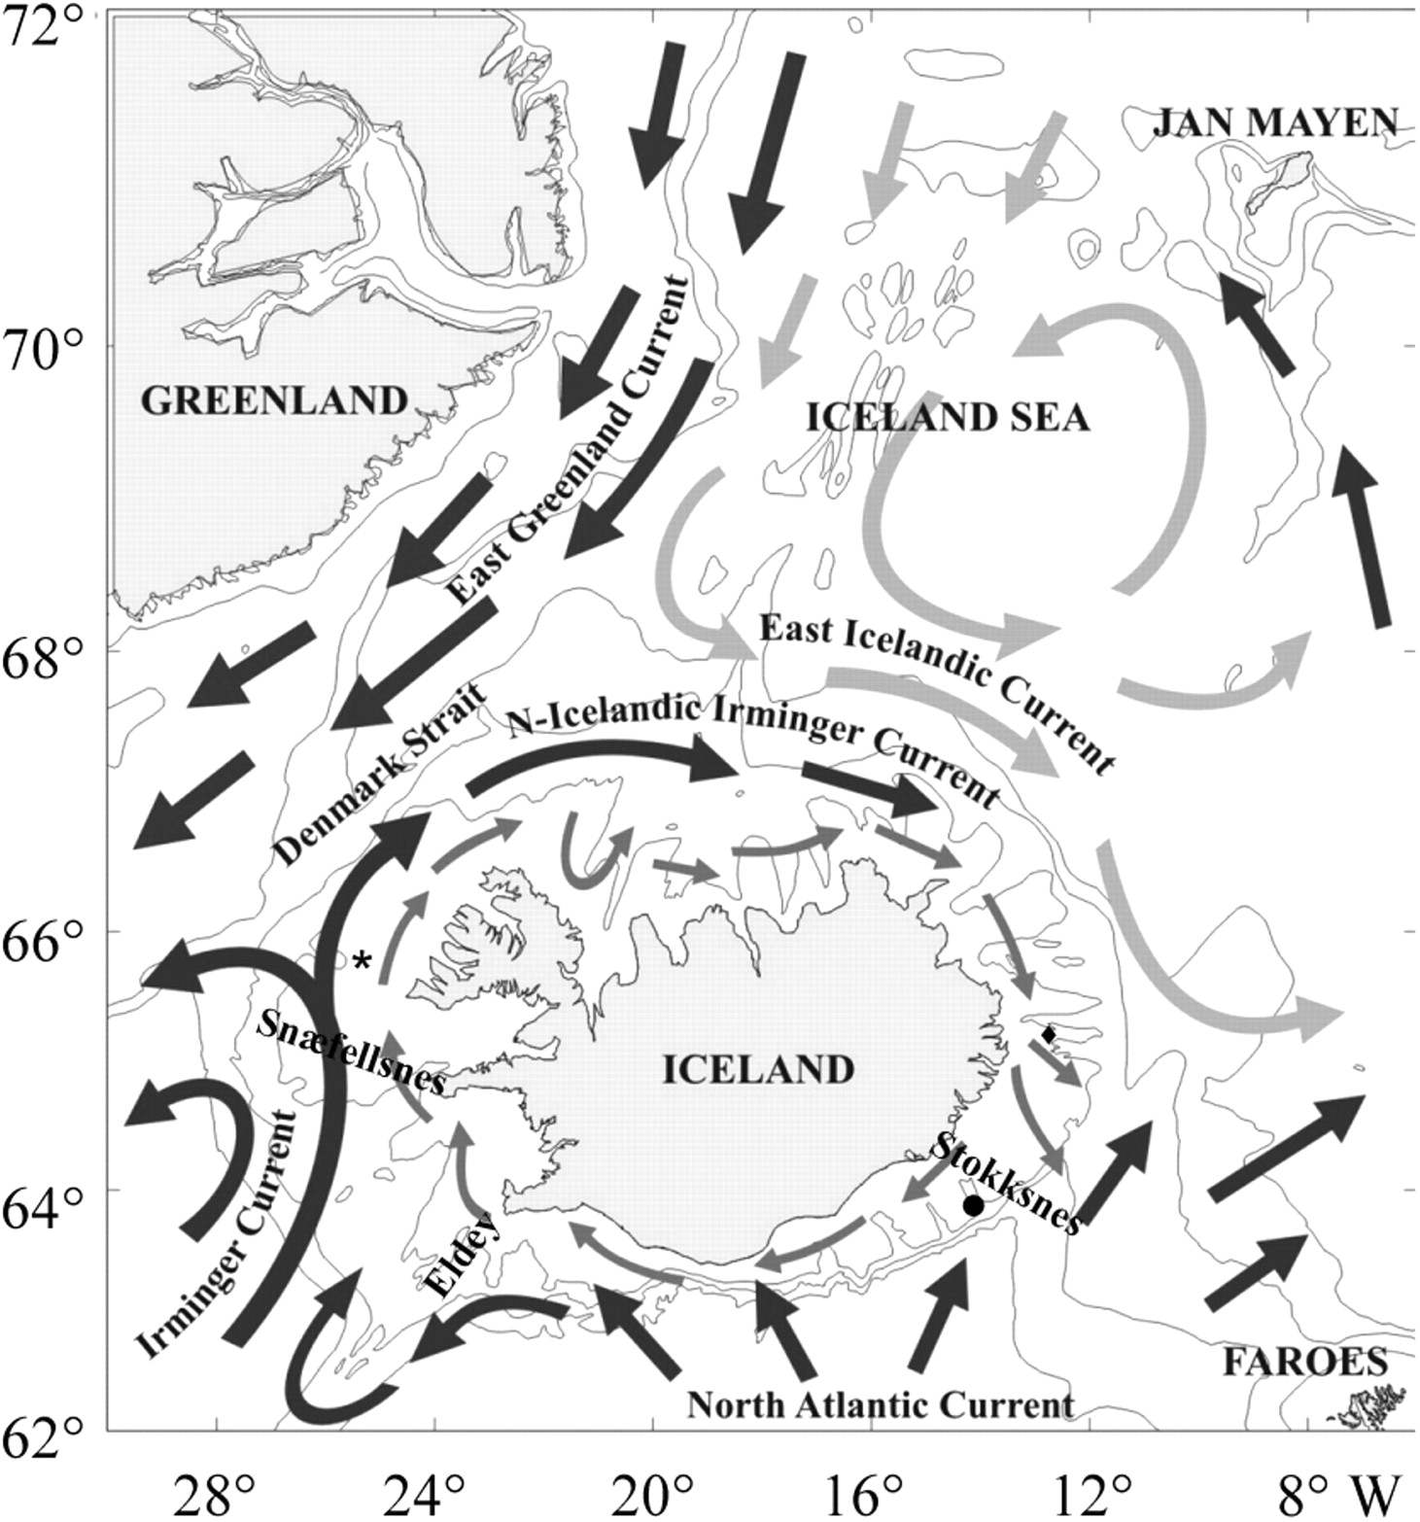
Ocean Currents
Image credit Marine Research Institute
Notes:
For simplicity, sailing west costs 5% more than sailing any other direction

Slide 6
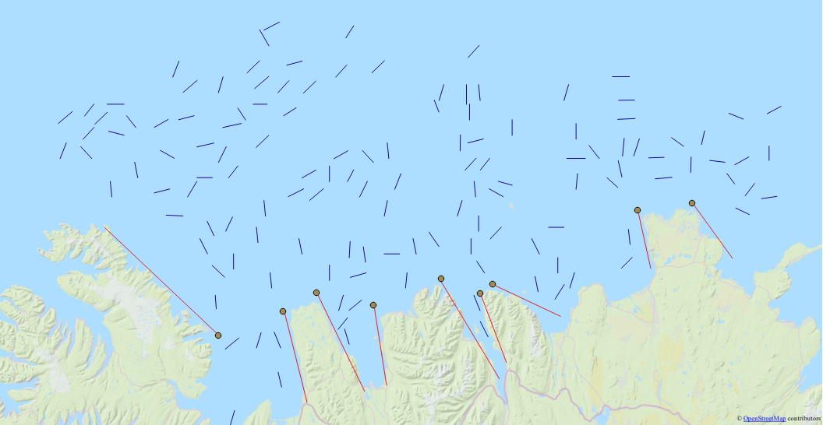
Land
Notes:
Drew lines that check for intersection with routes around land features

Slide 7
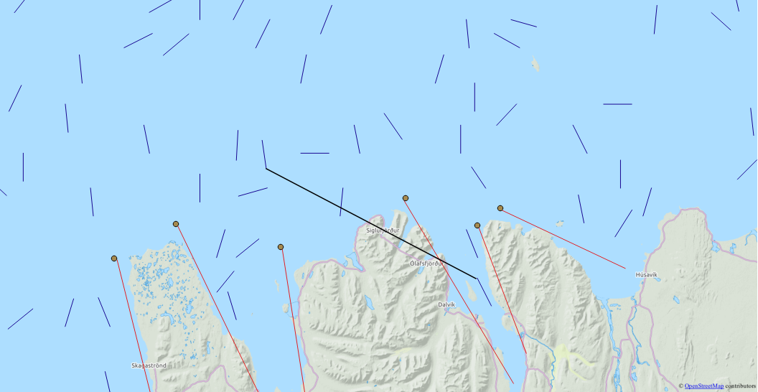
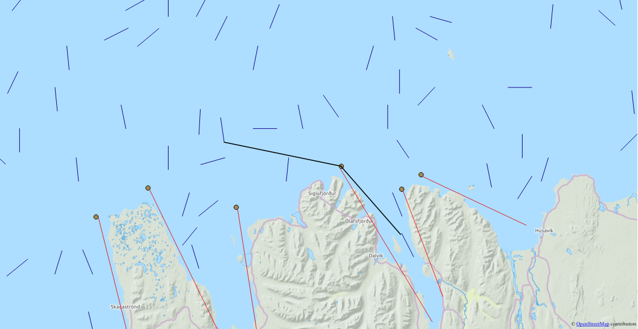
Land
Notes:
If route is calculated as top picture, distance of route will be calculated as bottom picture. Line segment that is created from algorithm will not show this but it will be accounted for in PI
Distance formula is recursive in case more than one line is intersected

Slide 8
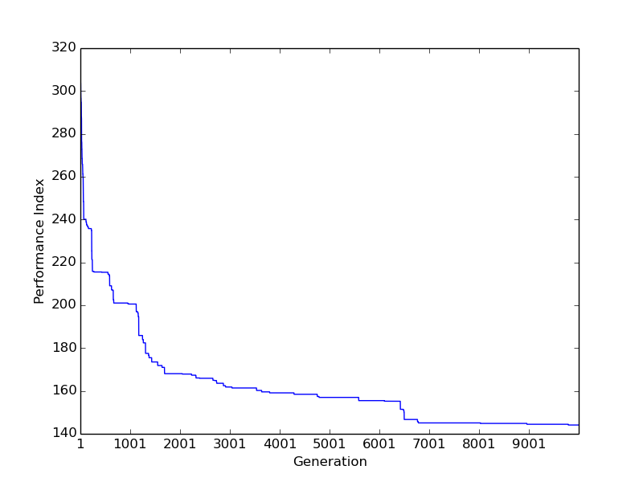
Ordered Crossover
10000 Generations
20 Pop. Size
PI: 144.103

Slide 9
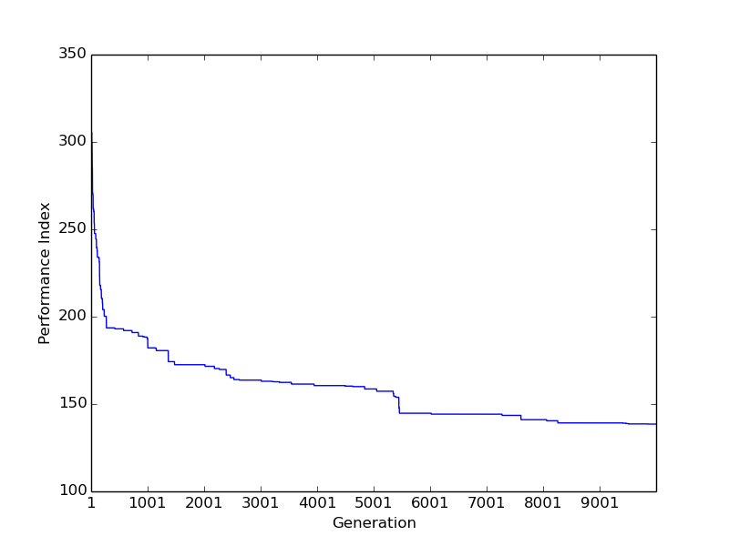
Edge Recombination
10000 Generations
20 Pop. Size
PI: 138.531

Slide 10
Result

