Slide 1
VEL113F Design Optimization
Project Introduction
Luke Peterson

Slide 2
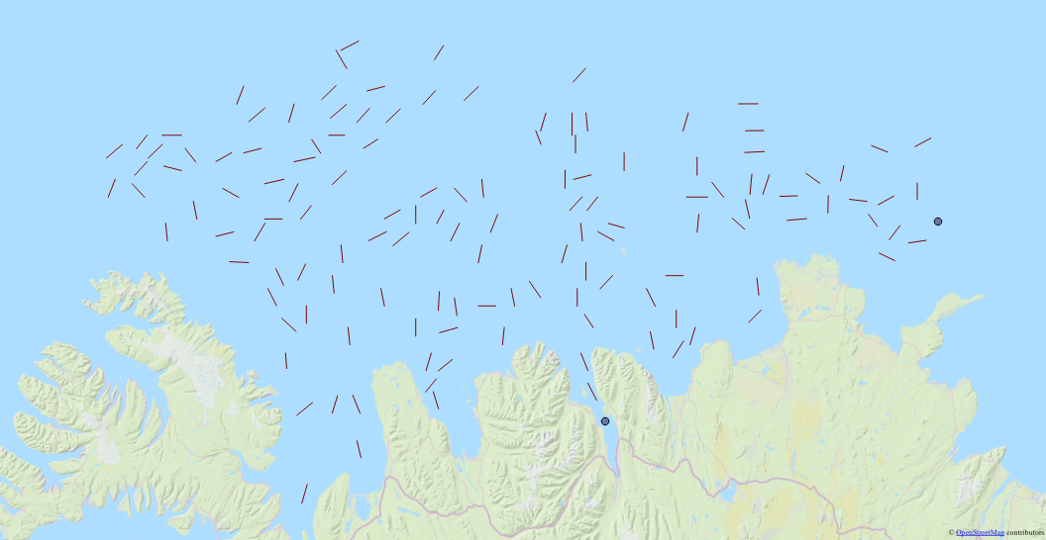
Traveling Salesman Problem
Notes:
Estimating Fish population
Must sail through each line (132 total)
Direction matters!
Start and End signified with points

Slide 3
Challenges
Wind Direction
Ocean Currents
Land
Notes:
Wind direction cannot be accurately predicted in Iceland

Slide 4
Status
Edge Recombination – 10000 gen
Ordered Crossover – 10000 gen
ER and OX run until PI hasn't changed for 30% of the generations

