Slide 1


Signa
Library

Slide 2
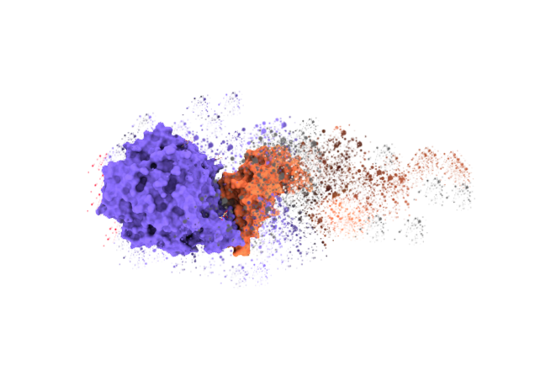

123
Convert proteins into numbers

Slide 3
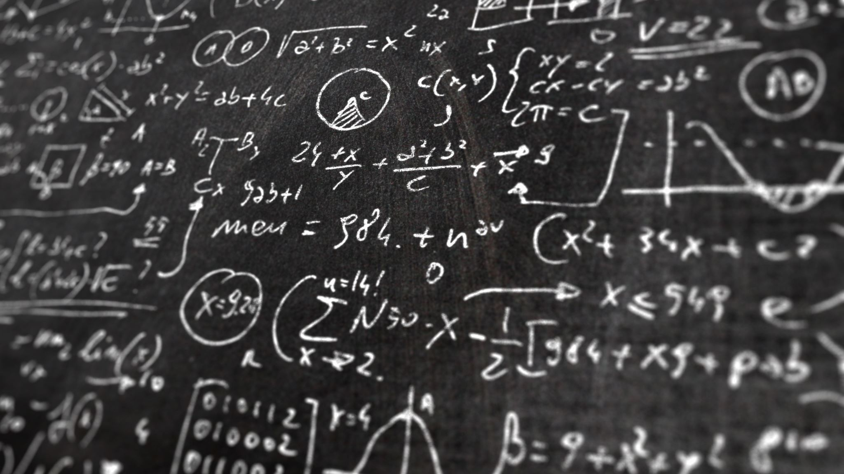
Structural Signatures
Fingerprints

Slide 4
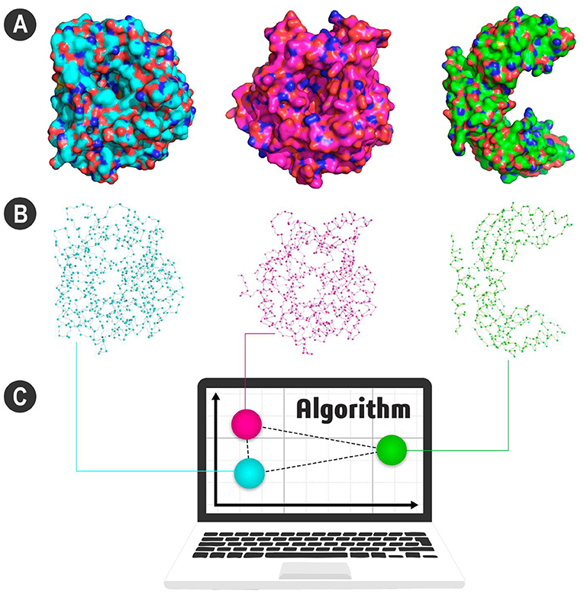
Why?
Comparing

Slide 5
Specifications
Python-based library
Command line interface
Fast performance
Until 5x faster than aCSM’s original implementation

Slide 6
SIGNA CORE
CSM
CSM-HP
aCSM
Capri
Proteus
Proteingo
SSV
ASMC
BioSVD
Propedia

Slide 7
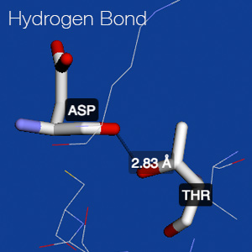
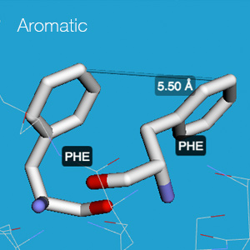
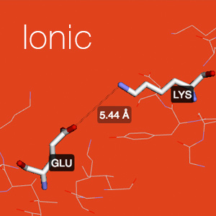
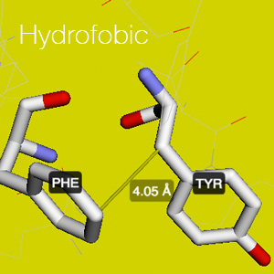
CONTACTS
Weak type of chemical bond
Stabilizes proteins
Proteus only consider
hydrogen bonds, ionic, and
SS-bond

Slide 8

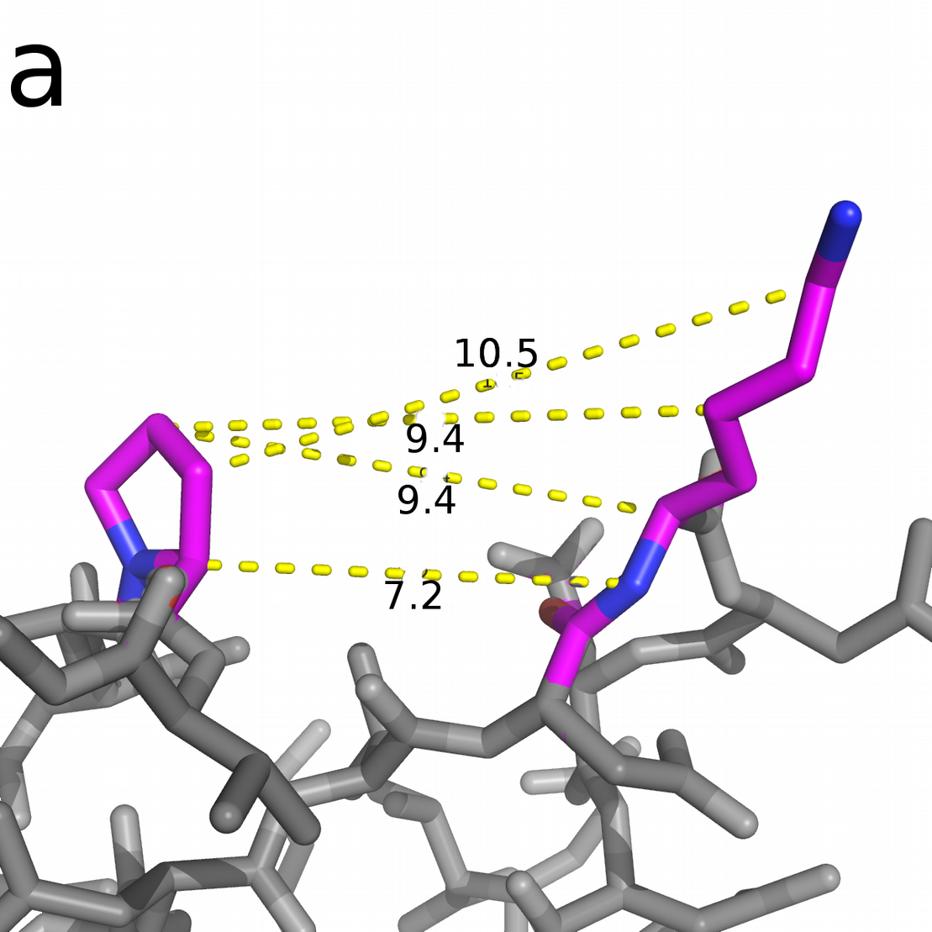
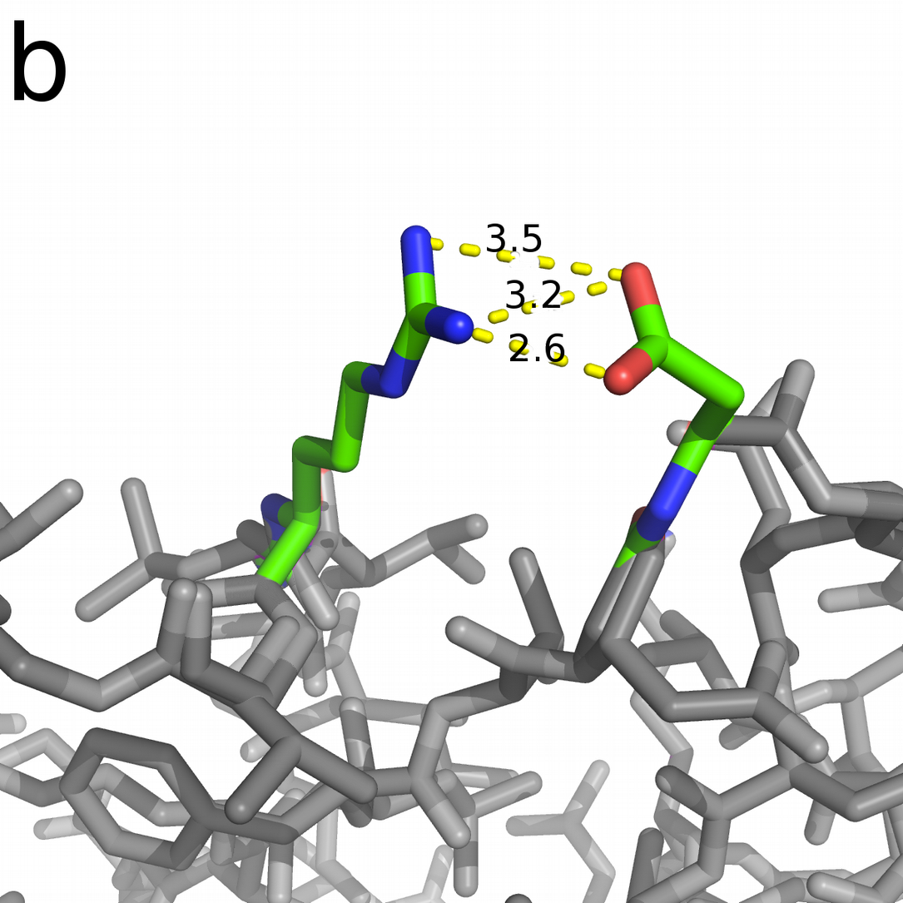
Non-contact
Contact
Example: P52R - K72D

Slide 9
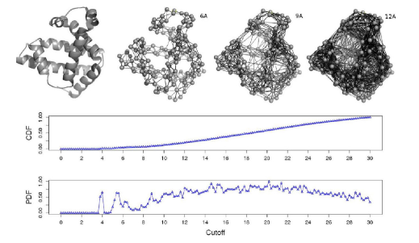

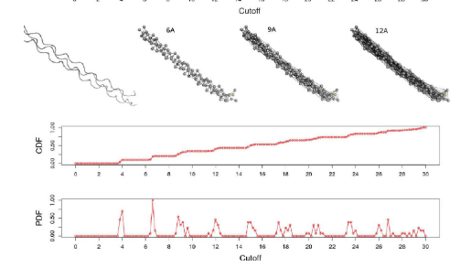
A
Graph modeling
B
Source: Pires DE, de Melo-Minardi RC, dos Santos MA, da Silveira CH, Santoro MM, Meira W. Cutoff Scanning Matrix (CSM): structural classification and function prediction by protein inter-residue distance patterns. BMC Genomics. 2011;12:S12.

Slide 10
SVD
576
4
Remove
noises
ProteusDB: 175,000 sextets
Before: 100,800,000 values
After: 700,000 values (144x)
SVD
Run each search in:
< 4 sec

Slide 11
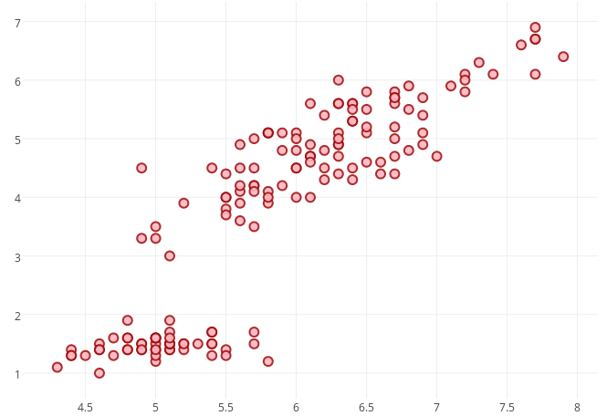
100%
FILTER
Cluster LYS-SER 13
E96/M416
Search ray
ProteusDB: ~175,000 clusters
* Value estimated by the number of tests performed for the protein 2LZM.

