Slide 1
Achieving leadership in China detergent market
– Project proposal –
Henkel (China) Investment Co. Ltd.
,
Roland Berger & Partners – International Management Consultants
Barcelona – Beijing – Berlin – Brussels – Bucharest – Budapest – Buenos Aires – Delhi – Detroit – Düsseldorf – Frankfurt – Hamburg – Kiev – Kuala Lumpur – Lisbon
London – Madrid – Milan – Moscow – Munich – New York – Paris – Prague – Riga – Rome – São Paulo – Shanghai – Stuttgart – Tokyo – Vienna – Zurich

Slide 2
Contents Page
  A. Fierce competition from international and domestic players has imposed 3
  great challenge on Henkel
  B. To achieve turnaround, Henkel should adopt an aggressive expansion strategy 10
  C. Roland Berger will help develop the appropriate strategy: project outline 12
  D. Project organization and time frame 22
  E. Value of the project 12
  F. Roland Berger is a best partner of Henkel to exploit China detergent market: 12
  selected reference
  Annex A: Case study - Qiqiang 32
  Annex B: Case study - P&G 42

Slide 3
A. Fierce competition from international and domestic players has imposed great challenge on Henkel

Slide 4
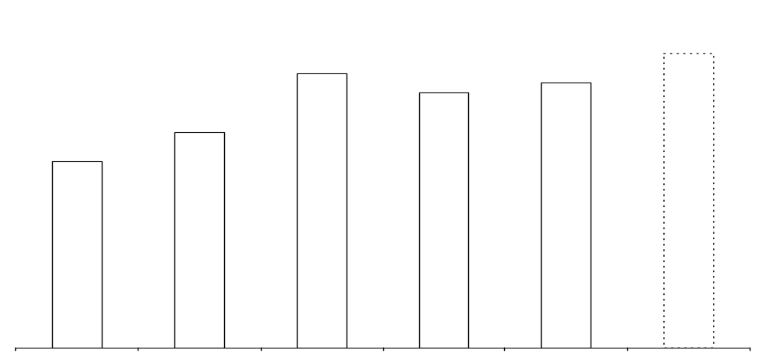
After fast increase in earlier 1990th, annual growth of China detergent market has slowed down in these years
National market volume of laundry detergent
[in Mio. tons]
+8.2% p.a.
2~3%p.a.
2.9~3.0
2.8
2.7
2.6
2.2
1.9
* Estimation
1993
1994
1995
1996
1997
2000*
Source: Chinese light Industry Yearbook(1999), Roland Berger & Partners’ analysis

Slide 5
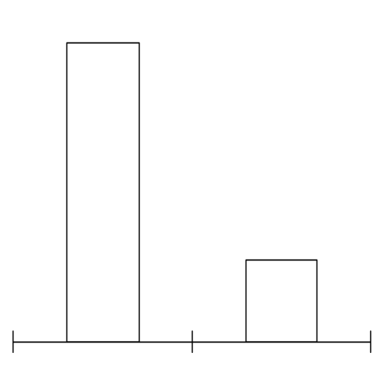
Overcapacity in detergent indudstry leads to price reduction and thus reduces the product profitability
Overcapcity in detergent industry
Price reduction of Major brand
(RMB/Kg)
Gross profitability of Whitecat regular powder
1998年
18.8
1999年
At present, there are about 150 manufactures in detergent industry with capacity of 3.8 million tons, but total market volume is about 2.7 million tons, so the utilization rate of capacity is about 70%
Marekt entry of detergent industry is pretty low and there lies a lot of unregistered factories, If taking their capacity into account, the utilizaition rate will be furthur reduced to about 50%-60%
18.0
17.3
11%
16.5
5.5
4.8
3%
OMO
Tide
Whitecat
(regular powder)
1998年
1999年
Average price reduction of the whole industry is 10%

Slide 6
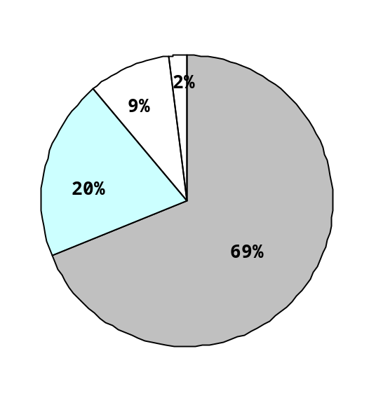
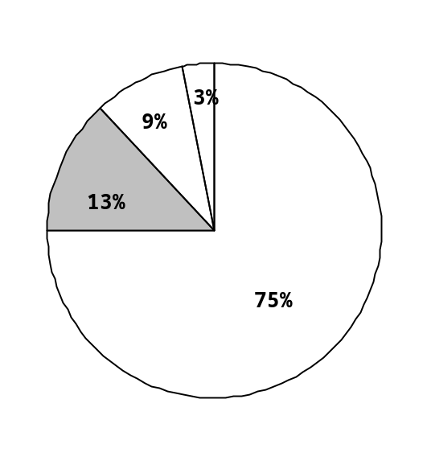
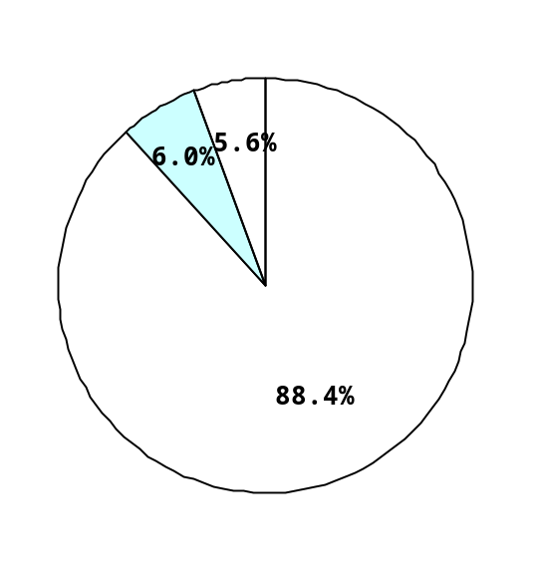
After having established prominent position in high end market, P&G and Unilever begin to penetrate middle and low end market
Market structure of high end
(Price：>10RMB/Kg)
Market stucture of middle end
(Price：7~10RMB/Kg)
Market structure of low end
(Price：<7RMB/Kg)
Proportion of high end market
is 11.9%
Proportion of middle end market
is 31.8%
Proportion of low end market
is 56.3%
Others
Benckiser
Henkel
Benckiser
Henkel
Unilever
Unilever
P&G
P&G
Others
Others
Resource: AC Nielson retailing audit 1999-2000

Slide 7
Market share of international players’brands in different segment
Back-up
Market structure of high end
(Price：>10RMB/Kg)
Market stucture of middle end
(Price：7~10RMB/Kg)
Market structure of low end
(Price：<7RMB/Kg)
Brand Share Company
Tide 6.0% P&G
Ariel 2.2% P&G
OMO 2.4% Unilever
Power 28 1.1% Benckiser
Persil 0.1% Henkel
Brand Share Company
GFL 2.2% P&G
Panda 1.9% P&G
WIPP 1.0% Henkel
Tianjin 1.8% Henkel
Dosia 1.0% Benckiser
Brand Share Company
Fangcao 2.5% Unilever
Yunquan 0.8% Unilever
Sunlight 0.2% Unilever
Seagull 2.9% Henkel
Tiantian 1.5% Henkel
Guilin 1.2% Henkel
Resource: AC Nielson retailing audit 1999-2000

Slide 9
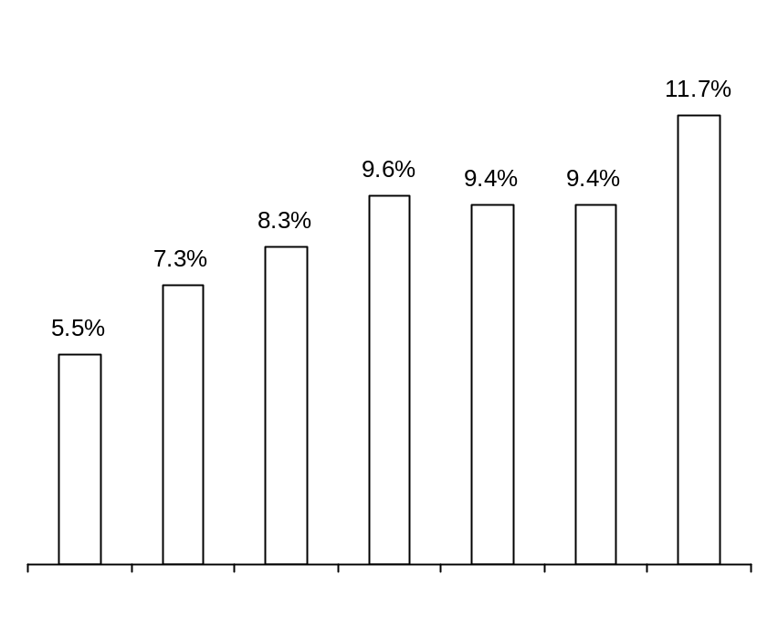
Although a late comer, Benckiser has successful penetrated north market with Dosia through well-designed entry strategy
Marekt share of Dosia in north China
Market entry design
  Through acquiring distributors from P&G, Dosia chose Liaoning province as its initial entry area
  In Heilongjiang and Jilin province, competitors are not so strong as that in other parts of China. local brands, such as Tiantian, are in dominant positions, so Dosia chose these two province as subsequent penetration areas
  Competition is in choas in Shandong, and distribution network is not well regulated with lots of small distributors/wholesalers competing with each other, so it is easy for Dosia to penetrate the market and cultivate its qualified disbition channel
  In order to guarantee the success, channel penetration is also backed up by strong advertisement champaign
Jan 1999
Mar 1999
May 1999
Jul 1999
Sep 1999
Nov 1999
Jan 2000
Resource: AC Nielson retailing audit 1999-2000

Slide 10
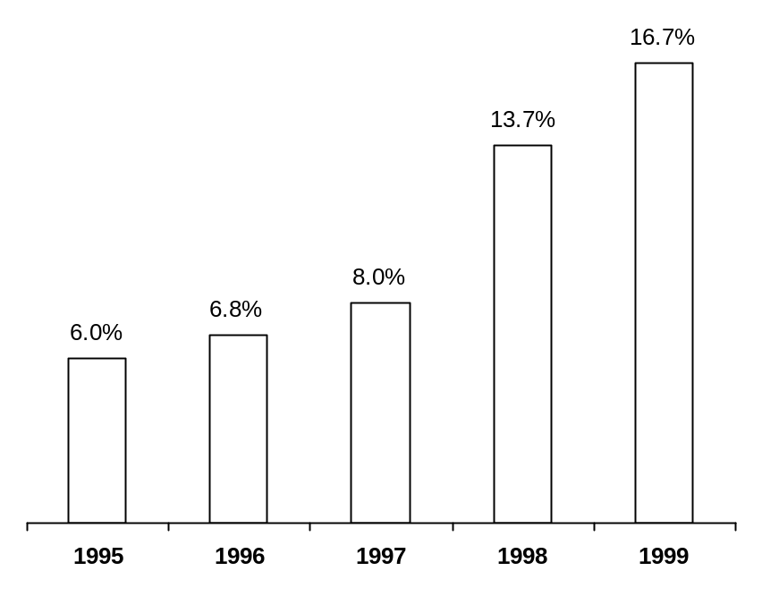
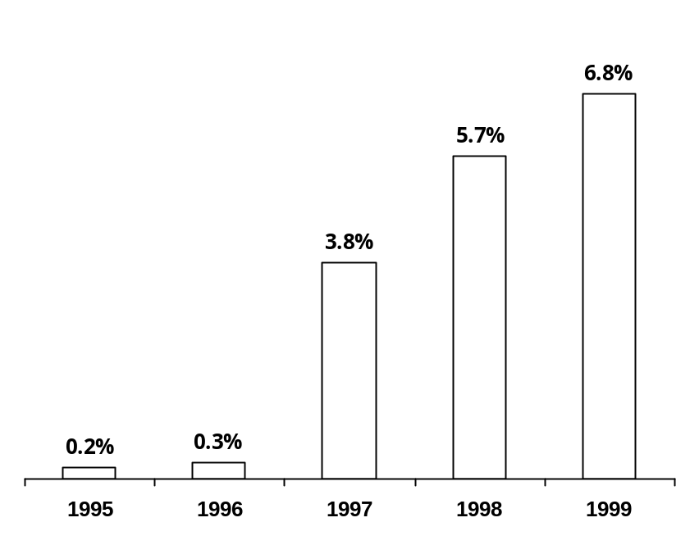
Some domestic players are also making efforts to achieve fast growth and national presence
Market share of Qiqiang
Market share of Libai
Resource: AC Nielson retailing audit 1999-2000

Slide 11
Fast growths of domestic players are supported by their rural focus strategy, nationwide manufacturing network and direct sales model
Market penetration strategy taken by fast growing domestic players
Rural focus strategy
Nationwide manufacturing network
Direct sales model
  Rural market is large but is dominanted by weak regional brands
  International players have weak performance in rural area
  Logistic cost is high in detergent industry accouting for over 10% in total value
  Long distance transportation in China is not oonvient
  For a new comer, it is not easy to get qualified local distirbutors
Reason
  First penetrate rural market and town
  After achieving strong perfromance in rural area, then penetrate city and large county
  Acquiring local players in different areas (Qiqiang)
  Signing OEMcontracts with local players in different areas(Guangdong Libai)
  Directly selling products to low level dealers or retailing outlet
  strong channel promotion
Method
  Avoiding competing with strongs players
  Gaining market share with comparatively low marketing investment
  Avoiding competing with local players
  Reduction in logistic cost
  Fast market penetration
  But the sales expense is high and the sales force should be very diligent
Result

Slide 12
In order to achieve turnaround, Henkel should adopt an aggressive expansion strategy
Leadership in
detergent market
Aggressive
expansion strategy
Deterioration of market share for each brand, defeated by strong international or domestic brands one by one
Six regional brands with
comparative weak
market performance
Turnaround
point
No change

Slide 13
Strategy formulation should be based on full understanding of China detergent market and full consideration of three strategic issues
Choice of focus brand and strategic expansion route
Strategy formulation
Developing rural entry model
Establishing reliable and low cost logistic network
Full understanding of China detergent market

Slide 14
Per capita consumption gradually decreases from south to north and from east to west
Consumption of laundry detergent in China
[kg, per capita]
>3 kg per capita
•
1.88
2~3 kg per capita
•
1.7~2 kg per capita
1.88
<1.7 kg per capita
•
1.88
Much low area
•
•
1.95
•
2
•
1.8
•
2
•
1.95
3.35
•
•
1.95
•
2.35
•
•
1.95
1.68
•
•
2.35
1.68
2.35
2
•
•
•
1.68
3.35
Source: Roland Berger & Partners’ interview

Slide 15
The high population density is located in the North China plain
Back up
Municipality population density
(includeing suburb area)
Shanghai 2512
Beijing 738
Tianjin 866
Chongqing 362
146(Jilin)
over 500 capita per
square kilogram
276(Liaoning)
738(Beijing)
400~500 capita per
square kilogram
866(Tianjin)
343(Hebei)
209(Shanxi)
300~400 capita per
square kilogram
586(Shandong)
188(Sanxi)
578(Henan)
715(Jiangsu)
200~300 capita per
square kilogram
177(Sichuan)
2512(Shanghai)
326(Hubei)
471(Anhui)
362(Chongqing)
443(Zhejiang)
308(Hunan)
100~200 capita per
square kilogram
273(Fujian)
108(Yuannan)
201(Guangxi)
less 100 capita per
square kilogram
392(Guangdong)
Source: Roland Berger & Partners’ interview

Slide 16
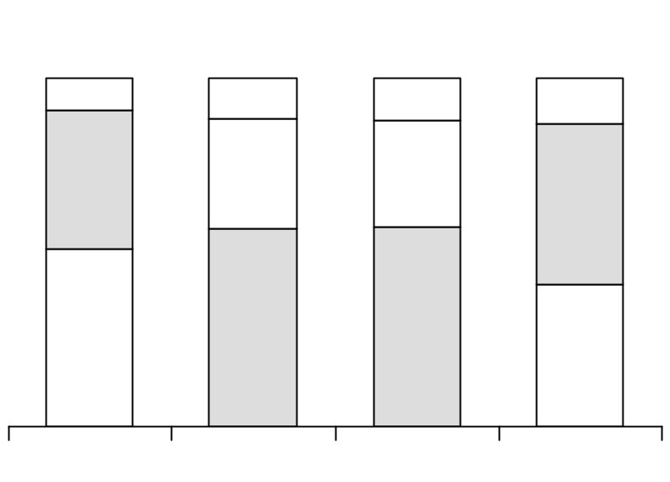
For different region, market segment structure is also different because of various income level and consumption habit
Segment structure by region
Comments
Total
[,000t]
778
668
537
745
Low end market account for over 50% of total market and is especially large in the low developing North and West of China
Middle-end product take a higher share in East and South of China
High end market is comparatively higher in south market because of its high income level and accptance of concentrate powder
High
(>10RMB/kg)
9.2%
11.5%
12.1%
13.2%
Middle-end
(7~10RMB/kg)
31.8%
30.6%
39.9%
45.9%
Low-end
(<7RMB/kg)
50.9%
56.7%
57.3%
40.9%
East
North
West
South
Resource: AC Nielson retailing audit 1999-2000

Slide 17
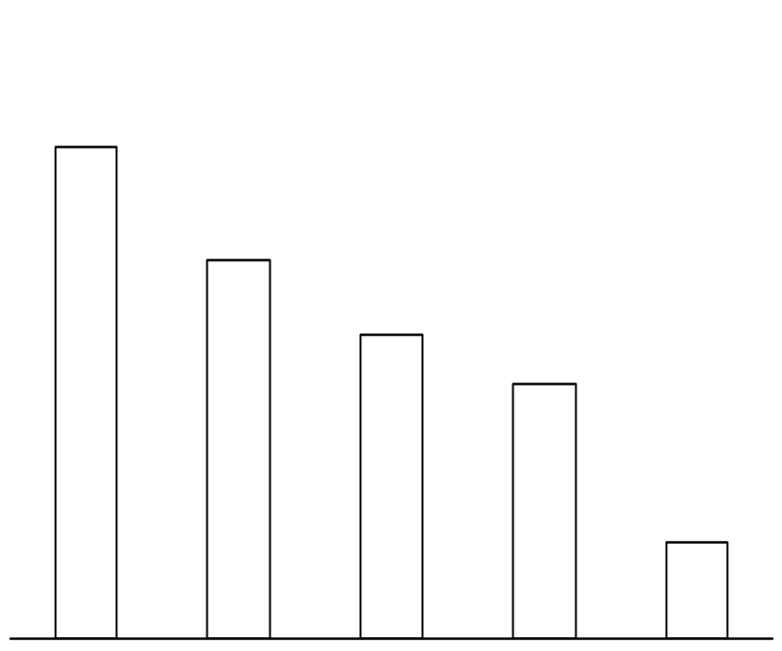
East China is in intense competition and major players are all national brands
East
market volume by province
[’000 ton]
Brief analysis
Total: 778,000 tons
Jiangsu and Henan have the largest market volume in east China
Jiamei, Whitecat, GiGE and Fangcao are traditional brands with strong regional market bases
distribution network is comparatively mature with some large distributors in dominance
Qiqiang has successfully penetrate east China and established leadership with strong sales campaign
Libai is planing to penetrate east China
Diaopai is also making efforts to enlarge its market share by offering high margin incentive to distributors
307.5
224.1
115.7
70.3
60.4
Jiangsu
Henan
Zhejiang
Anhui
Shanghai

Slide 18
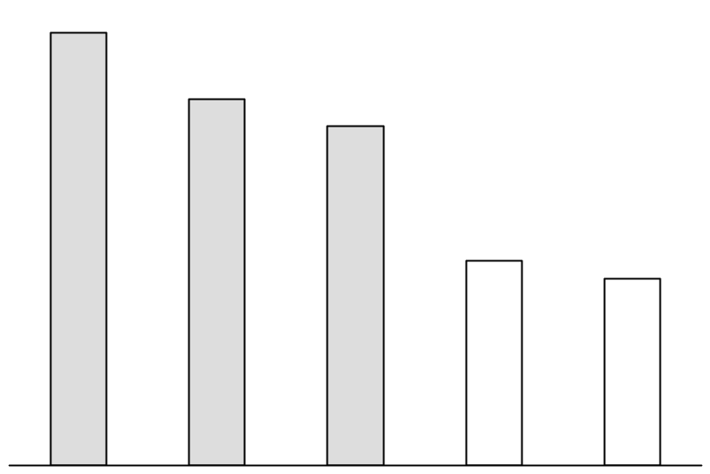
In South, we recommend Hunan and Hubei are target market for market entry because Libai almost control the whole low-end market in Guangdong
South
Low-end market size in South China
[’000 Ton]
Competitive landscape
Total: 745,000 tons
Libai almost control the whole low-end market in Guangdong
Resun as a regional brand holds half of Hunan’s low-end market
One flower and Quanli has 30% and 20% of low-end segment respectively in Hubei
190
179
170
118
84
Hunan and Hubei are the target market due to their large market size and weak competitors
Guangdong
Hunan
Hubei
Jiangxi
Fujian

Slide 19
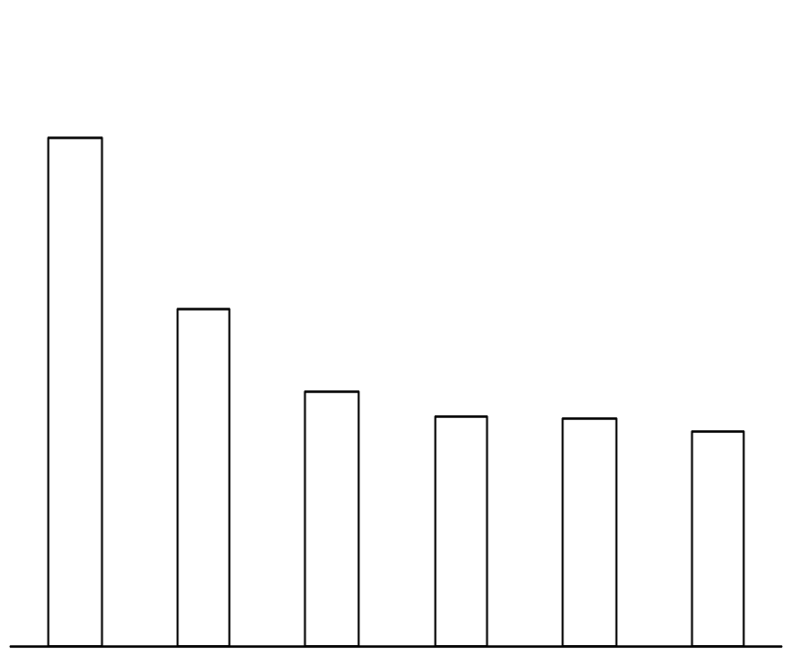
West region can only be Nirma’s potential market in the second stage because of its limited market size and strong competitor
West
Low-end market size
[’000 ton]
Analysis of opportunity
Total: 537,000 tons
154
Qiqiang takes 44% of low-end market with three manufacturing sites (Sichuan, Guizhou and Sanxi)
P&G take over one major local brand (Nanfeng) in chongdu to expand low-end market
Whitecat has setup a manufacturing site with 80,000 ton capacity in Chongqing
Low population density and per capita consumption
102
77
69
69
65
West region can only be Nirma’s potential market in the second stage
Sichuan
Guangxi
Yunnan
Guizhou
Shanxi
Chongqin

Slide 20
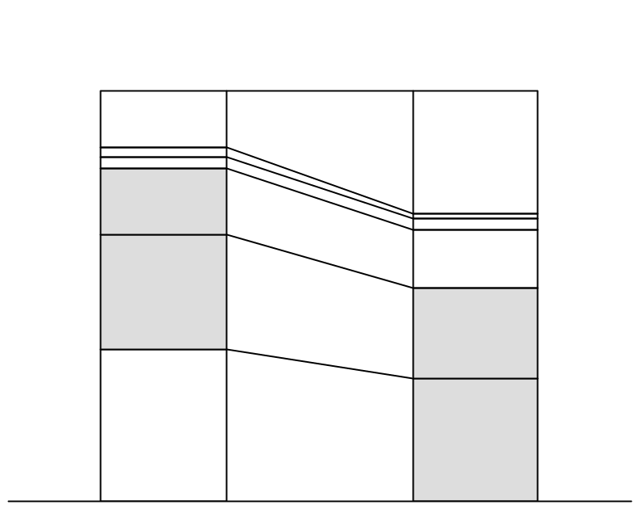
Regional and local brands play the major roles in the Northern market
North
Low-end market size in North 1 and North 2
[’000 ton]
Competition [volume share]
Others
14%
North1:
Liaoning, Jiling, Heilongjiang
Seagull
3%
2%
30%
Others
210
Jianlong
Jiali
16%
Jiali
458
14%
Mulan
28%
Qiqiang
North2:
Shandong, Hebei,
Shanxi, Beijing
Tianjing
Deer
22%
Yunquan
Qiqiang
37%
30%
Tiantian
North 2
North 1
Except Qiqiang four local brands are the major players in North 1 and North 2
Source: by Henkel (Tiantian) and Unilever (Yunquan)

Slide 21
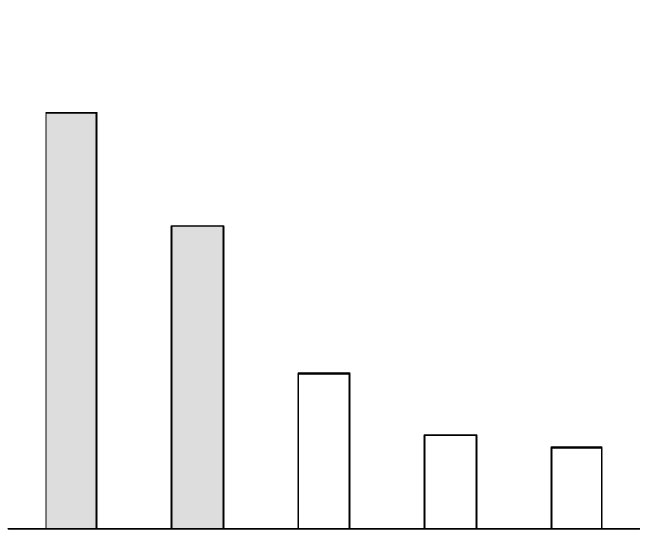
Shandong and Hebei are suggested as strategic focus in early entry period
North
market size in North 2 sub-region
[’000 ton]
Competition
Total:458,000 tons
181
In Shandong, Deer and Jiali holds 30% and 25% of the low-end market respectively. But weak financial srength and less sophisticated marketing skill undermine their competitiveness
In Hebei the detergent market is highly fragmented with Qiqiang winning less than 20% market share, the rest are insignificant
132
68
41.5
35.6
In Shandong and Hebei a strong and dominant brand is non-existent yet
Shandong
Hebei
Shanxi
Beijing
Tianjing

Slide 22
Spray-dry technology dominate the laundry powder industry sector
Profile of major product form
Production
technology
Major
brand
Market
share
Average
price [RMB/kg]
Product feature
Trend
Consumer
acceptance
Tide
Whitecat
Qiqiang
Hollow
Low density
Foaming
High water
solubility
Spray dry
90%
7.9

Well accepted
in rural
Regular
Solid
High density
Non-foaming
Excellent stain
removing efficacy
High price undermines affordability and consumer acceptable
Concen-
trate
Dry mix
Ariel
Whitcat
8%
11.4
➔
Ultra-
concen-
trate
Agglomera-
tion
OMO
Gaochao
(whitecat)
High fluidity
Excellent stain
removing efficacy
2%
18.0

New product
Source: Roland Berger & Partner interviews

Slide 23
Price and money value are two most important factors influencing rural consumers’ purchasing decision
Rural consumer preference
Product
Foaming
Fragrant
Water solubility
Big package size (400g, 750g)
Price range
Promotion
Effective tool to induce trial during introduction period
Using daily necessities as prize is well accepted
Popular acceptable price in rural market: 6.0 RMB/kg
Place
Primarily through grocery in village / town
Market / fair especially weekly market
Source: Roland Berger & Partners’ interview

Slide 24
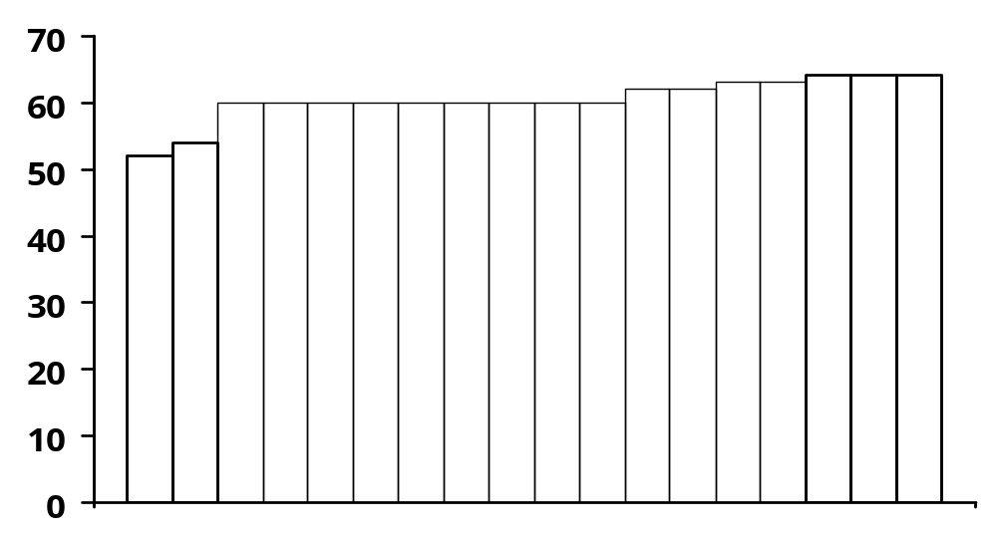
Qiqiang’s low price strategy proves to be successful in the low-end segment
Relative price comparison in low end segment (<7RMB/KG)
[Total low end segment =100%]
7
Price
(RMB/kg)
6.2
6.3
6.4
6
6.0
5.2
5.4
5
4
3
3%
3%
30%
6%
5%
3%
3%
3%
2
1
0
Quanli
Qiqiang
Fangcao
Resun
Volume share
Mianghua
Seagull
Yueyuehong
Tiantian

Slide 25
Price is the first decision factor for rural consumer to buy detergent power
Back-up
Example: Decision factors of rural consumer
Key factor
Importance
Rural consumer behavior
Price
Stain removing Efficacy
Foaming
Fragrance
Water solubility
Whitening
Enzymatic
+++
++
++
+
0
-
-
Price is the most important factor to affect consumer behavior in rural market
The consumer also pay considerable attention to the stain removing efficacy of detergent powder
The rural consumer often evaluate the stain removing ability through the foaming effect of the detergent powder
Most of the rural consumer also like the fraqrance brought by deterrent powder
Because in general fake product can’t solubilized in water, the feature can help consumer distinguish real product with fake product
The rural consumer seldom care for the whitening and enzymatic ability of detergent product
The customer behavior is fit with Nirma’s low price strategy
Source: Roland Berger & Partners’ interview

Slide 26
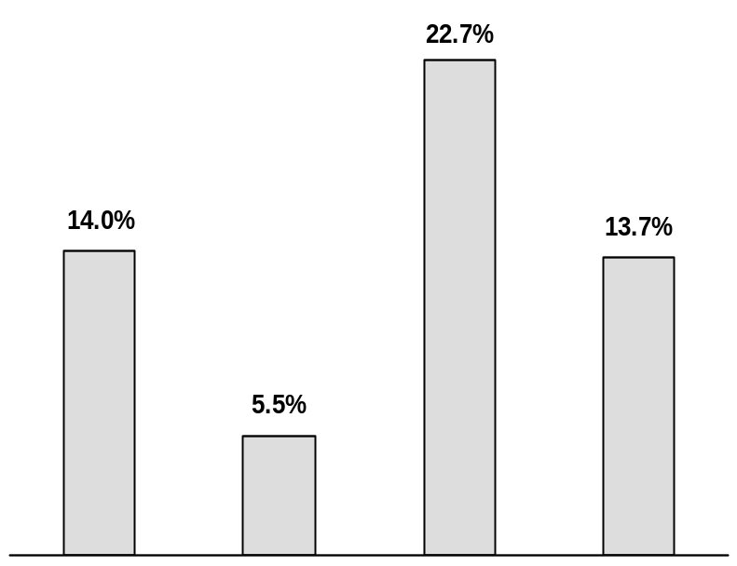
In order to reduce the transportation cost, Qiqiang set up seven mainfacturing site national wide
Example: Qiqiang’s manufacturing site vs. Market performance
Back up
Location of manufacturing site of Qiqiang
Market share by region
•
Benxi
•Neimeng
◆
Shanxi
•
•
Anhui
•
Xi’an
Sichuan
•Guizhou
No manufac-
ture site
◆
Qiqiang’s headquarter
East
South
West
North
Source: Roland Berger & Partners’ interview

Slide 27
3 A systematic expansion strategy should be applied
Description
A
Focus on one regional market and concentrate the marketing resources at the beginning
Using accumulated experience to expand new market
Regional penetration
B
Low price
Recommended retail price is about 5.5~6.0 RMB/kg
Higher price in the beginning to build up brand image
C
Allocating strong sales team to a new market by intensive marketing and promotion
Delegate the built up market to a qualified distributor to manage
Front attack
D
Motivated dealer
Development a incentive sales policy to motivate the dealers along the distribution channel
E
Benefited customer
Adopting well-acceptable approach to promote in the rural market
Source: Roland Berger & Partners’ interview and analysis

Slide 28
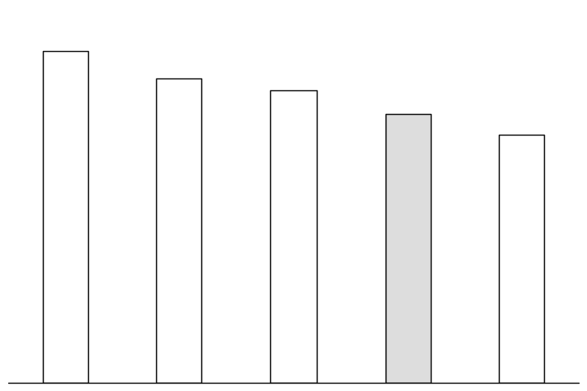
B The target retail price for Nirma should be less than 6 RMB/kg
Retail price of major brand in Chongqing
[RMB/kg]
Price positioning
6.0RMB (0.72USD)/kg is the most popular accepted price for rural market
The suggested retail price for Nirma is 5.5 ~6.0 RMB/kg
The whole selling price is about 80% of retail price
7.1
6.5
6.25
5.5~6.0
5.3
Libai
Whitecat
Qiqiang
Nirma
Resun²⁾
The initial retail price should be higher for setting up brand image
1) Libai’s headquater is in Guangzhou and it is mostly produced
by Resun in Hunan
2) Local brand in Hunan province
Source: Roland Berger & Partners’ survey and analysis

Slide 29
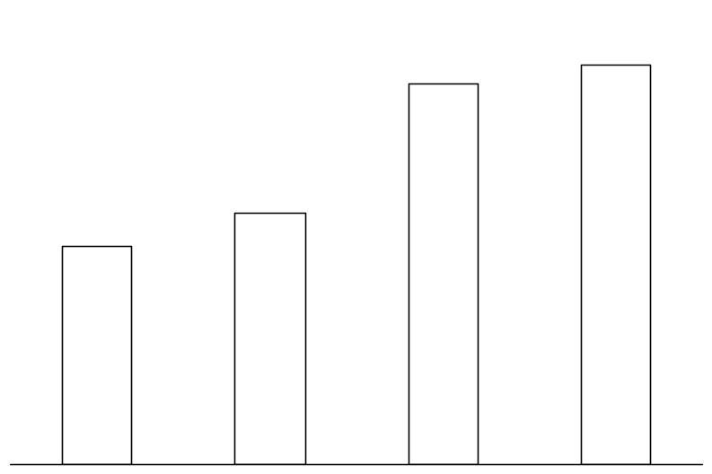
B Qiqiang fast expansion stems from its appropriate marketing strategy and
manufacturing strategy
Back up
Example: Success factors for Qiqiang
Success factors for Qiqiang
Market share of Qiqiang
Low cost & low price
- The salary level in Shanxi is about half of
whitecast in Shanghai
- raw-material advantage its Na2 So4
has 35% market share in China
Retail price: 6 RMB/kg
- Drreet approach low-level wholsaler
- Use strong promotion to push product
Local manufacture & local sales
- Seven manufacturing sites national wide with headquater in shanxi
Well financed
- 390 million RMB (47mio USD) was financed in
stock market in April 1997
80%p.a.
13.2%
12.6%
8.3%
7.2%
Aug.-Sep. 97
Dec.-Jan. 98
Apr.-May. 98
Aug.-Spt. 98

Slide 30
C Front attack strategy is recommended for Nirma to penetrate new market
Example: New market entry approach in Chongqing
Description of approach
Example
Front
attack
Develop customers and build up sales network
Delegate a reliable distributor to manage the network
The team is assigned to another new market
Build up a long-term agent relationship with the distributor
Diaopai
Yuxiu
Joint
attack
Use several qualified agents to sell product with long-term credit term (3 months)
Send a sales team to support agent to promote as well as build up own know-how
Take over the sales network and directly sell to whole sellers
Power 28 (benckiser)
Weibai (Henkel)
Direct attack
(sell)
Establish own sales branch locally
Directly sell product to wholesalers and large retailer
Tide (P&G)
OMO(OMO)
Qiqiang
Source: Roland Berger & Partners? interview

Slide 31
C Whitecat uses distributor as well as its own sales force to jointly explore
markets
Back up
Whitecat’s distribution channel mapping
Description
Whitecat
Strategy
Employ distributor and its own sales force (about 2000) to explore market in the meantime
Distributor focus on existing channels and areas
Whitecat sales force focus on unexplored new markets
Distributor
Whitecat regional sales office
PROS
Be flexible to different market situation
Low reliance on distributors
Secondary distributor
Distributor
CONS
Possible conflict between distributors and its own sales force
Therefore, distributors may lose interest to work with Whitecat
Slow response to changing market with hieratial management, e.g. the approval for a promotion plan will last 3 months
Wholesaler
Wholesaler
Retailer
Retailer
End consumer
End consumers
Incapable to response to changing
market and consumers
Source: Roland Berger & Partners? interview

Slide 32
C Qiqiang’s distribution system greatly facilitates its market expansion
despite of unprofessional management
Back up
Qiqing’s distribution channel mapping
Description
Qiqiang
Strategy
Dispatch huge sales force to directly approach wholesalers and retailers
Sales Rep. regularly visit wholesalers and retailers
Provide efficient logistics support and service
Wholesaler
Regular market/Fair*
PROS
Rapid penetration into rural area
Build fist-hand market an consumer knowledge
Quick learning
Secondary
wholesaler
CONS
Difficult to manage huge sales force (about 2000)
Delay of money collection and poor credit-term management
High selling expenses
Channel conflict
Retailer
End consumers
High risk in the mature phase
* Qiqiang’s sales force promote and sell product in weekly market
activity in rural area
Source: Roland Berger & Partners? interview

Slide 33
C After penetrating the new market by front attack, Nirma should shift the
distribution to a qualified distributor
Phase I: Entry period
Phase: Growth period
Regional sales office / team
Regional sales office
Province
First-tier distribution
Leverage distributor to multiple sales and coverage
Shift credit risk
Prefecture municipal
Second-tier distribution
Country
Wholesaler
Wholesaler
Town
Secondary*
wholesaler
Secondary
wholesaler
Rural
Retailer
Retailer
End consumers
End consumers
* Only partly exist in coastal market, E.g. Shandong
Source: Roland Berger & Partners? interview

Slide 34
D Attractive incentive package should be developed to motivate dealer to
promote Nirma
Impetus in the distribution channel
Key success factors
Discount
Margin
Subsidy
Bundling sales
Keep channel members motivated with sufficient incentive
Avoid channel conflict
Provide efficient logistics support
Keep close communication with channel members
First-tier distributor
Second-tier distributor
Wholesaler
Secondary
wholesaler
Retailer

Slide 35
D There are four driving forces in the distribution channel
Back up
Definition
Certain percentage of sales value, E.g. 3% if one dealer sells over 5,000 tons
Discount
The margin between in-stock price and out-stock price, E.g. 1-2% of out-stock price
Margin
Manufacturer pay the transportation fee or promotion fee for distribution with good performance
Subsidy
Wholesaler sell product to 2nd wholesaler or retailer by bundling the fast-moving product
with slow-moving but high margin goods
Bundling-sales
Source: Roland Berger & Partners’ interview

Slide 36
E Nirma should adopting a well-accepted approach to promote its brand and
product based on the survey of target consumers
Example: promotion approach in Chongqing rural market
Brand
Approach
Acceptability by rural consumers
Tide
Power 28
Weibai
Diaopai
Whitecat
Qiqiang
Bestowal(detergent 100g/bag)
Buy 2 get 1 free
Lucky draw
Bestowal ( a year calendar)
Recruit local resident to deliver billboard
Daily necessity as prize
Recruit local student to promote from door to door
Daily necessity as prize
Source: Roland Berger & Partners’ interview

