Slide 1
Project Portfolio Management
An Introduction
李俊伟
November 2002
Beijing
项目管理者联盟, MYPM.NET

Slide 2
Content
Emergence of Project Portfolio Management (PPM)
Portfolio Management in Financial Market
Overview of PPM
PPM, Process and Techniques

Slide 3
The Emergence of Project Portfolio Management
1952, Modern Portfolio Theory (MPT), Harry Markowitz, Journal of Finance, Portfolio Selection
1990, Harry Markowitz shared Nobel Prize, dominant approach used to manage risk and return within financial markets
1981, F.Warren McFarian, Portfolio Approach to Information Systems, HBR, to employ a risk-based approach to the selection and management of IT projects.
1990s, a broader use of ideas of portfolio management
1998, John Thorp, The Information Paradox. Portfolio management was used to manage risk and maximize return along a number of dimensions.
Present, portfolio management as central elements of good investment management

Slide 4
Portfolio Management, the overall picture
Focus
(Strategic
Planning )
Select
(Portfolio
Management)
Manage
(Project
Management)
Source: PM Solutions, Portfolio Management, Dianne Bridges

Slide 5
Content
Emergence of Project Portfolio Management (PPM)
Portfolio Management in Financial Market
Overview of PPM
PPM, Process and Techniques

Slide 6

The Old Philosophy about Portfolio
Don’t put all your eggs in one basket.
Risk aversion seems to be an instinctive trait
  in human beings.
Notes:
4

Slide 7
Return and Risk in Financial Market
20
18
16
14
12
10
8
6
4
2
0
small
company
stocks
capital appreciation
large company stocks
expected return
growth
of income
intermediate-term
government
bonds
long-term
corporate bonds
T-bills
inflation
long-term
government bonds
stability
of principal
income
0 6 12 18 24 30 36
standard deviation (%)

Slide 8
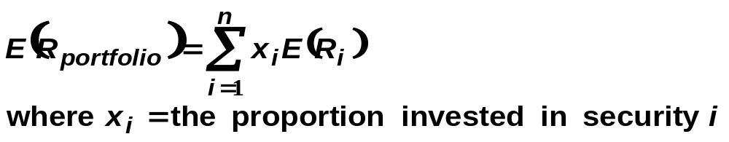
The Role of Combining Securities
The expected return of a portfolio is a
  weighted average of the component expected returns.

Slide 9
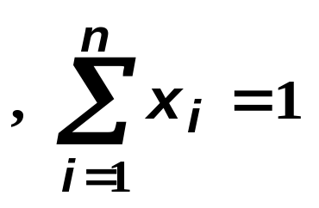
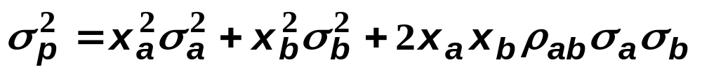
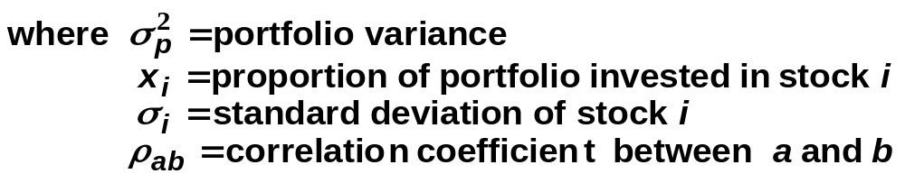
The Role of Combining Securities
The total risk of a portfolio comes from the
  variance of the components and from the relationships among the components.
two-security
portfolio risk
interactive
risk
= risk_{A} + risk_{B} +
10

Slide 10
The Role of Combining Securities
The point of diversification is to achieve a
  given level of expected return while bearing the least possible risk.
A portfolio dominates all others
  if no other equally risky portfolio has a higher expected return, or if no portfolio with the same expected return has less risk.
better
performance
expected return
risk

Slide 11
The Efficient Frontier :
Optimum Diversification of Risky Assets
efficient frontier
The optimal combinations result in lowest level of risk for a given return
The optimal trade-off is described as the efficient frontier
impossible
portfolios
expected return
dominated
portfolios
risk
(standard deviation of returns)

Slide 12
The Efficient Frontier vs Naive Diversification
Naive diversification is the random selection
  of portfolio components without conducting any serious security analysis.
As portfolio size increases,
  total portfolio risk, on average, declines. After a certain point, however, the marginal reduction in risk from the addition of another security is modest.
total risk
Non-diversifiable
risk
number of securities

Slide 13
Risk Reduction with Diversification
St. Deviation
Unique Risk
Market Risk
Number of Securities

Slide 14
Components of Risk
Market or systematic risk: risk related to the macro economic factor or market index
Unsystematic or firm specific risk: risk not related to the macro factor or market index
Total risk = Systematic + Unsystematic

Slide 15
Two-Security Portfolios with Different Correlations
E(r)
13%
ρ = -1
ρ = .3
ρ = -1
ρ = 1
%8
12%
20%
St. Dev

Slide 16
Portfolio Risk/Return, Correlation Effects
Relationship depends on correlation coefficient
-1.0 < ρ < +1.0
The smaller the correlation, the greater the risk reduction potential
If ρ = +1.0, no risk reduction is possible

Slide 17
Structuring a Portfolio : Asset Allocation
Portfolio
stocks
attitude
toward risk
real
estate
realized
return
and risk
with the
passage
of time
bonds
ASSET
CLASSES
need for
return
foreign
equities
cash
individual choice asset class mix investment results

Slide 18
Content
Emergence of Project Portfolio Management (PPM)
Portfolio Management in Financial Market
Overview of PPM
PPM, Process and Techniques

Slide 19
What is project portfolio management
Portfolio Management is the project selection process and involves identifying opportunities: assessing the organizational fit; analyzing the costs, benefits, and risks; and developing and selecting a portfolio.
The art of project portfolio management is: doing the right thing, selecting the right mix of projects and adjusting as time evolves and circumstances unfold.

Slide 20
Portfolio Management is:
Defining goals and objectives – clearly articulate what the portfolio is expected to achieve
Understanding, accelerating, and making tradeoffs – determine how much to invest in one thing as opposed to something else
Identifying, eliminating,minimizing, and diversifying risk – select a mix of investments that will avoid undue risk, will not exceed acceptable risk tolerance levels, and will spread risks across projects and initiatives to minimize adverse impacts
Monitoring portfolio performance – understand the progress that the portfolio is making toward the achievement of the goals and objectives
Achieving a desired objective – have the confidence that the desired outcome will likely be achieved given the aggregate of investments that are made

Slide 21
Portfolio Management is Not
Doing a series of project – specific calculations and analyses, such as return on investment, benefit-cost analysis, net present value, payback period, rate of return, and then adjusting them all to account for risk. – these are project specific
Collecting after-the-market information on projects to produce a report that the organization hopes will satisfy some organizational reporting requirement.

Slide 22
The benefits of Portfolio Management
Having a structure in place to select the right projects and immediately remove the wrong projects
Placing resources where it matters, reducing wasteful spending
Linking portfolio decisions to strategic direction and business goals
Establishing logic, reasoning, and a sense of fairness behind portfolio decisions
Establishing ownership amongst the staff by involvement at the right levels

Slide 23
Content
Emergence of Project Portfolio Management (PPM)
Portfolio Management in Financial Market
Overview of PPM
PPM, Process and Techniques

Slide 24
Project Portfolio Management, Process & Technique
Four steps
Project Evaluation Matrix
Evaluation Criteria
Examples

Slide 25
Step 1: Define the Portfolio
First, establish the overall portfolio mission. This mission statement will be used to initially determine what projects are in or out of the portfolio.
The mission statement can be simple, like:
The Intranet Portfolio covers all projects to be deployed on the corporate intranet.

Slide 26
Step 2: Gather the Projects
Now, gather all the projects together that you think might be in the portfolio.
This may not be the list you already have. Some projects, including duplicate efforts, may be underway in other parts of the organization.

Slide 27
Step 3: Begin Weeding
Once the project list is established, begin weeding the list down. Remove projects that:
  Are duplicate efforts. Here is an opportunity to save money by pooling two or more efforts into a single project.
  Do not meet the mission area. Some projects may be under your wing but do not fit in the mission area. Remove them from your portfolio and place them elsewhere.

Slide 28
Step 4: Begin Evaluating
Once the portfolio list is set, begin evaluating each project to determine what the overall portfolio will look like.
Using the four-quadrant matrix here, evaluate the projects against two major criteria:
  What are the potential risks in implementing this project?
  What are the potential benefits in implementing this project?

Slide 29
Project Evaluation Matrix
High
Quadrant
I
Quadrant
II
Quadrant
III
Quadrant
IV
Project Risk
Low
High
Project Benefits

Slide 30
Using the Matrix
The matrix is used as a scoring tool to map projects against the evaluated level of risk and the evaluated potential beneficial impact of a project.
Projects are evaluated on both risk and benefit from low to high using a series of questions and scores.
Projects are then evaluated in the worksheet and decisions made for inclusion and balancing the portfolio.

Slide 31
Matrix Decision Regions
Projects to remove from the portfolio
High
Quadrant
I
Quadrant
II
Quadrant
III
Quadrant
IV
Project Risk
Projects to keep in the portfolio
Low
High
Project Benefits

Slide 32
Evaluation Criteria
The Evaluation Matrix uses two basic criteria: Risk and Benefit.
Five sample risk areas:
    Risk of Completion On Time (Schedule Risk)
    Risk of Managing Multiple Organizations (Organizational Risk)
    Risk of Technologies Used for the Application (Technological Risk)
    Risk of Not Proceeding with the Project (Risk of Not Doing It)
    Projects Implementation and Maintenance Costs
Five sample benefit areas:
    Number of potential groups or users needing application
    Projects Impact on Cross-Functional Activities
    Projects Impact on Improving Internal Culture
    Projects Impact on Improving External Customer Service
    Estimated Benefit/Cost Ratio (Potential Savings or Profits)

Slide 33
Risk Assessment Scorecard- illustration
Risk Category | Weighted Scale Example | Low Risk Project Score | High Risk Project Score
Schedule Risk Assessment | 25% | 1 | 5
Organizational Risk Assessment | 20% | 2 | 4
Technological Risk Assessment | 20% | 1 | 7
Risk of Not Doing Project | 25% | 4 | 1
Project Support Costs | 10% | 1 | 4
TOTAL RISK SCORES | 100% | 9 | 26

Slide 34
Benefits Assessment Scorecard - illustration
Benefit Category | Weighted Scale Example | Low Benefit Project Score | High Benefit Project Score
Potential User Base | 20% | 2 | 5
Cross-Functional Improvements | 10% | 1 | 6
Improving Corporate Culture | 20% | 2 | 6
Improving Customer Service | 25% | 0 | 5
Benefit/Cost Ratio | 25% | 1 | 5
TOTAL RISK SCORES | 100% | 6 | 27

Slide 35
Plot the Project on the Matrix
High
Quadrant
I
Quadrant
II
Our High Risk/ High Benefit Project Might Be Approved
Quadrant
III
Quadrant
IV
Project Risk
Our Low Risk/ Low Benefit Project Might Be Rejected or Delayed
Low
High
Project Benefits

Slide 36
What is the difference
Portfolio Management in the financial market
Project management

Slide 37
Questions and Answers

Slide 38
Thank You!
李俊伟
Contact at: george.lee@TalentAllianz.com
Room 318, Jin’Ou Plaza, #2 An Zhen Li,
Chaoyang, Beijing, China 100029
Tel +86-10 6443 7361. 6443 7362
Fax +86-10 6443 7363

