Slide 1
RangeAnalysis 中期报告
张煌昭 1400017707 元培学院

Slide 2
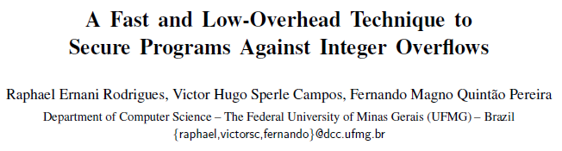
思路
.SSA文件解析为SSA
SSA -> e-SSA
e-SSA -> Constraint Graph
Widening, future Resolution, Narrowing

Slide 3
进展
.SSA文件解析为SSA √
SSA -> e-SSA √
e-SSA -> Constraint Graph √
Widening, future Resolution, Narrowing

Slide 4
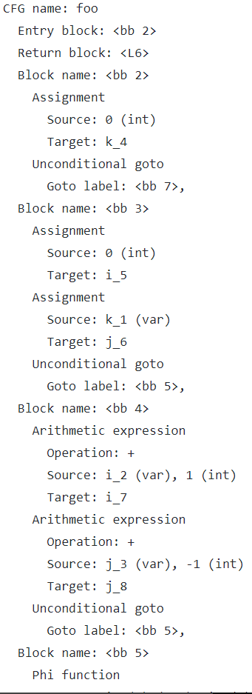
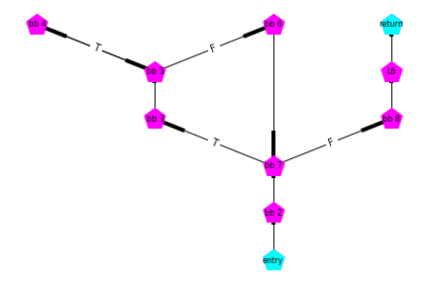
进展
t1.ssa

Slide 5
Thank you！

