Slide 1
P2 MLOps Final Results
PIU risk classification: tracking, search, registry, serving package, and visual evidence
Baseline QWK
Champion QWK
Formal Trials
Registry Aliases
0.3651
0.3672
10
3
Champion URI: models:/piu-risk@champion
Formal study: p2-formal-mlops-20260612
Main claim: complete MLOps loop; model lift is small and reported honestly.

Slide 2
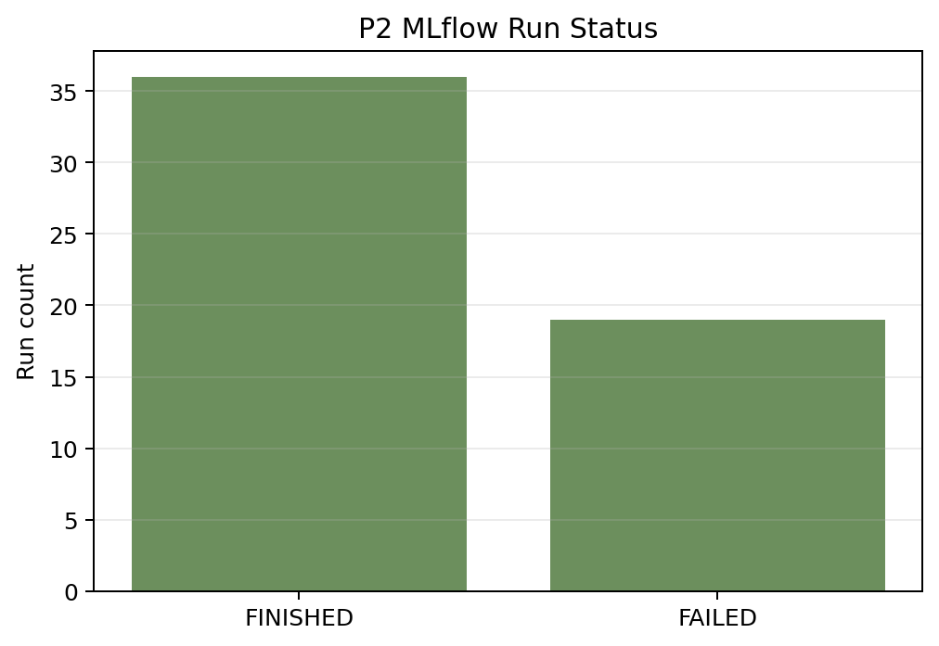
Pipeline Evidence
From data split to MLflow registry and API-compatible model
Canonical 5-fold split and feature tables are reused from P1.
Optuna explores model family, feature version, and hyperparameters.
Each formal trial logs metrics to MLflow; final model is registered.
baseline/candidate/champion aliases point to auditable model versions.
Reports and figures are regenerated from local SQLite stores.

Slide 3
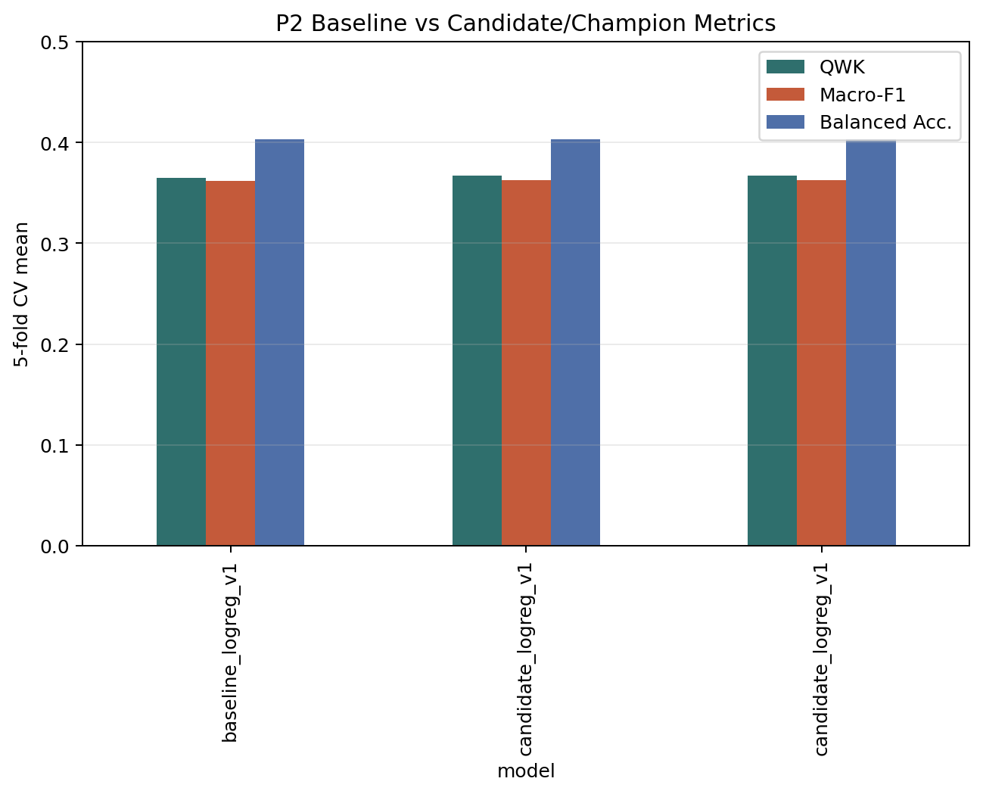
Model Metrics
Baseline vs selected champion
Baseline: Logistic Regression on feat_v1.
Champion: Optuna-tuned Logistic Regression on feat_v1.
QWK improves from 0.3651 to 0.3672.
The gain is modest; the MLOps workflow is the main deliverable.

Slide 4
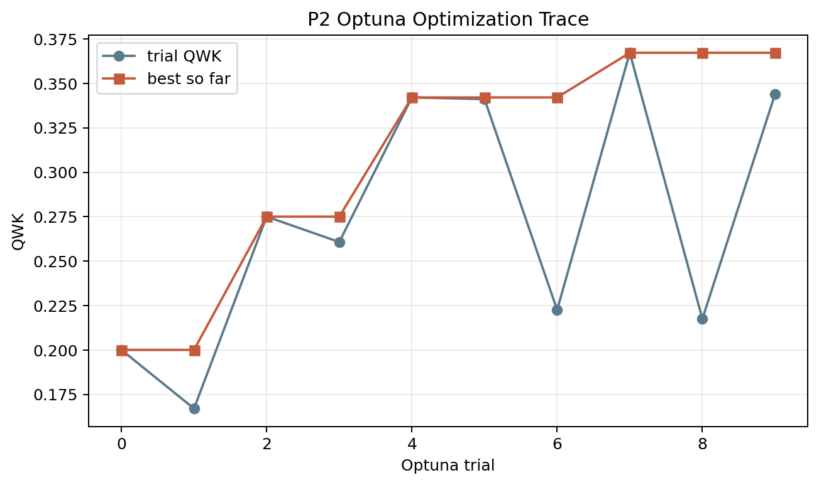
Optuna Search Trace
Trial objective and best-so-far curve
10 local formal trials were run.
Best trial: logreg_v1, C=1.1159.
MLP trials were fast but underperformed LR.
feat_v2 did not improve this final champion.

Slide 5
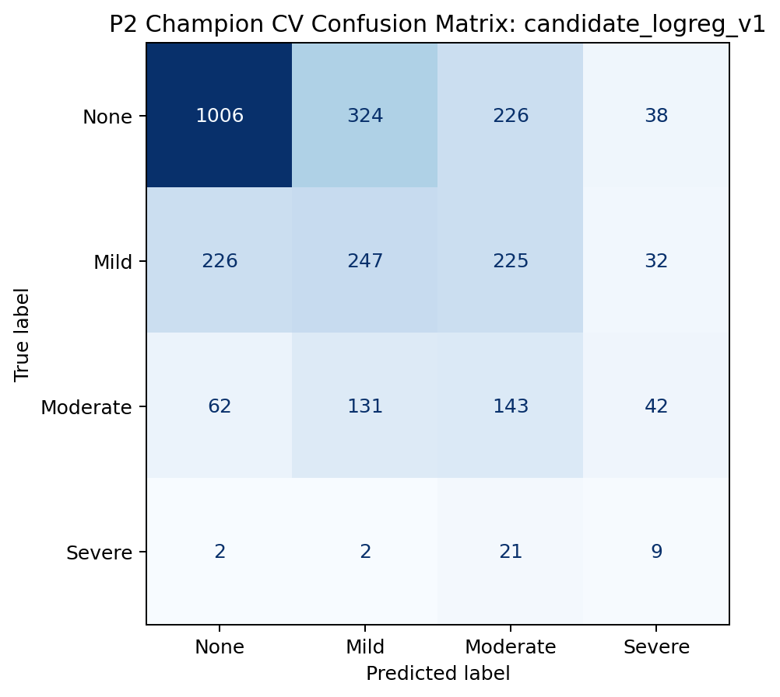
Champion Error Profile
5-fold CV confusion matrix
The class imbalance remains visible.
Most errors are between adjacent severity levels.
This supports reporting QWK as the primary metric.
Further model work should target minority classes and calibration.

Slide 6
Deliverables
What is ready for review
reports/P2/p2_final_report.md and p2_summary_report.md
reports/P2/figures/*.png and *.svg
reports/P2/p2_model_comparison.csv and p2_formal_optuna_trials.csv
MLflow model versions 4/5/6 with baseline/candidate/champion aliases
Champion can be loaded through models:/piu-risk@champion

