Slide 1
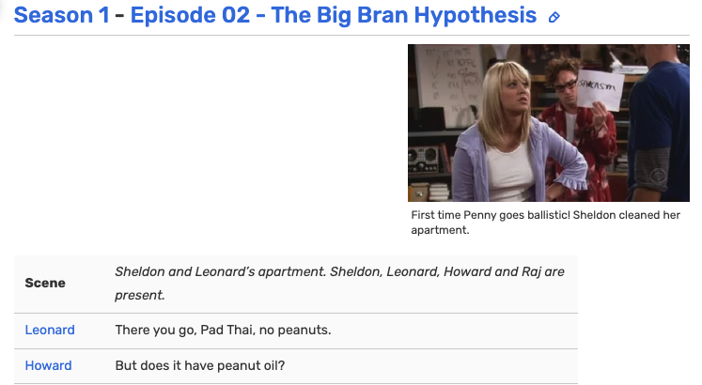
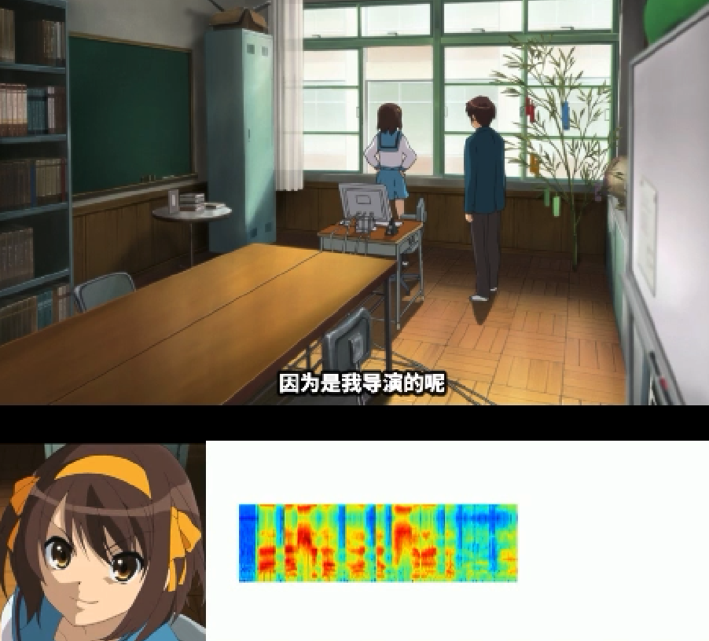

Speaker
Recognition
Kor Extracting
…
{"r": "McGonagall", ”d": "surely a sensible person like yourself can call him by his name? All this ‘You-Know-Who’ nonsense — for eleven years I have been trying to persuade people to call him by his proper name: Voldemort.", "action": "dialogue"}
{"r": "Dumbledore", ”d": "It all gets so confusing if we keep saying ‘You-Know-Who.’ I have never seen any reason to be frightened of saying Voldemort’s name.", "action": "dialogue"}
{"r": "McGonagall", ”d": "But you’re different. Everyone knows you’re the only one You-Know- oh, all right, Voldemort, was frightened of.", "action": "dialogue"}
{"r": "Dumbledore", ”d": "Voldemort had powers I will never have.", "action": "dialogue"}
…
阿虚:「喂 春日」
(可能)春日:「什么啊」
阿虚:「这电影我绝对会让它成功的」
春日:「当然啊」
春日:「因为是我导演的呢」
春日:「自然是和成功约好的 用不着你说也是」
Manually Cut
Automatic Cutting
McGonagall:「surely a sensible person like yourself can call him by his name? All this ‘You-Know-Who’ nonsense — for eleven years I have been trying to persuade people to call him by his proper name: Voldemort.」
Dumbledore:「It all gets so confusing if we keep saying ‘You-Know-Who.’ I have never seen any reason to be frightened of saying Voldemort’s name.」
McGonagall:「But you’re different. Everyone knows you’re the only one You-Know- oh, all right, Voldemort, was frightened of.」
Dumbledore:「Voldemort had powers I will never have.」
Manually Editing
Leonard:「There you go, Pad Thai, no peanuts.」
Howard:「But does it have peanut oil?」
Leonard:「Uh, I'm not sure, everyone keep an eye on Howard in case he starts to swell up.」
Sheldon:「Since it's not bee season, you can have my epinephrine.」
旁白:和阿虚吵架后，春日想扎个马尾让阿虚开心一下。
阿虚:「喂 春日」
春日:「什么啊」
阿虚:「这电影我绝对会让它成功的」
春日:「当然啊，因为是我导演的呢。自然是和成功约好的 用不着你说也是」

