Slide 1


Road Mapper
Mapeamento de faixas no CARMEN LCAD a partir do Mapa de Remission
Raphael V. Carneiro e Rafael C. Nascimento
04.07.2017

Slide 2
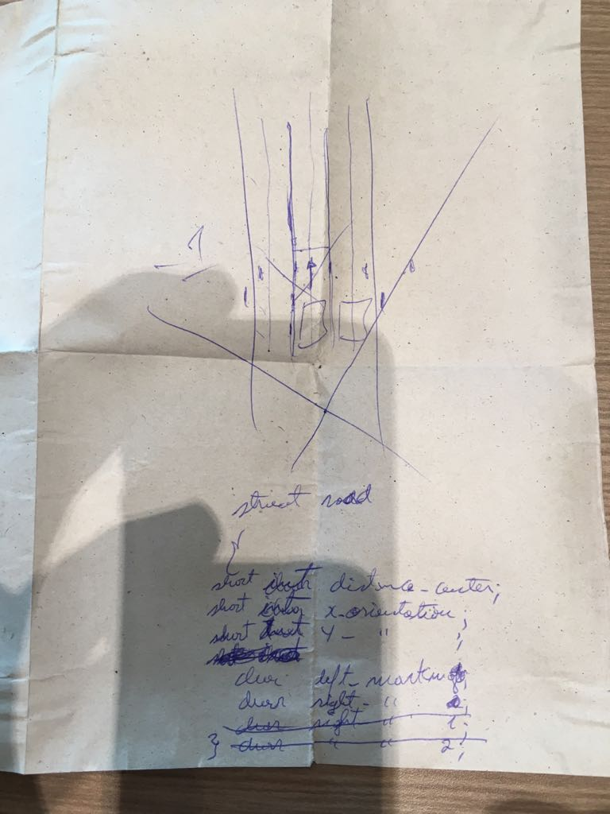
Ponto de partida...

Slide 3
Estrutura de Dados
struct pixel_str
{
short distance_center; /* Millimeters to center,
negative on the left */
short x_orientation; /* Lane orientation vector */
short y_orientation; /* Lane orientation vector */
char left_marking; /* Lane marking type */
char right_marking; /* Lane marking type */
}

Slide 4
Estratégia
Alterar o programa Clean Map no CARMEN, para gerar arquivos de imagem (i*.png) 350x350 pixels, a partir do Mapa de Remission médio (sum/count) do log map_ida_guarapari-20170403-2/*.map
Utilizar a ferramenta InkScape para anotar uma curva Bezier cúbica sobre a linha central de cada faixa de rolagem, salvando as anotações em arquivos (i*.svg)

Slide 5
Regras de Anotação
Use InkScape to draw a polyline all the way along the center of each road lane.
Place both the start and finish points out of the image limits, in order to provide a better fit for each polyline.
Place the start point of each polyline in such a way that lane orientation matches the direction from the start point to the finish point.
If two polylines either cross, merge or fork, then make sure to draw the "main" polyline before the secondary.
Make each point of the polyline auto-smooth, in order to generate a cubic Bezier curve.
Set each polyline stroke width properly, in order to fulfill each road lane and touch the borders of the neighbor lanes.
Select each line stroke paint color according to the following code:
  RGB(255, 0, 0) = #ff0000 = single line marking on both lane sides
  RGB(255, 0, 127) = #ff007f = single line marking on the right side and broken line marking on the left side
  RGB(127, 0, 255) = #7f00ff = broken line marking on the right side and single line marking on the left side
  RGB( 0, 0, 255) = #0000ff = broken line marking on both lane sides
  RGB( 0, 255, 0) = #00ff00 = no line marking on both lane sides
  RGB(255, 127, 0) = #ff7f00 = single line marking on the right side and no line marking on the left side
  RGB(127, 255, 0) = #7fff00 = no line marking on the right side and single line marking on the left side
  RGB( 0, 127, 255) = #007fff = broken line marking on the right side and no line marking on the left side
  RGB( 0, 255, 127) = #00ff7f = no line marking on the right side and broken line marking on the left side
Save the InkScape SVG file with same image name.

Slide 6
Formato SVG
<image sodipodi:absref="/dados/carmen_lcad/src/ lane_mapper/i7705600_-338380.00.png"
xlink:href="i7705600_-338380.00.png"
y="0"
x="0"
id="image10"
preserveAspectRatio="none"
height="350"
width="350" />

Slide 7
Formato SVG
<path
style="fill:none;stroke:#ff007f;stroke-width:16;stroke-linecap:butt;stroke-linejoin:miter;stroke-miterlimit:4;stroke-opacity:1;stroke-dasharray:none"
d="m 368.76271,99.92054 c 0,0 -25.9956,-1.86714 -39.30085,-2.78071 -10.41251,-0.714949 -16.93039,-0.487423 -33.36864,-0.185381 -14.32015,0.263123 -42.82309,2.780721 -42.82309,2.780721"
id="path12"
inkscape:connector-curvature="0"
sodipodi:nodetypes="cssc" />

Slide 8
Estratégia
Elaborar programa Generate GT:
''' This program reads a SVG file generated by InkScape and searches for "paths" containing a lane width and a sequence of points centered along a road lane.
The paths are then expanded to a continuum of points according to the cubic Bezier curve algorithm.
The road lane map is generated for all points within the lane width, setting the distance to the center of the lane, the lane orientation and the lane markings according to a color code. '''

Slide 9
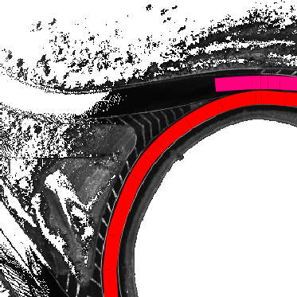
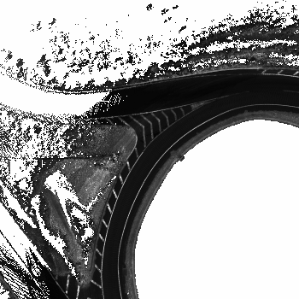
Generate GT

Slide 10

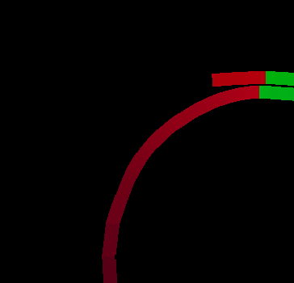
Generate GT
Distance to Center
Lane Orientation

Slide 11
Nova Estrutura de Dados
struct pixel_str
{
short off_the_road; /* Probability */
short solid_marking; /* Probability */
short broken_marking; /* Probability */
short lane_center; /* Probability */
}

Slide 12
Estratégia
Alterar o programa Generate GT para a nova estrutura de dados
Alterar os programas Navigator GUI e Map Server do CARMEN, para exibir os road map gerados
Alterar o programa Map Editor do CARMEN, para editar os mapas

Slide 13
Estratégia
Elaborar programa no CARMEN, para gerar dados de treinamento para uma rede neural, a partir dos mapas do log (Remission e Road):
    Seguir o caminho do RDDF
    Recortar amostras pequenas do mapa, em diferentes offsets em relação ao RDDF
    Multiplicar os dados, fazendo diversas rotações

Slide 14
Estratégia
Treinar uma rede neural que receba como entrada o Mapa de Remission e produza como saída o Road Map
Implementar no CARMEN um módulo que execute essa rede neural em tempo real (10 Hz)

