Slide 1
Rules & Structur

Slide 2
Drawing rules
LC-Pxxyy.nnnn-Mmmtt#RGBA
LC LCAMP
P Part
M Material
xx Baugruppe ➔ 10 DriveSystem 20 Wheel 30 Sensorbox s0 Sensoren
yy TeileGruppe ➔ Stepper, DC, Servo, Passive | Mecanum, Regular, Omni
nnnn Teilenummmer
mm Material
tt Technologie
#RGBA Farbcode in RGBA Farben hex
yy ≈ 00 = Gleichteile ⬅ Teilegruppe für z.B. Hub-Cap, Wheel-Hub
Folgende Zeichen sind nicht erlaubt: ⬅ können nicht in Dateinamen abgebildet werden
< > / \ : * ? " |
• Erlaubte Buchstaben: a b c d e f g h i ⬅ soll ersetzt werden mit ‚‘#ua‘‚‘#ub‘, ….
• Ersetze '-' durch '_'
• Ersetze '.' durch '&'

Slide 3
Assemblies
DriveSystem module 10, 20
  DC-Drive
  Stepper-Drive
  Passive-Drive
  …
  Regular Wheel
  Mecanum-Wheel
  Omni-Wheel
  …
SensorBox module 30, 40
  Curved
  Center
  Controller
Sensor module s0
  Range
  Light
  Cam
  Temp
  …
Base module 70, 80
  Center
  Bottom
  …

Slide 4
System Structure
Robot-Base
Drive
Drive
Drive
Drive
Main-Frame
Sensorbox f
Sensorbox b
Sensorbox l
Sensorbox c
Wheel
bottom
Sensor
Battery
Drive
center
Sensor
Controller

Slide 5
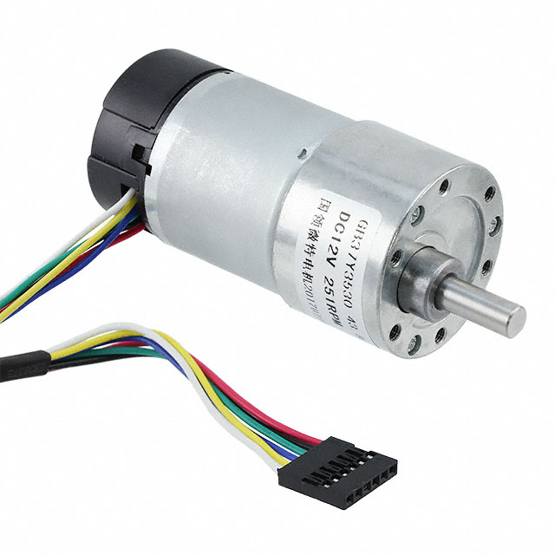
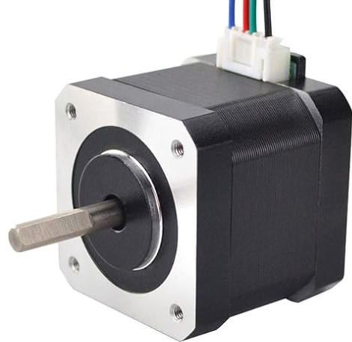
Wheel and Drive Structure
Drive
Wheel
Hub
Hub-Cab
Holder
Controller
Motor
Hub
Rim
Tire
Screw
Screw
Axis
Screw
Roller
pin
Center Screw
Cable
inner
outer
https://www.digikey.de/de/products/detail/dfrobot/FIT0186/6588528

Slide 6
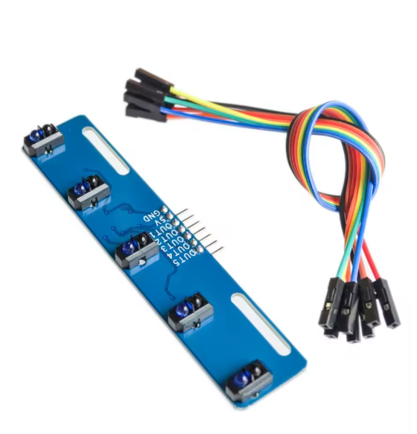
SensorBox
Sensorbox
Sensor
Sensor
Sensor
Sensor
Sensor
Aux Sensor
Controller
Base
PCB
Cap
Aux Sensor
Akku
Cable
Switch
5 kanal TCRT5000 IR Lichtschranke Barriere Linie Track Modul Infrarot Hindernis Vermeidung Sensor Für Arduino DIY

Slide 7
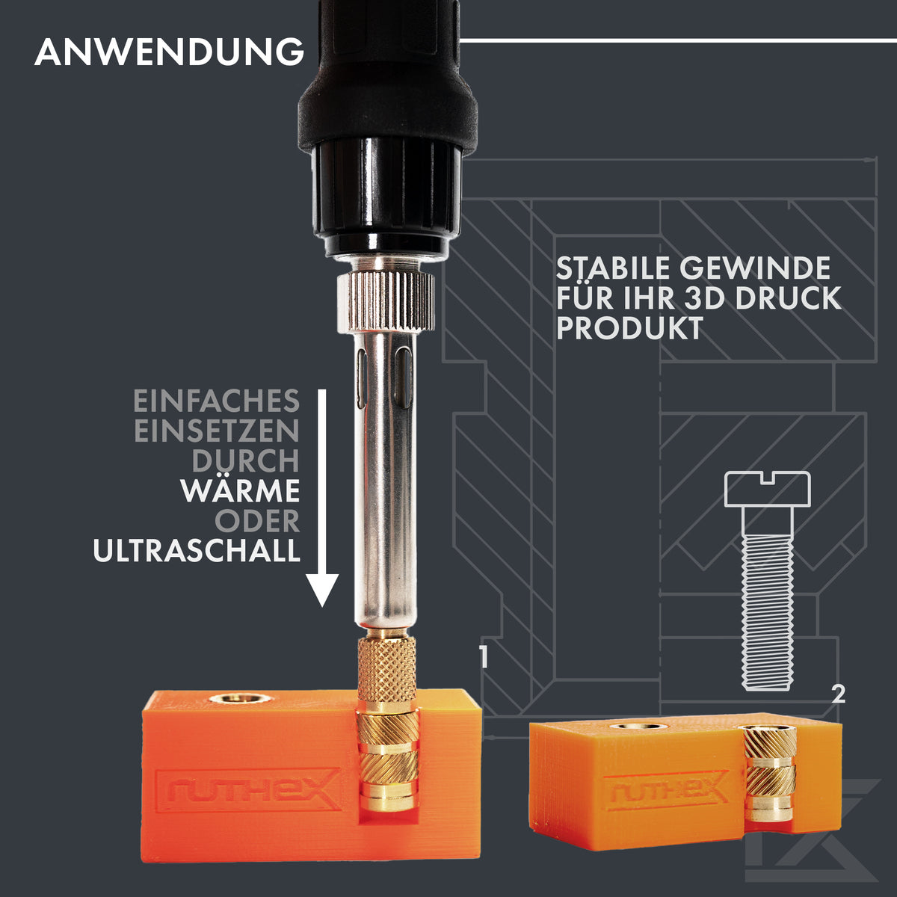
Main-Frame
MainFrame
Base-
Board
Bottom-
Sheed
Screws
Screws
Cable
Blocks

Slide 8
Packages
LCAMP Configurator.Core
.NET 8.0
NewtonSoft 13.03 ⬅ Json
LCAMP Configurator.Color
.NET 8.0-windows
SharpGLTF.Core 1.0.5
SharpGLTF.Toolkit 1.0.5
LCAMP Configurator.UI
.NET 8.0-windows
System .Windows .Forms
NewtonSoft 13.03 ⬅ Json
LCAMP Configurator
NewtonSoft
ClosedXml
URDF Importer
Siemens.Ros.Sharp.URDF
LCAMP Viewer
Assimp 3.0.0
HelixToolkit.Wpf 2.27.3
Microsoft.CSharp 4.7.0
Microsoft.Win32.Registry.AccessControl 8.0.0
Microsoft.Win32.SystemEvents 9.0.8
Microsoft.Windows.Compatibility 8.0.18
System.CodeDom 8.0.0
System.Configuration.ConfigurationManager 9.0.7
System.Data.Odbc 8.0.1
System.Data.OleDb 8.0.1
System.Diagnostics.PerformanceCounter 8.0.1
System.DirectoryServices.AccountManagement 8.0.1
System.DirectoryServices.Protocols 8.0.2
System.Drawing.Common 9.0.1
System.IO.Packaging 8.0.1
System.IO.Ports 8.0.0
System.Runtime.Caching 8.0.1
System.Runtime.CompilerServices.Unsafe 6.1.2
System.Security.AccessControl 6.0.0
System.Security.Cryptography.Pkcs 8.0.1
System.Security.Cryptography.Xml 8.0.2
System.Security.Permissions 8.0.0
System.ServiceModel.Duplex 6.0.0
System.ServiceModel.Http 8.1.2
System.ServiceModel.NetTcp 8.1.2
System.ServiceModel.Primitives 8.1.2
System.ServiceModel.Security 6.0.0
System.ServiceModel.Syndication 8.0.0
System.ServiceProcess.ServiceController 8.0.1
System.Speech 8.0.0
System.Text.Encoding.CodePages 8.0.0
System.Threading.AccessControl 8.0.0
System.Web.Services.Description 4.10.3
System.ServiceModel.Federation 8.1.2

Slide 9
Color Scheme
• Positionsangaben: front, back (rear), left,(center), right, (controller)
• IDs: 1, 2, 3, 4, ….
Type | Position | Code | Id
Body | front, back, left, right
Drive (DriveSystem) | front, back, left, right | ➔ fl,fr, bl, br
SensorBox | front, back, left, right | ➔ f, b, l, c
Wheel | hub, rim, tire, hubcap | ➔ fl, fr, bl, br | h, r, t, c
Sensor |  | ➔ f, b, l, c … | 1..4
Farbschemen gehen von obiger Struktur aus.

Slide 10
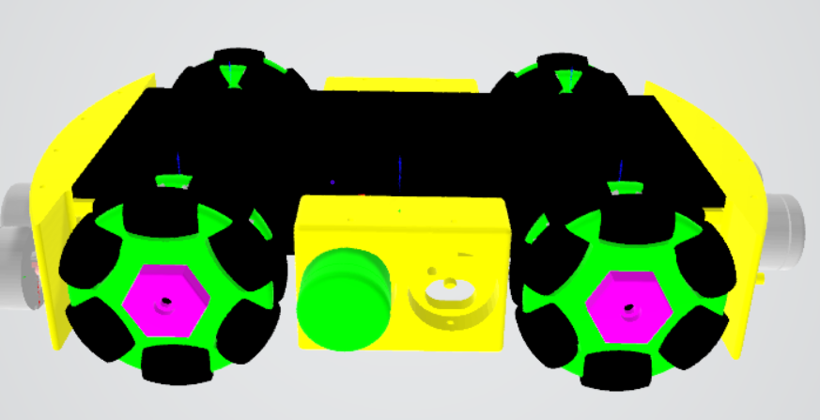
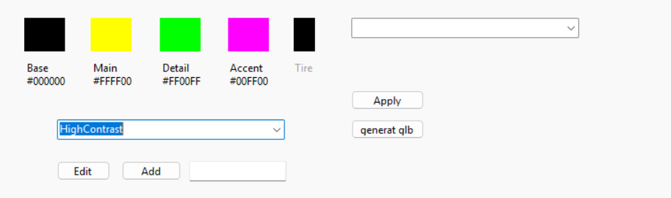
Color Scheme

Slide 11
Farben & Materialien
["Basis"] = setColors["Base"],
["Drive"] = setColors["Base"],
["Sensorbox front"] = setColors["Main"],
["Sensorbox back"] = ["Main"],
["Sensorbox center"] = setColors["Main"],
["Sensorbox left"] = setColors["Main"],
["Wheel"] = setColors["Detail"],
["HubCap fl"] = setColors["Accent"],
["HubCap fr"] = setColors["Accent"],
["HubCap bl"] = setColors["Accent"],
["HubCap br"] = setColors["Accent"],
["Tire"] = setColors.TryGetValue("Tires", out var tireColor)
? tireColor
: SharpDX.Color.Black,
// Sensors
["Sensor f 1"] = setColors["Detail"],
["Sensor f 2"] = setColors["Accent"],
["Sensor f 3"] = setColors["Accent"],
["Sensor f 4"] = setColors["Detail"],
["Sensor b 1"] = setColors["Detail"],
["Sensor b 2"] = setColors["Accent"],
["Sensor b 3"] = setColors["Accent"],
["Sensor b 4"] = setColors["Detail"],
["Sensor c 1"] = setColors["Detail"],
["Sensorc 2"] = setColors["Detail"],
["Sensor l 1"] = setColors["Detail"],
["Sensor l 2"] = setColors["Detail"]
Hauptfarbe Main
Grundfarbe Base
Detailfarbe Detail
Akzentfarbe Accent
(Tires ) black
→ RGBA Colors or Material list

