Slide 1
Growing impactful research and acquiring external funding
Christian Dondrup

Slide 2
Outline
Current research and impact
Future research focus
Immediate funding opportunities
EPSRC early career
Contribution/Extension to current L-CAS research
General funding opportunities
H2020
5 year plan

Slide 3
Current research and impact
People detection and tracking [1]
Used in STRANDS (FP7), SPENCER (FP7), ENRICHME (H20), McMan, FInCoR (RIF)
Qualitative Spatial Relations for reasoning under uncertainty [2]
Used in FInCoR RIF project on human-robot collaboration in a shared workspace and the STRANDS (FP7) project
Shaping human-aware navigation [3-4]
Learning over time based on QSRs
Physical therapy for older adults in permanent care [5]
[1] Dondrup, C.; Bellotto, N.; Jovan, F; Hanheide, M. Real-time multisensor people tracking for human-robot spatial interaction. In: Workshop on Machine Learning for Social Robotics at International Conference on Robotics and Automation (ICRA), 2015.
[2] Dondrup, C.; Bellotto, N.; Hanheide, M.; Eder, K.; Leonards, U. A Computational Model of Human-Robot Spatial Interactions Based on a Qualitative Trajectory Calculus. In: Robotics 2015, 4, 63-102.
[3] Dondrup, C.; Hanheide, M. Qualitative Constraints for Human-aware Robot Navigation using Velocity Costmaps. In: International Conference on Robotics and Automation (ICRA). 2016. (submitted)
[4] Dondrup, C.; Hanheide, M. Learning Qualitative Constraints from Demonstration for a Human-aware Local Planner. In: ACM/IEEE international conference on Human-robot interaction. ACM, 2016. (submitted)
[5] Hebesberger, D.; Dondrup, C.; Koertner, T.; Gisinger, C.; Pripfl, J.; Lessons learned from the deployment of a long-term autonomous robot as companion in physical therapy for older adults with dementia. A Mixed Methods Study. In: ACM/IEEE international conference on Human-robot interaction. ACM, 2016. (submitted)
Notes:
The current research I conducted at L-CAS together with my co-authors, has reached considerable impact thanks to the STRANDS EU project and the active L- CAS research community. The people perception is used in 3 EU projects and one internal project and together with a colleague we might also try to integrating it into a second internal project. All of these use different robots or workspace set-ups.
The qualitative reasoning is another aspect of my work that is used throughout the STRANDS project and internally in L-CAS to reason about the state of the world given uncertainty of the observations.
Shaping human-aware navigation is the most recent part of my research and closes the loop of perception, learning, decision making and behaviour generation for autonomous robots. The additional shaping component for live-long learning of an autonomous robot is currently being developed and will be finished and evaluated until the end of my PhD.
Focusing on healthcare and the wellbeing of older adults in permanent care, I assumed a key role in implementing a robotic therapy guide for a Nordic walking group consisting of patients suffering from dementia or Alzheimer’s disease. The initial results have been very promising and this kind of application could enrich the experience of the patients during the group and provide a focal point for therapists and discussion among the patients.

Slide 4
Previous research beyond L-CAS
Developmental Robotics [1]
How do humans learn and how to apply this to robots
Tutoring scenarios
Human tutor and robotic tutee.
Transferring principles from infant directed behaviour of parents to robotic learning
Extending current work at L-CAS
Include explicit tutoring into live-long learning cycle
Complimenting learning from observation/environmental or human feedback
[1] Dondrup, C.; Lohan, K.S.; Saunders, J.; Lehmann, H.; and Nehaniv, C.; Wrede, B. Keyword detection in human-robot tutoring scenarios. In: Humanoids, November 2012, Osaka, Japan.
Notes:
Before my time as a PhD student, I worked in developmental robotics and more classical HRI. The key question was to find a behaviour that could emulate human speech acquisition to abstract from the usual dictionary of words algorithms. As one of the aspects on how to achieve this, I developed a system that interprets so-called “looming” gestures which are child directed motions of parents to highlight an object and move it into the line of sight of an infant. This subconscious behaviour of humans while explaining was used to infer the most important words that describe an object without knowing their meaning a-priori. In a tutoring scenario, I recorded what was said during these gestures and used a fingerprinting method to find similar or the same words during the same interaction. Trying to prove the hypothesis that the more often a word was uttered, the more important it must be.
This work on HRI would compliment the current focus of L-CAS on human-populated environments and coping with and exploiting the changes humans introduce to infer meaning and structure. The explicit teaching of these structures or meaning of actions to an autonomous system is currently not represented in L-CAS and could be a future direction to take.

Slide 5
Future research focus
Human-centred robotics
Human-Robot Interaction
Healthcare for older adults
Assistive Living/Robotics
Live-long learning and adaptation.
Long-term autonomy in populated environments
Notes:
My preferred research focus, therefore, is human-centred robotics which also becomes an ever more important aspect of current research projects. Looking at manipulation tasks in shared workspaces or navigation in human-populated environments, the human factor is often underestimated but an integral part of a successful robot deployment in real-world environments.
I would like to put a special focus on Healthcare for older adults, assistive living, and live-long learning and combine these with my previous and current research. Also, the long-term autonomy aspect of my current work will play a big role in my future research, because in the STRANDS project we learned that this is an aspect of robotics that is crucial to the creation of useful applications for end-users.

Slide 6
Funding opportunities in the first 12 month
EPSRC early careers researcher
Grant proposal within the first 36 month of lecturer employment
Funding capped at £125,000 for maximum of 2 years
Possible focus:
Health care for the elderly
Elder care home/s in the greater Lincoln area
Building on walking therapy and human-aware navigation for older adults
Automated warehouse scenarios
Food production in Lincolnshire
Applying previous work to fleets of robots
Notes:
To generate immediate funding from my research, in the first 12 month I will apply for an EPSRC early career grant for which one is only eligible within the first 36 month of the first lecturer position. This funding is capped at £125,000 over two years and would have me as the principle investigator. The possible focus of the grant proposal would follow from my current work on health-care for the elderly using the physical therapy as a starting point and building on applications for mobile robots in care homes. This can be done together with one of the 83 care homes in Lincoln as already shown in the ENRICHME project. In contrast to the ENRICHME project, the focus on therapy instead of assistive living makes the decisive distinction and is an interesting new application for a mobile robot.
Another idea is to apply my current work on human-aware navigation to fleets of warehouse robots working with one of the local food producers. Creating automated warehouse solutions with robots that are able to work safely alongside humans is not only an interesting application but has the potential of benefiting the food producer by reducing the production costs as well as increasing their efficiency.
The final decision of the projects focus will depend on the possible end user and feasibility studies. Both options, however, follow quite naturally from my current work.

Slide 7
Funding opportunities in the first 12 month
Contributing to and extending current Agri-Food Technology projects
Automated harvesting
Possible funding bodies: BBSRC, Innovate UK, Local producers, etc.
Using computer vision detection and tracking pipeline
Developed for people detection and tracking
Simple algorithms transferrable to other applications
Tracking can be used in “3D Vision Assisted Robotic Harvesting of Broccoli” project
Notes:
Apart from the EPSCR grant, I would also be able to contribute to the currently conducted research at L-CAS in regards to Agri-food technology and the automated harvesting. This could either be in form a new proposal for automated harvesting solutions or by contributing to one of the already existing projects like the “3D Vision Assisted Robotic Harvesting of Broccoli” for which my people tracking framework could be used. The detector currently developed in Lincoln would feed into the tracking framework using an IMU on the tractor to create a precise motion model for the prediction, this would be able to produce reliable Broccoli tracks and enhance the harvesting approach.

Slide 8
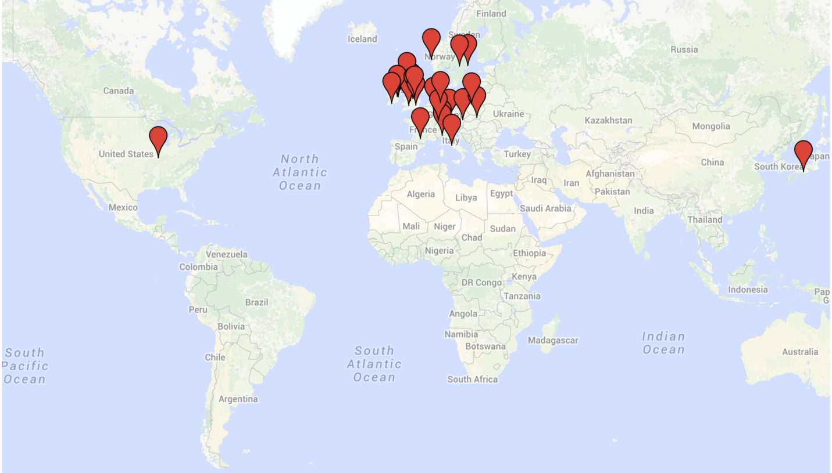
General funding opportunities
Follow-up projects of STRANDS
H2020/national projects
Birmingham
Bielefeld
Aachen
Munich
Vienna
BMW R&D
Freiburg
Edinburg
Stockholm
Bergen
Orebro
Etc.
Notes:
When it comes to general funding opportunities, follow-up projects of STRANDS like the Iliad, which was sadly rejected, will hopefully see my involvement. Additionally, over the course of my Diplom and PhD time, I built an international network of peers working on robotics and other automation related topics. The map shows all the connections where the list on the side only highlights a few in no particular order. These connections mainly involve other research institutes but also a select few business partners.

Slide 9
H2020 – SPARC
End User Market Domains
Healthcare
Assistive Robotics, Therapy and Rehabilitation
Consumer
Assistive Living
Logistics & Transport
Warehousing, Goods Transport
Agriculture
Agriculture
Robot Abilities
Adaptability
Shaping of robot behaviour
Interaction Ability
Human-aware navigation
Tutoring
Motion Ability
Human-aware and long-term navigation
Perception Ability
People perception
Notes:
One of the key aspects of H2020 is to move research results out of academia and into the industry which is why the end user market domains defined by the Strategic Research Agenda and the Multi-Annual Roadmap of the partnership for robotics in Europe SPARC play a key role in project proposals. This slide shows the main end user market domains my current and previous research is applicable to where we already talked about the Healthcare, Logistics, and Agriculture side. The Consumer, or more specific the Assistive Living domain, would mainly focus on mobile robots in privates homes to either support the elderly in being independent for longer or provide general services to the occupant. Work on adapting to the preferences and needs of the person living with the robot will be key in these projects which is why shaping might be a good solution to the problem.
The SAR also lists specific robot abilities that are important for the future development of robots in H2020. The right side of the slide shows the categories that my work contributes to already. Especially the perception part is already used in a number of projects but also my work on human-aware and long-term navigation combined with shaping for adaptability fit these categories quite well. Lastly, the interaction ability of robots has been the focus of my studies since I picked up the field of robotics either in human-aware navigation or fields like tutoring scenarios using a human tutor and a robotic tutee.
I am therefore confident that I am able to become an integral part to future H2020 proposals initiated by myself or in collaboration with previous co-workers and peers.

Slide 10
H2020 – Current calls
Advanced robot capabilities
“to develop robots that respond more flexibly, robustly and efficiently to the everyday needs of workers and citizens in professional or domestic environments”
“… moving from rigid to intuitive human-robot interfaces.”
System abilities, development and pilot installations
“To increase the system ability levels in terms of configurability, adaptability, motion, manipulation, decisional autonomy, dependability, interaction, perception and cognitive ability.”
Notes:
Looking at two examples of the current calls for H2020 concerning robotics, namely the “Advanced robot capabilities” and “Systems abilities, development and pilot installation”, these topics highlight the need for robots that are able to adapt to their human co-workers or inhabitants of the same environment. Especially things like the posted quotes fit my current work on creating an adaptive system that learns from human interaction with the robot using implicit or explicit feedback quite nicely. Realistically, since the deadline for these particular calls is the 12/4/2016 already, I won’t promise a proposal by then but they show that there is the need for this kind of background and that there are funding opportunities to develop my research further.

Slide 11
5 Year Plan
Immediate – within the next 12 month:
Extend contribution to existing projects
Involvement in current and future Agri-Food projects
EPSRC early career grant
Follow-up projects of STRANDS
General:
Contribution to National and H2020 projects
Long-term and human-centred robotics
Based on current and future contacts and network
REF output: Continue publishing to internationally renowned conferences/journals
Notes:
As a conclusion, my 5 year plan is split into more immediate and concrete actions for the first 12 month including the extension of my current involvement in different L-CAS projects but STRANDS and the EPSRC early careers grant and possible follow-up projects of STRANDS.
For the more general long term plan, I aim to contribute to national and European projects based on the previously shown fields which are almost identical for both national and international projects. Additionally, for the next REF, I will continue to publish to internationally renowned journals and conferences, as done previously, to enhance the schools external profile and increase the generated funding.

Slide 12
Thank you!

