Slide 1


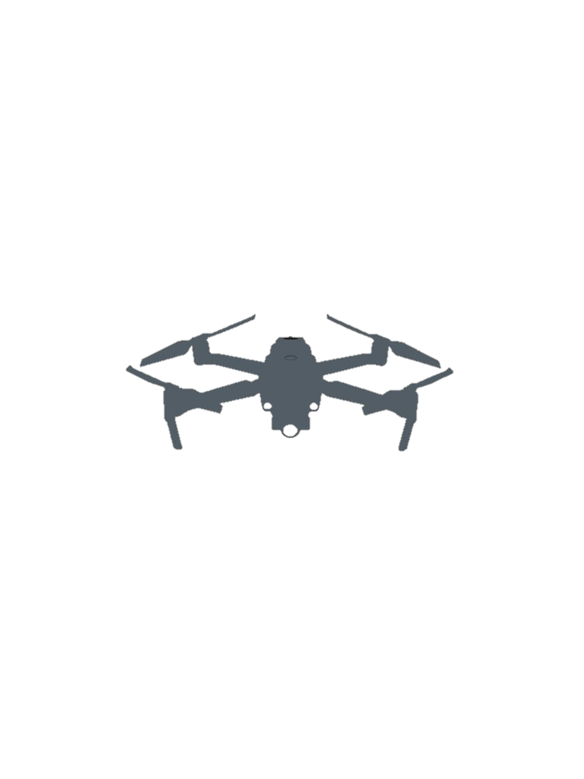

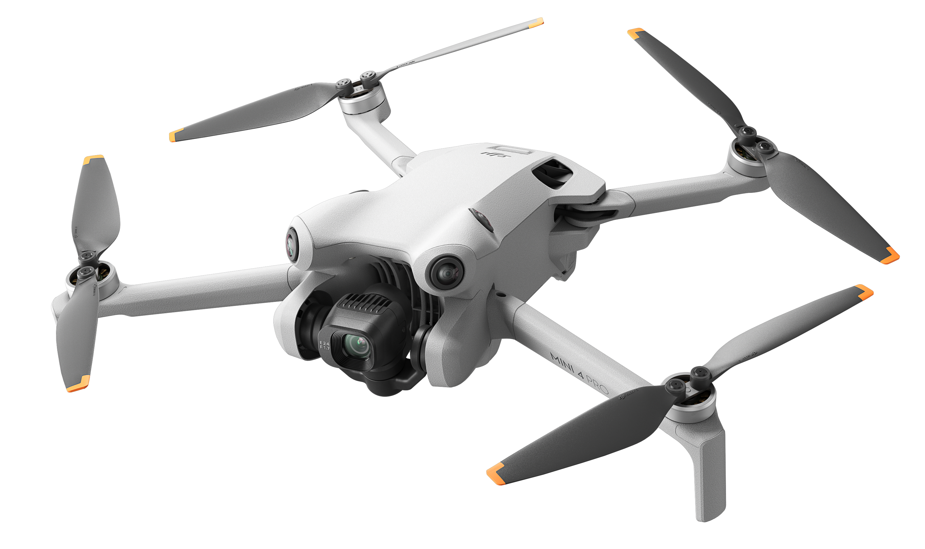











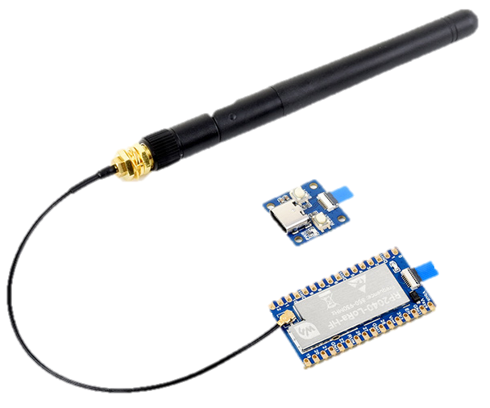
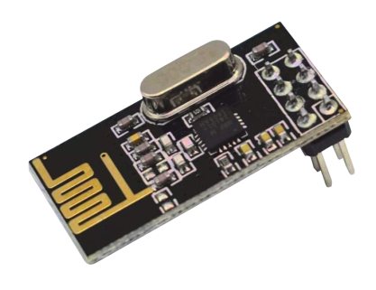

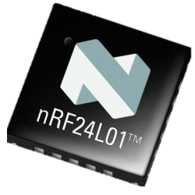


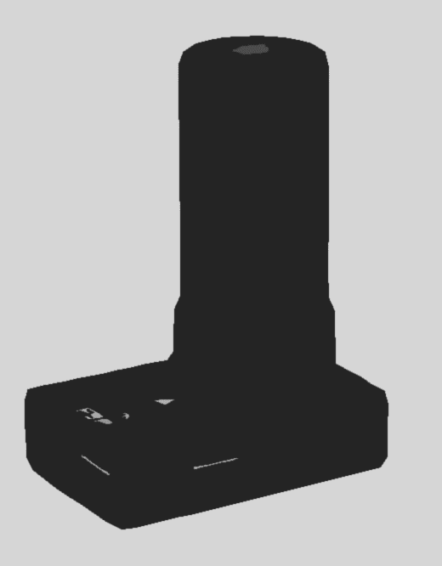


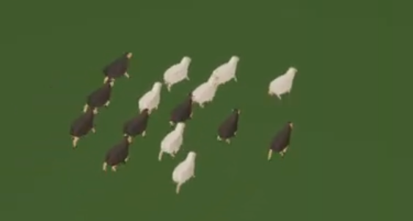



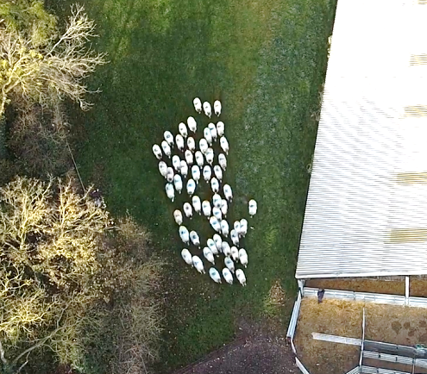



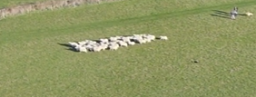
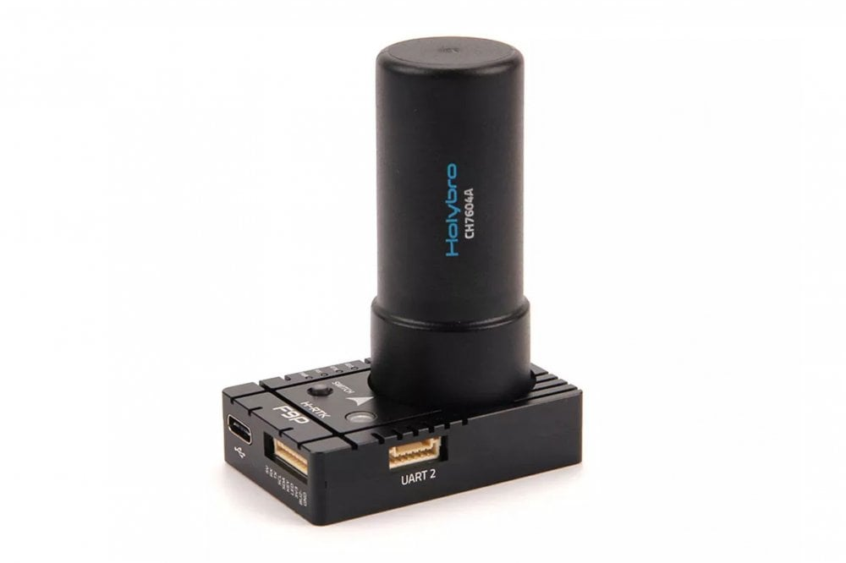

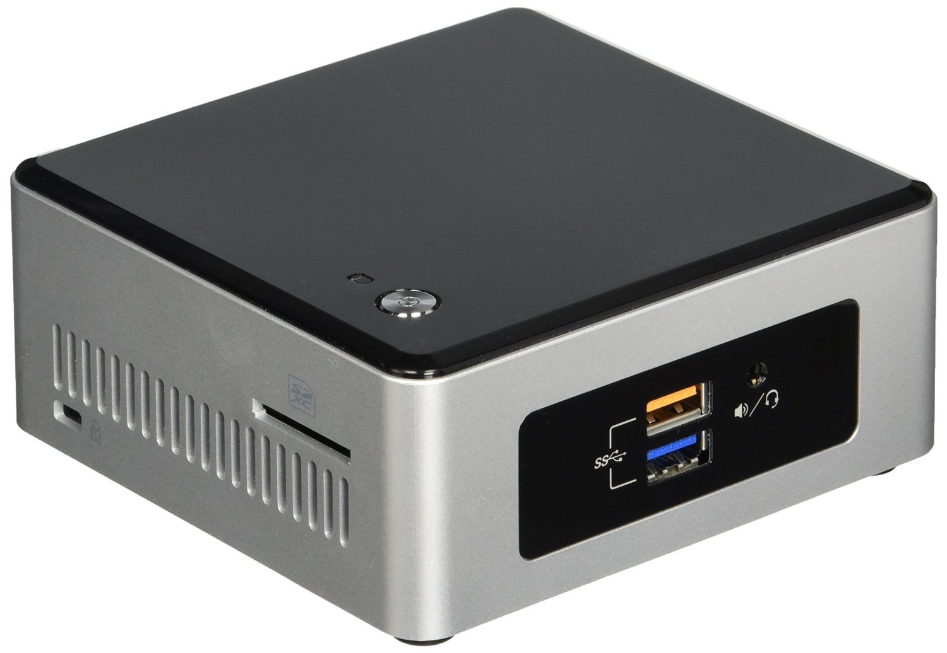

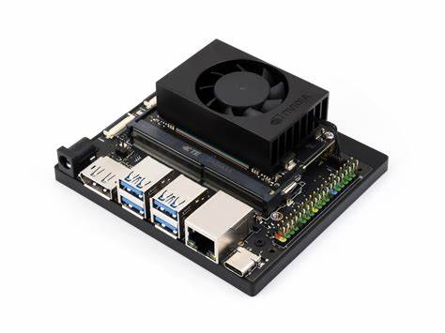

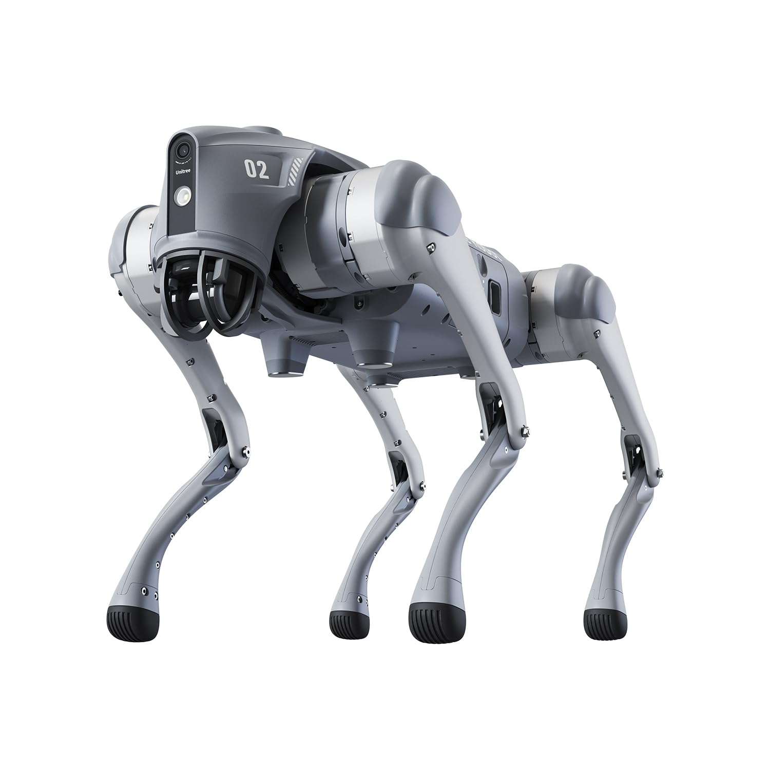
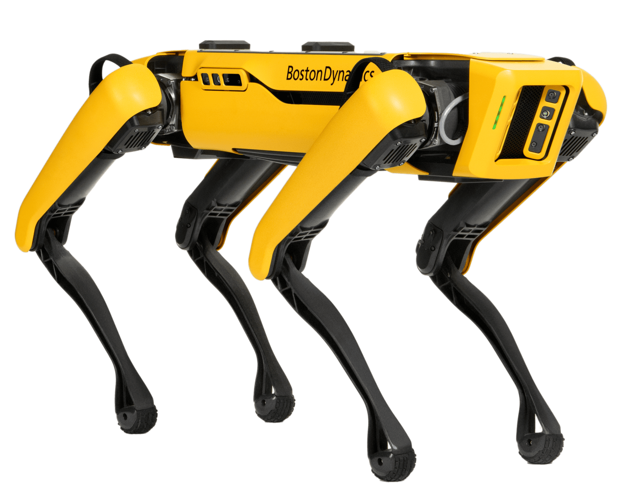

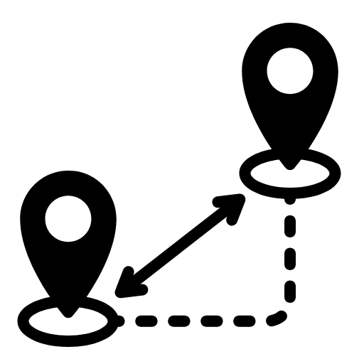

  5th Annual Summer School
  Going to the Dogs
Control
DJI
Mini 4
Pro
Nav Goal
Estimator
Android
Teleop Server
Drone Base Station
Teleop
Dashboard
Path
GPS
Video
LoRa
Bridge
nRF
Computer Vision Server
Stream
Detection
Holybro
H-RTK
Localisation
Geo-References
Onboard Compute
Drone
Path
Magnetometer
EKF
Pose
RTK
LoRa
Dog Path
Unity Sim
Synthetic
Data Stream
Drivers
Nav2
Bridge
nRF
Full System Simulation
Robot
Dog
Natural
System
Weights
LoRa
Bridge
Dog Pose
nRF
Tuning
Dog
Path
Goal
Pose
Simulations
Evaluation
N-Second
Simulation
Goal
Proximity
Score
Predicted
Poses
Sheep
Poses
Prediction & Control Server
Poses
Pose 0
Setup
Serial
ROS2 Topic
Unity Signal
RF Link
Natural-System Training

