Slide 1


The Fitness Place
logo
SUMMER CODING CAMP

Slide 2
EXECUTIVE SUMMARY
My job is to help other people to start to like exercise and working out.
SUMMER CODING CAMP

Slide 3
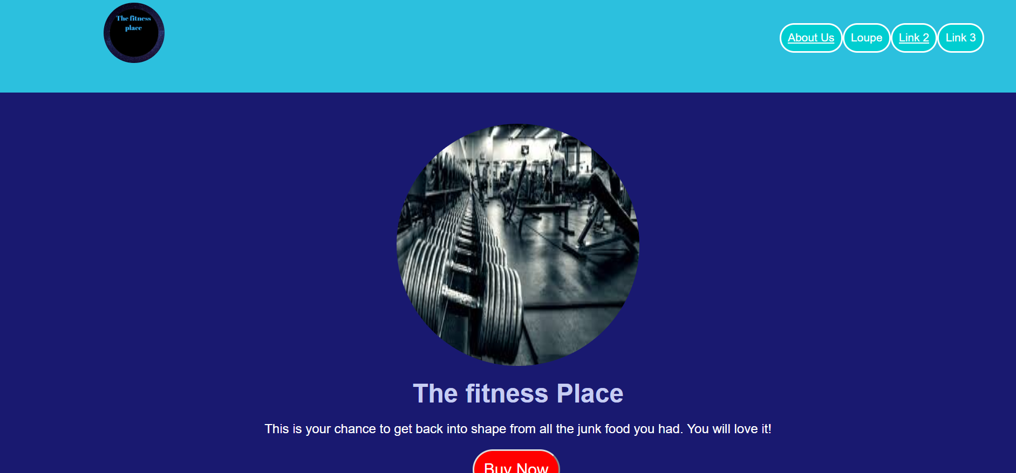
My website.
SUMMER CODING CAMP

Slide 4
THANK YOU!
SUMMER CODING CAMP

