Slide 1
Experimental setup of sound emitting and processing ROBOT for acoustic-based SLAM applications
Midterm Presentation
Frederike Dümbgen
Semester Project LCAV
EPFL
29.10.2015

Slide 2
s
Introduction echo-localisation + video
3d reconstruction room
Photo robot

Slide 3
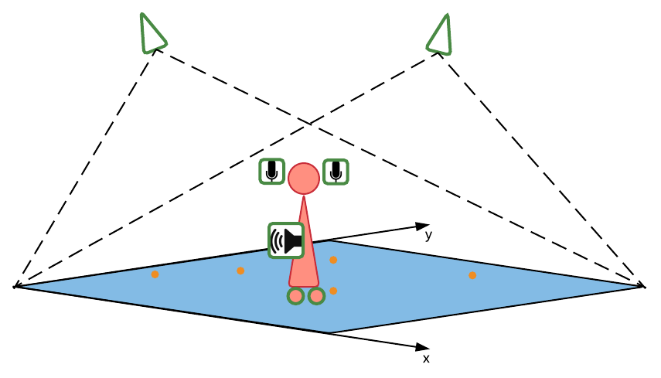
PROJECT DESCRIPTION
Image processing
ground truth
Odometry
position guess
Sound processing
new algorithm

Slide 4
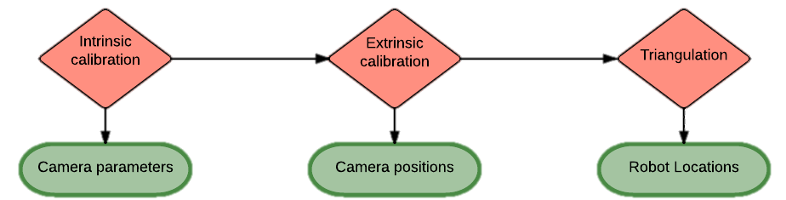
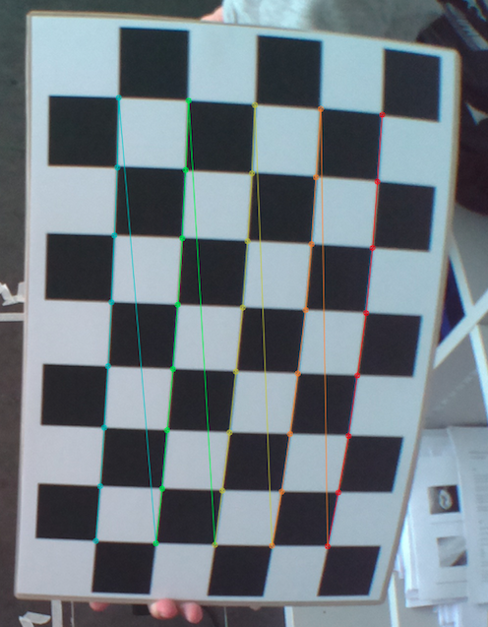
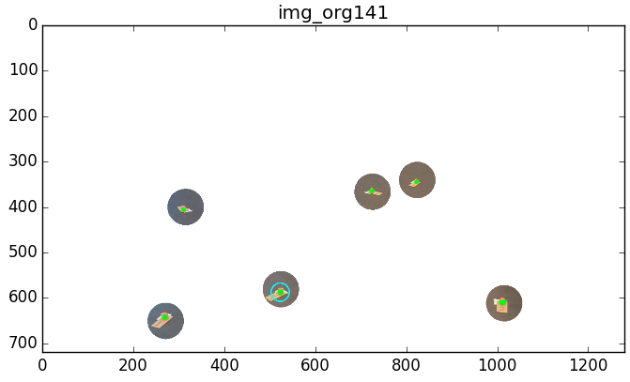
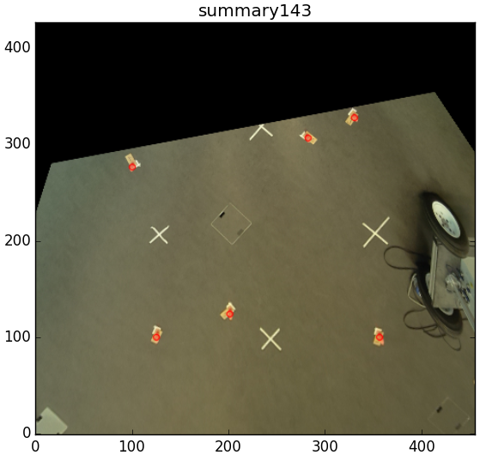
VISUAL LOCALIZATION IMPLEMENTATION

Slide 5
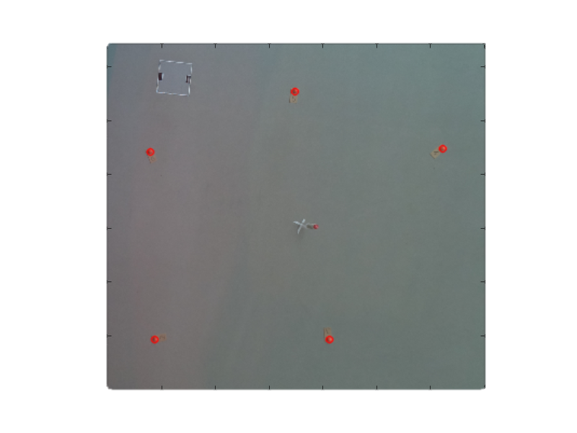
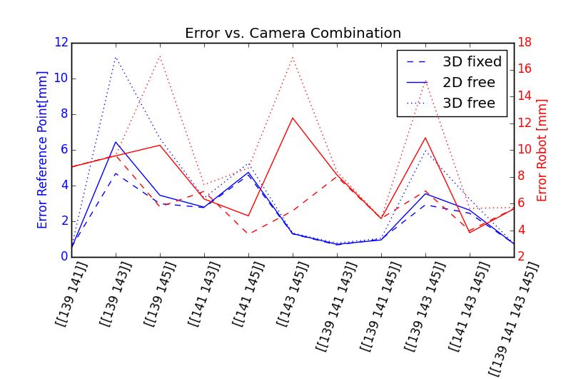
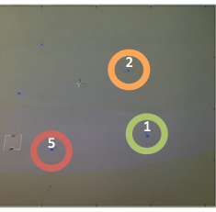
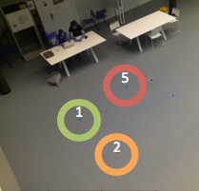
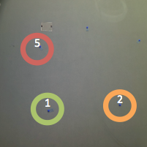
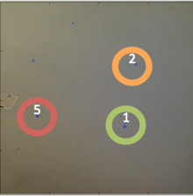
VISUAL LOCALIZATION ATRIUM
1.5 m
Fixed height [mm]: [1815 , 1521 , 182.0000], error 2D: 8.71 3D: 8.71
Free height [mm]: [1814.8182 , 1520.9611 , 181.6047], error 2D: 8.73 3D: 8.74
Real position [mm] :[1822.0000 , 1516.0000 , 182.0000]

Slide 6
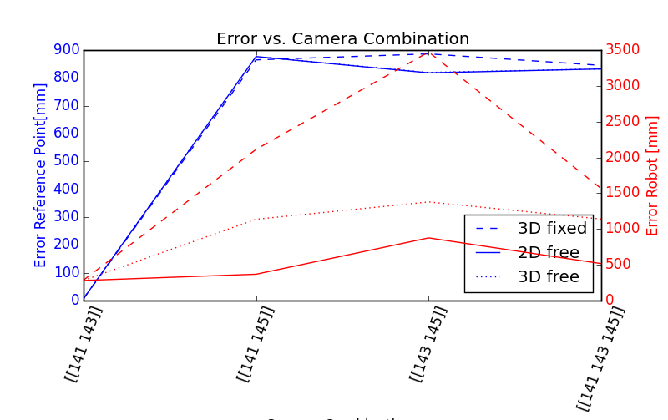
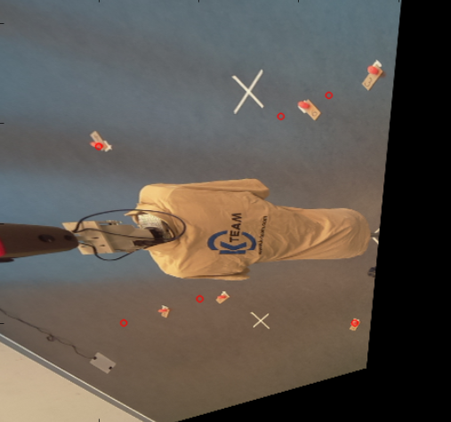
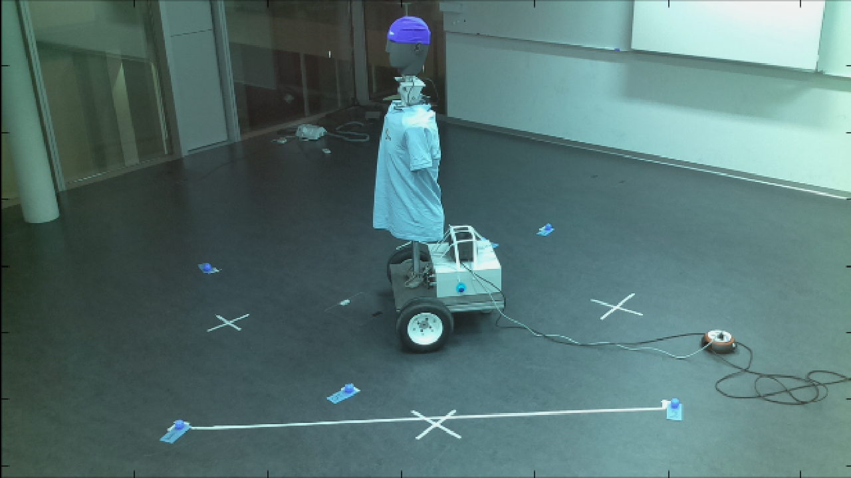
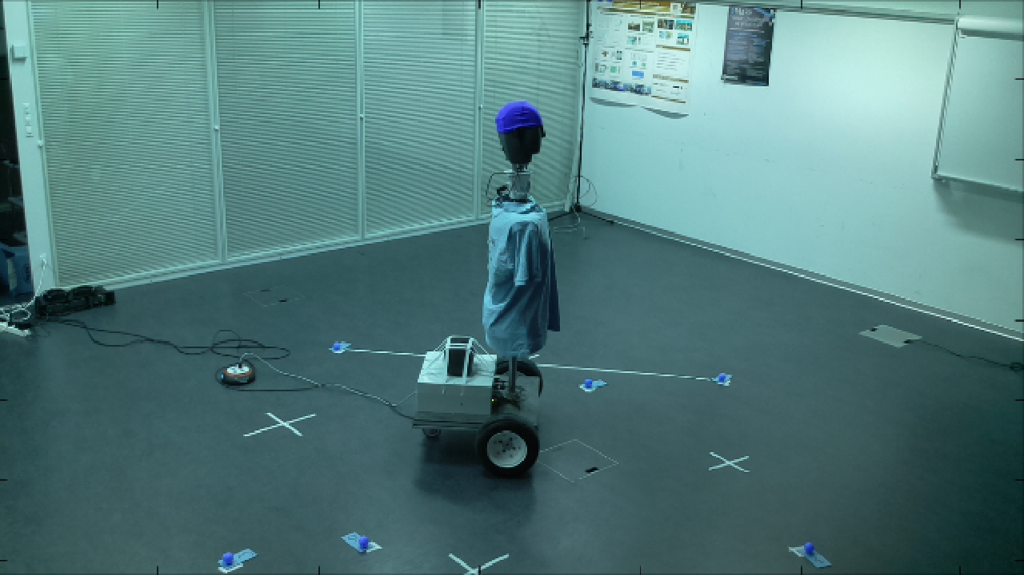
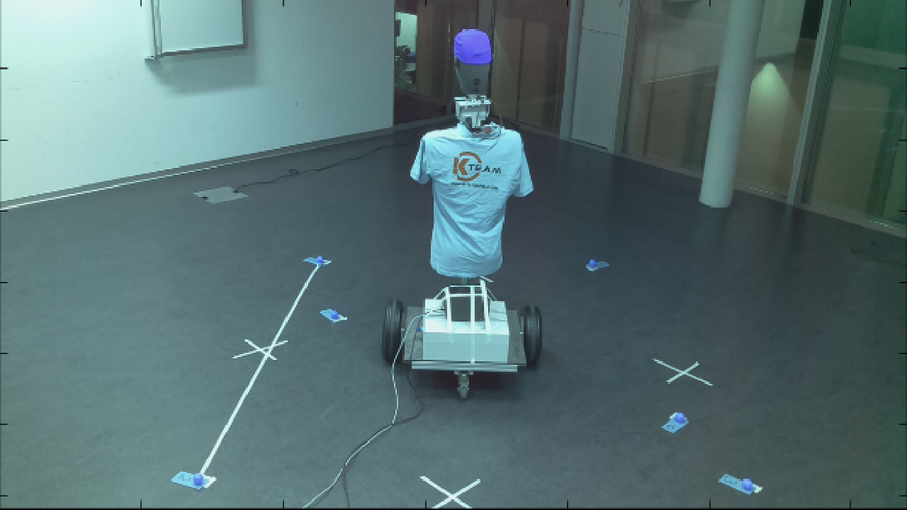
VISUAL LOCALIZATION MEETING ROOM
2.3 m
Best combination (based on best 3D error with free height):[[141 143]]
Fixed height [mm]: [2404.9351 , 1936.1593 , 1650.0000], error 2D: 286.45 3D: 286.45
Free height [mm]: [2401.6546 , 1971.9319 , 1632.8326], error 2D: 280.97 3D: 281.49
Real position [mm]:[2120.6853 , 1971.5825 , 1650.0000]

Slide 7
SOUND AND ODOMETRY
Video
First results odometry precision (real vs. Odometry)
Room impulse responses?

Slide 8
UPCOMING WORK
What works?
Debugging:
Try to improve image processing results by changing location of head, using fisheye.
Do more sound processing tests
Eventually test SLAM algorithm

