Slide 1

Program Development

Slide 2
Topics
Steps in the program development process

Slide 3
Intro
Developing computer programs involves problem solving
It is the process of creating the steps that will move from the initial problem situation to the solution
This means defining an algorithm and then implementing the algorithm by coding instructions that are understandable to a computer

Slide 4
Program Development
Steps in program development
  Define the problem
  Develop the solution algorithm
  Test the algorithm
  Implement the algorithm
  Document and maintain the program

Slide 5
Define the Problem
Be sure you understand the problem
  Information gathering
A method that is useful is to divide the problem into three separate components:
  Inputs: source data
  Outputs: output information
  Processing: actions to transform inputs into outputs

Slide 6
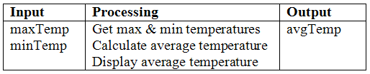
Example
Problem: Allow the user to enter max and min temperatures for a day then display the average temperature
Create the following input-processing-output (IPO) chart:

Slide 7
Develop the Solution Algorithm
Here there are normally two steps especially for complicated problems:
  A) Outline the solution – may not be needed for simple problems
  B) Expand outline into the algorithm – precise set of steps

Slide 8
A) Outline the Solution
Rough draft of the solution
Decompose the problem into smaller steps
Initial outline may include:
  major processing steps involved
  major subtasks if any
  major variables
  major control structures
  main logic

Slide 9
Example
Problem: Average temperature
Outline:
Get maxTemp and minTemp
avgTemp = (maxTemp + minTemp) / 2
Display avgTemp

Slide 10
B) Expand Outline into Algorithm
What is an algorithm? – a set of precise steps that describe exactly the tasks to be performed and the order in which they are to be carried out
Pseudocode is normally used to represent the solution algorithm

Slide 11
Considerations
The level of detail should be the same as the program that will eventually be written from the algorithm
That is, each statement in the algorithm corresponds to a statement in the program

Slide 12
Example
Problem: Average temperature
Algorithm in pseudocode (with statement numbers):
      1 Prompt for maxTemp
      2 Get maxTemp
      3 Prompt for minTemp
      4 Get minTemp
      5 avgTemp = (maxTemp + minTemp) / 2
      6 Display “Average temperature = ” + avgTemp

Slide 13
Test the Algorithm
We want to be sure the algorithm is correct, that is, that it solves the problem
  Best to make this a “desk check” before writing code
  Major logic errors can be detected and more easily corrected at this stage
  Go through the algorithm step-by-step with test data to ensure the program will actually do what it is supposed to do
  Keep track of all major variable values on paper

Slide 14
Desk Check
Choose at least two sets of input test data
Establish the expected result for each
Check the algorithm against the test data to confirm that it yields the expected results

Slide 15
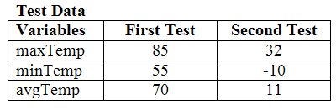
Example
Problem: Average temperature
Choose two sets of input data and establish by hand what the output should be:
Add 85 and 55 then divide by 2
Add 32 and -10 then divide by 2

Slide 16
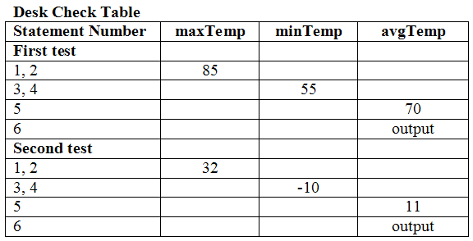
Example
To confirm that the algorithm produces the expected results, create a Desk Check Table and run through the statements by hand
Note that these match the expected results

Slide 17
Implement the Algorithm
After the previous steps have been completed, one implements the algorithm
This involves two substeps:
A) Coding the program
B) Running the program

Slide 18
A) Coding the Program
Use the algorithm to code the program into a chosen programming language
We’ll use Small Basic:
Notice that each statement in the algorithm becomes a statement in the program
1
2
3
4
5
6
TextWindow.Write("Enter max temperature: ")
maxTemp = TextWindow.Read()
TextWindow.Write("Enter min temperature: ")
minTemp = TextWindow.Read()
avgTemp = (maxTemp + minTemp) / 2
TextWindow.WriteLine("Average temperature = " + avgTemp)

Slide 19
B) Running the Program
Run the program on the computer to be sure it works correctly, i.e., test it
This involves translating the source code into machine code by using a compiler or interpreter, and then executing the machine code on the computer
Modern IDEs provide both features
Use programmer-designed test data to machine test the code for errors

Slide 20
Errors
Syntax errors
  Those not conforming to the rules of the programming language
  Detected by the compiler or interpreter
Logic errors
  Those not conforming to the requirements of the problem
  Detected at runtime

Slide 21
Example
Problem: Average temperature
In Small Basic, click the Run button and enter the test data we have been using
Small Basic will translate the code to machine language and run it

Slide 22
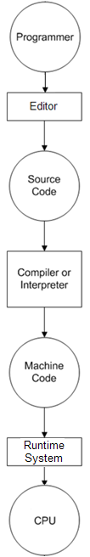
Implementing the Algorithm
Code the program
Translate to machine language
IDE
Run the program

Slide 23
Document and Maintain the Program
Written information that helps people to understand what the program is supposed to do and how it does it
Documentation should be an ongoing task from the initial definition of the problem to the final test
Documentation involves:
  External documentation – outside the program
  Internal documentation – in the program
    Most programming languages support comments that are not executed when the program runs

Slide 24
Document and Maintain the Program
Maintenance involves making appropriate changes to the program over time as needed to allow it to conform to new user requirements
It also involves fixing bugs that are discovered
This may be done by a different programmer than the one who created it
A well designed program using structured programming techniques and good programming style is easier to maintain

Slide 25
Summary
Steps in program development
  Define the problem
    Information gathering
    IPO chart
  Develop the solution algorithm
    Outline the solution
    Expand outline into the algorithm
  Test the algorithm
    Desk check

Slide 26
Summary
  Implement the algorithm
    Coding the program
    Running the program
      Syntax errors
      Logic errors
  Document and maintain the program
    Documentation
      External documentation
      Internal documentation
    Maintenance
      New/changed features
      Bug fixes

Slide 27
Terminology
IPO chart
Algorithm
Pseudocode
Desk check
Syntax errors
Logic errors
Program documentation
Program maintenance
Bug fixes

Slide 28
End

