Slide 1

Repetition Control Structure

Slide 2
Topics
Review sequence and selection
Repetition control structure
While and For loops
Infinite loops
Input validation
Structured programming
Hints for defining the problem

Slide 3
Control Structures
Recall that control structures refer to the flow of control through the statements in our algorithms and programs
That is, the order the statements are executed
We have discussed two control structures so far: Sequence and selection

Slide 4
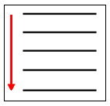
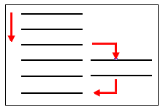
Sequence and Selection
Sequence: Top to bottom
Selection: One group of statements or another
Sequence Selection

Slide 5
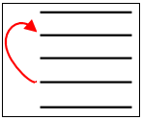
Repetition
Now, we want to describe repetition
A set of statements are repeated forming a loop, that is, there are multiple iterations of a block of code
Repetition

Slide 6
Repetition
With sequence and selection, each statement is executed no more than once
Often algorithms and programs need to perform statements more than once
For example, reading the address records from a file, or successively performing a calculation like adding all the prices to arrive at a total

Slide 7
Repetition
There are two main ways for repeating statements:
  While Loop: Repeats while condition is true
  For Loop: Repeats a counted number of times
We use the While statement and the For statement, respectively, to implement these two repetition control structures

Slide 8
While Loop
Example:
Initialize count to 0
While count < 10
Display count
Add 1 to count
EndWhile
While condition is true
  Perform these statements
EndWhile
condition = “count < 10” and this will be true or false

Slide 9
How It Works
When the While statement is encountered, the condition is tested
  If the condition is true the statements inside the loop are executed in sequence until the EndWhile statement is encountered, then the flow of control moves back to the While statement and the process is repeated
  If the condition is false the statement immediately after the EndWhile statement is executed, that is, the repetition structure is exited

Slide 10
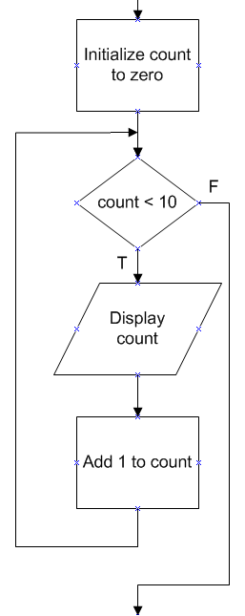
While Loop
Pseudocode Flowchart
Initialize count to 0
While count < 10
Display count
Add 1 to count
EndWhile
Small Basic code
count = 0
While (count < 10)
TextWindow.WriteLine("Count = " + count)
count = count + 1
EndWhile

Slide 11
Condition
The statements in the loop are repeated as long as a condition is true
The condition compares two values such that the result is either true or false
Recall that the selection control structure (If statement) also used a condition, in that case to select one block of code or another
With the While loop, the condition causes a block of code to repeat or not

Slide 12
Relational Operators
We use the same relational operators (comparison operators) in the While statement that were used with the If statement: <, >, =, <=, >=, < >
The logical operators And and Or can also be used in the condition

Slide 13
Common Options in While Loops
Sentinel value is a special input value that signals the end of a loop
Priming the loop means to set things up before the loop so the condition makes sense the first time it is tested
  For example, inputting before the loop a value for a variable used in the loop condition even though you will be inputting the same value within the loop

Slide 14
Example Using And
Problem statement: Have the program input a name in lower, upper, or mixed case then display the name in uppercase. The program should perform multiple iterations until the user enters a q or Q.

Slide 15
Example Using And
Pseudocode
Prompt for name
Get name
While name <> “q” And name <> “Q”
Convert name to uppercase yielding upperName
Display upperName
Prompt for name
Get name
EndWhile
Priming the loop
Sentinel values

Slide 16
Small Basic Text Object
Small Basic contains several objects containing predefined operations that are useful in many programs
They are like toolboxes in which there are tools that are handy for lots of situations
One of these is the Text object which contains operations for converting a character or string to uppercase or lowercase: ConvertToUpperCase and ConvertToLowerCase

Slide 17
Small Basic Text Object
You access the uppercase operation as follows:
upper = Text.ConvertToUpperCase(lower)
where lower is a variable containing a character or string in any case, and upper is the variable assigned the uppercase version of lower
Object
Operation

Slide 18
Example Using And
Small Basic code
TextWindow.Write("Enter a name (q to quit): ")
name = TextWindow.Read()
While (name <> "q" And name <> "Q")
upperName = Text.ConvertToUpperCase(name)
TextWindow.WriteLine("Uppercase version of " + name + " = " + upperName)
TextWindow.Write("Enter a name (q to quit): ")
name = TextWindow.Read()
EndWhile

Slide 19
Important Requirements
The loop-variable, that is, the variable in the condition of the loop should be initialized before the loop
There should be an instruction within the loop that changes the value of the loop-variable
The condition should eventually become false or there will be an infinite loop

Slide 20
Infinite Loop
Situation when the loop never stops because the condition on which the repetition structure is based never becomes false
This is a logic error, that is, it is found at desk check time for the algorithm or at run time for the program because it does not perform properly
The loop does not end gracefully, but continues to execute forever
We want to avoid this

Slide 21
Infinite Loop
Note at the right, count starts at 0 and continues to increment so it will always be greater than or equal to 0 and the loop never ends
Example:
Initialize count to 0
While count >= 0
Display count
Add 1 to count
EndWhile

Slide 22
Infinite Loop
Small Basic Example
Try this program in Small Basic. To stop the program press Ctrl+C or close the text window.
count = 0
While (count >= 0)
TextWindow.WriteLine("Count = " + count)
count = count + 1
EndWhile

Slide 23
Input Validation
Validating the user’s input is an important part of interactive programs
This means to check that what the user entered is legitimate, that is, meaningful given the situation
For example, if the user is to enter company part numbers and the part numbers start with P and have three digits, the programmer should not allow Q1234 in

Slide 24
Input Validation
The While loop may be used to force a user to enter appropriate values
For example, assume the user is supposed to enter a number between 100 and 200
We want to display an error message if the user enters an incorrect value and then request the user to try again

Slide 25
Input Validation Example
Pseudocode
Prompt for number
Get number
While number < 100 Or number > 200
Display error message
Prompt for number
Get number
EndWhile
Display good message

Slide 26
Input Validation Example
Small Basic code
TextWindow.Write("Enter a number between 100 and 200: ")
number = TextWindow.ReadNumber()
While (number < 100 Or number > 200)
TextWindow.WriteLine("Error - out of range")
TextWindow.Write("Enter a number between 100 and 200: ")
number = TextWindow.ReadNumber()
EndWhile
TextWindow.WriteLine("That’s good!")

Slide 27
For Loop
The second main repetition construct is the For loop
It is sometimes called a counted loop because it counts the number of iterations performed

Slide 28
For Loop
For loopIndex = initialValue To finalValue Step stepValue
  Perform these statements
EndFor
Example:
For index = 1 To 10 Step 2
Display index
EndFor
How many times is this loop performed?

Slide 29
How It Works
When the For statement is first encountered, the loopIndex is set to the initialValue
Test the value in loopIndex against the finalValue at the top of each iteration
When the loopIndex is greater than the finalValue, drop out of the loop
Increment the loopIndex by the stepValue for the second iteration and all iterations following

Slide 30
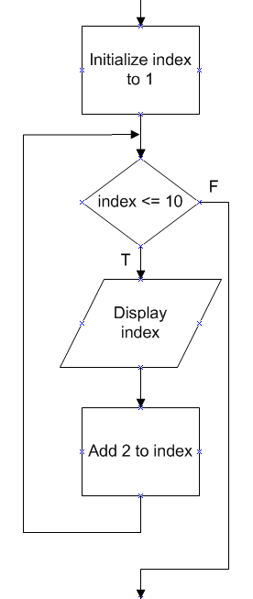
For Loop
Pseudocode Flowchart
For index = 1 To 10 Step 2
Display index
EndFor
Small Basic code
For index = 1 To 10 Step 2
TextWindow.WriteLine("Index = " + index)
EndFor

Slide 31
For Loop
Use when the exact number of iterations is known ahead of time
Note that the Step keyword is not required--if it is left out the stepValue defaults to 1
It is common to need a stepValue of 1, and so it is common to have a For loop without using Step

Slide 32
For without Step
Example pseudocode:
Initialize total to zero
For i = 1 To 100
total = total + i
EndFor
Display "Sum of the numbers from 1 to 100 = " + total
Small Basic code
total = 0
For i = 1 To 100
total = total + i
EndFor
TextWindow.WriteLine("Sum of the numbers from 1 to 100 = " + total)

Slide 33
Negative stepValue
One may use a negative stepValue
For example,
    For index = 100 To 1 Step -1
    Display index
    EndFor
Small Basic code
For index = 100 To 1 Step -1
TextWindow.WriteLine("Index = " + index)
EndFor

Slide 34
Structured Programming
As with the selection control structure, use indentation to show dependency of statements in the repetition control structure
This is good programming style and makes the algorithms and programs more readable
The Structure Theorem that we discussed before indicates that sequence, selection, and repetition are enough control structures for any computer program

Slide 35
Structured Programming
One of the main implications of the Structure Theorem is that Goto’s are not necessary in modern high-level languages
Early programming languages did not implement the three structured programming constructs and hence the Goto statement was used where the flow of control is directed to a label statement
Goto’s lead to “spaghetti” code which is unreadable

Slide 36
Structured Programming
Hence, it is considered poor programming style by modern programmers in high-level languages to use Goto statements which is sometimes called branching
You should not use Goto’s in your algorithms and programs

Slide 37
Hints for Defining the Problem
Now that we know all three control structures, we have the tools to solve more complex problems than we have previously attempted
Recall that in the “Define the Problem” step of Program Development, we analyze the problem statement to understand what input, output, and processing is involved
Now that we may be dealing with more complex problems, it may be more difficult to figure out what needs to be done

Slide 38
Hints for Defining the Problem
Here are some hints*
Input and output are indicated by descriptive words such as nouns and adjectives
The processing is identified as actions using verbs and adverbs
So, analyze the words in the problem statement and divide them into two groups: Those that are descriptive and those that imply actions
* Reference: Simple Program Design: A Step-By-Step Approach, Lesley Anne Robertson, 5th Edition, Thomson, 2006

Slide 39
Hints for Defining the Problem
If the input is not clearly defined concentrate on the output because the output will help determine the input (if a cake is the output, there must be flour as an input)
At this early stage, the processing should be a list of actions that need to be performed, not how those actions will be accomplished
Because at the Define the Problem step, we are not finding the solution yet (we want to know what the problem is before we solve it)

Slide 40
Example
Problem statement: The program should determine the extended price by multiplying the unit price by the quantity purchased. The unit price and quantity are to be entered by the user and the extended price displayed.
Analysis to define the problem: Look for the nouns (extended price, unit price, quantity) to find the input/output, and look for the verbs (determine, multiply, enter, display) to find the actions, that is, the processing
This helps use to create the IPO Chart (next slide)

Slide 41

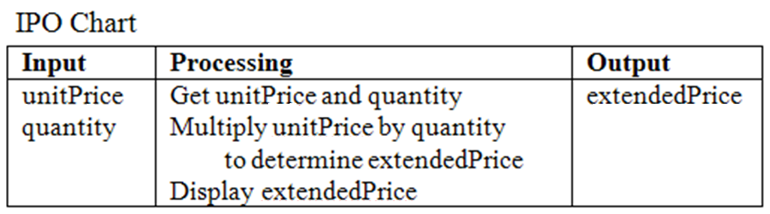
Example

Slide 42
Summary
The repetition control structure is one of the three control structures needed to create programs
Repetition involves looping through a block of statements
There are two main types of repetition
  While loop
  For loop
The While loop is controlled by a logical condition

Slide 43
Summary
The For loop is controlled by an index variable that runs through a range of values
The For loop is used when the number of iterations is known in advance
Structured programming and good programming style dictate that one should not use Goto’s (branching)
By analyzing the language in a problem statement, we often can determine the input, output, and processing required

Slide 44
Terminology
Control structures
Sequence
Selection
Repetition
Loop
Iteration
While loop
For loop
Condition
Relational operator
Logical operator
Sentinel value
Priming the loop
Small Basic Text object
Infinite loop
Input validation
Logic error
Counted loop
Structured programming
Structure theorem
Programming style
Goto
Branching

Slide 45
Review Small Basic Commands
Selection
If age < 65 Then
charge = 10.00
Else
charge = 8.00
EndIf
If balance > 0.0 And monthsPastDue >= 3 Then
balance = balance + fee
EndIf
If age < 21 Or age > 65 Then
TextWindow.WriteLine("You are not eligible.")
EndIf

Slide 46
Review Small Basic Commands
Repetition – While loop
Repetition – For loop
count = 0
While (count < 10)
TextWindow.WriteLine("Count = " + count)
count = count + 1
EndWhile
For index = 1 To 10 Step 2
TextWindow.WriteLine("Index = " + index)
EndFor

Slide 47
End

