Slide 1
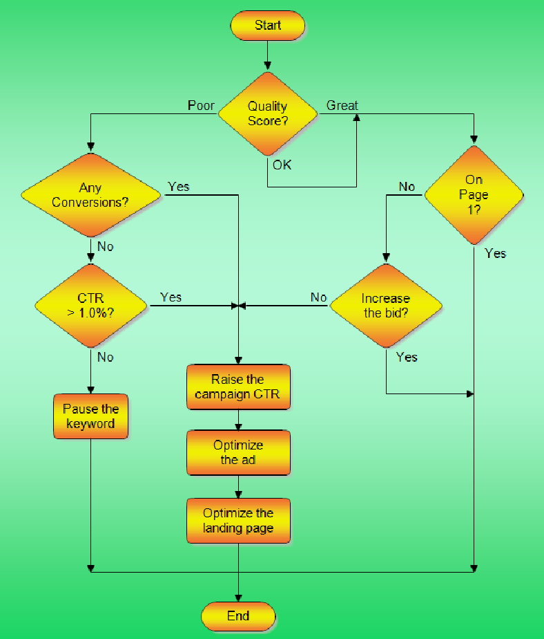
Flowcharts
Introduction

Slide 2
Topics
Characteristics
Six standard flowchart symbols
Three basic control structures

Slide 3
Flowcharts
Besides pseudocode another common way to represent algorithms is with flowcharts
It is a graphical method of representing program logic
One connects a series of standard geometric symbols with lines which represent the flow of control in an algorithm
Many people find them more intuitive than pseudocode

Slide 4
Flowcharts
Often at a glance without reading the detailed text within the symbols one may recognize the structure of the algorithm because of the flowchart’s graphical nature
However, they often take more space than a pseudocode representation of the same algorithm, and it is sometimes difficult to fit the text details within the symbols

Slide 5
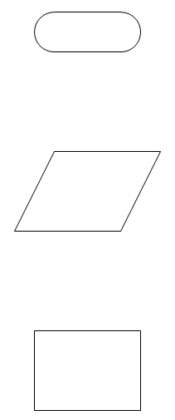
Six Standard Flowchart Symbols
Terminator – indicates start and stop points, each flowchart should have a start and stop
Input/Output – indicates data coming in or going out
Process – a single process in the algorithm, e.g., performing a calculation

Slide 6
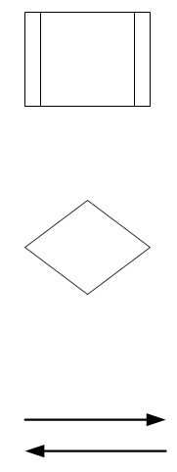
Six Standard Flowchart Symbols
Predefined Process – a module in an algorithm that has its own flowchart
Decision – indicates alternative paths based on a comparison of values
Flowlines – connect the symbols together and indicate the flow of control

Slide 7
Flowlines
There are two accepted formats for flowlines:
  Always include an arrowhead at one end
  Only include an arrowhead when the flow of control is not from top to bottom or left to right
You may use either approach in this class, but be consistent within one flowchart

Slide 8
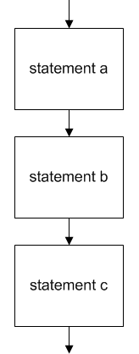
Three Basic Control Structures
The three basic control structures for algorithms may be represented by flowcharts as follows:
Sequence – execution of one step after another, a series of symbols one beneath another

Slide 9
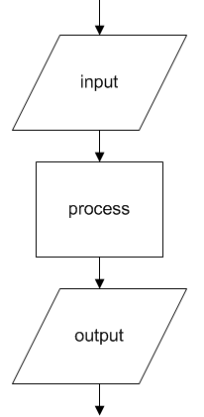
Sequence
Sequence may include symbols other than the process symbol, for example:
Sequence – another example

Slide 10
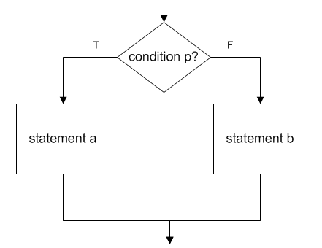
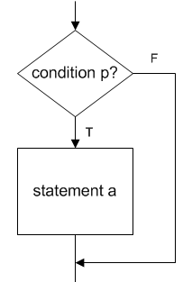
Three Basic Control Structures
Selection – choice between two actions depending on whether condition is true or false
Null Else Selection – a common variation of the selection structure

Slide 11
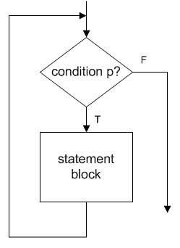
Three Basic Control Structures
Repetition – set of instructions performed repeatedly as long as condition is true

Slide 12
Summary
Flowcharts are a graphical, intuitive way to represent algorithms
They are alternatives to pseudocode
The standard flowchart symbols are:
  Terminator, Input/output, Process
  Predefined process, Decision, Flowlines
The basic control structures may be represented by flowcharts:
  Sequence, Selection, Repetition

Slide 13
Terminology
Flowchart
Terminator symbol
Input/Output symbol
Process symbol
Predefined process symbol
Decision symbol
Flowline symbol
Sequence
Selection
Repetition

Slide 14
End

