Slide 1

Problem Solving with Computers
Introduction

Slide 2
Topics
Course purpose
Problem solving basics
Fundamental terminology

Slide 3
CIS 102
In this course, we will learn what is involved when we solve problems with computers
During the term, we will use a conceptual as well as hands-on approach
This introductory lecture will set the context for our investigations, and help us to understand some basic terminology applicable to this activity

Slide 4

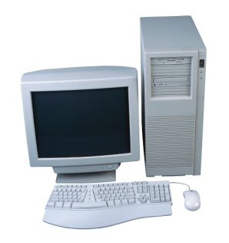
Examples
As motivation, let’s first consider a variety of problems (not necessarily all solvable by computer) and try to identify common characteristics:
  Putting a model airplane together
  Connecting the main computer components (keyboard, mouse, monitor, system unit) together

Slide 5


Examples
  You need to develop a recipe for a new variety of chocolate cake
  You need to fix the kitchen sink

Slide 6
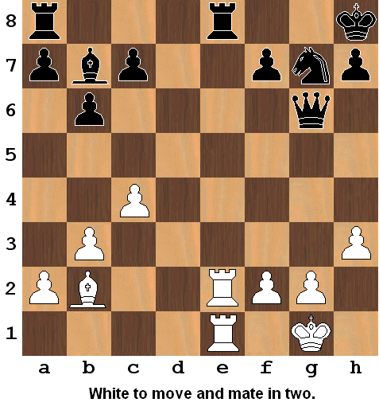
Examples

Slide 7
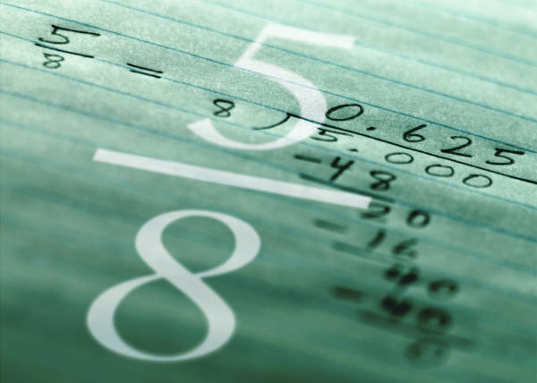

Examples
What is the difference 157 - 78?
What is the quotient 123 ÷ 17?
Setup a network in Building A to provide connectivity for 50 users

Slide 8

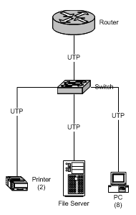
Examples
You need to create a bar graph depicting company sales for last year
You need to draw a network map illustrating the various nodes and topology of the company’s network

Slide 9
Characteristics
What are some common characteristics of these problems?

Slide 10
Characteristics
What are some common characteristics of these problems?
  There is an initial statement defining the problem
  There is a goal to be reached
  Path to the goal usually requires several steps

Slide 11
Characteristics
What are some common characteristics of these problems?
  We may solve the problems by carrying out a series of steps that take us from the initial state to the goal state

Slide 12
Problem Solving
Initial state
  Problem solving starts with a given initial situation
Mental activity
  Based on the problem situation and your prior knowledge you work towards a solution
Intermediate states
  On the way from the initial state to the goal state, one passes through a number of other states
Goal state
  The solution

Slide 13
Problem Solving
Initial
State
Solution Procedure
Problem Statement
Inter-
mediate
States
Inter-
mediate
States
Inter-
mediate
States
Goal
State
Solution

Slide 14
Well Defined vs Ill Defined
  Note that some problems are well defined, others are ill defined and require us to gather more information in order to understand what the problem is or how to reach a solution
  Which of the above examples would you say are “well defined” and which “ill defined?”
    The same problem may be both depending on a person’s experience or knowledge
    Before we try to solve a problem, it is very important to be sure it is well defined for us (information gathering)

Slide 15
Universal Technique
When we solve problems with computers, we need to figure out a series of steps that take use from the current situation to the solution, and then implement these steps
As the above examples suggest, many problems in various disciplines may be solved in this way.
Note that there are two major activities:
  Analysis/planning – design the steps needed to solve it
  Implementation – execute the steps to arrive at a solution

Slide 16
Terminology
Now that we have introduced the basic concept, let’s backup and define a few fundamental terms to help us understand the intentions of the course more thoroughly

Slide 17
Problem Solving
What is problem solving?

Slide 18
Problem Solving
What is problem solving?
    “Solving a problem means finding a way out of a difficulty, a way around an obstacle, attaining an aim which was not immediately attainable.”
  −George Polya

Slide 19
Problem Solving with Computers
What is problem solving with computers?

Slide 20
Problem Solving with Computers
Problem solving with computers means to utilize a computer for solving problems, that is, to use the special characteristics of computers to help us reach a solution
Computer characteristics:
  Speed
  Accuracy
  Consistency
  Indefatigable

Slide 21
How Does a Computer Solve a Problem?
Software (also called programs) are that part of a computer system that provides humans with solutions to certain kinds of problems
Software examples: Excel, Visio, Word, Power Point, email, antivirus, integrated development environment (IDE), …

Slide 22
Kinds of Problems
What kinds of problems are solvable by computers?

Slide 23
Kinds of Problems
What kinds of problems are solvable by computers?
  Those for which there is a program available to solve them, or those for which we may effectively create a program to solve them

Slide 24
Types of Software
Application software
  Programs that are directly used by end users to solve problems
  For example, Excel and Visio
System software
  Programs that support the fundamental operation of the computer system, or are used to maintain the computer system, or are used to create programs
  For example, operating system, antivirus and backup software, and IDE’s

Slide 25
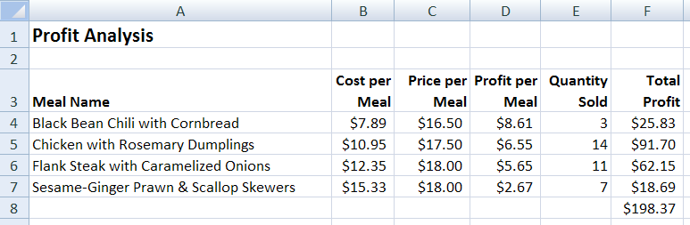
Application Software
We will use these two applications in the course:
Excel – create and manage electronic spreadsheets
Visio – used for drawing diagrams of various types

Slide 26
Step-By-Step is the Key
In order to solve problems with computers using either application or system software, we need to create a series of steps that will lead us from an initial problem state to the goal state or solution

Slide 27
Types of Problems
Algorithmic – problems that have a guaranteed solution that may be reached with a series of steps
Not all problems are of this type
Heuristic – problems for which there are guidelines for arriving at possible solutions and for which there are no series of steps to arrive at a guaranteed solution

Slide 28
Examples of Types of Problems
Algorithmic
  What is the average gross sales for the past fiscal year for the western region?
  Write a program to input student scores and assign letter grades based on them.
  Given this chess position, find the mate in two.
  Alphabetize the list of 20,000 customers.
Heuristic
  Compose a beautiful song.
  How does one find a satisfying job?
  Given the chess position at the beginning of the game, how does one mate the opponent?
  Should I sell my stock?

Slide 29
Step-By-Step
We will study algorithmic problems in this course
Because computers are designed to solve problems for which there are a series of steps to reach a solution
Instructions in programs are executed in step-by-step fashion

Slide 30
Computer Problem Solving
In this course, we will investigate computer problem solving techniques that are applicable to the activities of creating software (programming) and of utilizing existing software for problem resolution
We will learn that both activities are similar:
  In order to be successful at either, one needs to utilize a logical, analytical approach (analytical reasoning – separating a whole into its components)
  We implement a step-by-step process for problem resolution

Slide 31

What is a Computer?
Raw Data
Input
Output
Information
Processing
A computer is a machine that transforms raw data into meaningful information

Slide 32
How Does a Computer Do That?
The input is transformed into output by manipulating or changing the input in a prescribed way, that is, by processing it
This processing is accomplished by programs

Slide 33
What is a Program?
A program is a set of instructions that may be executed by a computer
For example:
TextWindow.Write("Enter your Name: ")
name = TextWindow.Read()
TextWindow.WriteLine("Hello " + name)

Slide 34
Where is a Program?
Programs are in main memory (called RAM) when they are executing
Since RAM is not permanent storage, programs are stored permanently on auxiliary storage media like the hard disk

Slide 35
Primary Computer Components
CPU
Central Processing Unit
Main Memory
RAM
HD
Hard Disk
Program
Program
permanent storage
executes from here

Slide 36
How Does a Program Run?
When a user enters a command to run a program, the operating system of the computer locates the program on auxiliary storage and loads it into RAM
Then the instructions in the program are fed to the CPU for execution
The CPU is the hardware component that acts on these instructions

Slide 37
How a Program Runs
CPU
Instructions fed to CPU for execution
RAM
Program
Hard Disk
Program’s
Instructions
Load

Slide 38


How To Create a Program
As we have indicated above, one creates a program by first designing the steps needed to solve the identified problem. This is called the algorithm.
Then converting the algorithm into a related set of instructions in some computer language that when executed by the computer will produce the desired results

Slide 39
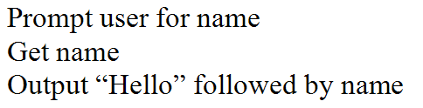
What is an Algorithm?
An algorithm is a precise set of steps that describe exactly the tasks to be performed and their order for producing a specified result
For example:

Slide 40
How to Create an Algorithm
Define the problem
  Be sure you have a well defined statement that you thoroughly understand. If you don’t you will need to do information gathering until you do.
Establish a solution outline
  By breaking the problem down into smaller tasks or steps, create a rough draft of the solution.
Develop the algorithm
  Expand the outline into the precise steps that describe exactly the tasks to be performed and their order.

Slide 41
Information Gathering
Before you begin to solve a problem, you need to have a clear problem statement
Things you can do in this course to help you when a problem seems ambiguous:
  Re-read the problem statement
  Read appropriate material in the text
  Do a Google search
  Ask other students, the lab aides, or the instructor for clarity

Slide 42
How to Represent an Algorithm
Algorithms are language independent, that is, they are not represented by a computer language because they are generic definitions of solutions that may later be converted to any suitable computer language
The two methods we will use in this class to represent algorithms are pseudocode and flowcharts

Slide 43
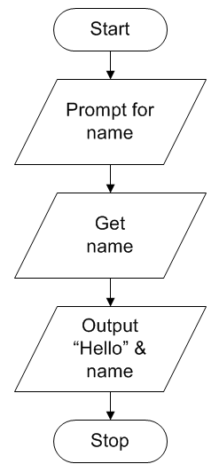
Pseudocode & Flowchart Examples
pseudocode
flowchart

Slide 44
Converting an Algorithm into a Program
Once the algorithm has been defined, programmers need to convert the steps in the algorithm to a specific computer language so that they may execute on a computer
This is called implementing the algorithm
The group of instructions created by the programmer is called the program code, and the act of writing the computer instructions is called coding
Today programmers normally use integrated development environments (IDEs) to write code

Slide 45
What is a Computer Language?
A computer language is a language designed to be understood by a computer
It is an “artificial language” in the sense that it is not used for communication between humans (“natural language”), but is used by humans to communicate with a machine
There are many different varieties of computer languages, for example, Visual Basic, C++, Java, PHP, …

Slide 46
What is an IDE?
An IDE (integrated development environment) is a program that integrates several components that are needed by programmers to develop software, for example, source code editor, debugger, compiler or interpreter, and a run-time system

Slide 47
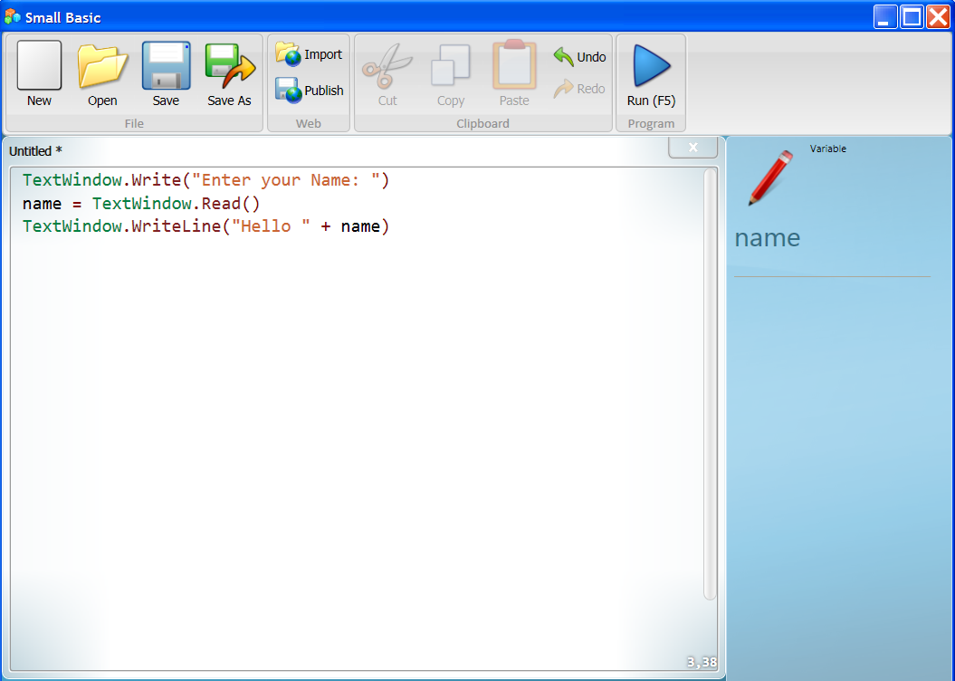
Microsoft Small Basic IDE

Slide 48
What is Source Code?
Source code are the instructions written by the programmer
Programmers write program code using languages that are easier to grasp than the languages used by CPUs (text-based commands)
The source code needs to be translated to machine code (the language of the CPU, 0’s and 1’s) before it will run
This translation is accomplished by a compiler or interpreter

Slide 49
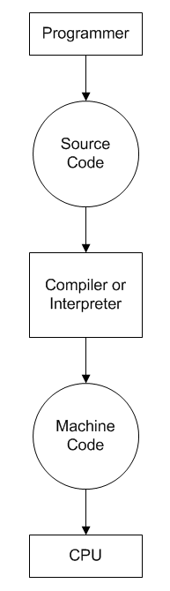

Relationships

Slide 50
Summary
A good method for solving problems in many disciplines is to first define the problem clearly
Then to design a solution by breaking the problem down into subtasks or steps
Finally, to carry out the steps to arrive at a solution

Slide 51
Summary
The development of computer programs involves creating solutions to problems that may be solved by a computer
That is, the act of programming is problem solving
  define the problem clearly
  develop the algorithm
  implement the algorithm
We implement the algorithm by using special system software called an integrated development environment (IDE)

Slide 52
Summary
We can also solve problems with computers by using pre-existing programs (either application or system software)
In which case, we also need to clearly understand the problem, design the steps to reach the solution, and implement those steps

Slide 53
Terminology
Problem solving
Problem solving with computers
Program
Software
Application software
System software
Algorithmic problems
Heuristic problems
Computer
RAM
CPU
Hard disk

Slide 54
Terminology
Load a program
Run a program
Algorithm
Information gathering
Pseudocode
Flowcharts
Implementing an algorithm
Coding
Computer language
IDE
Source code
Machine code
Compiler or interpreter

Slide 55
End

