Slide 1

Selection Control Structure

Slide 2
Topics
Review sequence control structure
Structure theorem
Selection control structure
If statement
Relational operators
Types of selection
Truth tables

Slide 3

Sequence
Recall that the default control structure is sequence
Our examples up to this point have all been of this type
That is, the flow of control through the statements in our algorithms and programs is from top to bottom, sequentially

Slide 4
Structure Theorem
There are two other control structures used in algorithms: Selection and repetition
It has been shown that these three (sequence, selection, and repetition) are enough control structures to write any computer program—The Structure Theorem
http://en.wikipedia.org/wiki/Structured_program_theorem

Slide 5
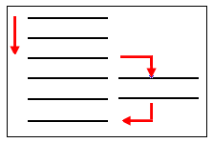
Selection
We will deal with repetition later
Selection involves making a decision to execute several statements or not
Computers have the capability of making a decision by comparing one value with another

Slide 6
Selection
To introduce selection control, we include a condition statement that compares two values such that the result is true or false
That is, there will be a choice between two cases
  If the condition is true one choice is selected
  If it is false the other choice is selected
The condition statement is written as an If statement and it allows the algorithm and program to make a decision

Slide 7
If Statement
Example:
If book is hardback Then
price = 65.00
Else
price = 35.00
EndIf
If condition is true Then
  Perform these statements
Else
  Perform these statements
EndIf
condition = “book is hardback” and this will be true or false

Slide 8
Relational Operators
Also called comparison operators
We use these operators in our conditions to compare two values:
< less than <= less than or equal
> greater than >= greater than or equal
= equal < > not equal

Slide 9
Examples
Condition Result
10 < 5 false
5 < 10 true
1 > 3 false
3 > 1 true
15 >= 10 true
15 >= 15 true
Condition Result
110 <= 100 false
12.5 <= 13.0 true
5 = 5 true
10.5 = 5.75 false
90 < > 80 true
90 < > 90 false

Slide 10
Different Operators
Note that we are using the same character, the equal sign =, as the assignment operator and the equal comparison operator
They are different operators
Examples (these are different operations)
Assignment: tot = tot + 1
Comparison: If tot = 100 Then

Slide 11
Types of Selection
There are three main varieties of the selection structure:
  Simple selection – choice between two alternatives
  Null else selection – perform statements only when condition is true
  Combined selection – multiple conditions using And or Or
The following slides illustrate these showing the flowchart, pseudocode, and Small Basic code

Slide 12
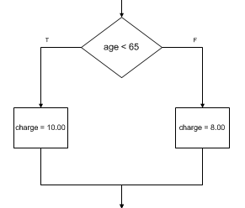
Simple Selection
Pseudocode Flowchart
If age < 65 Then
charge = 10.00
Else
charge = 8.00
EndIf
Small Basic code
If age < 65 Then
charge = 10.00
Else
charge = 8.00
EndIf

Slide 13
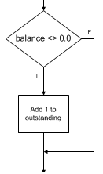
Null Else Selection
Pseudocode Flowchart
If balance <> 0.0 Then
Add 1 to outstanding
EndIf
Small Basic code
If balance <> 0.0 Then
outstanding = outstanding + 1
EndIf

Slide 14
Null Else Selection
As shown in the last example, when the Else clause is not needed, one simply doesn’t use the Else keyword
This situation arises often

Slide 15
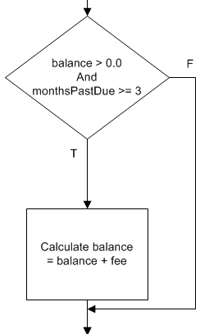
Combined Selection (And)
Pseudocode
If balance > 0.0 And monthsPastDue >= 3 Then
Calculate balance = balance + fee
EndIf
Flowchart
Small Basic code
If balance > 0.0 And monthsPastDue >= 3 Then
balance = balance + fee
EndIf

Slide 16
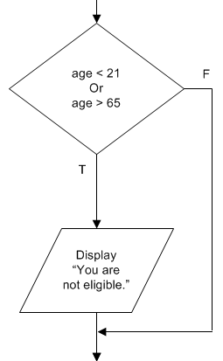
Combined Selection (Or)
Pseudocode Flowchart
If age < 21 Or age > 65 Then
Display “You are not eligible.”
EndIf
Small Basic code
If age < 21 Or age > 65 Then
TextWindow.WriteLine("You are not eligible.")
EndIf

Slide 17
Combined Selection
The examples above for combined selection don’t have an Else clause
But if the situation warrants it the Else clause can be used with combined selection, for example:
      If age < 21 Or age > 65 Then
      Display “You are not eligible.”
      Else
      Display “You are eligible.”
      EndIf

Slide 18
Multiple Statements
The above examples show just one statement in the Then and Else clauses of the If statement
But if needed there may be multiple statements in those clauses, for example:
      If age < 21 Or age > 65 Then
      totNotEligible = totNotEligible + 1
      Display “You are not eligible.”
      Else
      totEligible = totEligible + 1
      Display “You are eligible.”
      EndIf

Slide 19
Structured Programming
Notice how the indentation in the above examples helps us to see which statements are dependent on others
This is one feature of what is called “structured programming,” that is, using good programming style
There are multiple ways to write an algorithm and program, but some ways are better than others

Slide 20
Structured Programming
One feature of good programming style, is to make our algorithms and programs typographically readable by indenting statements properly
Look at the following two examples
Which do you think uses good programming style and is more readable?

Slide 21
Structured Programming
Example 1
If age < 21 Or age > 65 Then
totNotEligible = totNotEligible + 1
Display “You are not eligible.”
Else
totEligible = totEligible + 1
Display “You are eligible.”
EndIf
Example 2
If age < 21 Or age > 65 Then
totNotEligible = totNotEligible + 1
Display “You are not eligible.”
Else
totEligible = totEligible + 1
Display “You are eligible.”
EndIf

Slide 22
Structured Programming
It is not enough to write algorithms and programs that work, we need to follow good programming style so that they are easier to read and maintain
That is, well written algorithms and programs allow the person who writes the statements to make fewer errors, and allows the person maintaining the code to do that more easily

Slide 23
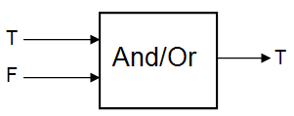
Truth Tables for And & Or
When combining conditions with And or Or, we are effectively combining true’s and false’s to arrive at a new true or false
That is, And and Or are binary operations that take two true/false values and produce one true/false value:
The way these operations do this is shown in the following truth tables

Slide 24


Truth Tables for And & Or
For example, (1 = 2 And 3 = 3) is false because 1 = 2 is false and 3 = 3 is true, but the And truth table indicates that false And true is false
Also, (4 < 5 Or 6 > 7) is true because 4 < 5 is true and 6 > 7 is false, but the Or truth table indicates that true Or false is true

Slide 25
Summary
Control structures refer to the order in which statements are executed in algorithms and programs
There are three main control structures: Sequence, selection, and repetition
In selection, there is a comparison of values that determines which statement(s) are executed next

Slide 26
Summary
We use the If statement in pseudocode and Small Basic to implement the selection control structure
The relational operators are used to make the comparison
Types of selection include:
  Simple selection
  Null else selection
  Combined selection
Truth tables for And and Or help us to understand how the combined selection structure works

Slide 27
Terminology
Selection control structure
Structure theorem
Condition
If statement
Relational operators
Simple selection
Null else selection
Combined selection
Structured programming
Programming style
Truth tables

Slide 28
End

