Slide 1
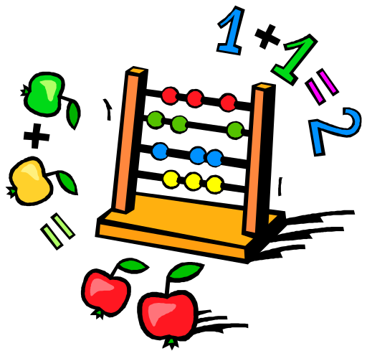
Number Systems

Slide 2
Number Systems
Numbers
143 1101 D4 IV ||||
Value vs representation
  These are two different things:
    Concept of a numeric value
    How that value is represented

Slide 3

Number Systems
The number 123 is pronounced “one hundred and twenty-three”
It is not “one, two, and three” things (not 1 + 2 + 3 = 6 things)
Because each digit, based on its position, is assigned a weight
The 1 represents 100, the 2 twenty, the 3 just 3
The weights are powers of ten:

Slide 4

Number Systems
So, 123 is interpreted as:
= 100 + 20 + 3

Slide 5
Decimal Number System
  Base 10
  Powers of 10
  Digits 0, 1, … , 9

Slide 6
Binary Number System
  Base 2
  Powers of 2
  Bits 0,1

Slide 7
Hexadecimal (Hex)
  Base 16
  Powers of 16
  Hex digits 0, 1, … , 9, A, B, … , F

Slide 8
Decimal, Binary, Hex
Decimal Example 135
135₁₀ = 1x10² + 3x10¹ + 5x10⁰
= 1x100 + 3x10 + 5x1
= 100 + 30 + 5
Binary Example 1011
1011₂ = 1x2³ + 0x2² + 1x2¹ + 1x2⁰
= 1x8 + 0x4 + 1x2 + 1x1
= 8 + 2 + 1 = 11₁₀
Hex Example A3D
A3D₁₆ = Ax16² + 3x16¹ + Dx16⁰
= 10x256 + 3x16 + 13x1
= 2,560 + 48 + 13 = 2,621₁₀

Slide 9
Why Different Systems?
Decimal
  Commonly used in society
Binary
  Computer storage system
  Reliability
Hexadecimal
  Conserves space
  Easy conversion to/from binary

Slide 10
Comparison
--- one digit ---
System Digits Largest Values
Decimal 0,...,9 9 10
Binary 0,1 1 2
Hex 0,…,F 15 16

Slide 11
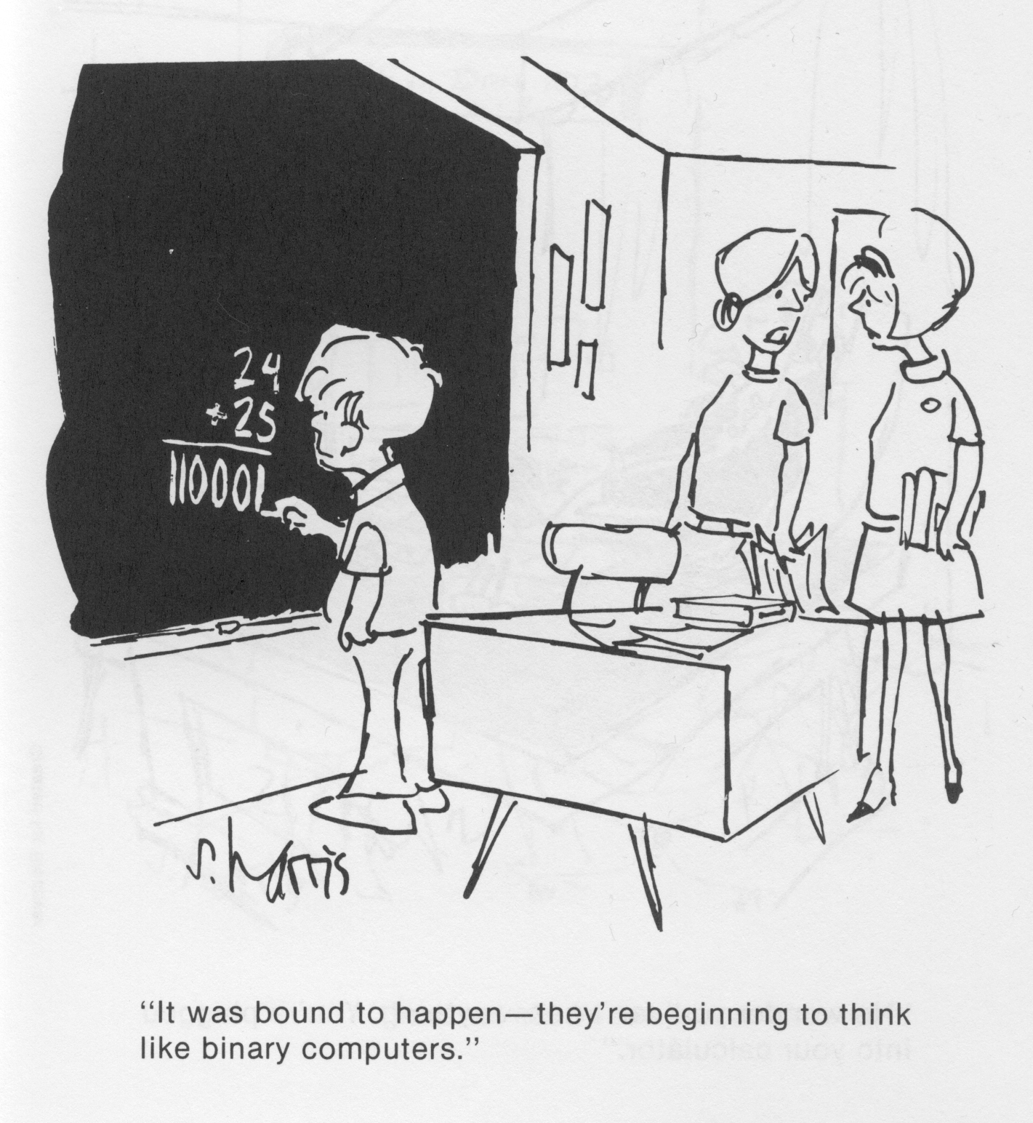

Slide 12
End

