Slide 1
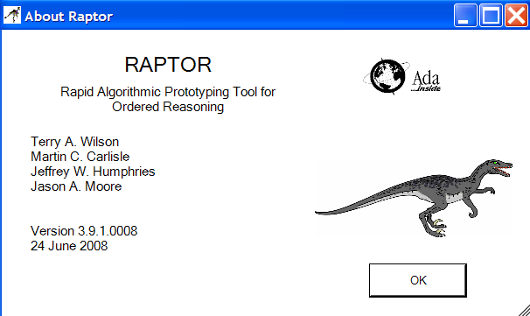
Raptor
Rapid Algorithmic Prototyping Tool for Ordered Reasoning

Slide 2
Topics
Introduction
Primary window
Getting help
Executing the algorithm
Flowchart documentation

Slide 3
Raptor
Raptor is a simple-to-use problem solving tool that enables the user to generate executable flowcharts
Raptor was written for students being introduced to the computing discipline in order to develop problem solving skills and improve algorithmic thinking
Free and downloadable from http://raptor.martincarlisle.com/
Raptor is already installed on the lab room PCs

Slide 4
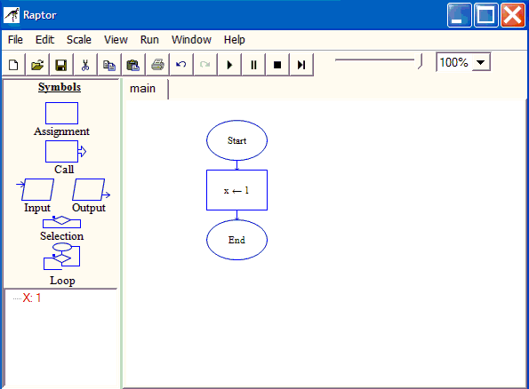
Primary Window
Four main areas
Menu & Toolbar
Help>General>Programming Concepts>Names
Symbols
Watch
Window
Workspace

Slide 5
Four Main Areas
Symbols – flowchart symbols that you may drag to the Workspace
Watch Window – view the current contents of variables as the flowchart executes
Workspace – build flowcharts here and watch them execute
Menu & Toolbar – change settings and control the view and execution of flowchart

Slide 6
Help
Extensive help is available from the menu choice Help>General Help
For example, discussion of using Raptor is in Help>General Help>Using Raptor
There is a tutorial at Help>General Help>Raptor Tutorial
Rules for names are at Help>General>Programming Concepts>Names
Information on variables is at Help>General>Programming Concepts>Variables

Slide 7
Executing Flowchart
A flowchart may be executed using the menu choice Run>Execute to Completion or the toolbar button
The symbol being executed is highlighted in green
Any variables changed by the execution of a symbol are highlighted in red in the Watch Window.

Slide 8
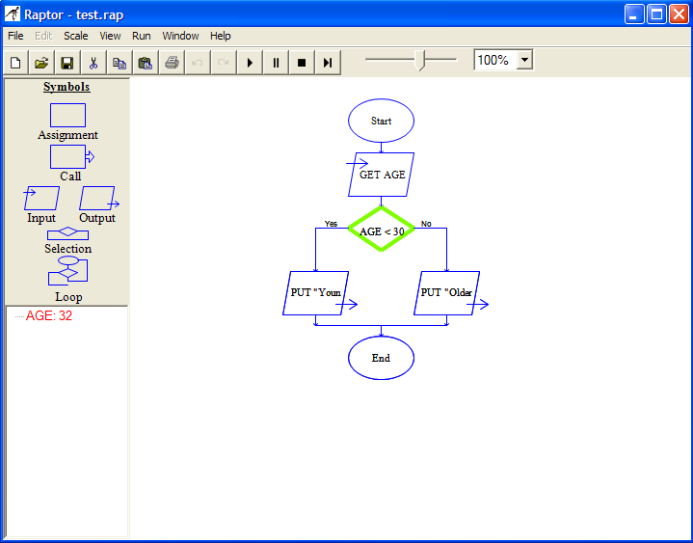

Execution

Slide 9
MasterConsole Window
The MasterConsole window displays program output
Output is achieved using the output flowchart symbol

Slide 10
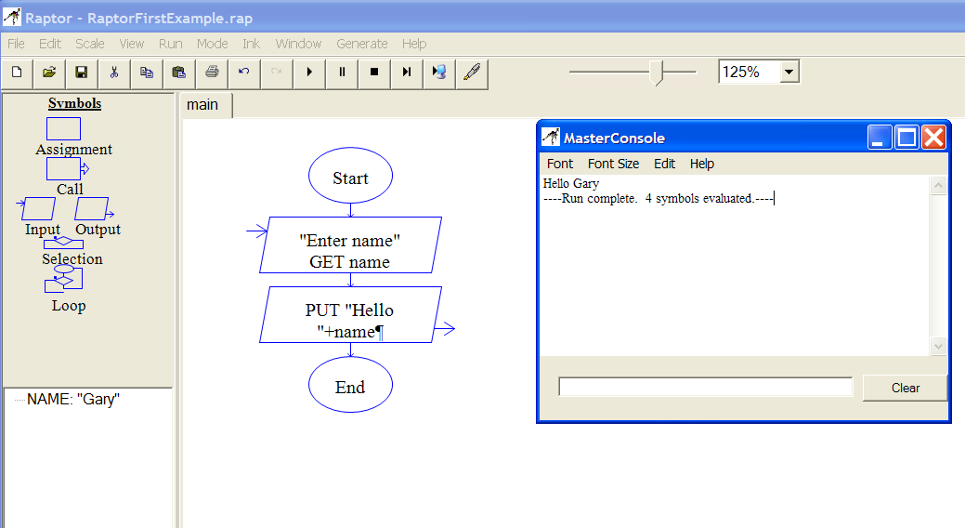
MasterConsole

Slide 11
Zoom & Speed Slider
One may change the size of the flowchart in the workspace through the zoom box
Sometimes the statements in the flowchart symbols extend beyond the borders of the symbols so one may enlarge the symbols through the zoom box
Speed Slider sets the speed of program execution

Slide 12
Flowchart Document
Raptor may also be used to document flowcharts by printing them with the menu choice File>Print or File>Print to Clipboard
File>Print to Clipboard allows you to paste the flowchart into a Word document at whatever location you want

Slide 13
One Step At A Time
The toolbar button Step or function key F10 executes one shape at a time
This is a good way to look for problems with your logic and to observe the variable values as they change

Slide 14
Summary
Raptor is a graphical tool that allows one to easily create flowcharts representing algorithms and then to run them
It is also a way to document the flowcharts by copying them to other documents or printing them

Slide 15
End

