Slide 1

Microsoft Small Basic
Programming Language

Slide 2
Topics
Introduction
Primary window
Getting help
Using Small Basic

Slide 3
Small Basic
Small Basic is an easy to learn programming language inspired by the original BASIC language and is based on Microsoft’s .NET platform
The language is aimed at bringing "fun" back to programming.
It has a friendly, graphical integrated development environment (IDE)
It helps beginners take the first step into the wonderful world of programming

Slide 4
Small Basic
Small - contains just 15 keywords and uses minimal concepts to keep the barrier to entry as low as possible
The IDE contains instant context sensitive help
Free and downloadable from http://msdn.microsoft.com/en-us/devlabs/cc950524.aspx
Small Basic is already installed on the lab room PCs

Slide 5
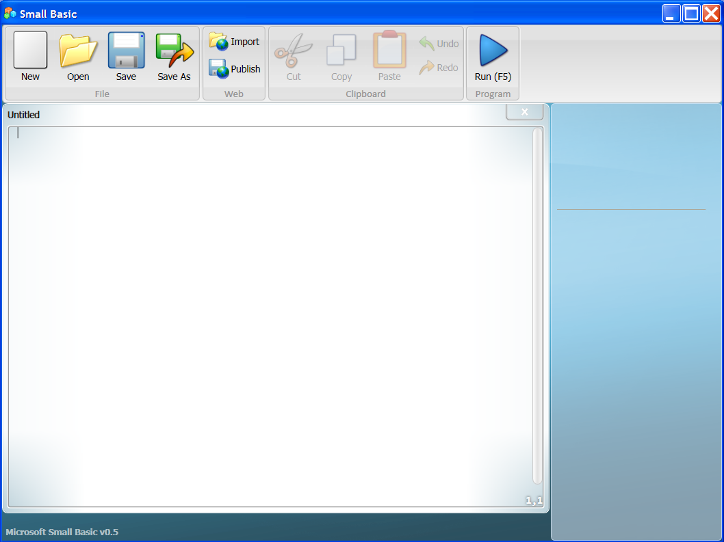
IDE Window
Toolbar
Cursor
Editor
Window
Details Panel

Slide 6
Help
As one enters commands, help appears instantly on the screen
The details panel provides a definition of the commands
“Introducing Small Basic.pdf” is available from the Windows programs menu after installation

Slide 7
Using Small Basic
One enters a Small Basic program into the editor window
Run the program by clicking the Run button in the toolbar
Save the program by clicking Save or Save As
Open an existing program using the Open button
The normal editing operations of Cut, Copy Paste, Undo, and Redo are available from the toolbar

Slide 8
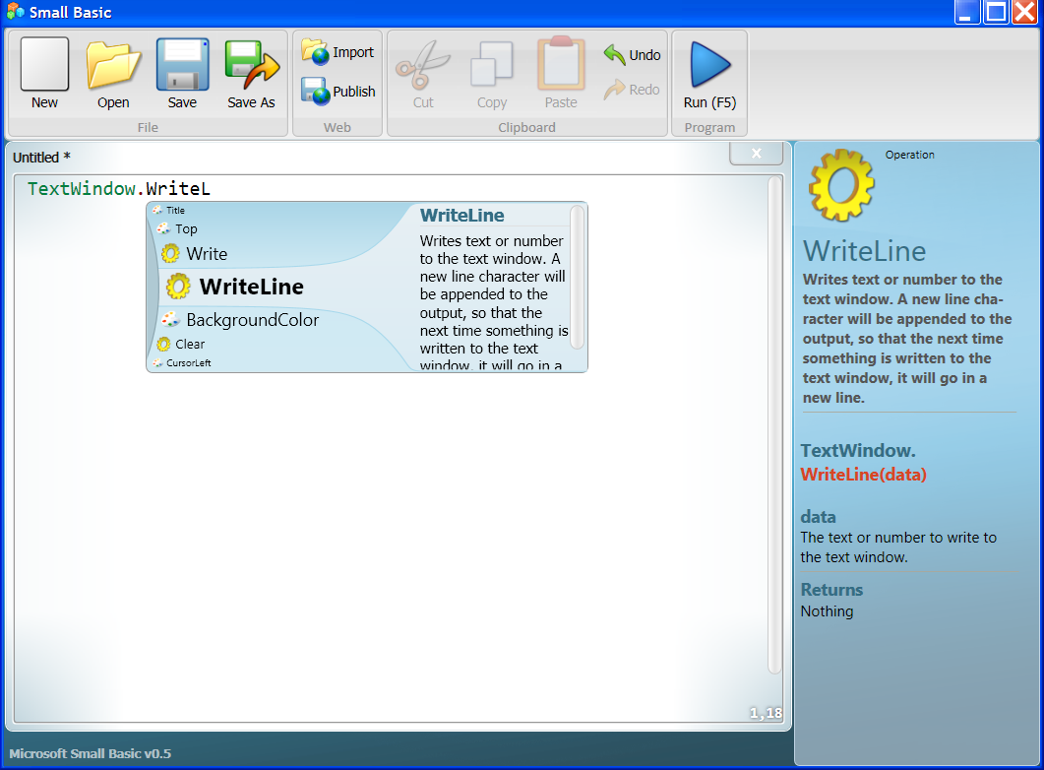
Entering Code
As one enters code, instant context sensitive help appears below the cursor listing commands available. Details are in the right panel.
Command type
Instant Help
Command
Description

Slide 9
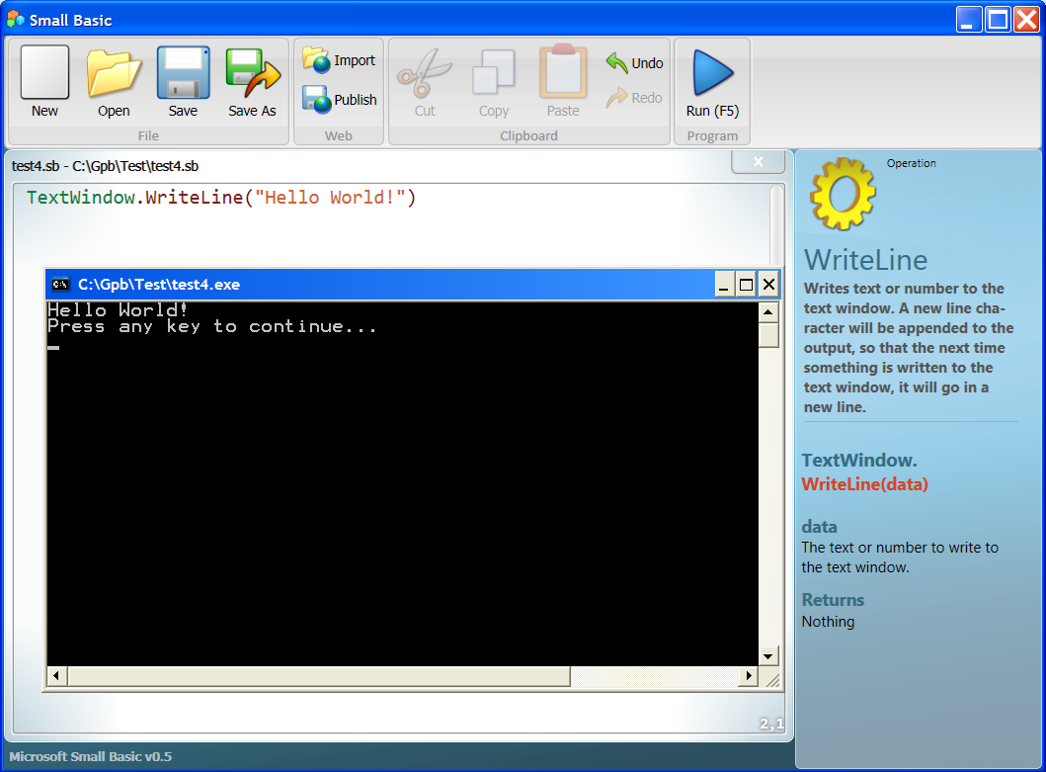
TextWindow
The TextWindow, sometimes called Console, is where the output of the program goes
TextWindow

Slide 10





Command Types
Object – an entity that the program performs actions on like the TextWindow or a File
Operation – actions performed on associated objects like WriteLine for outputting to the TextWindow
Property – characteristics of an object like foreground or background color for the TextWindow
Variable – a storage location in RAM defined by the program
Keyword – reserved identifier for performing special actions like If or For

Slide 11
Syntax
Small Basic statements normally start with an object, a keyword, or a variable
An object normally is followed by an operation or property
The dot . separator character between an object and an operation or property associates the object with the following operation or property
For example:
Object
Operation
TextWindow.WriteLine
Property
TextWindow.ForegroundColor

Slide 12
Syntax
Operations are followed by parenthesis ( ) inside which is the input value for the operation, we call this the argument of the operation
Properties of an object are set by using the assignment operator, an equal sign =, followed by the value the programmer wants to set for that property
For example:
Argument
TextWindow.WriteLine("Hello World!")
Property Value
TextWindow.ForegroundColor = "Yellow"

Slide 13
Execution
As with all programming languages, by default the statements in a Small Basic program are executed in sequence from top to bottom
This order may be changed through special control structures which we will discuss later

Slide 14
Color Coded Code
The components in the code entered into the editor window are color coded
This helps one to identify the type
For example:
  Green for object
  Dark brown for operation or property
  Black for variable
  Light brown for data (literals)
  Light blue for keyword

Slide 15
Summary
Microsoft Small Basic is a simple to use language designed to introduce students to programming
It has a friendly, graphical integrated development environment that lets one enter program code, edit it, save it, compile it, and run it

Slide 16
End

