Slide 1
Web Development & Design Foundations with XHTML
Chapter 6 Key Concepts

Slide 2
Learning Outcomes
In this chapter, you will learn how to:
Describe the most common types of Web site organization
Create clear, easy Web site navigation
Design user-friendly Web pages
Improve the readability of the text on your Web pages
Use graphics appropriately
Create accessible Web pages
Describe design principles
Describe Web page design techniques
Apply best practices of Web design

Slide 3
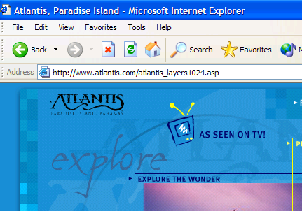
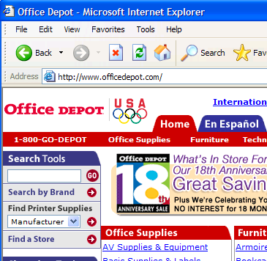
Overall Design Is Related to the Site Purpose
Consider the target audience
of these sites.

Slide 4
Examples from the Textbook
NASA
Bureau of Labor Statistics

Slide 5
Web Site Organization
Hierarchical
Linear
Random (sometimes called Web Organization)

Slide 6
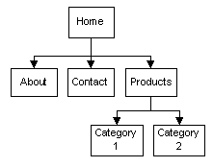
Hierarchical Organization
A clearly defined home page
Navigation links to major site sections
Often used for commercial and corporate Web sites

Slide 7
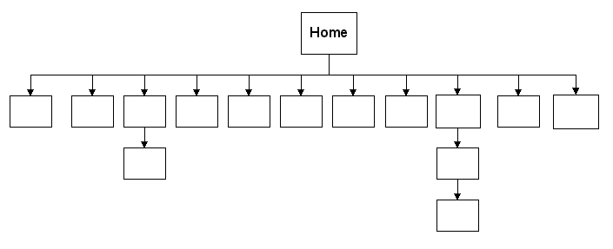
Hierarchical Too Shallow
Be careful that the organization is not too shallow.
Too many choices → a confusing and less usable web site
Information Chunking
“seven plus or minus two” principle
George A. Miller found that humans can store only five to nine chunks of information at a time in short-term memory
Many web designers try not to place more than nine major navigation links on a page or in a well-defined page area.

Slide 8
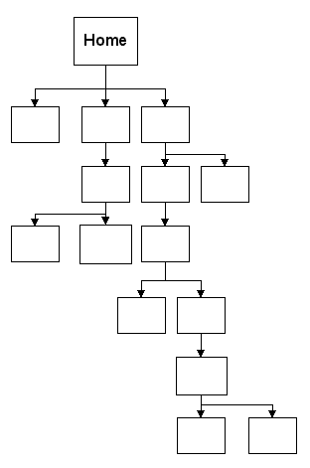
Hierarchical Too Deep
Be careful that the organization is not too deep.
This results in many “clicks” needed to drill down to the needed page.
User Interface “Three Click Rule”
A web page visitor should be able to get from any page on your site to any other page on your site with a maximum of three hyperlinks.

Slide 9
Linear Organization
A series of pages that provide a tutorial, tour, or presentation.
Sequential viewing

Slide 10
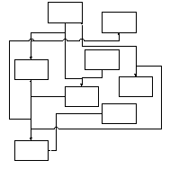
Random Organization
Sometimes called “Web” Organization
Usually there is no clear path through the site
May be used with artistic or concept sites
Not typically used for commercial sites.

Slide 11
Web Site Navigation Best Practices(1)
Make your site easy to navigate
Provide clearly labeled navigation in the same location on each page
Most common – across top or down left side
Provide “breadcrumb” navigation
Types of Navigation
Graphics-based
Text-based
Interactive Navigation Technologies
Image Roll-overs
Java Applet
Flash
DHTML fly-out or dropdown menus

Slide 12
Web Site Navigation Best Practices(2)
Accessibility Tip
Provide plain text links in the page footer when the main navigation is non-text media such as images, Flash, Java Applet or DHTML.

Slide 13
Web Site Navigation Best Practices(3)
Use a Table of Contents (with links to other parts of the page) for long pages.
Consider breaking long pages in to multiple shorter pages using Linear Organization.
Large sites may benefit from a site map or site search feature

Slide 14
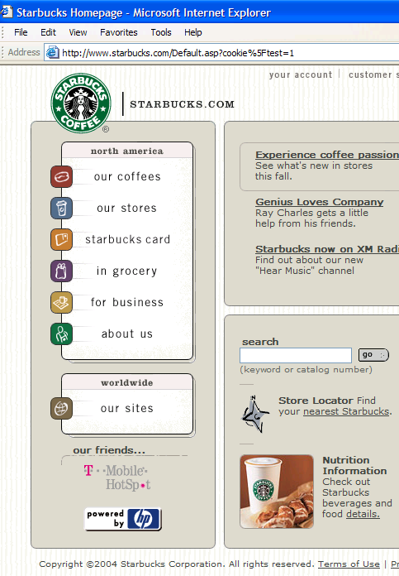
Design Principles
Repetition
Repeat visual elements throughout design
Contrast
Add visual excitement and draw attention
Proximity
Group related items
Alignment
Align elements to create visual unity

Slide 15
Web Page Design Best Practices
Page layout design
Text design
Graphic design
Accessibility considerations

Slide 16
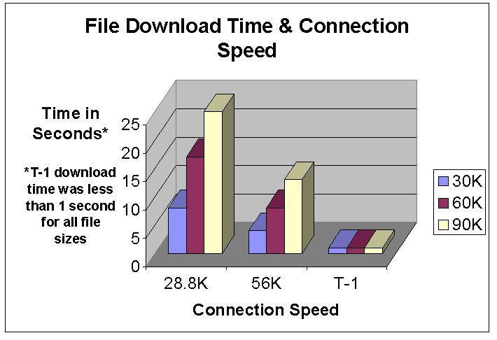
Web Page Design Load Time
Watch the load time of your pages
Try to limit web page document and associated media to under 60K on the home page

Slide 17
Web Page Design Target Audience
Design for your target audience
Appropriate reading level of text
Appropriate use of color
Appropriate use of animation

Slide 18
Web Page Design Colors & Animation
Use colors and animation that appeal to your target audience
Kids
Bright, colorful, tons of animation
Generation X,Y,Z,etc.
Dark, often low contrast, more subtle animation
Everyone:
Good contrast between background and text
Easy to read
Avoid animation if it makes the page load too slowly
Accessibility Tip: Many individuals are unable to distinguish between certain colors.
See http://www.vischeck.com/showme.shtml

Slide 19
Web Page Design Browser Compatibility
Web pages do NOT look the same in all the major browsers
Test with current and recent versions of:
Internet Explorer 8
Firefox 3.5, Mozilla
Opera
Mac versions (Safari)
Google Chrome
Design to look best in one browser and degrade gracefully (look OK) in others

Slide 20
Web Page Design Screen Resolution
Test at various screen resolutions
Most widely used: 1024x768, 1280x1024, and 800x600
Design to look good at various screen resolutions
Centered page content
Set to either a fixed or percentage width

Slide 21
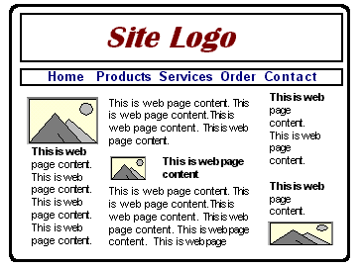
Wireframe
A sketch of blueprint of a Web page
Shows the structure of the basic page elements, including:
Logo
Navigation
Content
Footer

Slide 22
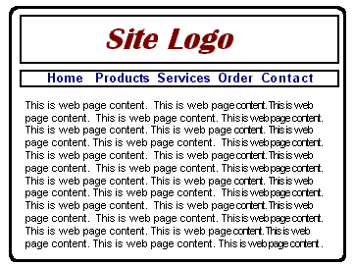
Web Page Design Page Layout(1)
Place the most important information "above the fold"
Use adequate "white" or blank space
Use an interesting page layout
This is usable, but a little boring. See the next slide for improvements in page layout.

Slide 23
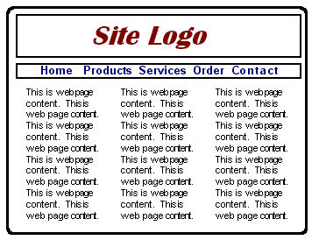
Web Page Design Page Layout(2)
Better
Columns make the page more interesting and it’s easier to read this way.
Best
Columns of different widths interspersed with graphics and headings create the most interesting, easy to read page.

Slide 24
Page Layout Design Techniques
Ice Design
AKA rigid or fixed design
Fixed-width, usually at left margin www.students.gov
Jello Design
Page content typically centered
Often configured with a fixed or percentage width such as 80% Department of Energy
Liquid Design
Page expands to fill the browser at all resolutions. State of Illinois

Slide 25
Checkpoint 5.1
1. List the four basic principles of design. View the home page for Lane and describe how each principle is applied.
2. View http://www.walmart.com, http://www.mugglenet.com, and http://www.sesameworkshop.org/sesamestreet. Describe the target audience for each site. How do their designs differ? Do the sites meet the needs of their target audiences?

Slide 26
Checkpoint 5.1
3. View your favorite web site (or a URL provided by your instructor).
Maximize and resize the browser window.
Decide whether the site uses ice, jello, or liquid design.
List two recommendations for improving the design of the site.

Slide 27
Text Design Best Practices
Avoid long blocks of text
Use bullet points
Use short paragraphs

Slide 28
Text Design “Easy to Read” Text (1)
Use common fonts:
Arial, Helvetica, Verdana, Times New Roman
Use appropriate text size:
medium, 1em, 16px, 12 pt, 100
Use strong contrast between text & background
Use columns instead of wide areas of horizontal text

Slide 29
Text Design “Easy to Read” Text (2)
Bold text as needed
Avoid “click here”
Hyperlink key words or phrases, not entire sentences
Separate text with “white space” or empty space.
Chek yur spellin (Check your spelling)

Slide 30
Graphic Design Best Practices(1)
Be careful with large graphics!
Remember 60k recommendation
Use the alt attribute to supply descriptive alternate text
Be sure your message gets across even if images are not displayed.
If using images for navigation provide plain text links at the bottom of the page.
Use animation only if it makes the page more effective and provide a text description.

Slide 31



Graphic Design Recommended Practices(2)
Choose colors on the web palette if consistency across older Windows/Mac platforms is needed
Use anti-aliased text in images
Use only necessary images
Reuse images
Goal: image file size should be as small as possible

Slide 32
Designing for Accessibility(1) Quick Checklist Courtesy of W3C
Images & animations
Use the alt attribute to describe the function of each visual.
Image maps
Use the client-side map and text for hotspots.
Multimedia
Provide captioning and transcripts of audio, and descriptions of video.

Slide 33
Designing for Accessibility(2) Quick Checklist Courtesy of W3C
Hypertext links
Use text that makes sense when read out of context. For example, avoid "click here."
Page organization
Use headings, lists, and consistent structure.
Use CSS for layout and style where possible.
Graphs & charts
Summarize or use the longdesc attribute.

Slide 34
Designing for Accessibility(4) Quick Checklist Courtesy of W3C
Check your work.
Validate. http://validator.w3.org
Test for Accessibility
Use tools, checklist, and guidelines at http://www.w3.org/TR/WCAG

Slide 35
Web Design Best Practices Checklist
Table 5.1 in your Textbook http://terrymorris.net/bestpractices
Page Layout
Browser Compatibility
Navigation
Color and Graphics
Multimedia
Content Presentation
Functionality
Accessibility

Slide 36
Checkpoint 5.2
1. View the home page of your school. Use the Best Practices Checklist (Table 5.1) to evaluate the page. Describe the results.
2. List three best practices of writing text for the Web. See your text for the rest of this question.
3. List three best practices of using graphics on web pages. View the home page of your school. Describe the use of graphic design best practices on this page.

