Slide 1
Tutorial 2 Developing a Basic Web Site

Slide 2
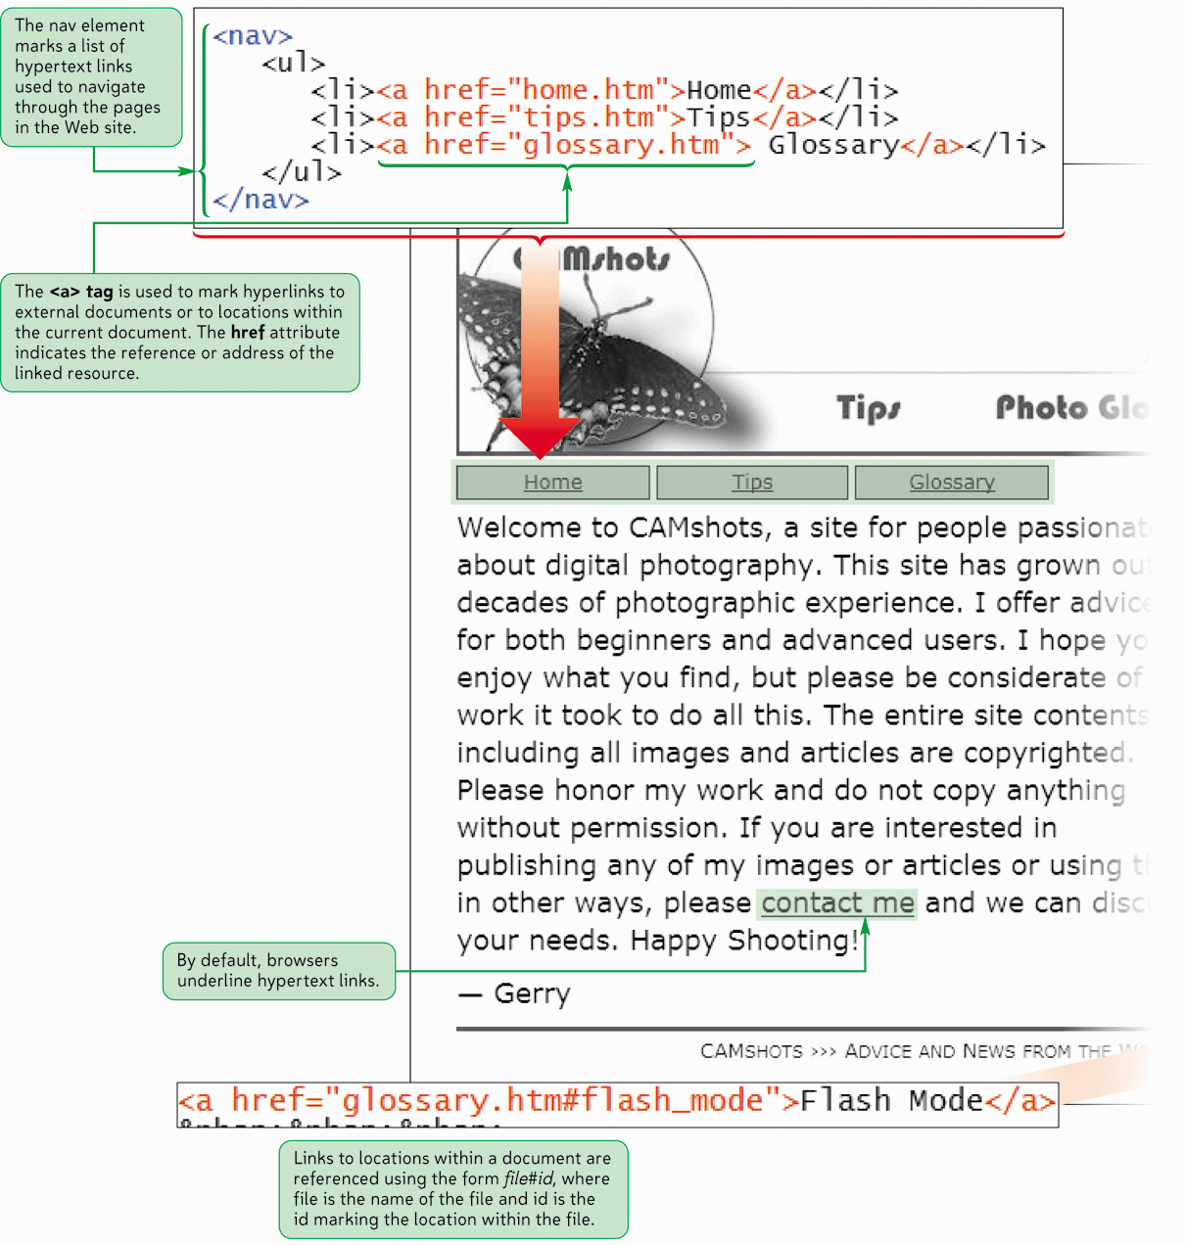
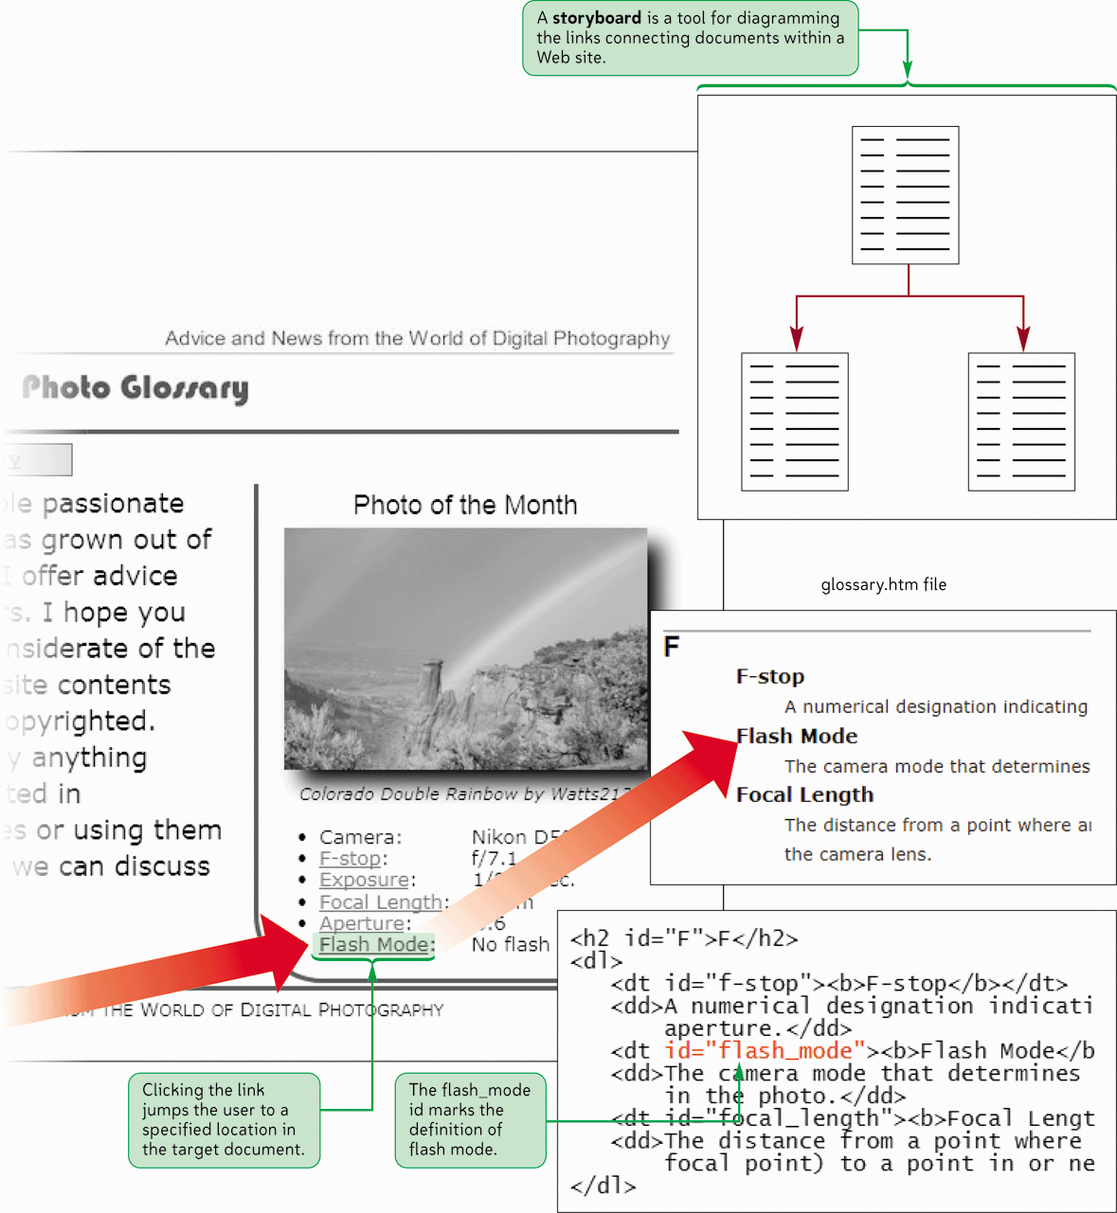
Creating Hyperlinks

Slide 3
Objectives
Explore how to storyboard a Web site
Create navigation lists
Create links between documents in a Web site
Understand absolute and relative folder paths
Set a base path
Mark a location with the id attribute
Create a link to an id

Slide 4
Objectives
Mark an image as a link
Create an image map
Understand URLs
Link to a resource on the Web
Link to an e-mail address
Work with hypertext attributes
Work with metadata

Slide 5
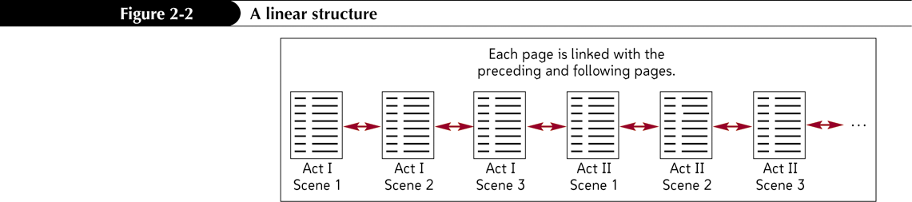
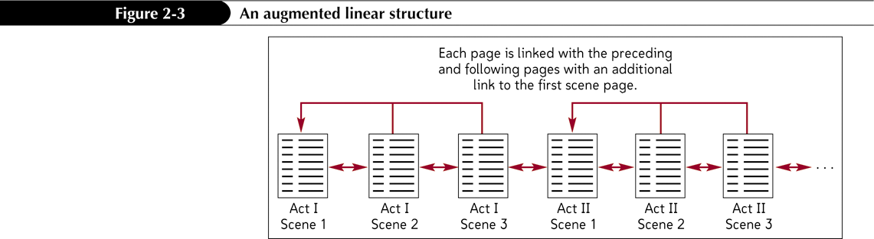
Linear Structures
A linear structure
An augmented linear structure

Slide 6
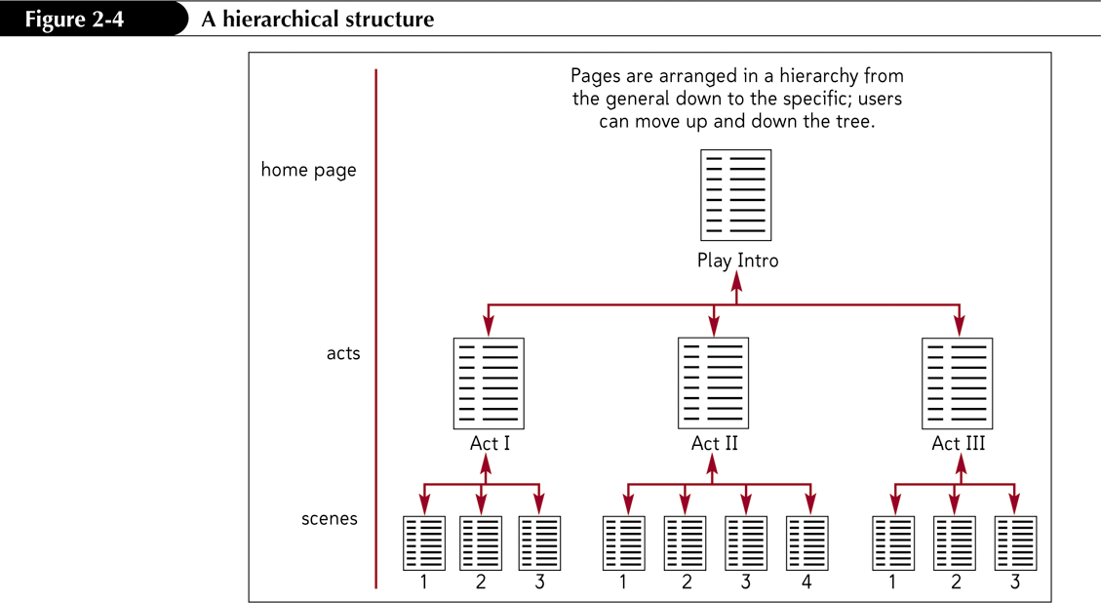
Hierarchical Structures

Slide 7
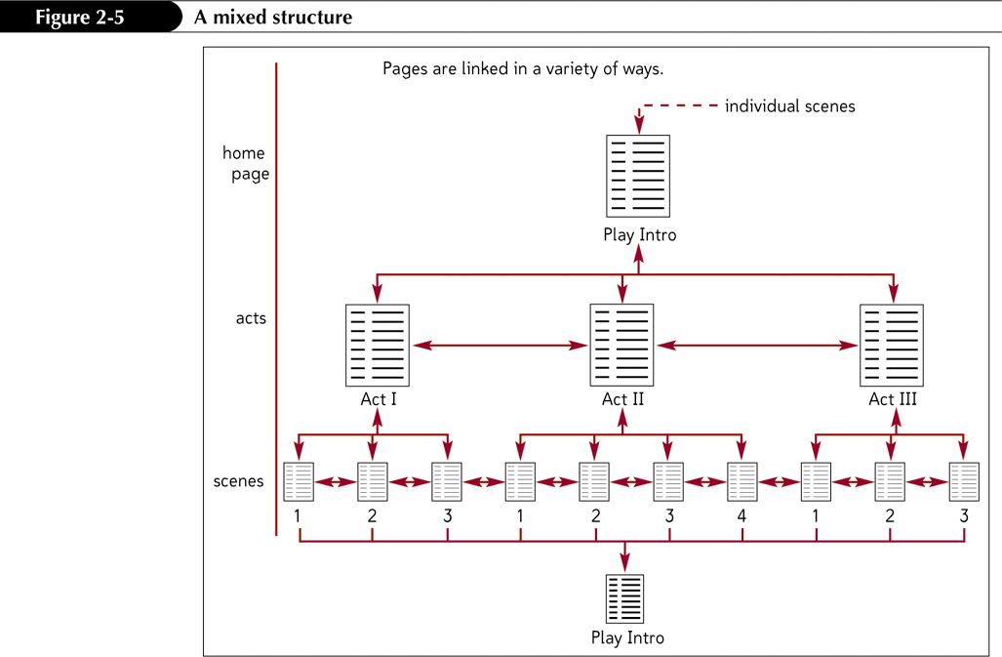
Mixed Structures

Slide 8
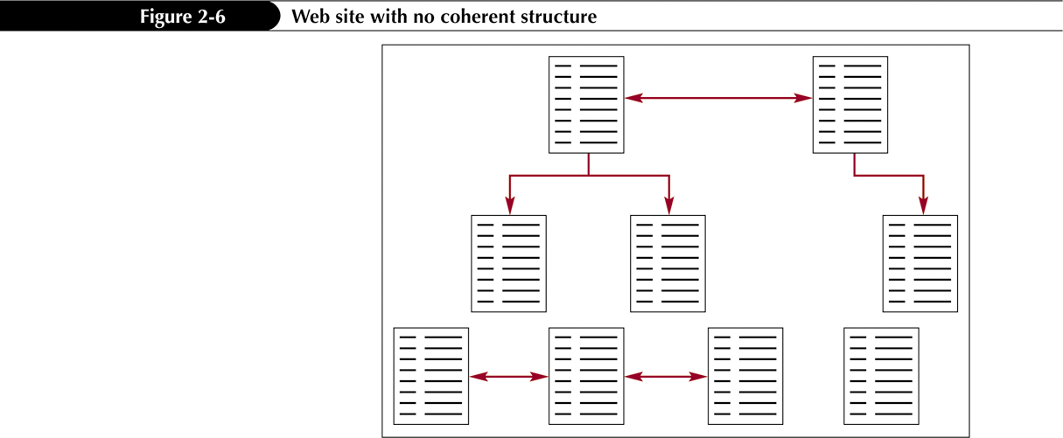
Web Site with No Coherent Structure

Slide 9
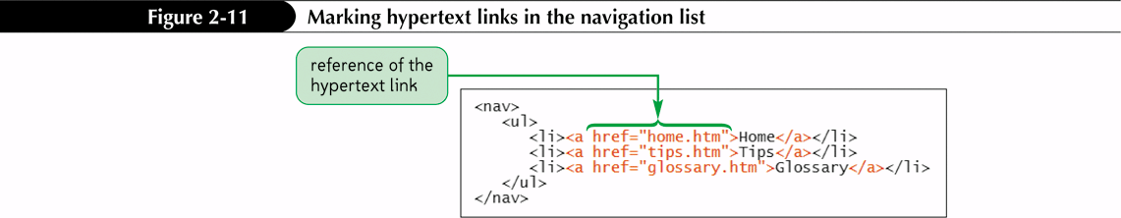
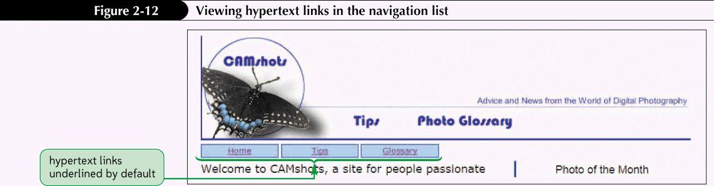
Creating a Nav List with Hyperlinks
Notes:
Figures 2-11 – 2-12

Slide 10
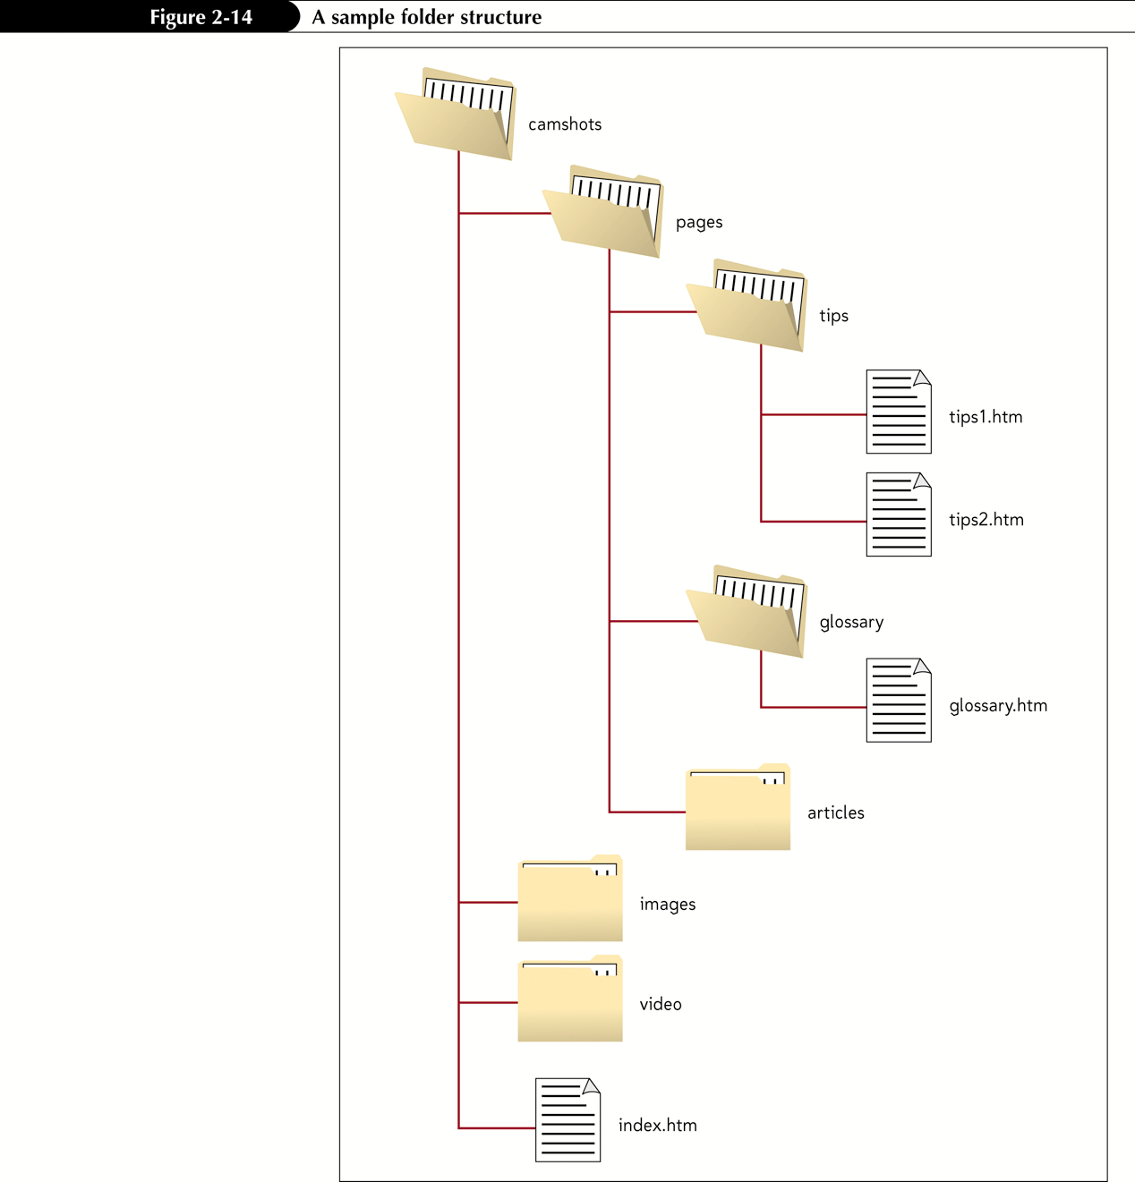
Specifying a Folder Path

Slide 11
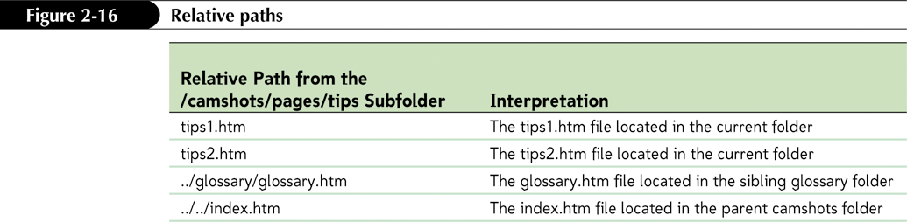
Specifying a Folder Path

Slide 12
Marking Locations with the id Attribute
To jump to a specific location within a document, you first need to mark that location
One way to identify elements in an HTML document is to use the id attribute
Id names must be unique
Id names are not case sensitive

Slide 13
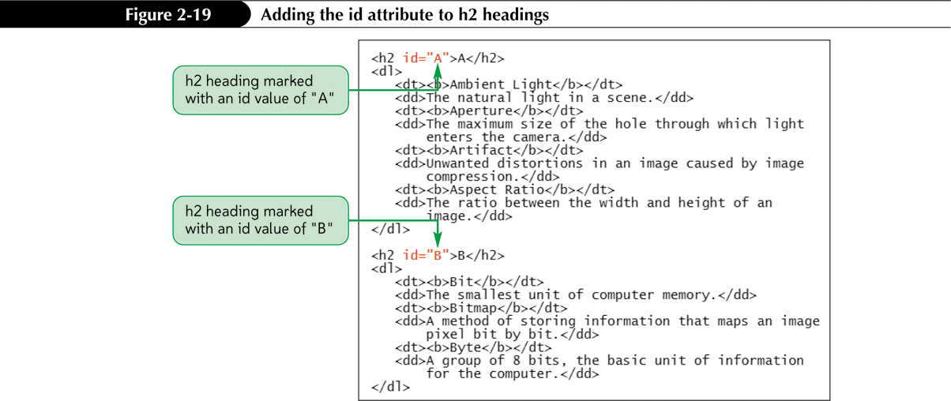
Linking to Locations within Documents

Slide 14
Linking to an id
Once you’ve marked an element using the id attribute, you can create a hypertext link to that element using the a element
<a href=”#id”>content</a>

Slide 15
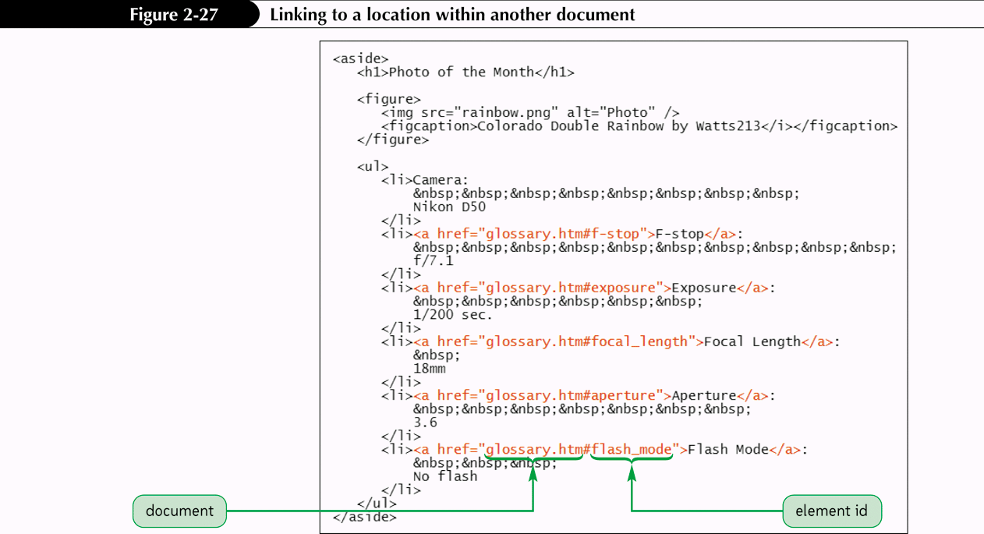
Creating Links between Documents

Slide 16
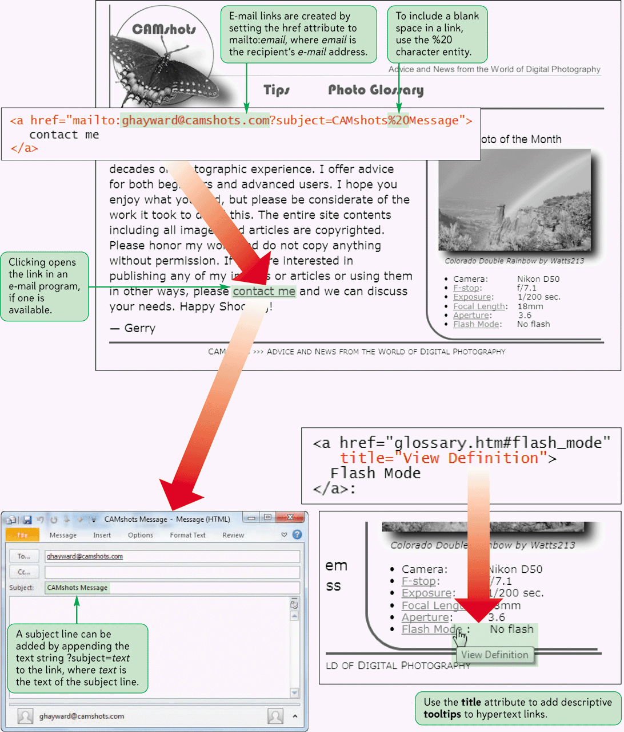
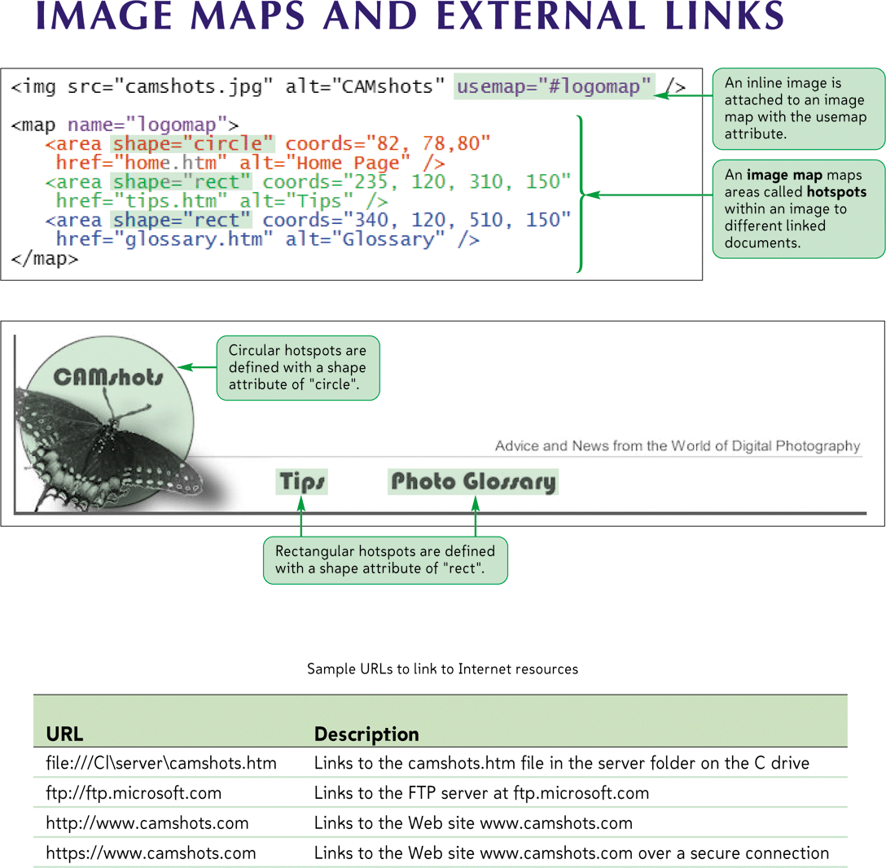
Image Maps and External Links

Slide 17
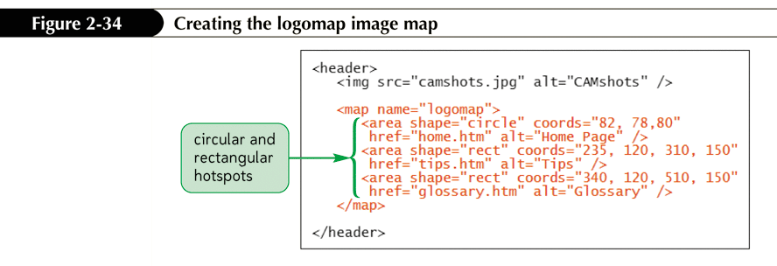
Applying an Image Map

Slide 18
Creating a Circular Hotspot
A circular hotspot is defined by the location of its center and its radius
A sample code for a circular hotspot is:
<area shape=“circle” coords=“307,137,66” href=“karts.htm”>
Coordinates are (307, 137), and it has a radius of 66 pixels
The hotspot is a hypertext link to karts.htm

Slide 19
Creating a Rectangular Hotspot
Two points define a rectangular hotspot:
the upper-left corner
the lower-right corner
A sample code for a rectangular hotspot is:
<area shape=“rect” coords=“384,61,499,271” href=“water.htm”>
Coordinates are entered as a series of four numbers separated by commas
HTML expects that the first two numbers represent the coordinates for the upper-left corner of the rectangle, and the second two numbers indicate the location of the lower-right corner
The hotspot is a hypertext link to water.htm

Slide 20
Creating a Polygonal Hotspot
To create a polygonal hotspot, you enter the coordinates for each vertex in the shape
A sample code for a polygonal hotspot is:
<area shape=“polygon” coords=“13,60,13,270,370,270,370,225,230,225, 230,60” href=“rides.htm”>
Coordinates are for each vertex in the shape
The hotspot is a hypertext link to rides.htm

Slide 21
Creating a Default Hotspot
<area shape="default" coords="0, 0, x, y" … />
where x is the width of the inline image in pixels and y is the image’s height
Any spot that is not covered by another hotspot will activate the default hotspot link

Slide 22
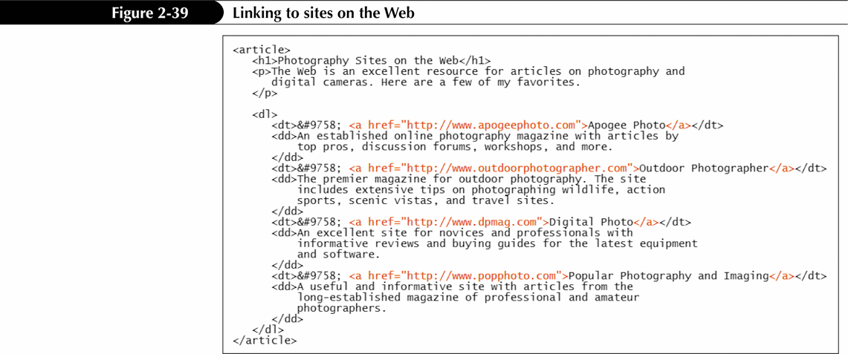
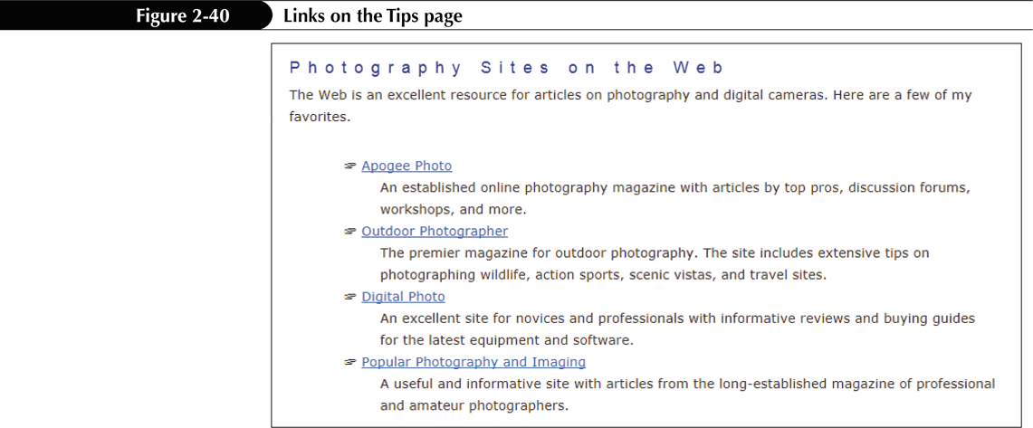
Linking to a Web Site

Slide 23
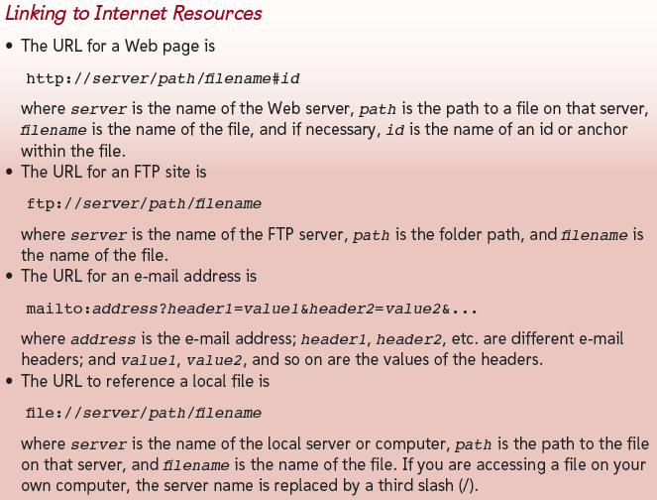
Linking to an E-Mail Address

Slide 24
Working with Metadata
Web authors often turn to search engine optimization (SEO) tools to make their sites appear more prominently in search engines.
Information about the site is called metadata
Add metadata to your Web pages by adding a meta element to the head section of the document
<meta name="text" content="text" scheme="text" http-equiv="text" />

Slide 25
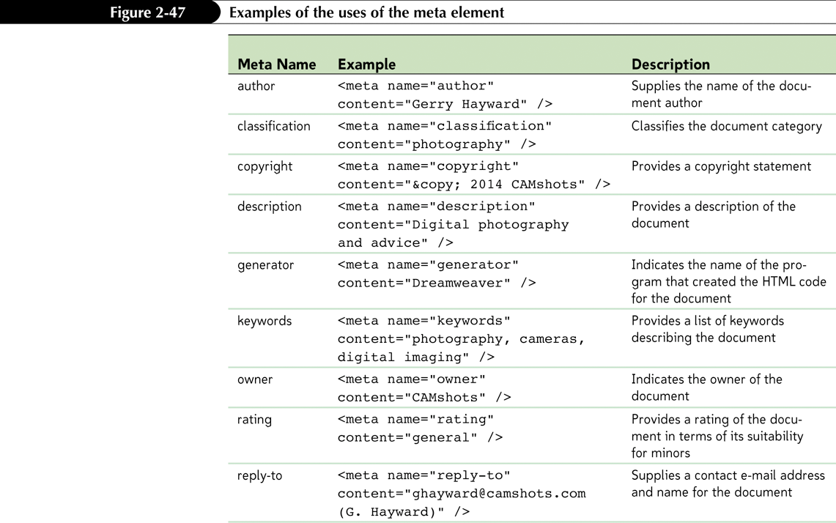
Working with Metadata

Slide 26
Working with Metadata
You can add information and commands to this communication stream with the meta element’s http-equiv attribute of the meta element
Force the Web browser to refresh the Web page at timed intervals
<meta http-equiv="refresh" content="60" />
Redirect the browser from the current document to a new document
<meta http-equiv="refresh" content="5;url=www.camshots.com" />

