Slide 1
Tutorial 4 Creating Page Layouts with CSS

Slide 2
Objectives
Set display properties
Create a reset style sheet
Define a background image
Set background image properties
Use browser extension styles
Explore fixed, fluid, and elastic layouts
Float elements in a Web page

Slide 3
Objectives
Set margin and padding spaces
Format an element border
Create rounded corners
Display an element outline
Explore absolute and relative positioning
Work with overflow content
Explore clipped objects
Stack objects in a page

Slide 4
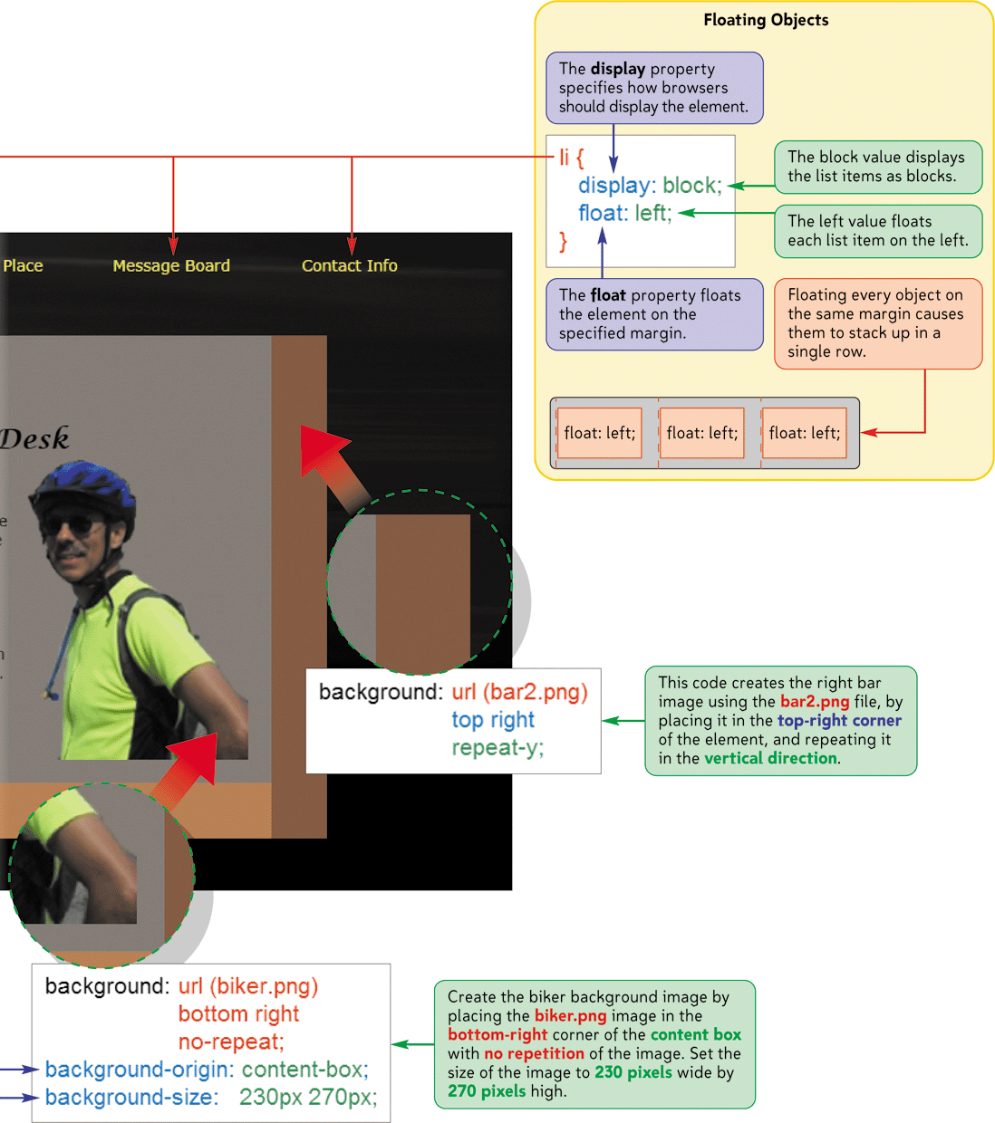
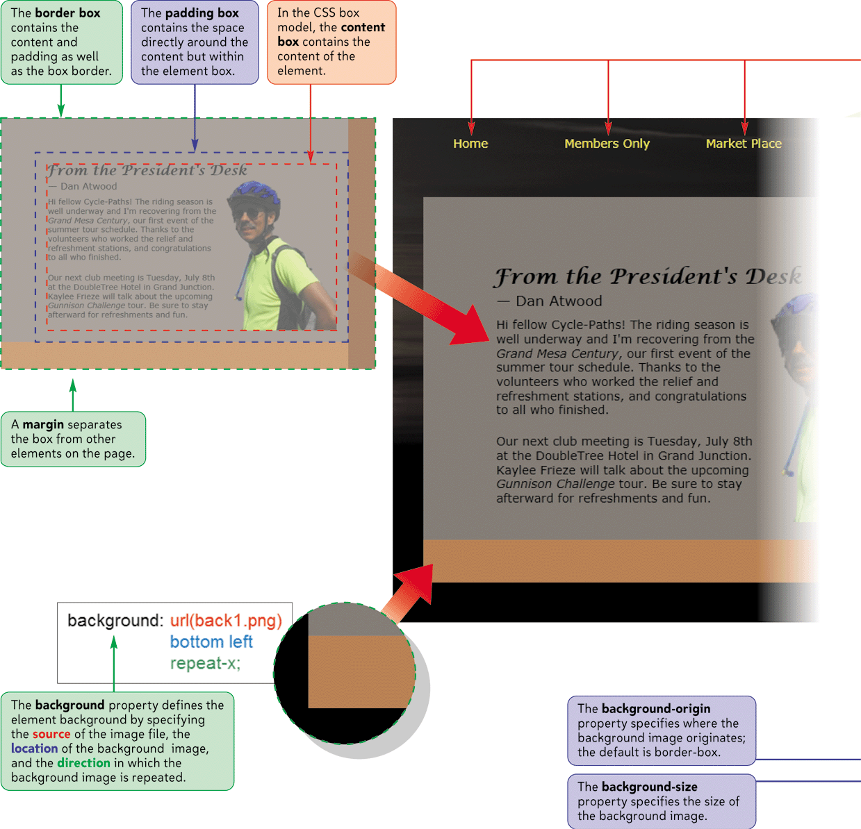
Backgrounds and Floating Objects

Slide 5
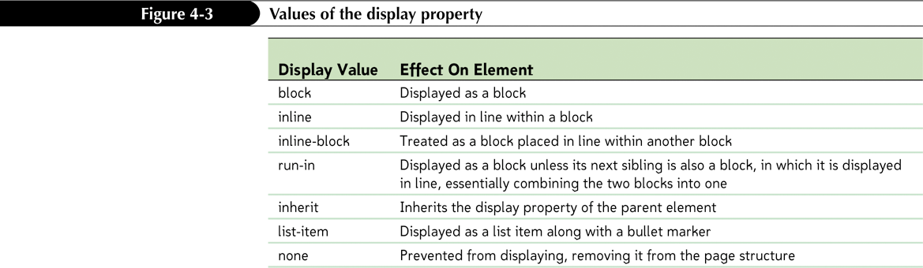
The display style
Most page elements are displayed in one of two ways
Blocks occupy a defined rectangular area within a page
Inline elements flow within a block

Slide 6
The Box Model
Elements also are laid out in a Web page following the structure of the box model
the content of the element itself
the padding extending between the element’s content and the border
the border of the box surrounding the padding space
the margin containing the space between the border and the next page element

Slide 7
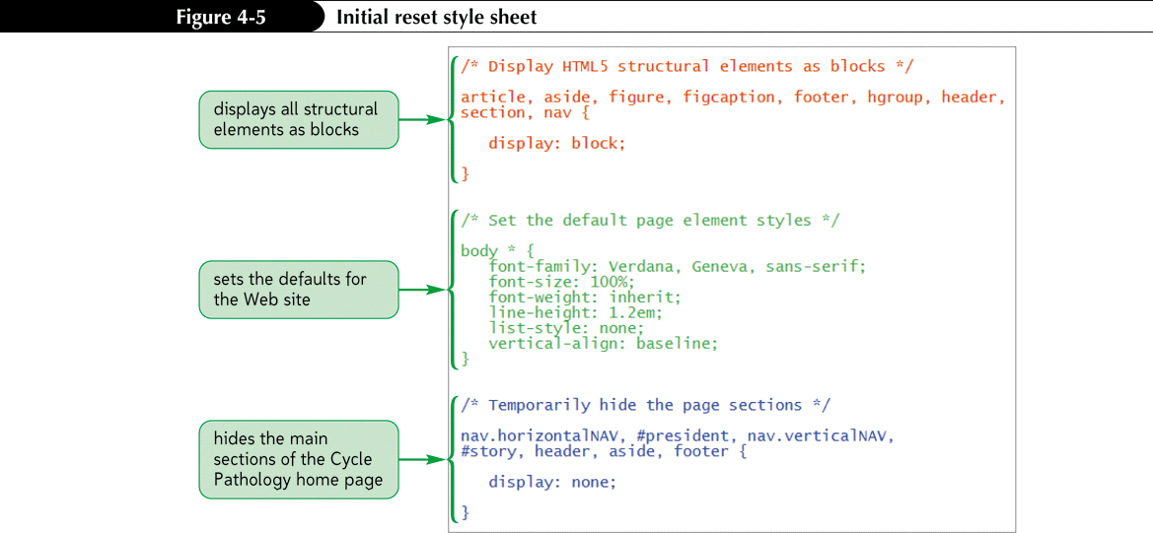
Creating a Reset Style Sheet
Many designers create a reset style sheet to define their own default styles

Slide 8
Designing the Background
CSS also supports background images using
background-image: url(url);
Background Image Options:
background-repeat
background-position
background-attachment
background-size
background-clip

Slide 9
Designing the Background
You can combine the various background properties into the shorthand property
background: color url(url) attachment position repeat;
CSS allows you to specify multiple images and their properties in a comma-separated list
background-property: value1, value2, … ;

Slide 10

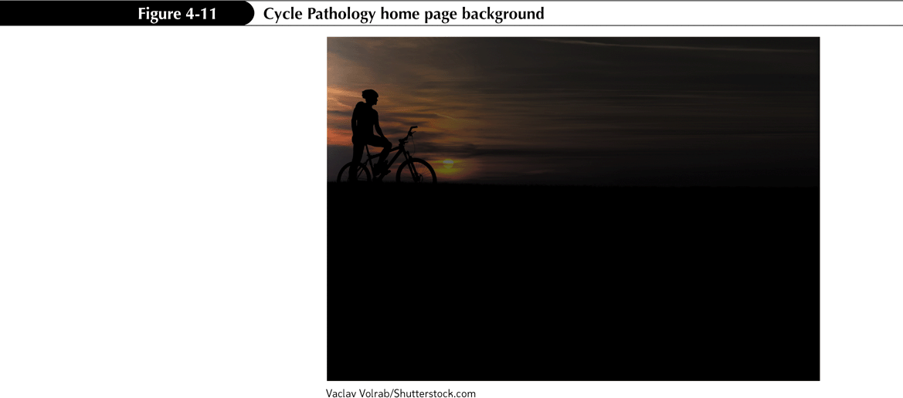
Adding a Page Background

Slide 11
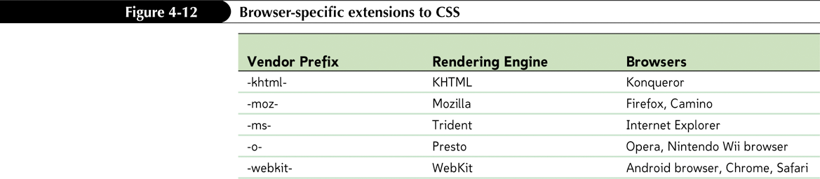
Exploring Browser Extensions
Browser extensions that are not part of the official CSS specifications can be identified through the use of a vendor prefix that indicates the browser vendor that created and supports the property

Slide 12
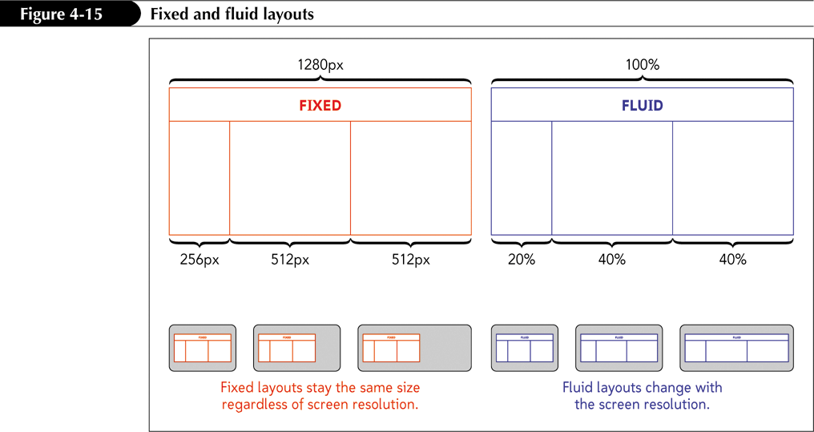
Fixed and Fluid Layouts

Slide 13
Elastic Layouts
Some designers propose the use of elastic layouts, in which all measurements are expressed relative to the default font size using the em unit
If a user or the designer increases the font size, the width, height, and location of all of the other page elements, including images, change to match

Slide 14
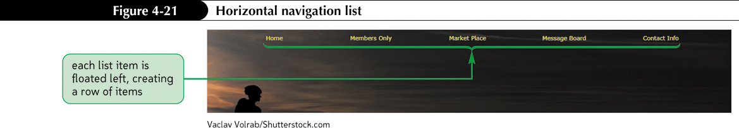
Floating Elements
Floating an element takes that element out of the normal flow of the document and positions it along the left or right edge of its containing element
float: position;

Slide 15
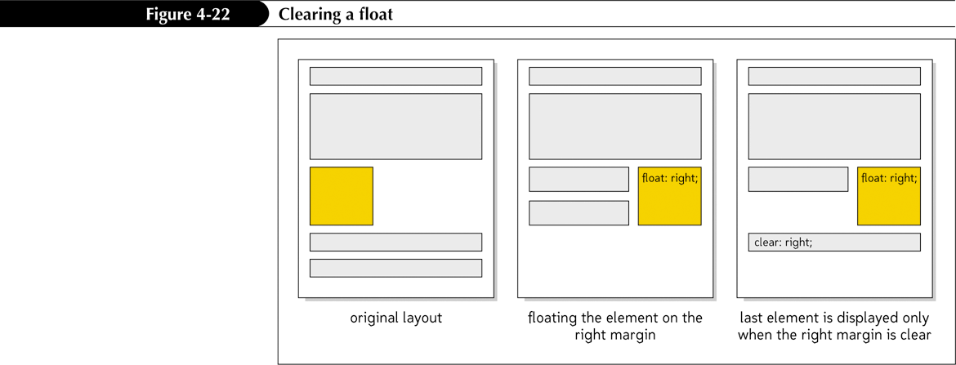
Floating Elements
Clearing a float
clear: position;

Slide 16
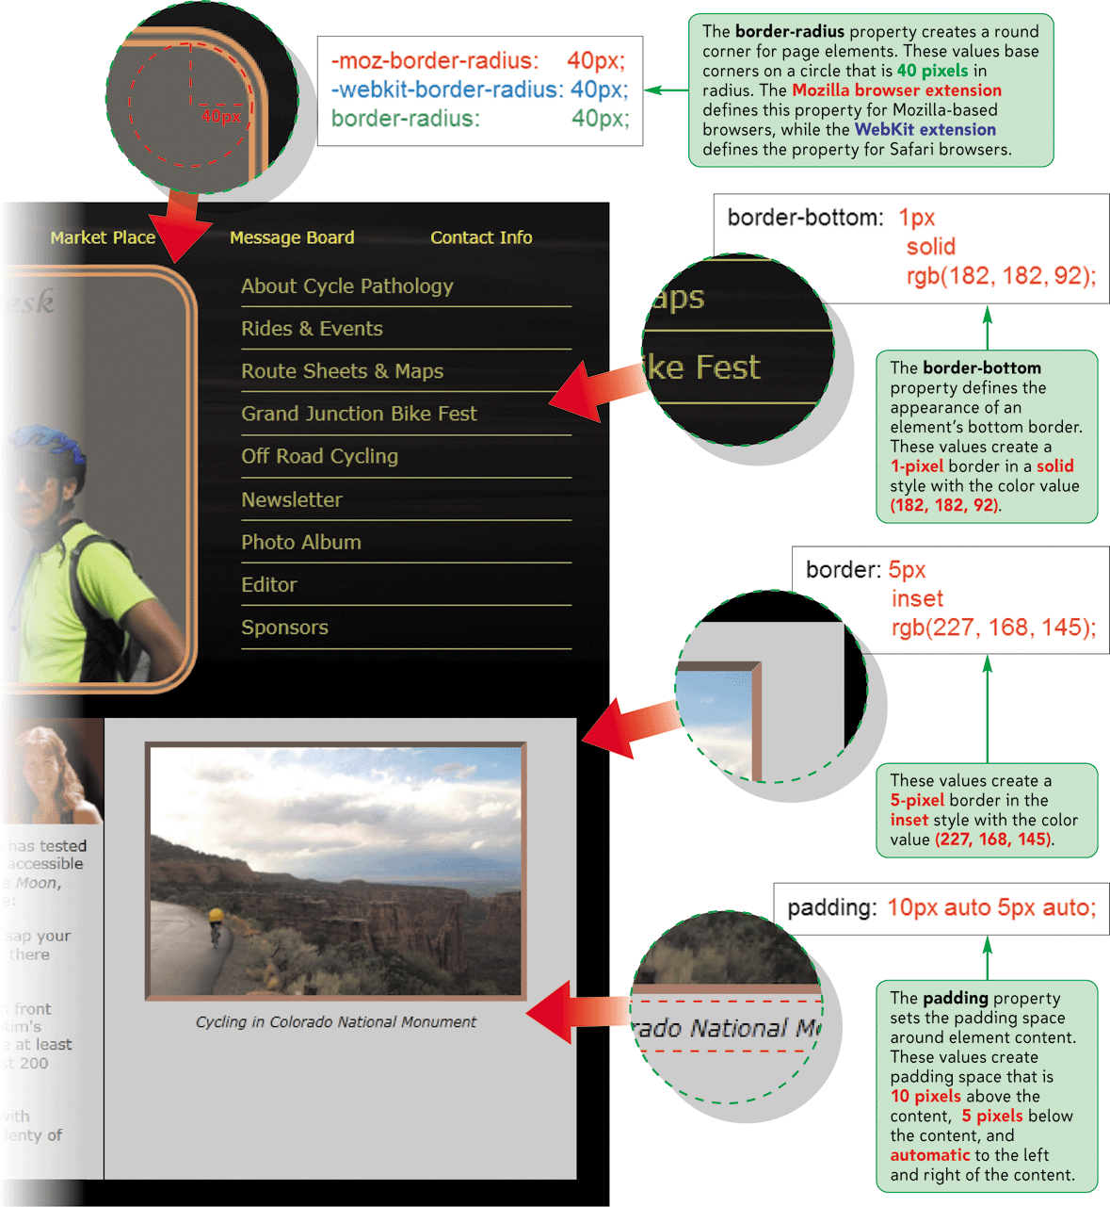
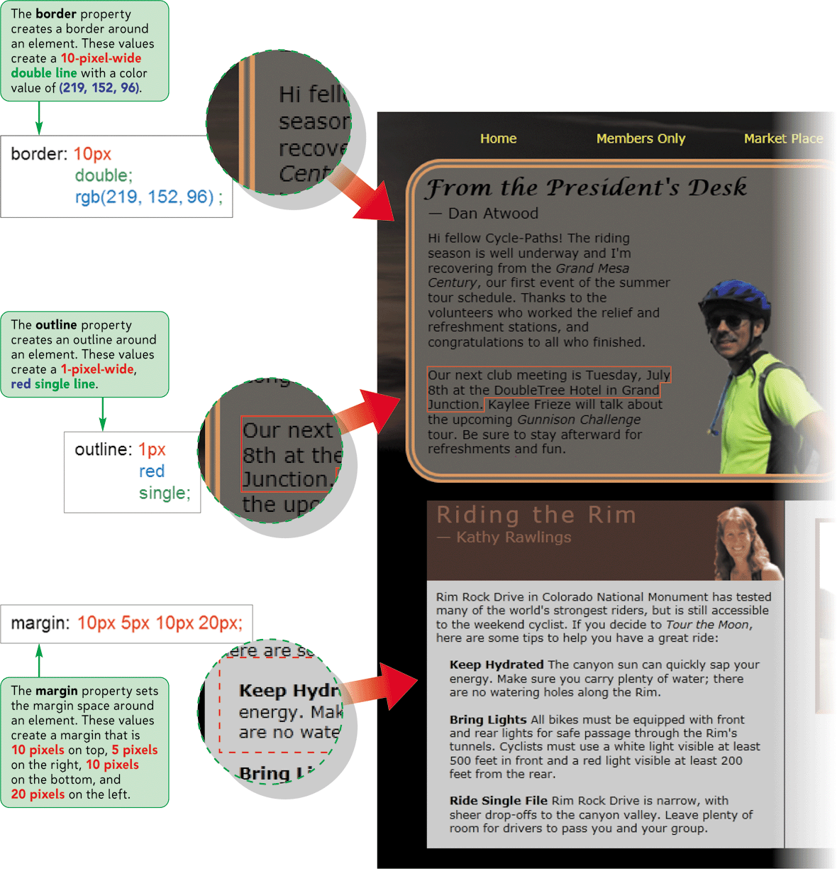
Margins, Padding, and Borders

Slide 17
Setting Margin and Padding Space in the Box Model
To set the margin space around an element, use
margin: length;
where length is the size of the margin using one of the CSS units of measure
To set the padding space within an element, use the following:
padding: length;
To set a margin or padding for one side of the box model only, specify the direction (top, right, bottom, or left). For example, use
margin-right: length;
to set the length of the right margin.

Slide 18
Setting Margin and Padding Space in the Box Model
To set multiple margin or padding spaces, specify the values in a space-separated list starting from the top and moving clockwise around the element. For example, the style
margin: top right bottom left;
sets margins for the top, right, bottom, and left sides of the element, respectively
To set matching top and bottom values and matching right and left values for margins and padding, enter only two values. For example, the style
margin: vertical horizontal;
sets margins for the top and bottom sides of the element to the value specified by vertical, and sets margins for the right and left sides of the element to the value specified by horizontal

Slide 19
Working with Borders
To set the border width, use the property
border-width: width;
where width is the thickness of the border using one of the CSS units of measure.
To set the border color, use
border-color: color;
where color is a color name or value.

Slide 20
Working with Borders
To set the border design, use
border-style: style;
where style is none, solid, dashed, dotted, double, outset, inset, groove, or ridge
To set all of the border options in one style, use the following:
border: width color style;

Slide 21
Creating Rounded Corners
Rounded corners can be applied to any of the four corners of a block element using the styles
border-top-left-radius: radius;
border-top-right-radius: radius;
border-bottom-right-radius: radius;
border-bottom-left-radius: radius;
border-radius: top-left top-right bottom-right bottom-left;

Slide 22
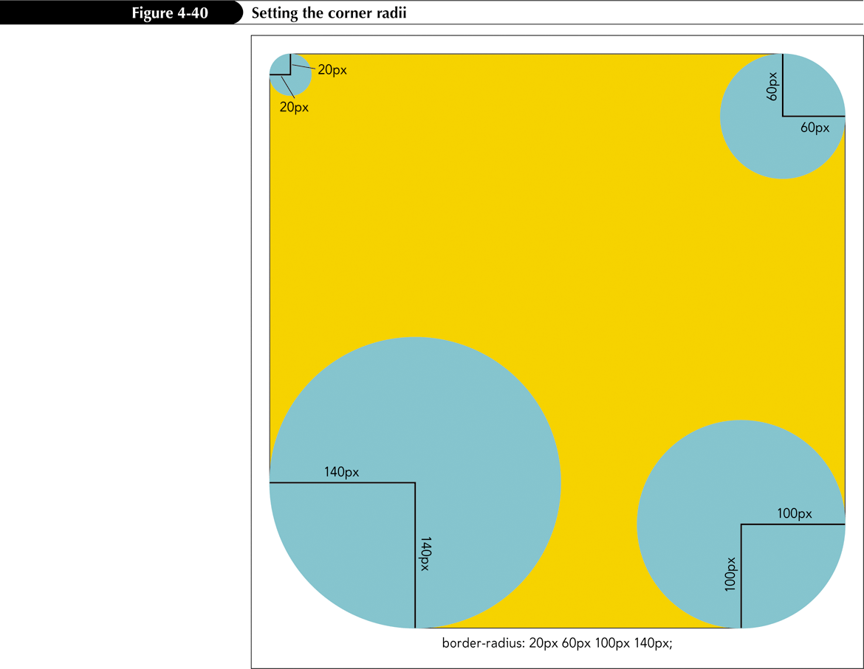
Creating Rounded Corners

Slide 23
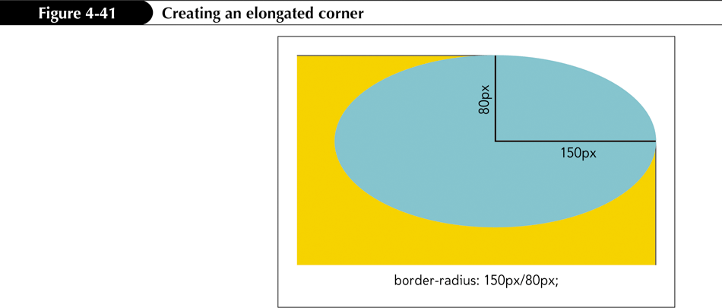
Creating Rounded Corners

Slide 24
Managing Your Layout
To add an outline around an element, use the style property
outline: width color style;
where width, color, and style are the outline width, outline color, and outline style, respectively

Slide 25
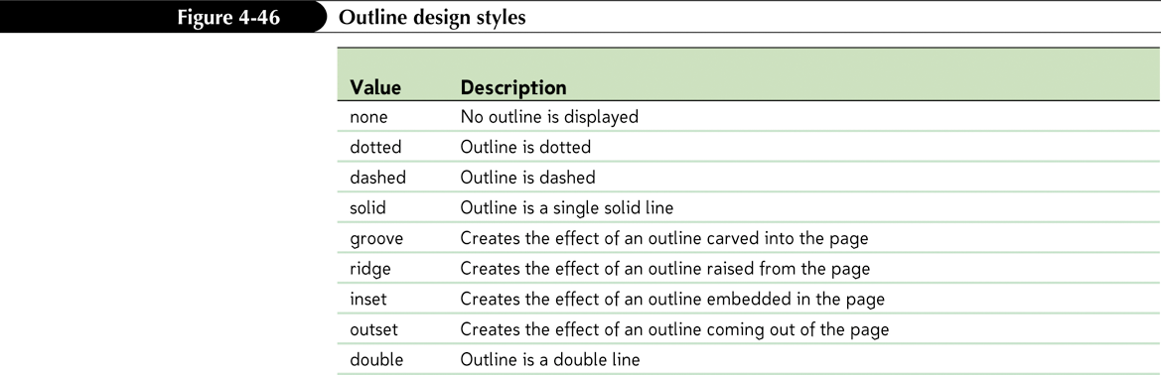
Managing Your Layout

Slide 26
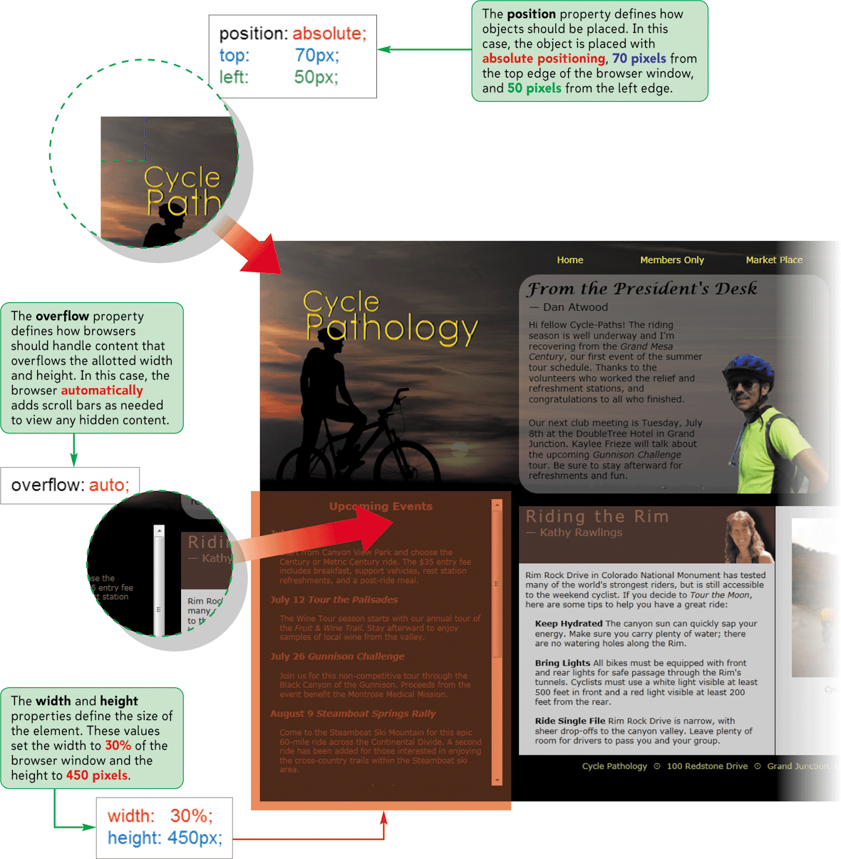
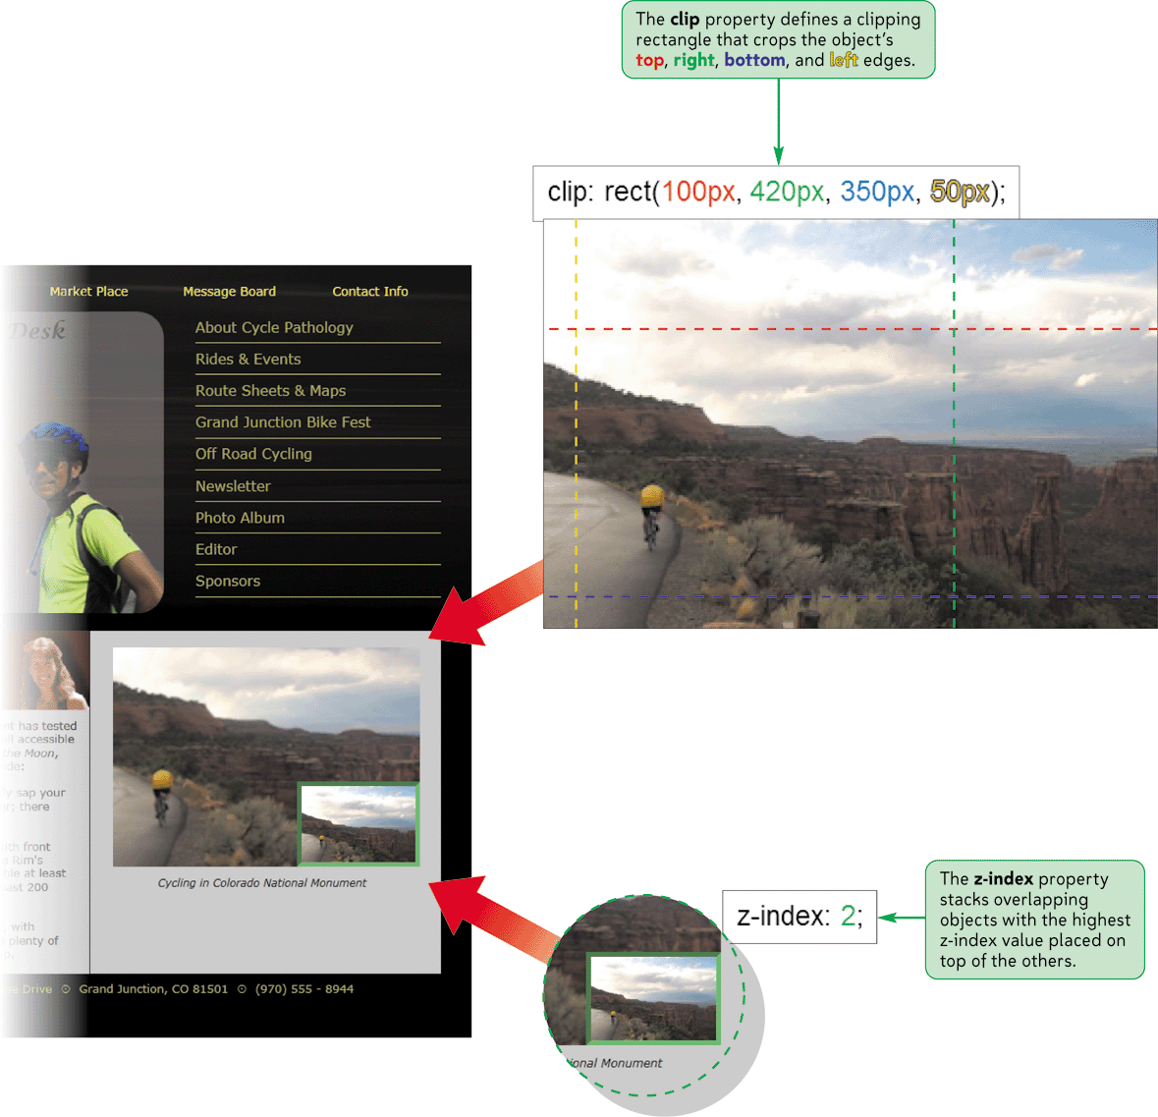
Positioning Elements

Slide 27
Positioning Objects
To position an object at a specific coordinate, use the style properties
position: type;
top: value;
right: value;
bottom: value;
left: value;
where type indicates the type of positioning applied to the object (absolute, relative, static, fixed, or inherit), and the top, right, bottom, and left properties indicate the coordinates of the object

Slide 28
Positioning Objects
Absolute positioning places an element at specific coordinates either in the page or within a container element
Relative positioning is used to move an element relative to where the browser would have placed it if no positioning had been applied

Slide 29
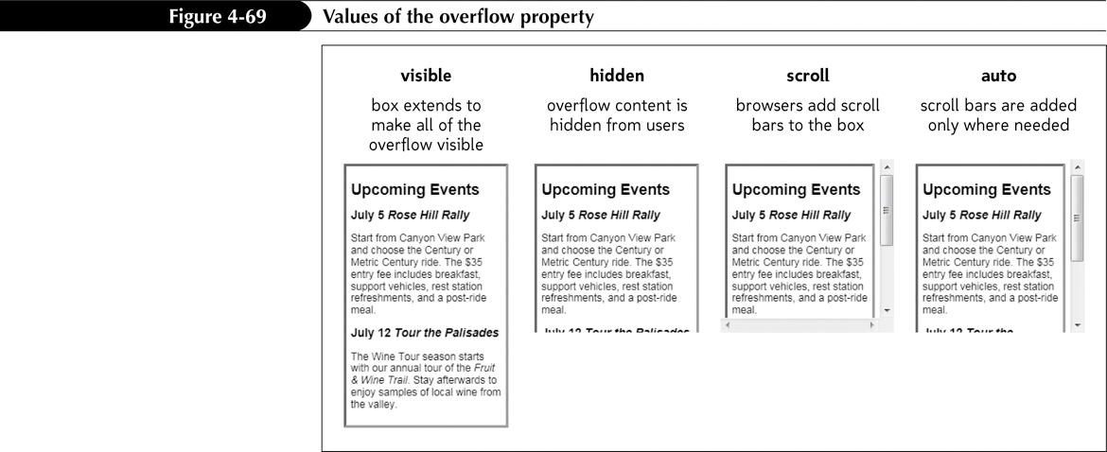
Working with Overflow and Clipping
When you force an element into a specified height and width, you can define how browsers should handle content that overflows allotted space using the style
overflow: type;

Slide 30
Working with Overflow and Clipping
To specify how browsers should handle content that overflows an element’s boundary, use the style
overflow: type;
where type is visible (to expand the element height to match the content), hidden (to hide the excess content), scroll (to always display horizontal and vertical scroll bars), or auto (to display scroll bars if needed)
To specify how browsers should handle content that overflows in the horizontal direction, use the following style:
overflow-x: type;

Slide 31
Working with Overflow and Clipping
To specify how browsers should handle content that overflows in the vertical direction, use the following style:
overflow-y: type;
To clip an element’s content, use the style
clip: rect(top, right, bottom, left);
where top, right, bottom, and left define the boundaries of the clipping rectangle

Slide 32
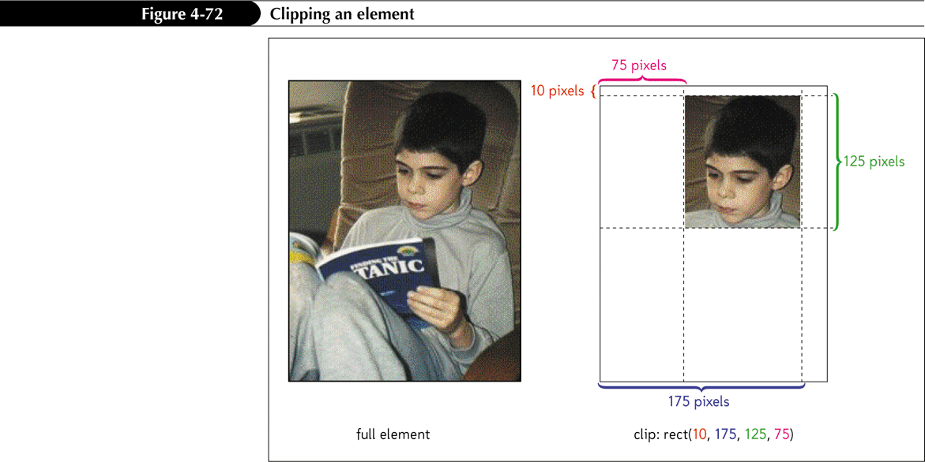
Clipping an Element

Slide 33
Stacking Elements
Positioning elements can sometimes lead to objects that overlap each other
By default, elements that are loaded later by the browser are displayed on top of elements that are loaded earlier
To specify a different stacking order, use the style property
z-index: value;

Slide 34
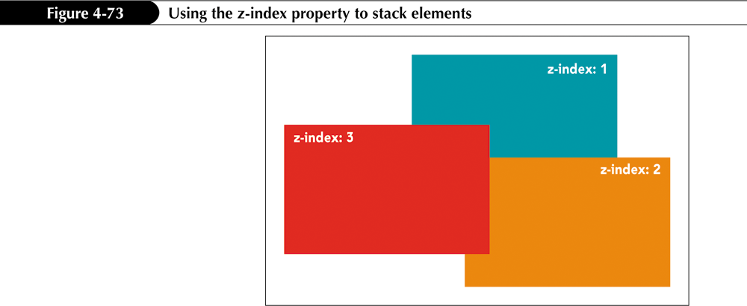
Stacking Elements

