Slide 1
Web Development & Design Foundations with XHTML
Chapter 10
Key Concepts

Slide 2
Web Development & Design
Topics:
  Skills, functions, and job roles needed for a web development project
  Standard System Development Life Cycle
  Web hosting alternatives

Slide 3
SKILLS AND FUNCTIONS NEEDED ON A WEB PROJECT
Web Development & Design

Slide 4
Skills and Functions Needed for a Successful Large-Scale Project
Project Manager
Information Architect
Marketing Representative
Copy Writer & Editor
Content Manager
Graphic Designer
Database Administrator
Network Administrator
Web Developer

Slide 5
Skills and Functions Needed for a Successful Small Project
The skills and functions are essentially the same as on a large project
Each person may wear many “hats” and juggle their job roles
  Example: The web developer may also be the graphic designer.
Some job roles may be outsourced
  Most Common:
  An external web site provider is used so there is less (if any) need for a Network Administrator.

Slide 6
Project Staffing
Criteria
Finding the right people to work on a project is crucial
  Consider:
    work experience
    Portfolio
    formal education
    industry certifications
Alternative: Outsource all or portions of the project to a web design/development firm

Slide 7
WEB SITE DEVELOPMENT PROCESS
Web Site Design & Development

Slide 8
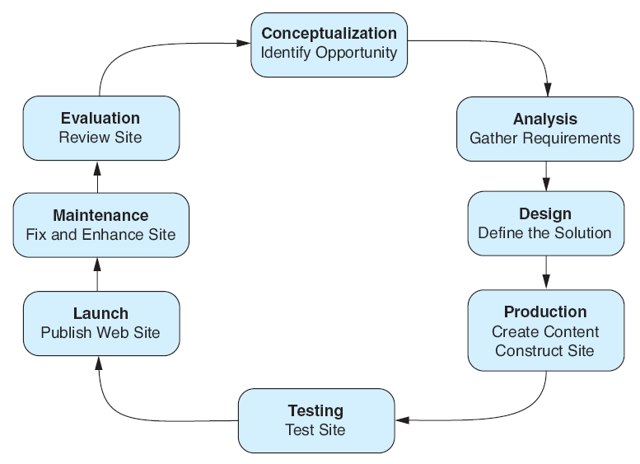
The Development
Process
Life cycle

Slide 9
Web Development:
Conceptualization
Determine the intended audience
Determine the goals or mission of the web site
  Short-term goals
  Long-term goals
  Develop measurable objectives such as:
    Number of visitors
    Percent of product sales
Main Job Roles Involved:
  Client, Project Manager, Information Architect, Marketing Representative, Senior Web Developer

Slide 10
Web Development:
Analysis
Determine the following:
  information topics
  functionality requirements (high-level)
    Determine “what” a site will do – not “how” it will do it
  environmental requirements
  Content requirements
If a redesign, compare the old approach with the new approach
Review competitor’s sites
Estimate costs
  Cost/Benefit analysis

Slide 11
Web Development:
Analysis
Main Job Roles Involved:
  Client,
  Project Manager
  Information Architect or other Analyst
  Marketing Representative
  Senior Web Developer
  Network Administrator
  Database Administrator
  Content Manager

Slide 12
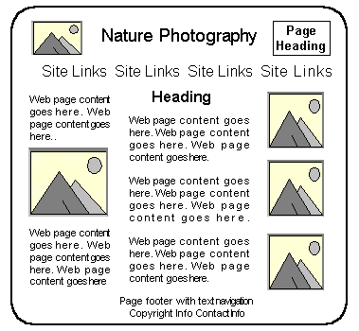
Web Development:
Design
Determine the site organization
Prototype the design
Determine a page layout design
Document each page
Main Job Roles Involved:
  Information Architect
  or other Analyst,
  Graphic Designer,
  Senior Web Developer,
  Content Manager,
  Client, Project Manager,
  Marketing Representative
Main Navigation Area

Slide 13
Web Development:
Production
Choose a web authoring tool
Organize your site files
Develop and individually test components
Add content
Main Job Roles Involved:
  Project Manager, Senior Web Developer, Web Developer, Graphic Designer, Database Administrator, Content Manager

Slide 14
Web Development:
Testing
Test on different web browsers and browser versions
Test with different screen resolutions
Test using different bandwidths
Test from another location
Test, Test, Test
Main Job Roles Involved:
  Project Manager, Web Developer, Tester (sometimes web developer, sometimes Quality Assurance person), Client, Content Manager

Slide 15
Web Development:
Types of Testing
Automated Testing Tools and Validation
  Software packages exist that will test a web site in an automated manner
  W3C offers XHTML and CSS validation tests
Usability Testing
  Testing how actual web page visitors use a web site
  Can be done at almost any stage of development
    Early –- use paper and sketches of pages
    Design – use prototype
    Production & Testing – use actual pages

Slide 16
Web Development:
Test Plan
Compatibility
  Different browsers
  Different screen resolutions
  Different OSes
Validation
  CSS
  XHTML
  Functionality
Accessibility
Usability

Slide 17
Web Development:
Approval & Launch
User or Client Testing
  Client will test site before giving official approval for site launch
Approval & Launch
  Obtain sign-off form or email from client
  Upload files to web server
  Create backup copies of files
  MAKE SURE YOU TEST THE WEB SITE AGAIN!

Slide 18
Web Development:
Maintenance
Maintenance – the never-ending task…
  Enhancements to site
  Fixes to site
  New areas added to site
A new opportunity or issue is identified and another loop through the development process begins.

Slide 19
Web Development:
Evaluation
Re-visit the goals, objectives, and mission of the web site
Determine how closely they are being met
Develop a plan to better meet the goals, objectives and mission

Slide 20
WEB HOSTING
Web Design and Development

Slide 21
Checkpoint 10.1
Describe the role of the project manager.
Explain why so many different roles are needed on a large-scale web project.
List three different techniques used to test a web site. Describe each technique in one or two sentences.

Slide 22
Web
Hosting
Some organizations administer a web server in house and host their own web site.
Many companies use a web host provider.
  A good web hosting service will provide a robust, reliable home for your web site.
  A poor web hosting service will be the source of problems and complaints.
  Do not use free web hosting for a commercial web site.

Slide 23
Types of
Web Hosting(1)
Hosting Needs:
Small to Medium Web Site
  Virtual Hosting
    The web host provider's server is divided into a number of virtual domains and multiple web sites are set up on the same computer.
  Consider:
    Future growth and scalability of web host
    Operating System
    Types of server-side processing supported
    Bandwidth of Internet connection
    Both local and national web host providers
    Guaranteed uptime – service level agreement (SLA)
    Technical support

Slide 24
Types of
Web Hosting(2)
Hosting Needs:
Large to Enterprise Web Site
  Dedicated Web Server
  Co-located Web Server
  Consider:
    National web host providers
    Guaranteed uptime – service level agreement (SLA)
    Bandwidth of Internet connection
    Technical Support

Slide 25
Dedicated
Web Server
Dedicated Web Server
  The exclusive use of a rented computer and connection to the Internet that is housed in the Web hosting company's premises.
  The server can usually be configured and operated remotely from the client company or you can pay the web host provider to administer it for you.

Slide 26
Co-Located
Web Server
Co-Located Web Server
  A computer that your organization has purchased and configured.
  Your organization effectively rents space at the web host provider's location.
  Your server is kept and connected to the Internet at their location.
  Your organization administers this computer.

Slide 27
Choosing a Virtual Host
See the Web Host Checklist (Table 10.1)
Operating System
Web Server Software
Bandwidth
Technical Support
Service Agreement
Disk Space
E-mail
Uploading Files
Canned Scripts
Scripting Support
Database Support
E-Commerce Packages
Scalability
Backups
Site Statistics
Domain Name
Price

Slide 28
Checkpoint 10.2
Describe the type of web host that would meet the needs of a small company for their initial web presence.
Describe the difference between a dedicated web server and a co-located web server.
Explain why price is not the most important consideration when choosing a web host.

