Slide 1
Web Development & Design Foundations with XHTML
Chapter 4 Key Concepts

Slide 2
Learning Outcomes
In this chapter, you will learn to:
Create and format lines and borders on Web pages
Decide when to use graphics and what graphics are appropriate
Apply the image element to add graphics to Web pages
Configure images as backgrounds on Web page elements
Configure images as hyperlinks
Follow recommended Web design guidelines when using graphics on Web pages

Slide 3
Lines and borders
Visual Elements and Graphics

Slide 4

The Horizontal Rule Element
Configures a horizontal line
<hr />

Slide 5

The CSS border Property
Configures a border on the top, right, bottom, and left sides of an element
Consists of
border-width
border-style
border-color
h2 { border: 2px solid #ff0000 }

Slide 6
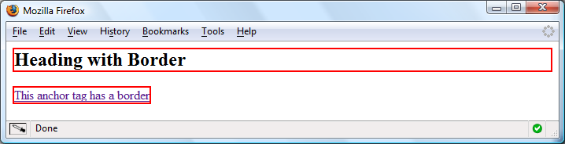
CSS Borders: Block / Inline Elements
Block element
default width of element content extends to browser margin (or specified width)
Inline element
Border closely outlines the element content
h2 { border: 2px solid #ff0000; }
a { border: 2px solid #ff0000; }

Slide 7

Configuring Specific Sides of a Border
Use CSS to configure a line on one or more sides of an element
border-bottom
border-left
border-right
border-top
h2 { border-bottom: 2px solid #ff0000 }

Slide 8

The CSS padding Property
Configures empty space between the content of the XHTML element and the border
Set to 0px by default
h2 { border: 2px solid #ff0000;
padding: 5px; }
No padding configured:

Slide 9
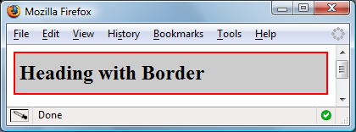
Configuring Padding on Specific Sides of an Element
Use CSS to configure padding on one or more sides of an element
padding-bottom
padding-left
padding-right
padding-top
h2 { border: 2px solid #ff0000;
background-color: #cccccc;
padding-left: 5px;
padding-bottom: 10px;
padding-top: 10px;}

Slide 10
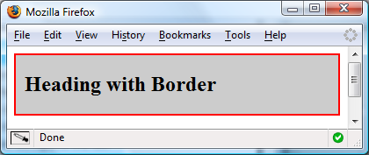
CSS padding Property Shorthand: two values
Two numeric values or percentages
first value configures top and bottom padding
the second value configures left and right padding
h2 { border: 2px solid #ff0000;
background-color: #cccccc;
padding: 20px 10px;
}

Slide 11
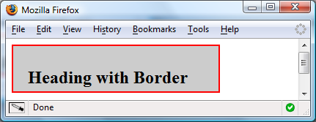
CSS padding Property Shorthand: four values
Four numeric values or percentages
Configure top, right, bottom, and left padding
h2 { border: 2px solid #ff0000;
width: 250px;
background-color: #cccccc;
padding: 30px 10px 5px 20px;
}

Slide 12
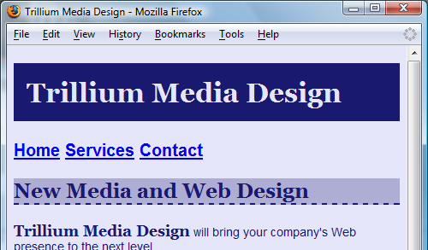
Hands-On Practice
h1 { background-color:#191970;
color:#E6E6FA;
padding: 15px;
font-family: Georgia, "Times New Roman", serif; }
h2 { background-color:#AEAED4;
color:#191970;
font-family: Georgia, "Times New Roman", serif;
border-bottom: 2px dashed #191970; }

Slide 13
Graphics File Formats
Visual Elements and Graphics

Slide 14
Types of Graphics
Graphic types commonly used on Web pages:
GIF
JPG
PNG

Slide 15

GIF
Graphics Interchange Format
Best used for line art and logos
Maximum of 256 colors
One color can be configured as transparent
Can be animated
Uses lossless compression
Can be interlaced

Slide 16
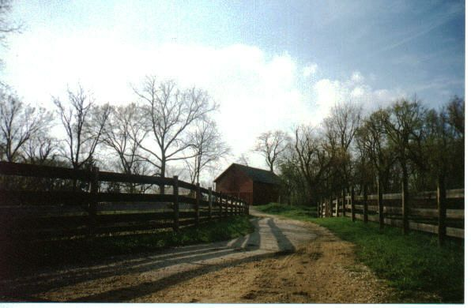
JPEG
Joint Photographic Experts Group
Best used for photographs
Up to 16.7 million colors
Use lossy compression
Cannot be animated
Cannot be made transparent
Progressive JPEG – similar to interlaced display

Slide 17
PNG
Portable Network Graphic
Support millions of colors
Support multiple levels of transparency (but browsers do not -- so limit to one transparent color for Web display)
Support interlacing
Use lossless compression
Combines the best of GIF & JPEG
Browser support is growing

Slide 18
Images with XHTML
Visual Elements and Graphics

Slide 19
XHTML Image Element
Configures graphics on a Web page
src Attribute
File name of the graphic
alt Attribute
Configures alternate text content (description)
height Attribute
Height of the graphic in pixels
width Attribute
Width of the graphic in pixels
<img src=“cake.gif” alt=“birthday cake” height=“100” width=“100” />

Slide 20
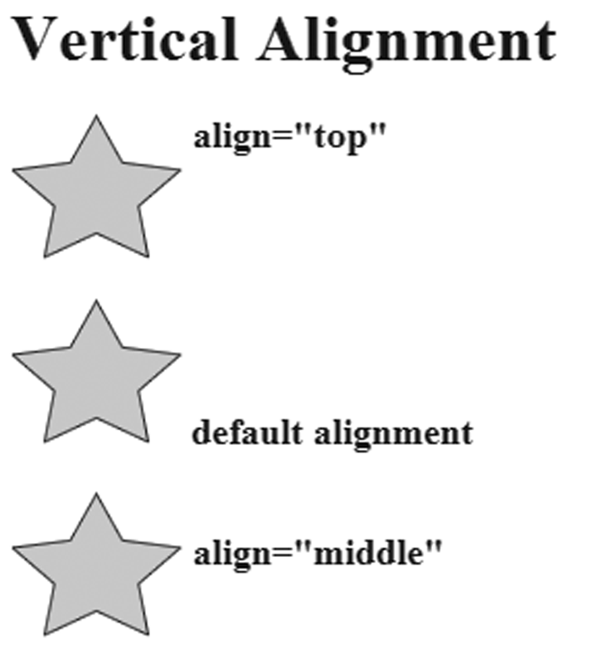
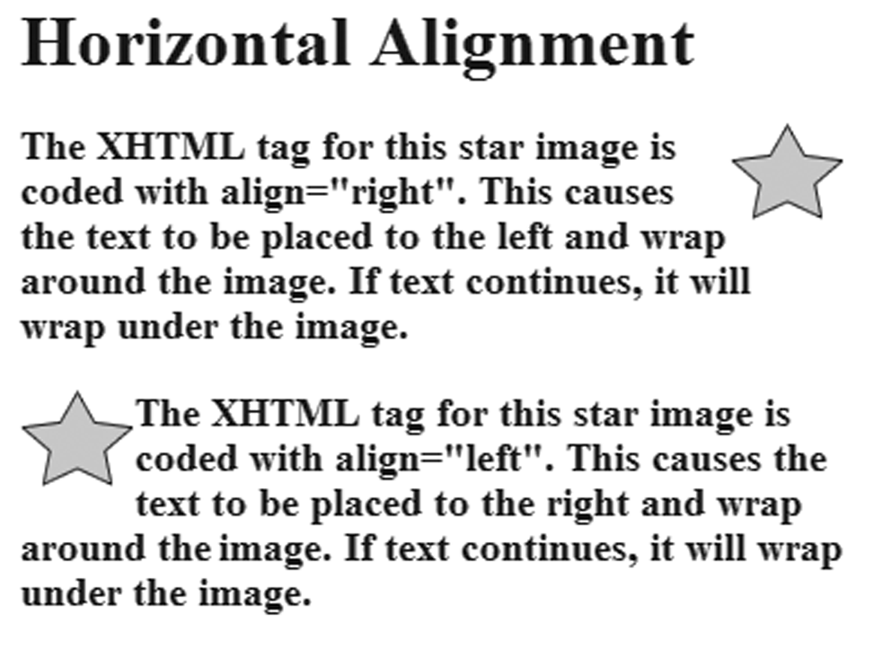
XHTML<img /> Alignment
Note: In Chapter 6 you’ll learn to use CSS to configure image alignment.

Slide 21
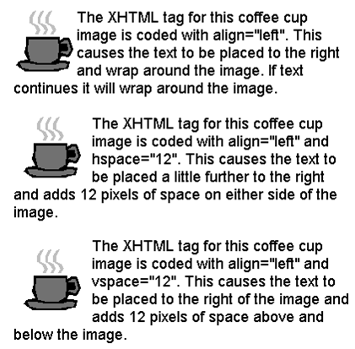
XHTML More<img /> Attributes
Adding Vertical Space
vspace Attribute
Adding Horizontal Space
hspace Attribute
Note: A more modern approach is to use the CSS padding property

Slide 22
Accessibility & Images
Required:
Configure the alt attribute
Alternate text content to convey the meaning/intent of the image
NOT the file name of the image
Use alt=“” for purely decorative images
Optional:
Configure the longdesc attribute
Used when meaning cannot be conveyed in the alt text
Usually a URL to a Web page with text

Slide 23
Hands on Practice 4.3
Follow the instructions on page 135 to place a graphical logo banner on a web page.

Slide 24
Image Links
To create an image link use an anchor element to contain an image element
Browsers automatically add a border to image links.
Configure CSS to eliminate the border img {border:0 }
<a href="index.html"><img src="home.gif" height="19" width="85" alt="Home" /></a>
Home

Slide 25
Hands on practice 4.4
Follow the instructions on pages 136 and 137 to add image links to a web page.

Slide 26
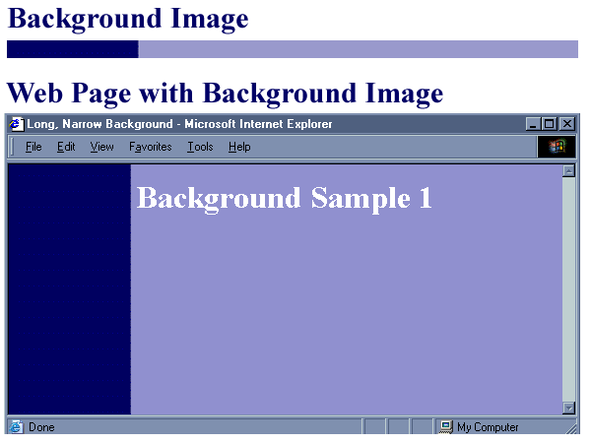
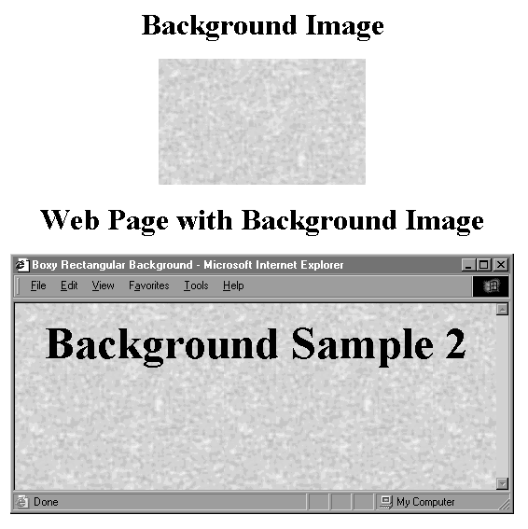
CSS background-image Property
Configures a background-image
By default, background images tile (repeat)
body { background-image: url(background1.gif); }

Slide 27
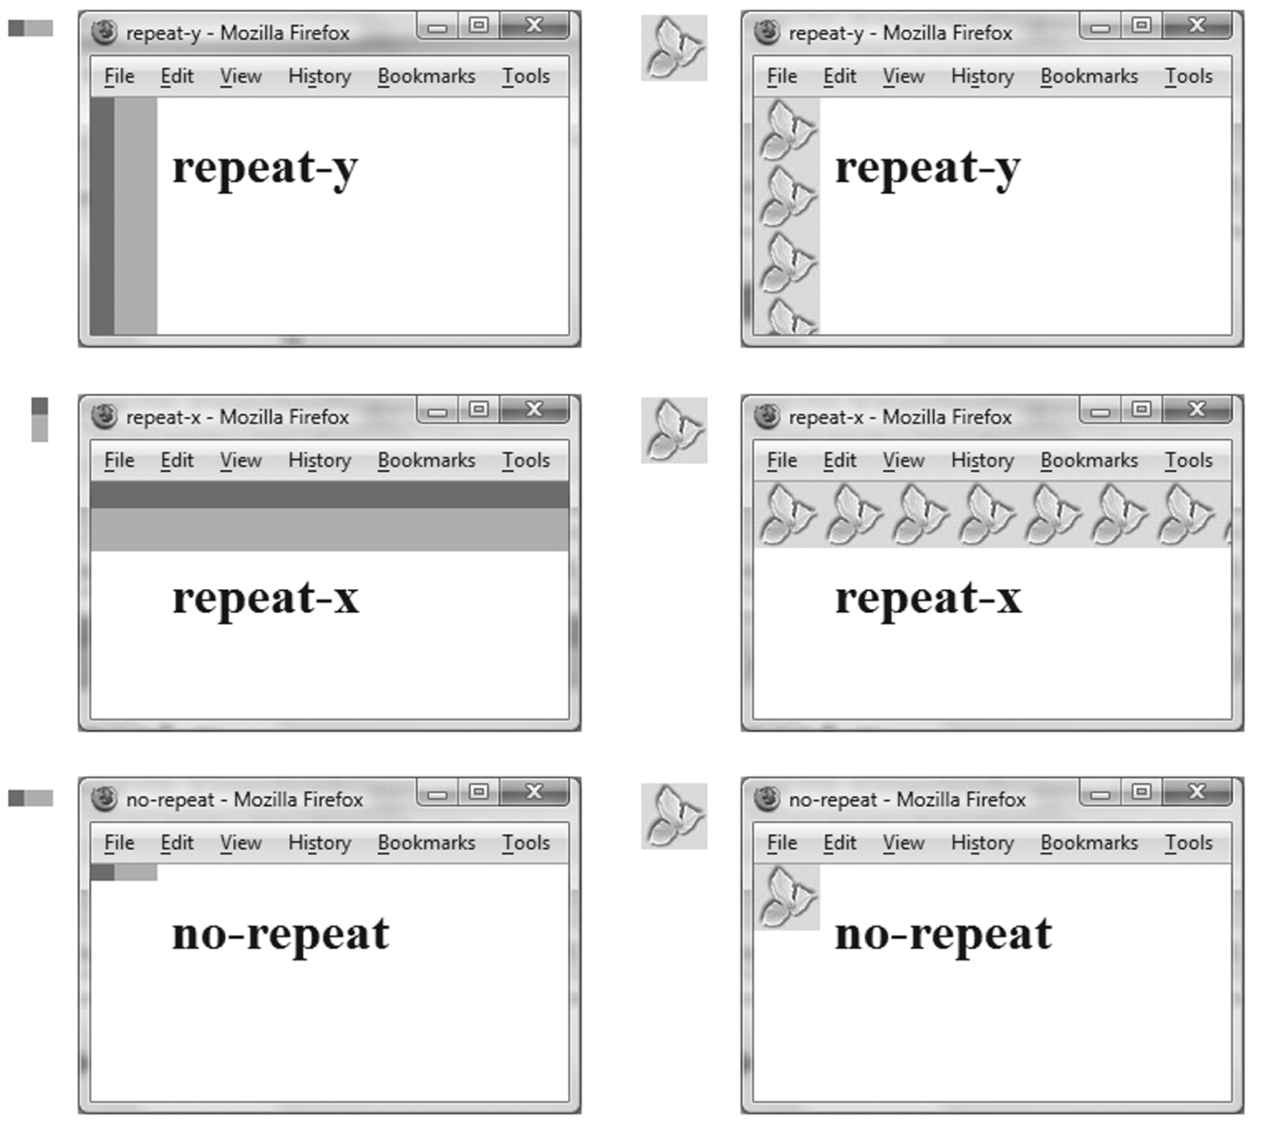
CSS background-repeat Property

Slide 28

Using background-repeat
trilliumbullet.gif:
h2 { background-color: #d5edb3;
color: #5c743d;
font-family: Georgia, "Times New Roman", serif;
padding-left: 30px;
background-image: url(trilliumbullet.gif);
background-repeat: no-repeat;
}

Slide 29
Choosing Names for Image Files
Use all lowercase letters
Do not use punctuation symbols and spaces
Do not change the file extensions (should be .gif, .jpg, .jpeg, or .png)
Keep your file names short but descriptive
i1.gif is probably too short
myimagewithmydogonmybirthday.gif is too long
dogbday.gif may be just about right

Slide 30
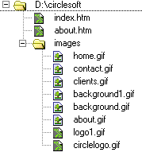
Organizing Your Site
Place images in their own folder
Code the path to the file in the src atttribute
<img src=“images/home.gif” alt=“Home” height=“100” width=“200”/>

Slide 31
Other Image Topics
Thumbnail Images
Image Maps
Sources for Graphics
Guidelines for Using Images
Accessibility

Slide 32

Thumbnail Image
A small image configured to link to a larger version of that image.

Slide 33
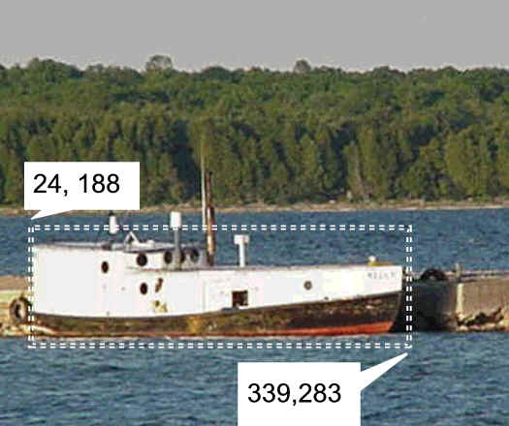
Image Maps
<map> element
Defines the map
<area> element
Defines a specific area on a map
Can be set to a rectangle, circle, or polygon
href Attibute
shape Attribute
coords Attribute

Slide 34
Sample Image Map
<map name="boat" id="boat">
<area href="http://boat.com" shape="rect" coords="24, 188, 339, 283" alt=“fishing boat" />
</map>
<img src="boat.jpg" usemap="#boat" alt=“Lake Michigan" width="416" height="350" />

Slide 35
Images and Accessibility
Don't rely on color alone.
Some visitors may have color perception deficiencies. Use high contrast between background and text color.
Provide a text equivalent for non-text elements.
Use the alt attribute on your image elements
If your site navigation uses image links, provide simple text links at the bottom of the page.

