Slide 1
Web Development & Design Foundations with XHTML
Chapter 8
Key Concepts

Slide 2
Learning
Outcomes
In this chapter, you will learn how to:
  Create a table on a web page
  Apply attributes to format tables, table rows, and table cells
  Format the layout of a Web page with a table
  Use nested tables
  Use CSS to configure an XHTML table

Slide 3
Table
Tables are commonly used
on Web pages in two ways:
  To organize information
  To format the layout of an entire Web page

Slide 4
XHTML
Using Tables
Composed of rows and columns -- similar to a spreadsheet.
Each individual table cell is at the intersection of a specific row and column.
Configured with <table>, <tr>, and <td> elements

Slide 5
XHTML
Table Elements
<table> Element
  Contains the table
  Common attributes: border, width, align
<tr> Element
Contains a table row
<td> Element
Contains a table cell

Slide 6
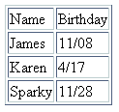
XHTML
Table Example
<table border="1">
<tr>
<td>Name</td>
<td>Birthday</td>
</tr>
<tr>
<td>James</td>
<td>11/08</td>
</tr>
<tr>
<td>Karen</td>
<td>4/17</td>
</tr>
<tr>
<td>Sparky</td>
<td>11/28</td>
</tr>
</table>

Slide 7
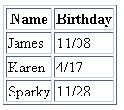
XHTML
Table Example 2
<table border="1">
<tr>
<th>Name</th>
<th>Birthday</th>
</tr>
<tr>
<td>James</td>
<td>11/08</td>
</tr>
<tr>
<td>Karen</td>
<td>4/17</td>
</tr>
<tr>
<td>Sparky</td>
<td>11/28</td>
</tr>
</table>
Using the <th> Element

Slide 8
XHTML
Common Table Attributes
align
bgcolor
border*
bordercolor* (non W3C)
cellpadding
cellspacing
summary
title
width*
  Percentage or pixels?
* Could be used in lab 8

Slide 9
XHTML
Common Table Cell Attributes
align
bgcolor
colspan
rowspan
valign
width

Slide 10

XHTML colspan Attribute
<table border="1">
<tr>
<td colspan=“2”>
Birthday List</td>
</tr>
<tr>
<td>James</td>
<td>11/08</td>
</tr>
<tr>
<td>Karen</td>
<td>4/17</td>
</tr>
</table>

Slide 11
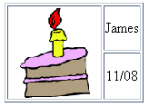
XHTML rowspan Attribute
<table border="1">
<tr>
<td rowspan=“2>
<img src=“cake.gif” alt=“cake” height=“100” width=“100” /></td>
<td>James</td>
</tr>
<tr>
<td>11/08</td>
</tr>
</table>

Slide 12
Accessibility and Tables
Use <th> elements to indicate column or row headings.
Table element summary attribute
  provide an overview of the table contents
Table element title attribute
  provide a brief description of the table.
Associate <td> tags with corresponding <th> tags
  <th> tag id attribute
  <td> tag headers attribute
table cell values with their corresponding headers. This technique uses the id attribute
(usually in a <th> element) to identify a specific header cell and the headers attribute
in a <td> element. Figure 8.18 shows a table that has been configured in this manne

Slide 13
<table border="1" width="75%" title="Educational Background"
summary="This table lists my educational background including school attended, years, subject, and degree awarded (column headings). ">
<tr>
<th id="school">School Attended</th>
<th id="years">Years</th>
<th id="subject">Subject</th>
<th id="degree" >Degree Awarded</th>
</tr>
<tr>
<td headers="school">Schaumburg High School</td>
<td headers="years">2000 - 2005</td>
<td headers="subject">College Prep</td>
<td headers="degree">H.S. Diploma</td>
</tr>
</table>

Slide 14
Checkpoint 8.1
1. Describe two reasons to use tables on a web page.
2. Describe the difference between the cellpadding and cellspacing table attributes.
3. Describe one coding technique that increases the accessibility of an XHTML table.

Slide 15
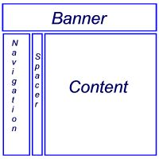
XHTML– Using a Table to
Format a Web Page
<table border="0" width="80%">
<tr>
<td colspan="3">
<h2>This is the banner area</h2>
</td>
</tr>
<tr>
<td width="20%" valign="top">
Place Navigation here</td>
<td width="10">&nbsp;</td>
<td>Page content goes here</td>
</tr>
</table>

Slide 16
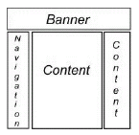
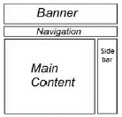
Additional Table Layouts

Slide 17
Flexible & Fixed Table Widths
Fixed Table:
  Table width attribute in pixels
  http://gamestop.com
  http://berkeley.edu
  http://www.redenvelope.com
Flexible Table:
  Table width attribute in percent

Slide 18
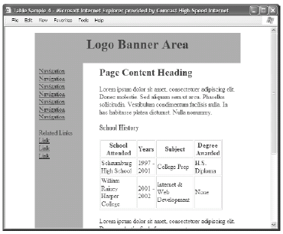
Nested Tables
Outer table configures page layout
Inner table organizes
some information on the page

Slide 19
Checkpoint 8.3
1. Describe a reason to use a percentage width for a table that configures a web page layout.
Provide an example of a page that uses this technique.
2. Describe a reason to use a fixed pixel width for a table that configures a web page layout.
Provide an example of a page that uses this technique.
3. True or False. Tables can be nested within other tables.

Slide 20
Using CSS to Style a Table
XHTML Attribute | CSS Property
align | Align a table: table { width: 75%; margin: auto; } Align within a table cell: text-align
bgcolor | background-color
cellpadding | padding
cellspacing | To configure a shared common border and eliminate space between table cells: table { border-collapse: collapse; }
height | height
valign | vertical-align
width | width

Slide 21
Summary
This chapter introduced the XHTML techniques used to create and configure tables.
You will use these skills over and over again as you create Web pages.

