Slide 1
Web Development & Design Foundations with XHTML
Chapter 9
Key Concepts

Slide 2
Learning
Outcomes
In this chapter, you will learn how to:
  Describe common uses of forms on web pages
  Create forms on web pages using the <form>,
  <input />, <textarea>, and <select> tags
  Create forms that provide additional accessibility features using the accesskey and tabindex attributes
  Associate form elements and element groups using the <label>, <fieldset>, and <legend> tags
  Create custom image buttons and use the <button> tag to include more variety and richer content than the standard form button
  Describe the features of CGI
  Invoke server-side processing to handle form data
  Find free CGI resources on the Web

Slide 3

Overview of Forms
Forms are used all over the Web to
  Accept information
  Provide interactivity
Types of forms:
  Search form, Order form, Newsletter sign-up form, Survey form, Add to Cart form, and so on…

Slide 4
Overview of Forms
Form
  An XHTML element that contains and organizes other Web document objects such as
  text boxes,
  check boxes,
  and buttons
  that can accept information from web site visitors.

Slide 5
Two Components of Using Forms
1. The XHTML form
  -- the web page user interface
and
2. The server-side processing
  CGI - Common Gateway Interface
  CGI works with the form data and sends e-mail, writes to a text file, updates a database, or performs some other type of processing on the server.

Slide 6
XHTML
Using Forms
<form> tag
  Contains the form elements on a web page
  Container tag
<input /> tag
  Configures a variety of form elements including text boxes, radio buttons, check boxes, and buttons
  Stand alone tag
<textarea> tag
  Configures a scrolling text box
  Container tag
<select> tag
  Configures a select box (drop down list)
  Container tag
<option> tag
  Configures an option in the select box
  Container tag

Slide 7
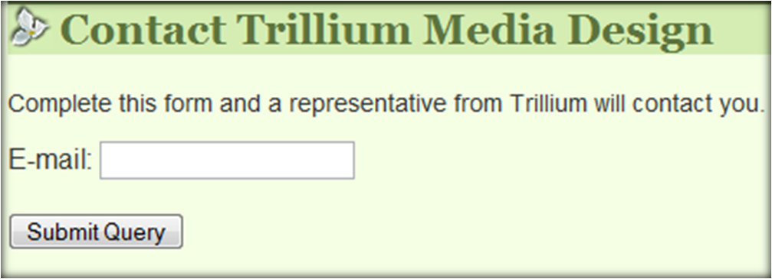
Sample Form
XHTML
<form>
Email: <input type="text" name="CustEmail" id="CustEmail" /><br />
<input type="submit" />
</form>

Slide 8
XHTML
<form> element
The form tag attributes:
  action
    Specifies the server-side program or script that will process your form data
  method
    get – default value, form data passed in URL
    post – more secure,
    form data passed in HTTP Entity Body
  name
    Identifies the form
  id
    Identifies the form

Slide 9
Basic Form Elements
Text Box
Password Box
Check Box
Radio Button
Scrolling Text Box
Select List
Submit Button
Reset Button
Button

Slide 10
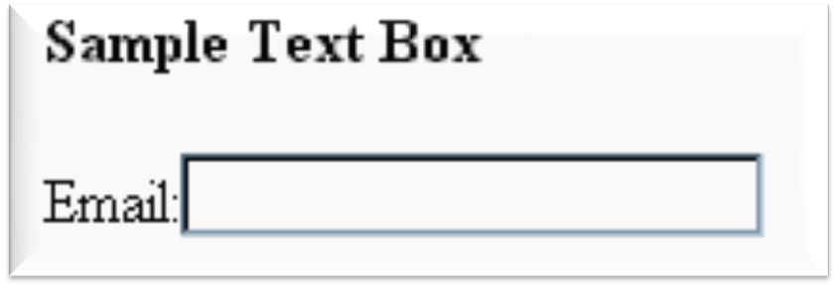
XHTML<input /> Element
Text box
Accepts text information
Attributes:
  type=“text”
  name
  id
  size
  maxlength
  value

Slide 11
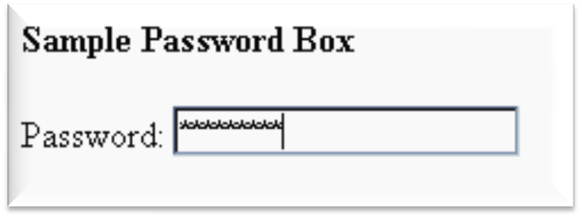
XHTML<input /> Element
Password box
Accepts text information that needs to be hidden as it is entered
Attributes:
  type=“password”
  name
  id
  size
  maxlength
  value

Slide 12
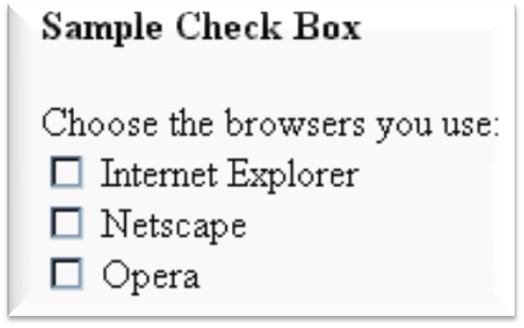
XHTML<input /> Element
Check box
Allows the user to select one or more of a group of predetermined items
Attributes:
  type=“checkbox”
  name
  id
  checked
  value

Slide 13
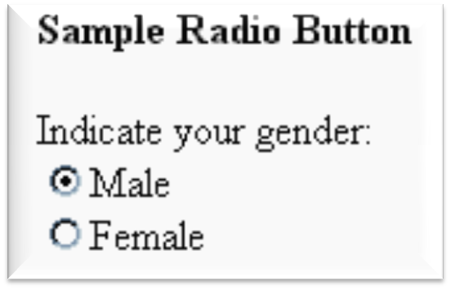
XHTML<input /> Element
Radio Button
Allows the user to select exactly one from a group of predetermined items
Each radio button in a group is given the same name and a unique value
Attributes:
  type=“radio”
  name
  id
  checked
  value

Slide 14
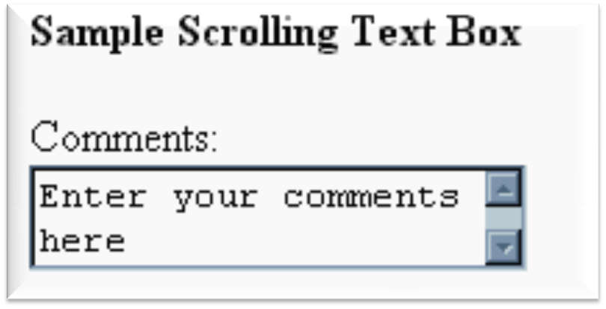
XHTML<textarea> Element
Scrolling Text Box
Configures a scrolling text box
Attributes:
  name
  id
  cols
  rows

Slide 15
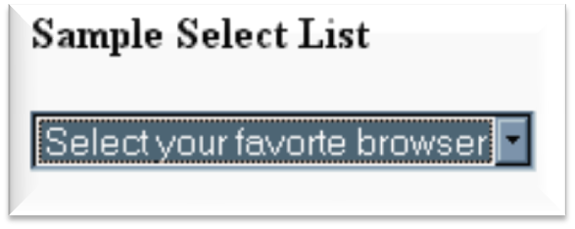
XHTML<select> Element
Select List
Configures a select list (along with <option> tags)
Also known as: Select Box, Drop-Down List, Drop-Down Box, and Option Box.
Allows the user to select one or more items from a list of predetermined choices.
Attributes:
  name
  id
  size
  multiple

Slide 16
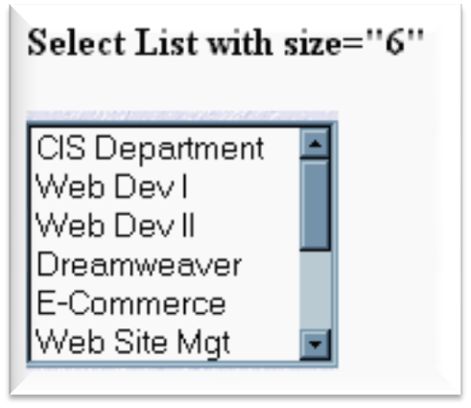
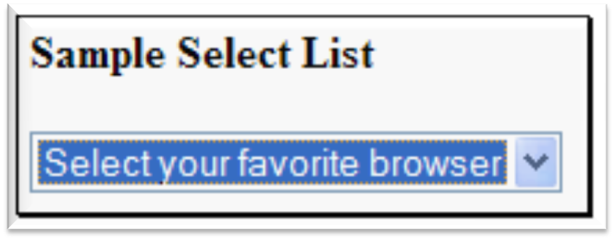
XHTML<option> Element
Options in a Select List
Configures the options in a Select List
Attributes:
  value
  selected

Slide 17
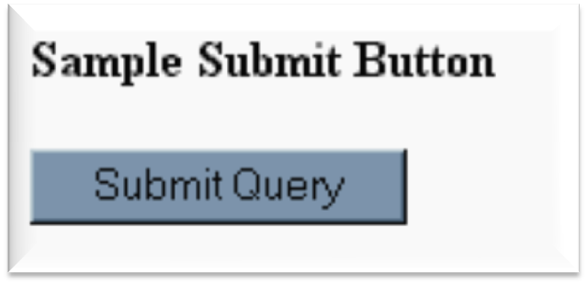
XHTML<input /> Element
Submit Button
Submits the form information
When clicked:
  Triggers the action method on the <form> tag
  Sends the form data (the name=value pair for each form element) to the web server.
Attributes:
  type=“submit”
  name
  id
  value

Slide 18
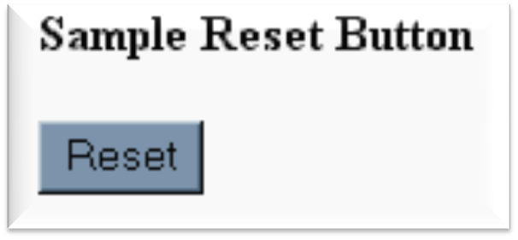
XHTML<input /> Element
Reset Button
Resets the form fields to their initial values
Attributes:
  type=“reset”
  name
  id
  value

Slide 19
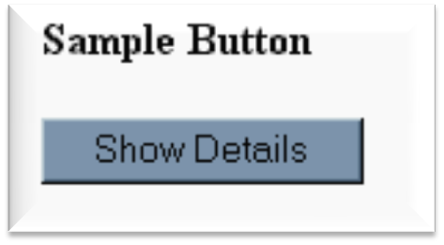
XHTML<input /> Element
Button
Offers a flexible user interface
There is no default action when the button is clicked
Usually a JavaScript function is invoked when a button is clicked
Attributes:
  type=“button”
  name
  id
  value

Slide 20

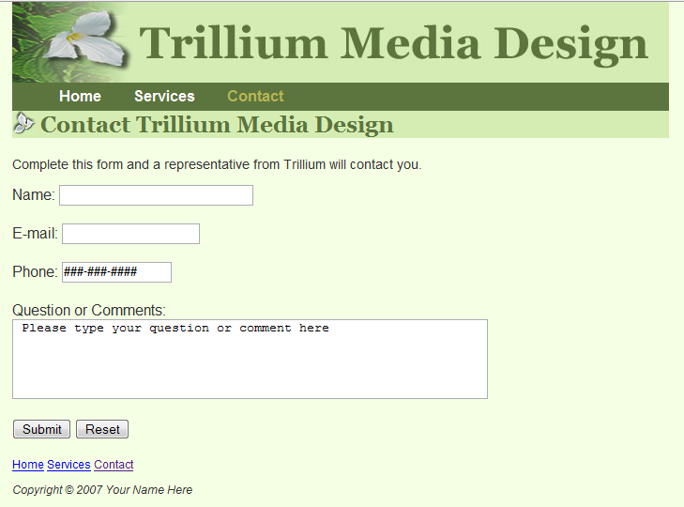
Hands-On Practice 9.2

Slide 21

Checkpoint 9.1
1. You are designing a web site for a client who sells items in a retail store.
They want to create a customer list for e-mail marketing purposes. Your client sells to consumers and needs a form that accepts their customer’s name and e-mail address.
Would you recommend using two input boxes (one for the name and one for the e-mail) or three input boxes (for the first name, last name, and email address)?
Explain your answer.

Slide 22
Checkpoint 9.1
2. You are designing a survey form for a client. One of the questions has 10 possible responses.
Only one response can be selected per question.
What type of form element would you use to configure this question on the web page?
3. True or False.
In a radio button group, the value attribute is used by the browser to process separate elements as a group.

Slide 23
XHTML
Using a
Table to
Format a Form
<form>
<table border="0" width="75%">
<tr>
<td align="right" width="10%">Name: </td>
<td>
<input type="text" name= "CustName"
id= "CustName " size="30" /></td>
</tr>
<tr>
<td align="right" width="10%">Email: </td>
<td>
<input type="text" name="CustEmail"
id="CustEmail" /></td>
</tr>
<tr>
<td align="right" width="10%">
<input type="submit" value="Submit" /></td>
<td><input type="reset" /></td>
</tr>
</table>
</form>

Slide 24
XHTML Form Enhancements
<label> Element
Associates a text label with a form element
Two Different Formats:
  <label>Email: <input type="text" name="CustEmail" id ="CustEmail" /></label>
  Or
  <label for="email " >Email: </label><input type="text" name="CustEmail" id= "email " />

Slide 25
XHTML Form Enhancements
<fieldset> & <legend> elements
The Fieldset Element
  Container tag
  Creates a visual group of form elements on a web page
The Legend Element
  Container tag
  Creates a text label within the fieldset
  <fieldset><legend>Customer Information</legend>
  <label>Name:
  <input type="text" name="CustName"
  id="CustName" size="30" /></label><br />
  <label>Email:
  <input type="text" name="CustEmail"
  id="CustEmail" /></label>
  </fieldset>

Slide 26
XHTML Form Enhancements tabindex attribute
Attribute that can be used on form elements and anchor tags
Not supported by all browsers
Modifies the default tab order
Assign a numeric value
<input type="text" name="CustEmail" id="CustEmail" tabindex="1" />

Slide 27
XHTML Form Enhancements accesskey attribute
Attribute that can be used on form elements and anchor tags
Not supported by all browsers
Create a “hot-key” combination to place the focus on the component
Assign a value of a keyboard letter
On Windows use the CTRL and the “hot-key” to move the cursor
<input type="text" name="CustEmail" id="CustEmail" accesskey="E" />

Slide 28
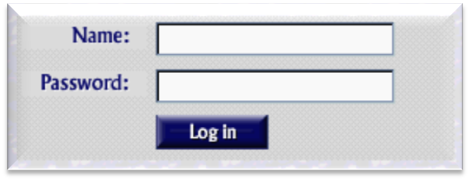
XHTML Form Enhancements
<input /> Element Image Button
Submits the form
When clicked:
  Triggers the action method on the <form> tag
  Sends the form data (the name=value pair for each form element) to the web server.
Attributes:
  type=“image”
  name
  id
  src

Slide 29
XHTML Form Enhancements
<button> Element
A container tag
When clicked, its function depends on the value of the type attribute.
Can contain a combination of text, images, and media
Attributes:
  type=“submit”, type=“reset”, type=“button”
  name
  id
  alt
  value

Slide 30
Checkpoint 9.2
1. Describe the purpose of the fieldset and legend tags.
2. Describe the purpose of the accesskey attribute and how it supports accessibility.
3. When designing a form, should you use the standard submit button, an image button or a button tag?
Are these different in the way that they provide for accessibility?
Explain your answer.

Slide 31
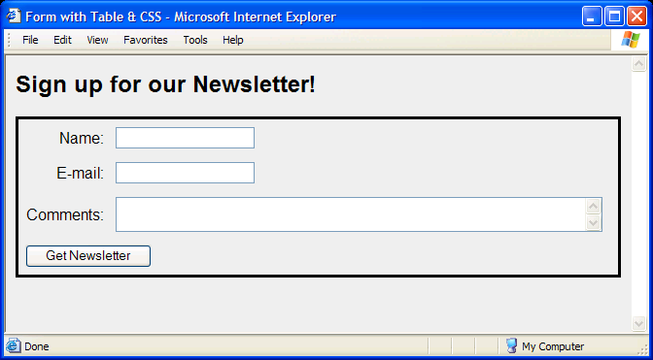
Using CSS to Style a Form
Moderate Approach
  Use a table to format the form but configure styles instead of XHTML table attributes.
table { border: 3px solid #000000;
width: 100%;}
td { padding: 5px;
margin: 0px;}
.mylabel { text-align: right;}

Slide 32
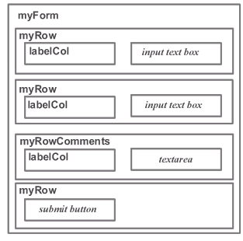
Using CSS to
Style a Form
“Pure" CSS Approach
  Do not use a table to format the form.
  Use CSS divs and spans with positioning properties to configure the page.
#myForm {border:3px solid #000000;
padding:10px;margin:10px;}
.myRow {height:30px;}
.myRowComments {margin-bottom:20px;}
.labelCol {float:left;width:100px; text-align:right;}

Slide 33
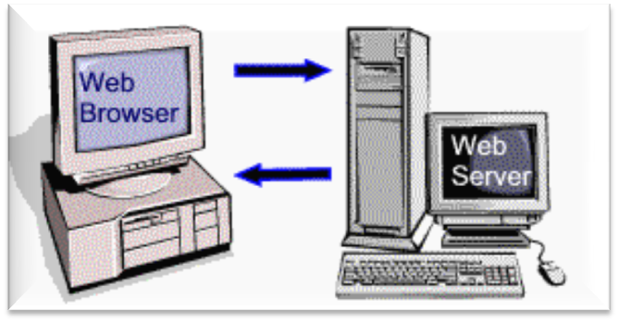
Server-Side
Processing
Your web browser requests web pages and their related files from a web server.
The web server locates the files and sends them to your web browser.
The web browser then renders the returned files and displays the requested web pages for you to use.

Slide 34
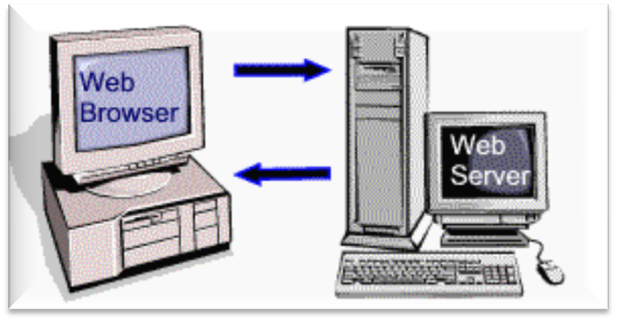
CGI
Common Gateway Interface
A protocol for a web server to pass a web page user's request to an application program and accept information to send to the user.

Slide 35
Steps in Utilizing CGI
1. Web page invokes CGI by a form action or hyperlink, etc...
  Any form information is sent in the form of name=value pairs to the web server.
2. Script on web server is executed
3. Script accesses requested database, file, or process
4. Web server returns web page with requested information or confirmation of action

Slide 36
Common Uses of
Server-Side Scripting & CGI
Search a database
Place an order at an online store
Send a web page to a friend
Subscribe to a newsletter
Any type of server-side file or e-mail processing is a candidate for CGI

Slide 37
Checkpoint 9.3
Describe CGI.
Code the form tag for a web page form that will use the post method to invoke a server-side script located at http://webdevfoundations.net/scripts/formdemo.asp

Slide 38
Sources of Free
Server-Side Processing
Many web host providers offer free scripts for their clients. Contact their support area or FAQ to learn more about their services.
Some web sites that offer FREE remotely hosted scripts (in return for displaying an ad).
  http://formbuddy.com
  http://hostedscripts.com
  http://response-o-matic.com
  http://master.com
  http://www.formmail.com
  http://wufoo.com
  http://iceberg.com
  http://formassembly.com

Slide 39
Languages that support CGI
Programs or scripts that work with CGI can be written in many languages:
PHP
Perl
C
C++
Active Server Pages (ASP)
Java Server Pages (JSP)
ASP.NET
Ruby on Rails
And so on….

Slide 40
Summary
This chapter introduced the use of forms on web pages.
You learned about how to configure form elements and provide for accessibility.
You also learned about CGI and how to configure a form to access server-side processing.

