Slide 1
Android Activity Lifecycle
CS235AM
Android App Development
by Brian Bird
Spring 2016
Lane Community College

Slide 2
New Course Agenda (Syllabus updated)
Wk | Topic
1 | Intro + single-screen apps
2 | Multi-screen (multi-activity) apps
3 | Activity lifecycle and state
4 | List Views
5 | App menus
Wk | Topic
6 | Adapting to size and orientation: fragments
7 | Managing data: SQLite
8 | Consuming web services
9 | Geolocation
10 | Publishing to the Google Play Store
Notes:
This week we are going deeper into the activity lifecycle and we’ll be exploring ways to save and retrieve activity state.
The original play had ListViews as the topic for this week and the ActionBar as a topic for week 4. We will cover the ActionBar in a future week, maybe week 5

Slide 3
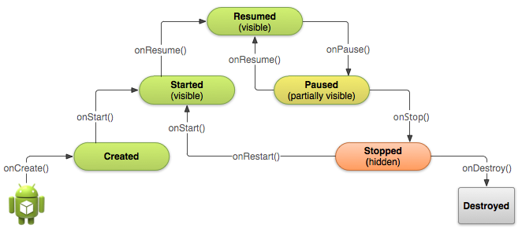
Activity Lifecycle
From http://developer.android.com/training/basics/activity-lifecycle/
Notes:
We will cover this in more detail next week

Slide 4
Lifecycle and Activity State
Values stored in variables or objects in an Activity are not retained when an Activity is destroyed and then re-created.
Activities are destroyed when:
The device is rotated.
The Activity is removed from the back-stack (system back button)
The Activity has stopped and subsequently the system needs to allocate some of its resources (like memory).
Code in an activity explicitly destroys it (uncommon).

Slide 5
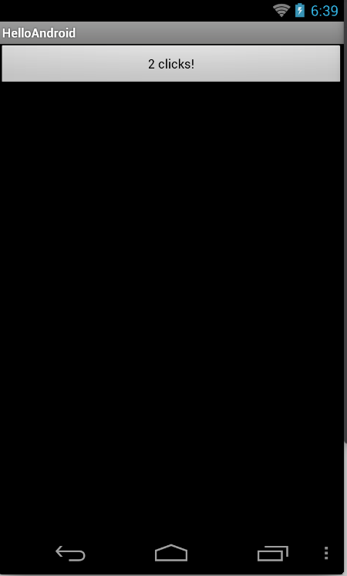
Experiment: Activity State
Build and run the default click-counter app
See what happens to the count when you:
Tap (click) the back button, then resume the activity
Tap (click) the home button
Start another activity
Turn off (sleep) the device
Rotate the device
Force-stop the app
Notes:
1. Count lost, 2. Count retained (activity still in back-stack), 3. Count retained, 4. Count retained? 5. Count lost, 6. Count lost.

Slide 6
Means for Saving Activity State
Values in input widgets (EditText, Spinner, RaidoButton, etc.) are automatically retained. (Similar to the behavior or HTML input elements).
Use OnSaveInstanceState to save data in a Bundle object. Mainly for configuration changes, like rotation.
Use OnRetainNonConfigurationInstance to save custom objects. Used when saving larger data objects.
Notes:
3. Deprecated in API 13! Use the new Fragment API setRetainInstance(boolean) instead.
developer.android.com/reference/android/app/Activity.html

Slide 7
Save State in a Bundle
Save the state in OnSaveInstanceState
protected override void OnSaveInstanceState(Bundle state)
{
state.PutInt("counter", c);
base.OnSaveInstanceState(state);
}
Bundle class PutInt method
First parameter: key
Second parameter: value
Notes:
https://developer.xamarin.com/api/member/Android.OS.Bundle.PutInt/p/System.String/System.Int32

Slide 8
Bundle Class
Stores information as key-value pairs (like a Dictionary or Map)
Has Put and Get methods for:
Primitive types | Arrays of primitive types
byte | byte[ ]
char | char[ ]
float | float[ ]
int | int[ ]
string | string[ ]
And more (see https://developer.xamarin.com/api/type/Android.OS.Bundle
Notes:
Xamarin API documentation: https://developer.xamarin.com/api/type/Android.OS.Bundle
Google Android docs: http://developer.android.com/reference/android/os/Bundle.html

Slide 9
Retrieve State from a Bundle
Retrieve state in OnCreate
c = bundle.GetInt ("counter", -1);
Bundle class GetInt method
First parameter: key
Second parameter: default value
Notes:
https://developer.xamarin.com/api/member/Android.OS.Bundle.GetInt/p/System.String/System.Int32/

Slide 10
Do it: Save the Count
Add the code shown in the previous slides to the click counter app.
Test it:
Rotate the device
Force stop the app and restart it
The count should be maintained
Notes:
https://developer.xamarin.com/api/member/Android.OS.Bundle.GetInt/p/System.String/System.Int32/

