Slide 1
Geolocation Overview
CS235AM
Android App Development
by Brian Bird
Winter 2018
Lane Community College

Slide 2
Course Schedule
Wk | Topic
1 | Intro + single-screen apps
2 | Multi-screen (multi-activity) apps
3 | Activity lifecycle + state
4 | Adapting to size and orientation: Layouts
5 | Fragments
Wk | Topic
6 | List Views
7 | Managing data: SQLite
8 | Geolocation
9 | Publishing to an App Store
10 | Term Project

Slide 3
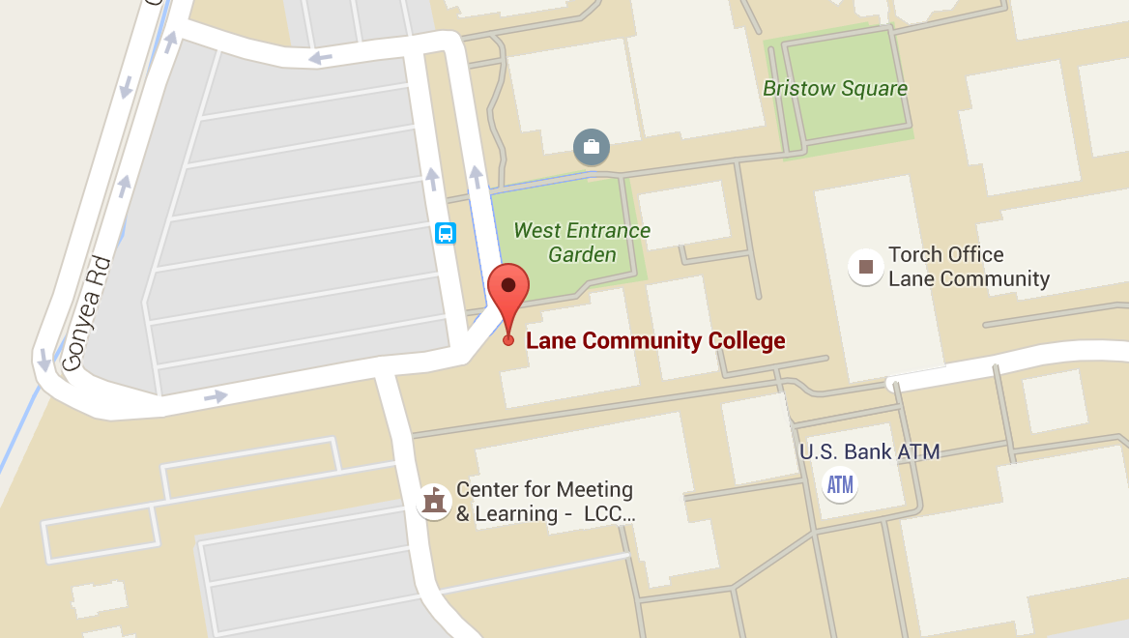
Geolocation
Notes:
Tutorial: https://developer.android.com/training/location/index.html

Slide 4
Geolocation APIs
Information provided:
Latitude and longitude
Altitude
Speed
Heading

Slide 5
Location Data Sources
Source | Accuracy | Battery Drain
GPS | High | Highest
Cellular Towers | Medium | Lower
Wi-Fi | Variable: medium to low | Lower
Notes:
https://developer.android.com/guide/topics/location/strategies.html

Slide 6
Choice of APIs
Android Location Services API
Lets you choose between: GPS, Cellular, Wi-Fi
No longer recommended by Google
Fused Location Provider
Dynamically chooses the best location provider
Preferred by Google, requires Google Play Services (Covered in separate PPT slides)
Notes:
Xamarin tutorial on the first two APIs listed above: https://developer.xamarin.com/guides/android/platform_features/maps_and_location/location/

Slide 7
Fused Location Provider
Location sources are selected based on priorities:
Balanced power/accuracy
~100 m accuracy
medium power draw
High accuracy
~5 meter accuracy
highest power draw
Low power
~10km accuracy
minimum power draw
No power
uses location data requested by other apps

Slide 8
Fused Location Provider
Gets the best available provider
Provides last known location (usually current)
Provides continuous location updates
Location client
Connects to Google Play Services
Developer needs to implement interfaces for callbacks
Notes:
https://developer.android.com/training/location/retrieve-current.html

Slide 9
Related APIs
Geocoder
Get address from latitude and longitude
Get latitude and longitude from address
Geofencing
Monitor distance from a point of interest
Get notifications when entering or leaving area of interest

Slide 10
Testing on an Emulator

Slide 11
Simulating Location
Android Location Services API
The Google Emulator Control panel lets you send mock location points to the emulator.
Fused Location Provider
You have to publish mock locations programmatically.

