Slide 1
ListViews and Adapters Part 2: Section Indexer
CS235AM
Android App Development
by Brian Bird
Spring 2017
Lane Community College

Slide 2
Course Schedule
Wk | Topic
1 | Intro + single-screen apps
2 | Multi-screen (multi-activity) apps
3 | Activity lifecycle and state
4 | List Views
5 | ListViews continued
Wk | Topic
6 | App menus
7 | Adapting to size and orientation: fragments
8 | Managing data: SQLite
9 | Consuming web services
10 | Geolocation

Slide 3
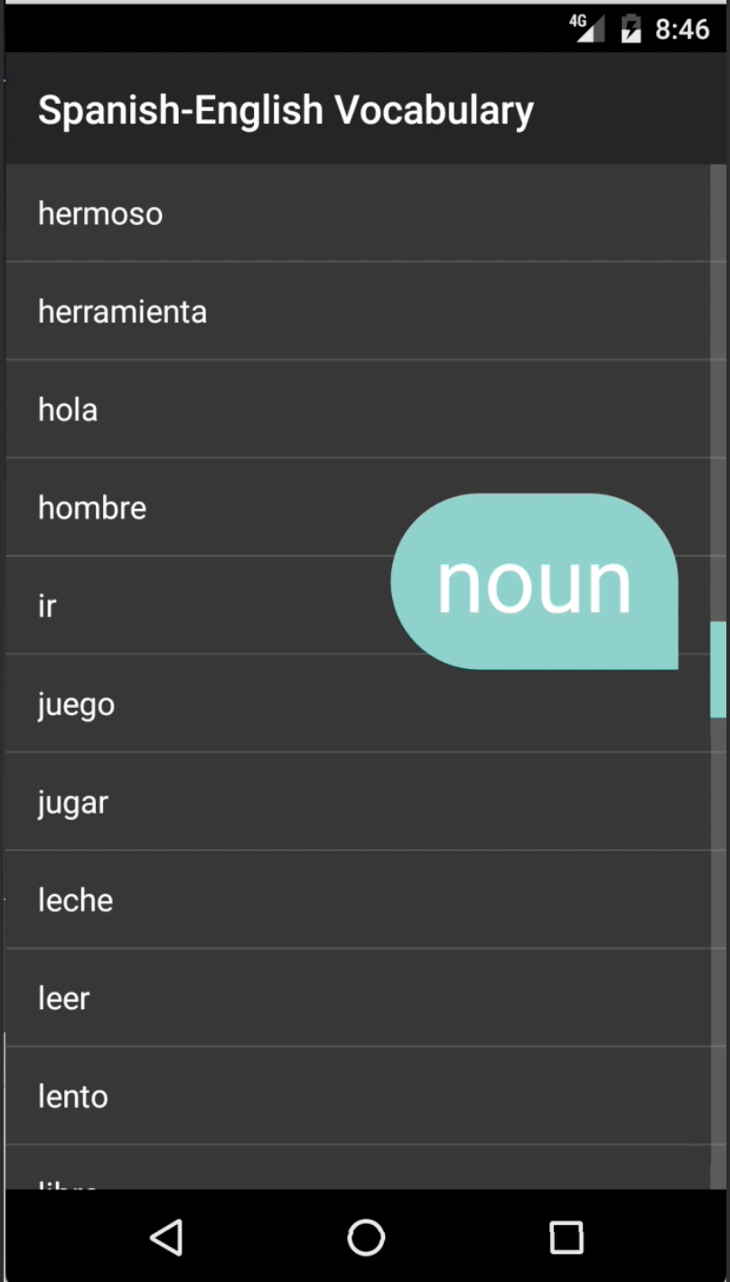
Section Index Example

Slide 4
Fast Scrolling
Fast Scrolling
Drag a scroll-bar
Customizable in API 11+
Section Index
Section titles appear while scrolling

Slide 5
BaseAdapter<T>
Create a custom adapter by sub-classing BaseAdapter<T> (a generic class)
Can also be used as a data adapter for Spinner widgets
Notes:
Xamarin API documentation: https://developer.xamarin.com/api/type/Android.Widget.SimpleAdapter/

Slide 6
BaseAdapter<T> Inheritance
Object
abstract Android.Widget.BaseAdapter
abstract Android.Widget.BaseAdapter<T>
Note: All abstract methods in an abstract class must be implemented by the inheriting class.
Notes:
Xamarin API documentation: https://developer.xamarin.com/api/type/Android.Widget.ArrayAdapter/
Android Developer’s API documentation: https://developer.android.com/reference/android/widget/ArrayAdapter.html

