Slide 1
SQLite & SQLite.Net Part 1
CS235AM
Android App Development
by Brian Bird
Winter 2018 Lane Community College

Slide 2
Course Schedule
Wk | Topic
1 | Intro + single-screen apps
2 | Multi-screen (multi-activity) apps
3 | Activity lifecycle + state
4 | Adapting to size and orientation: Layouts
5 | Fragments
Wk | Topic
6 | List Views
7 | Managing data: SQLite
8 | Geolocation
9 | Publishing to an App Store
10 | Term Project
Wk | Topic
1 | Intro + single-screen apps
2 | Multi-screen (multi-activity) apps
3 | Activity lifecycle and state
4 | List Views + Adapters
5 | Layouts + orientation
Wk | Topic
6 | Adapting to size and orientation: fragments
7 | Managing data: SQLite
8 | Consuming web services
9 | Geolocation
10 | Publishing to the Google Play Store
Wk | Topic
6 | Layouts + orientation
7 | Adapting to size and orientation: fragments
8 | Managing data: SQLite
9 | Consuming web services
10 | Geolocation

Slide 3
Why Use a Database?
How is using a DBMS (Database Management System) better than using a simple file (text, XML, or JSON) for persisting data?

Slide 4
Advantages of Using a Database
Data items can be found quickly (without having all of the data in memory)
Data can be filtered based on complex criteria
Data items can be added, changed, or deleted without rewriting the entire file.

Slide 5
Features of a Relational Database
In an RDBMS (Relational Database Management System):
Data is stored in tables (also called relations) which organize data by column and row (like a spreadsheet)
Queries return rows of data based on column-oriented criteria

Slide 6
Schema
The schema of a database is the definition of the database’s tables and the names and types of each column in each table.
ID | English | Spanish | PartOfSpeech
1 | cat | gato | noun
2 | dog | perro | noun
3 | to jump | saltar | verb
4 | to read | leer | verb
5 | big | grande | adj
6 | night | noche | noun
Dictionary table

Slide 7
Primary Key
Each row should have a primary key
The PK is a unique identifier
Integers are often used, but strings can be used too
They don’t need to be in any particular sequence
Note: The rows in a table have no inherent order.
ID | English | Spanish | PartOfSpeech
1 | cat | gato | noun
2 | dog | perro | noun

Slide 8
SQL
SQL (pronounced sequel) is the most popular language for querying.
It has some attributes of a functional language
No state (no variables)
No sequence of operations (all at once operations)
Many popular RDBMS’s use SQL: Oracle, SQL Server, My SQL

Slide 9
Example Query
Select Spanish from Dictionary where English = “dog”
Select * from Dictionary where PartOfSpeech = “verb”
Spanish
perro
ID | English | Spanish | PartOfSpeech
3 | to jump | saltar | verb
4 | to read | leer | verb

Slide 10
SQLite
A popular Open Source RDBMS
Used mainly in embedded applications
Built into Android and iOS (as well as other operating systems)
Implements most of the SQL92 standard

Slide 11
SQLite.NET ORM
Object Relational Mapper
A C# wrapper around the database API
Table Schema are represented by C# classes (data models)
Let’s you use C# (including LINQ) to perform database operations so you don’t need to learn SQL

Slide 12
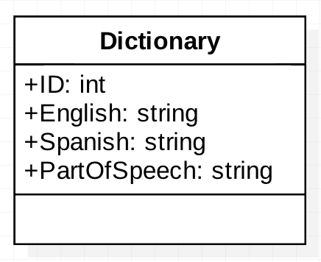
Data Model
UML Class Diagram
C# Class Definition
[Table] public class Dictionary
{
[PrimaryKey]
public int ID {get; set;}
public string English {get; set;}
public string Spanish {get; set;}
public string PartOfSpeech {get; set}
}
Note: These are not public fields, they are C# properties

Slide 13
Data Operations Using LINQ
LINQ is a part of all .NET languages
Language Integrated Query uses the syntax of a functional language – this is why it resembles SQL
LINQ can be used to query data from any class that implements IQueryable

Slide 14
LINQ Example
from w in db.Table<Dictionary> () where w.English == “dog” select w.Spanish;
from w in db.Table<Dictionary>() where w.PartOfSpeech == “verb” select w;

Slide 15
Next Session …
In this session you were introduced to:
The SQLite RDBMS
The SQLite.Net ORM
In Part 2, we will dig deeper into using SQLite.Net in an Android application

