Slide 1
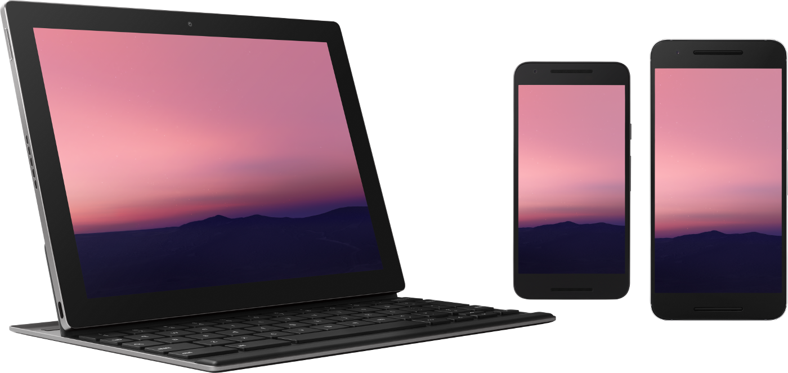
Mobile Application Development: Android
CS235AM

Slide 2
Course Overview
Wk | Topic
1 | Intro + single-screen apps
2 | Multi-screen apps + activity state
3 | List Views
4 | Navigation with the ActionBar
5 | App Menus
Wk | Topic
6 | Adapting to size and orientation: Fragments
7 | Managing Data: SQLite
8 | Consuming Web Services
9 | Geolocation
10 | Publishing to the Google Play Store

Slide 3
About me
BSEE from PSU, MA from UO
Worked as a EE at TriQuint Semiconductor, then morphed into a software engineer
Senior software engineer at Axian Inc.
Started Creative CyberSolutions, a software development business
Started teaching at LCC in 2009

Slide 4
About you
Which degree or certificate are you pursuing?
What mobile devices do you own?
Programming experience?
Notes:
Take roll

Slide 5
Introduction
Why learn to do mobile app development?
Why Android?
How is mobile app development different from other types of development?
What tools and frameworks can be used for mobile app development?
Notes:
This is the outline for today’s session

Slide 6
Why learn mobile app development?
What reasons can you think of?
Notes:
Pop up the Collaborate whiteboard

Slide 7
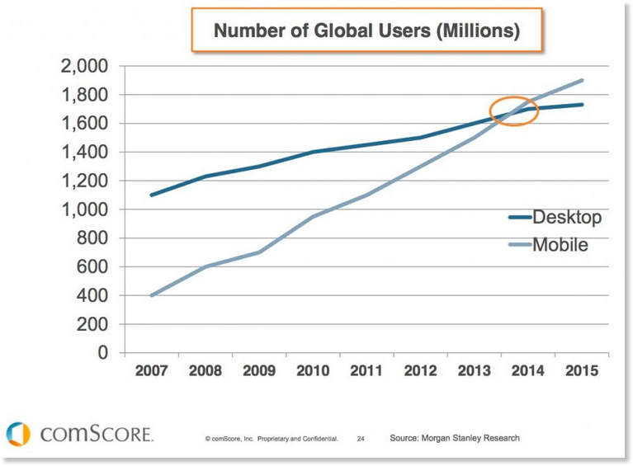
Why learn mobile app development? 1. Business opportunity
Mobile users outnumber desktop users
Notes:
In 2010, Steve Jobs famously announced the beginning of the “post-PC era”.

Slide 8
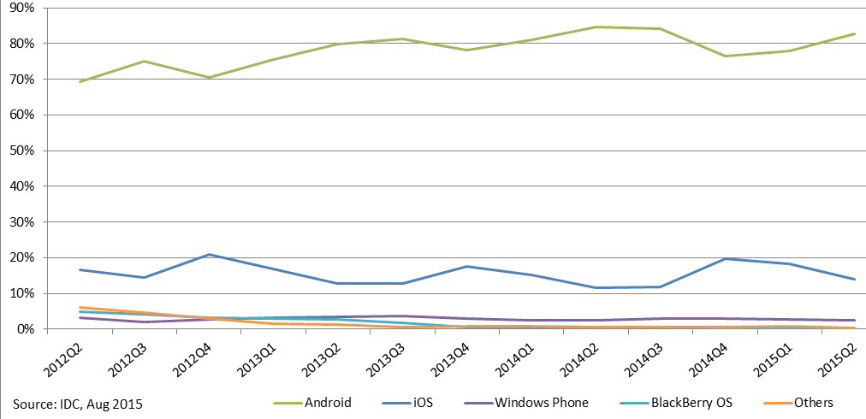
Why learn Android app development?
Android devices outnumber iOS devices
Units shipped, source: IDC
Notes:
This is the outline for today’s session

Slide 9
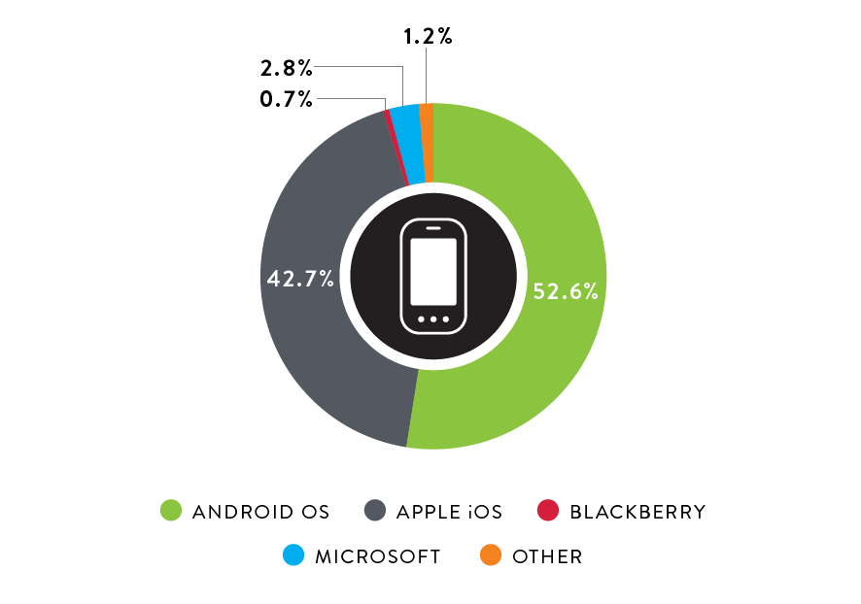
Market Share of US Smartphone Operating Systems in Q3, 2015
Source: The Nielson Company, 12/17/2015

Slide 10
Why learn mobile app development?
2. It’s fun and interesting
What is fun and interesting about it to you?

Slide 11
Why learn mobile app development? 2. It’s fun and interesting
Mobile apps are more “personal”. They go with you everywhere
Mobile devices have interesting sensors: geolocation, temperature, accelerometers, touch, etc.
Mobile phone apps can incorporate communication features

Slide 12
How is mobile app development different from other types of development?
What differences can you think of?
Notes:
This is the outline for today’s session

Slide 13
Differences between desktop and mobile development
Low power devices require apps that use less memory and processor power.
Small screens and a wide variety of form factors and screen rotation require flexible UI designs
Lack of true multi-tasking requires different app lifecycle management (prior to Android 5.0 – Lollypop)
A wide variety of sensors can be used by the app.
Connectivity to the internet is not always assured- apps need to handle intermittent connectivity.
Users have higher expectations for responsiveness of the UI.

Slide 14
Development environments
iOS: Objective C or Swift using X-Code
Android: Java using Eclipse or Android Studio (intelliJ)
Cross-platform (Android and iOS) using Flutter and the Dart programming language
Cross-platform using HTML5 & JavaScript: Apache Cordova (Phone-gap, etc.), React Native, Ionic
Cross-platform native code: Xamarin. All code except the UI is portable across Windows, Linux, Mac, iOS, and Android

Slide 15
Syllabus
Let’s look at the syllabus together on Moodle

Slide 16
Certificate in Mobile Application Development
LCC offers a Career Pathway Certificate in Mobile App Development which requires:
Two terms of a programming language:
Beginning and Intermediate C# (CS 133N & 233N)
Beginning and Intermediate Java (CS 161J & 162J)
Beginning and Intermediate C++ (CS 161C+ & 162C+)
Intermediate Mobile App Dev: iOS (CS 235IM)
Intermediate Mobile App Dev: Android (CS 235AM)
Career Pathways web page: http://oregon.ctepathways.org/c/post/2338/lcc-mobile-application-development-career-pathway.html

Slide 17
Degree Elective Requirements
This course (CS235AM) satisfies a directed elective requirement for following degrees:
Computer Programming
Computer Simulation and Game Development?

Slide 18
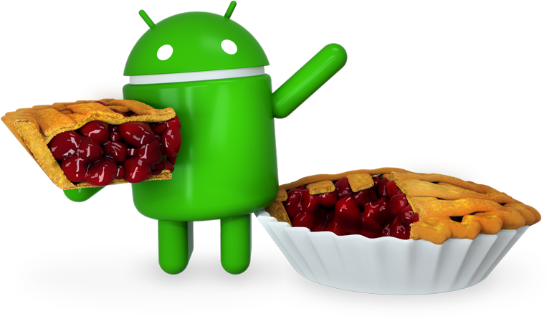
Android Versions
Android Versions are named after deserts. The latest version is Pie.

Slide 19
Android Versions and API Levels
There are version names, numbers and API levels
API28 (Android 9.0) – Pie, released August 2018
API 27 (Android 8.1) – Oreo, released December 2017.
API 26 (Android 8.0) – Oreo, released August 2017.
API 25 (Android 7.1) – Nougat, released December 2016.
API 24 (Android 7.0) – Nougat, released August 2016.
API 23 (Android 6.0) – Marshmallow, released August 2015.
API 22 (Android 5.1) – Lollipop, released March 2015.
API 21 (Android 5.0) – Lollipop, released November 2014.
API 20 (Android 4.4W) – Kitkat Watch, released June 2014.
API 19 (Android 4.4) – Kitkat, released October 2013.
Source: https://developer.xamarin.com/guides/android/application_fundamentals/understanding_android_api_levels/

Slide 20
Development Environment for Xamarin Android
Uses Mono framework, Open-source, cross-platform port of a subset of Microsoft’s .NET Libraries
IDEs:
Visual Studio https://www.visualstudio.com
for Mac OS (Based on MonoDevelop)
for Windows
Jet Brains Rider (new in 2017) https://www.jetbrains.com/rider/
for Windows
for Mac
for Linux

Slide 21
Testing and Emulators for Android
Android Debug Bridge (ADB) - part of the Android SDK
Connects the IDE to a device or Emulator
Google Emulator (part of the Android SDK)
Cross-platform (Windows, Mac, Linux)
Notoriously slow
Intel Haxm – speeds up the Google emulators
Downloadable via the Android SDK Manager
GenyMotion
https://www.genymotion.com/pricing-and-licensing
The Individual, Basic plan is free
Visual Studio Android Emulator
https://www.visualstudio.com/en-us/features/msft-android-emulator-vs.aspx
Requires Windows 10
Actual Android device

