Slide 1
ListViews and Adapters
CS235AM
Android App Development
by Brian Bird
Winter 2018
Lane Community College

Slide 2
Course Schedule
Wk | Topic
1 | Intro + single-screen apps
2 | Multi-screen (multi-activity) apps
3 | Activity lifecycle + state
4 | Adapting to size and orientation: Layouts
5 | Fragments
Wk | Topic
6 | List Views
7 | Managing data: SQLite
8 | Geolocation
9 | Publishing to an App Store
10 | Term Project
Wk | Topic
1 | Intro + single-screen apps
2 | Multi-screen (multi-activity) apps
3 | Activity lifecycle and state
4 | List Views
5 | App menus
Wk | Topic
6 | Adapting to size and orientation: fragments
7 | Managing data: SQLite
8 | Consuming web services
9 | Geolocation
10 | Publishing to the Google Play Store

Slide 3
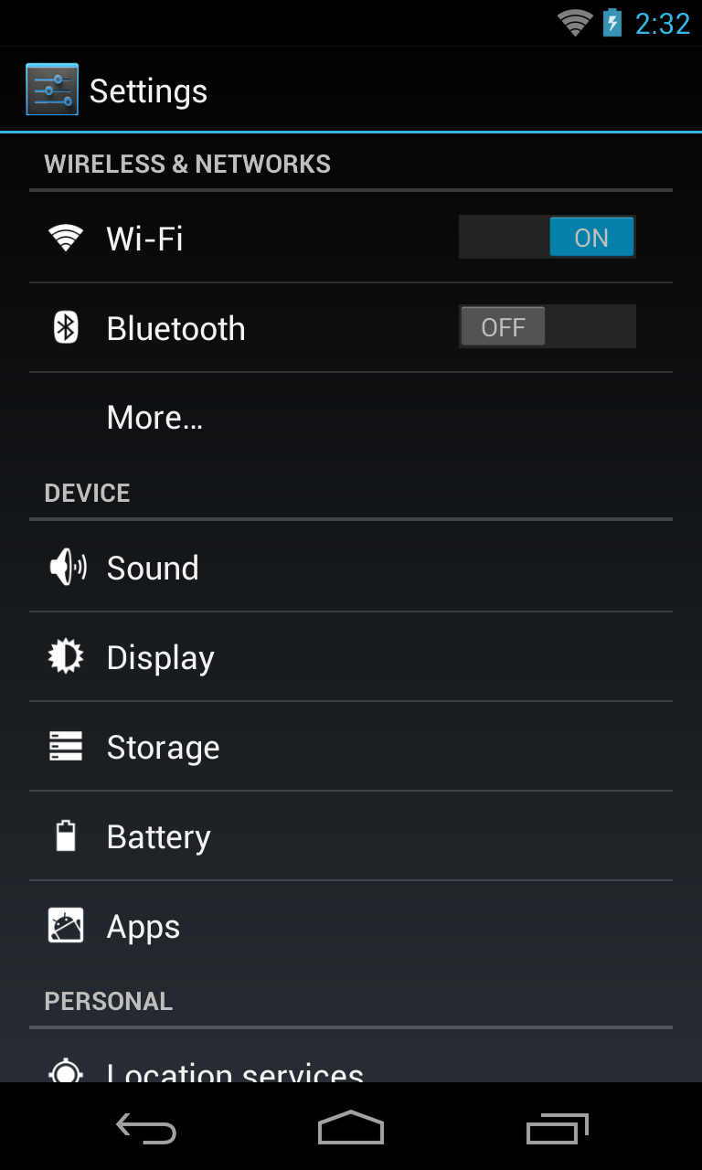
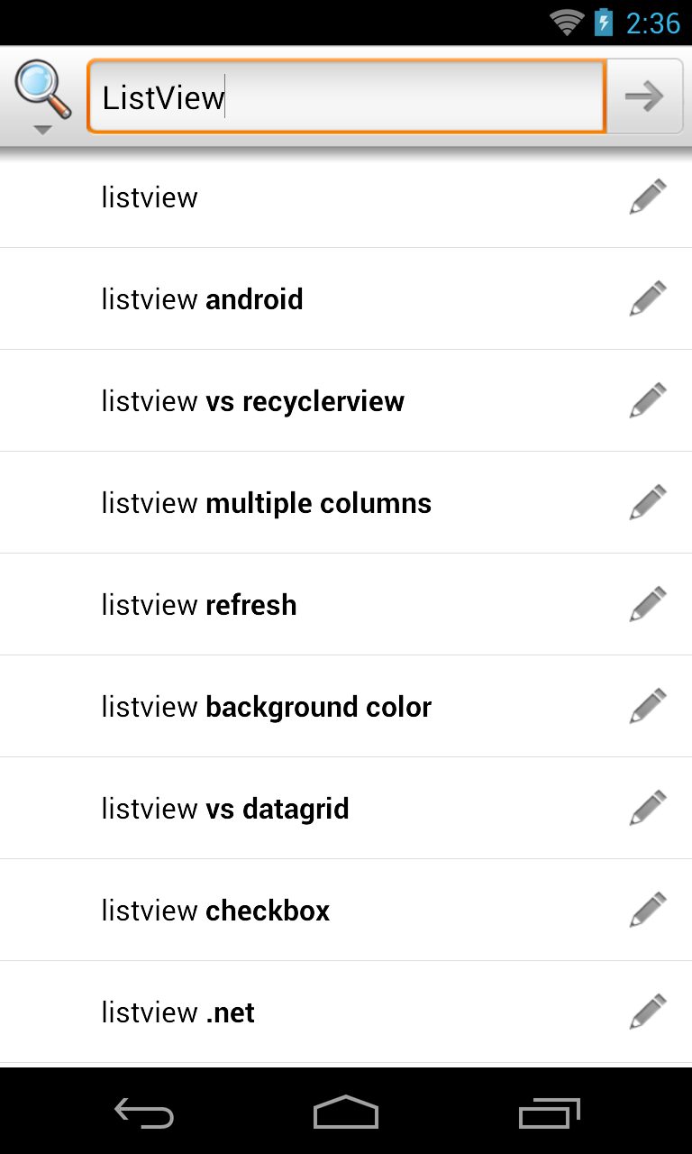
Examples of ListViews

Slide 4
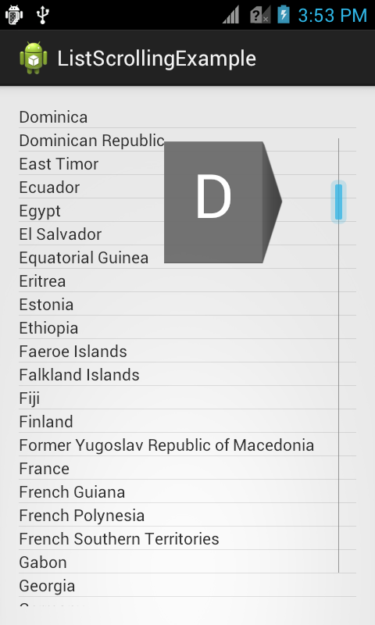
ListView Features
Fast Scrolling
Drag a scroll-bar
Customizable in API 11+
Section Index
Section titles appear while scrolling

Slide 5
Parts of a ListView
The ListView displays a list of scrollable View objects.
Each View object is a row in the list
A ListView requires a data adapter
An adapter is a non-visible object that binds a data source to a ListView

Slide 6
ListActivity
A class that inherits from the Activity class and has a ListView filling the entire screen

Slide 7
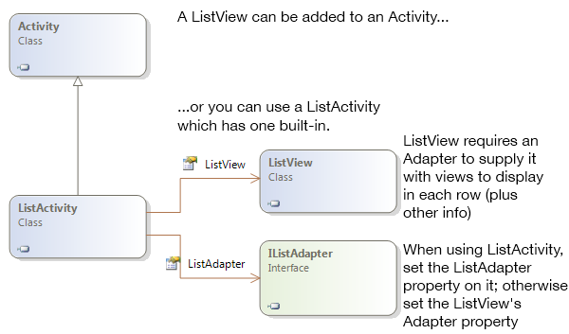
ListActivity
The ListView displays a list of scrollable View objects.
Each View object is a row in the list
A ListView requires a data adapter
An adapter is a non-visible object that binds a data source to a ListView

Slide 8
Adapters
Five types of adapters:
BaseAdapter<T> – abstract class, needs to be sub-classed
SimpleAdapter<T> – source is a List of Dictionary objects
ArrayAdapter<T> – source is an array of type T
CursorAdapter – abstract class, needs to be sub-classed
SimpleCursorAdapter – source is a SQLite cursor

Slide 9
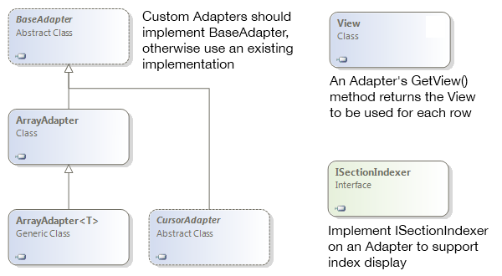
Adapters

Slide 10
BaseAdapter<T>
Create a custom adapter by sub-classing BaseAdapter<T> (a generic class)
Can also be used as a data adapter for Spinner widgets
Notes:
Xamarin API documentation: https://developer.xamarin.com/api/type/Android.Widget.SimpleAdapter/

Slide 11
BaseAdapter<T> Inheritance
Object
abstract Android.Widget.BaseAdapter
abstract Android.Widget.BaseAdapter<T>
Note: All abstract methods in an abstract class must be implemented by the inheriting class.
Notes:
Xamarin API documentation: https://developer.xamarin.com/api/type/Android.Widget.ArrayAdapter/
Android Developer’s API documentation: https://developer.android.com/reference/android/widget/ArrayAdapter.html

Slide 12
BaseAdapter Public Overridable Methods
override Object GetItem (Int32)
Get the data item for specified position in the data set
abstract Int64 GetItemId (Int32)
Get the row id for the specified position in the data set
abstract View GetView (Int32, View, ViewGroup)
Get a View with the data at the specified position in the data set
Notes:
Xamarin API documentation: https://developer.xamarin.com/api/type/Android.Widget.ArrayAdapter/
Android Developer’s API documentation: https://developer.android.com/reference/android/widget/ArrayAdapter.html

Slide 13
BaseAdapter Public Overridable Properties
abstract Int32 Count
Get a count of the items in the data set
override T this[int position]
Indexer for the data set
Notes:
Xamarin API documentation: https://developer.xamarin.com/api/type/Android.Widget.ArrayAdapter/
Android Developer’s API documentation: https://developer.android.com/reference/android/widget/ArrayAdapter.html

Slide 14
BaseAdapter<T> Example
ListActivityDemo-VocabularyParseSectionIndex
Project: CustomAdapterDemo
Define a custom class that inherits from BaseAdapter
In the OnCreate method of an Activity that sub-classes ListActivity:
Create an instance of the custom adapter
Add data to the data set in the custom adapter
Set the ListAdapter property to the custom adapter object
Notes:
https://github.com/LCC-CIT/CS235AM-Demos/tree/master/ListActivityDemo-VocabParseSecIndex/ListActivityDemo

Slide 15
Array Adapter<T>
Uses an Array<T> as a data source (Generic array)
Also used for Spinner widgets
Notes:
Xamarin API documentation: https://developer.xamarin.com/api/type/Android.Widget.SimpleAdapter/

Slide 16
ArrayAdapter<T> Inheritance
Object
abstract Android.Widget.BaseAdapter
Android.Widget.ArrayAdapter
Android.Widget.ArrayAdapter<T>
Notes:
Xamarin API documentation: https://developer.xamarin.com/api/type/Android.Widget.ArrayAdapter/
Android Developer’s API documentation: https://developer.android.com/reference/android/widget/ArrayAdapter.html

Slide 17
ArrayAdapter<T> Public Overridable Methods
override T GetItem (Int32)
Get the data item for specified position in the data set
override Int64 GetItemId (Int32)
Get the row id for the specified position in the data set
override View GetView (Int32, View, ViewGroup)
Get a View with the data at the specified position in the data set
Notes:
Xamarin API documentation: https://developer.xamarin.com/api/type/Android.Widget.ArrayAdapter/
Android Developer’s API documentation: https://developer.android.com/reference/android/widget/ArrayAdapter.html

Slide 18
ArrayAdapter<T> Constructor (just one of 6 overrides)
Context context
Reference to the Activity that uses this adapter
Int32 resource
Resource identifier of layout for the rows
Object[ ] objects
The array data source to which the ListView will be bound
Notes:
Xamarin API documentation: https://developer.xamarin.com/api/type/Android.Widget.SimpleAdapter/
Android Developer’s API documentation: https://developer.android.com/reference/android/widget/SimpleAdapter.html

Slide 19
ArrayAdapter<T> Example
ListActivityDemo-VocabularyParseSectionIndex
Project: ListActivityDemo
In the ListActivity
Create an array of data items
In the activity’s OnCreate method:
Instantiate an ArrayAdapter<T> object passing the array of data items into the constructor.
Set the ListAdapter property to the ArrayAdapter<T> instance you just created.
Notes:
https://github.com/LCC-CIT/CS235AM-Demos/tree/master/ListActivityDemo-VocabParseSecIndex/ListActivityDemo

Slide 20
Simple Adapter<T>
Uses a List of Dictionary objects as a data source
Works especially well with the .NET XmlReader class
Notes:
Xamarin API documentation: https://developer.xamarin.com/api/type/Android.Widget.SimpleAdapter/

Slide 21
Simple Adapter<T> Inheritance
Object
abstract Android.Widget.BaseAdapter
Android.Widget.SimpleAdapter<T>
Notes:
Xamarin API documentation: https://developer.xamarin.com/api/type/Android.Widget.SimpleAdapter/
Android Developer’s API documentation: https://developer.android.com/reference/android/widget/SimpleAdapter.html

Slide 22
Simple Adapter<T> Constructor
Context context – Reference to the host Activity
IList<IDictionary<string, object>> data – The data set
Int32 resource – Resource identifier for a row layout
String[ ] from – Dictionary keys for columns
Int32[ ] to – Resource ID of each column’s TextViews
Notes:
Xamarin API documentation: https://developer.xamarin.com/api/type/Android.Widget.SimpleAdapter/
Android Developer’s API documentation: https://developer.android.com/reference/android/widget/SimpleAdapter.html

Slide 23
Simple Adapter<T> Overridable Methods
Object GetItem (Int32)
Get the data item for the specified position in the data set
Int64 GetItemId (Int32)
Get the row id for the specified position in the data set
View GetView (Int32, View, ViewGroup)
Get a View for the data at the specified position
Note: Overriding these methods is optional
Notes:
Xamarin API documentation: https://developer.xamarin.com/api/type/Android.Widget.SimpleAdapter/
Android Developer’s API documentation: https://developer.android.com/reference/android/widget/SimpleAdapter.html

Slide 24
Simple Adapter<T> Example
ListActivityDemo-VocabularyParseSectionIndex
Project: ListActivity+SimpleAdapter+XmlFile
In the activity’s OnCreate method:
Instantiate a SimpleAdapter<T> object
Set the ListAdapter property to the SimpleAdapter<T> instance you just created.
Notes:
https://github.com/LCC-CIT/CS235AM-Demos/tree/master/ListActivityDemo-VocabParseSecIndex

