Slide 1
Fragments Part 2
CS235AM
Android App Development
by Brian Bird
Winter 2018
Lane Community College

Slide 2
In Part 1 …
You learned how to declare and load one fragment. But you need to use two or more fragments to make an adaptive UI. That’s what we’ll cover in this session.

Slide 3
In Part 2 …
You will learn to define two C# fragment classes and the AXML UI layouts for them.
You will set up the Activities so that:
On a small (or normal) sized screen, each fragment will be loaded in a separate activity
On a large screen, both fragments will be loaded side-by-side

Slide 4
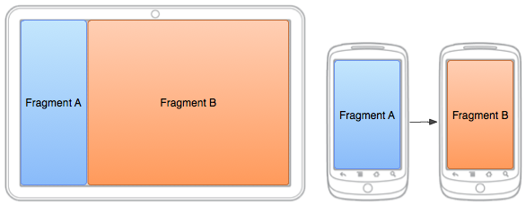
Fragments on Large and Small Screens
Large Screen Small Screen

Slide 5
Small Screen
Each activity loads a single fragment (just like in part 1)
Activity AXML layout: instantiates a Fragment object
Fragment object: inflates fragment AXML UI layout
Fragment AXML UI layout is displayed by the activity
Activity: loads an AXML layout

Slide 6
Large Screen
Activity: loads an AXML layout
AXML layout: instantiates two Fragment objects
Fragment object: inflates AXML UI layout
Fragment object: inflates AXML UI layout
AXML UI layout is displayed by the activity
AXML UI layout is displayed by the activity

Slide 7
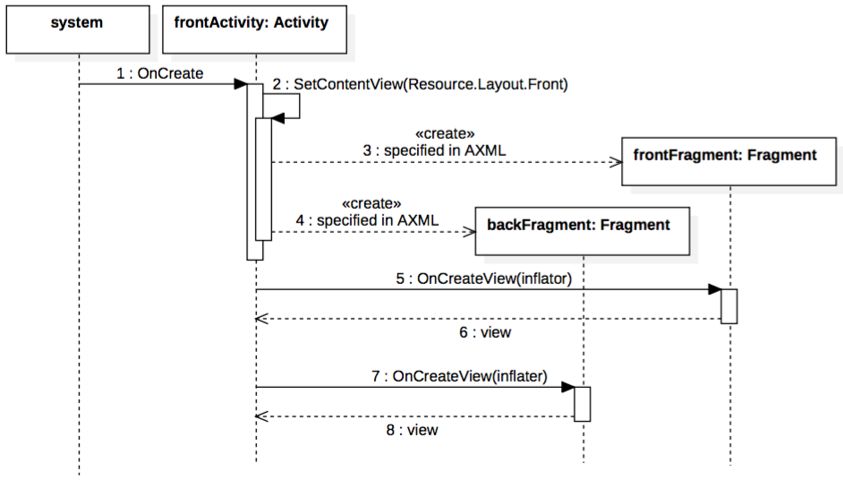
Large Screen Sequence

Slide 8
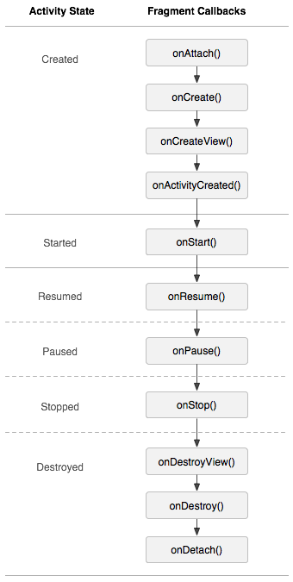
Fragment Life-Cycle

Slide 9
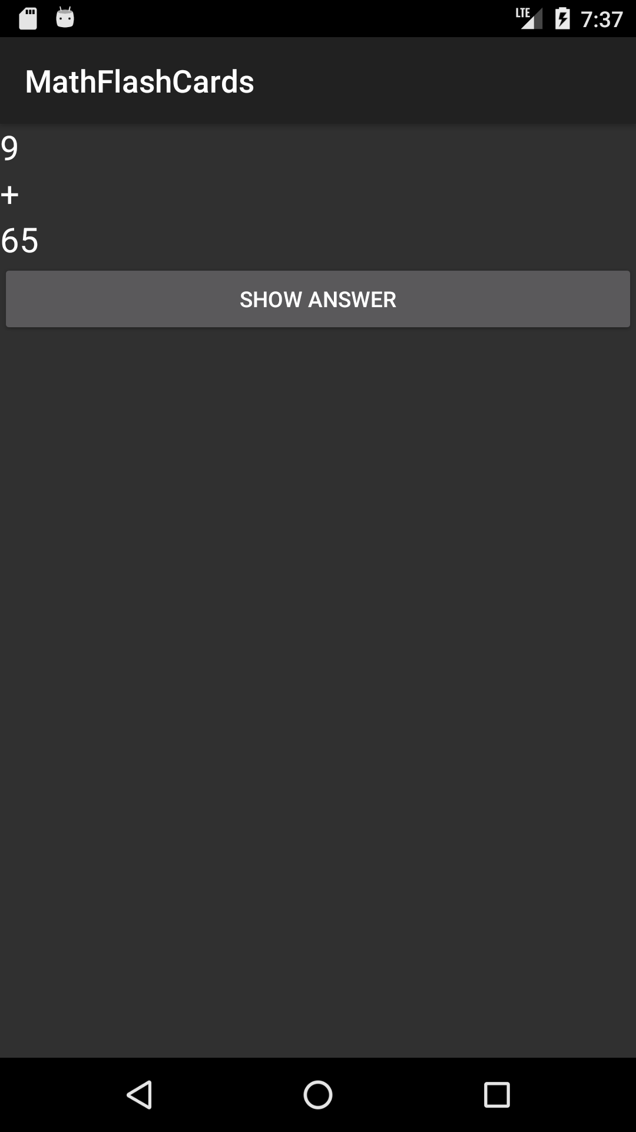
Example: Math Flash Cards

Slide 10
Mission
Modify the MathFlashCards project (which currently has two activities) to adapt to devices with both large and small screens.

Slide 11
Small Screen
Steps to set up the app to use Fragments on a small screen:
Declare two Fragment classes
Make a UI layout for each fragment
Make an layout with a fragment element for each Activity
Put both Activity’s layouts in a folder named layout-small
Add code to inflate the UI in the OnCreateView method of each Fragment class

Slide 12
Large Screen
Steps to set up the app to use Fragments on a small large:
Make an layout for the main Activity with two fragment elements
Put the Activity’s layout in a folder named layout-large

Slide 13
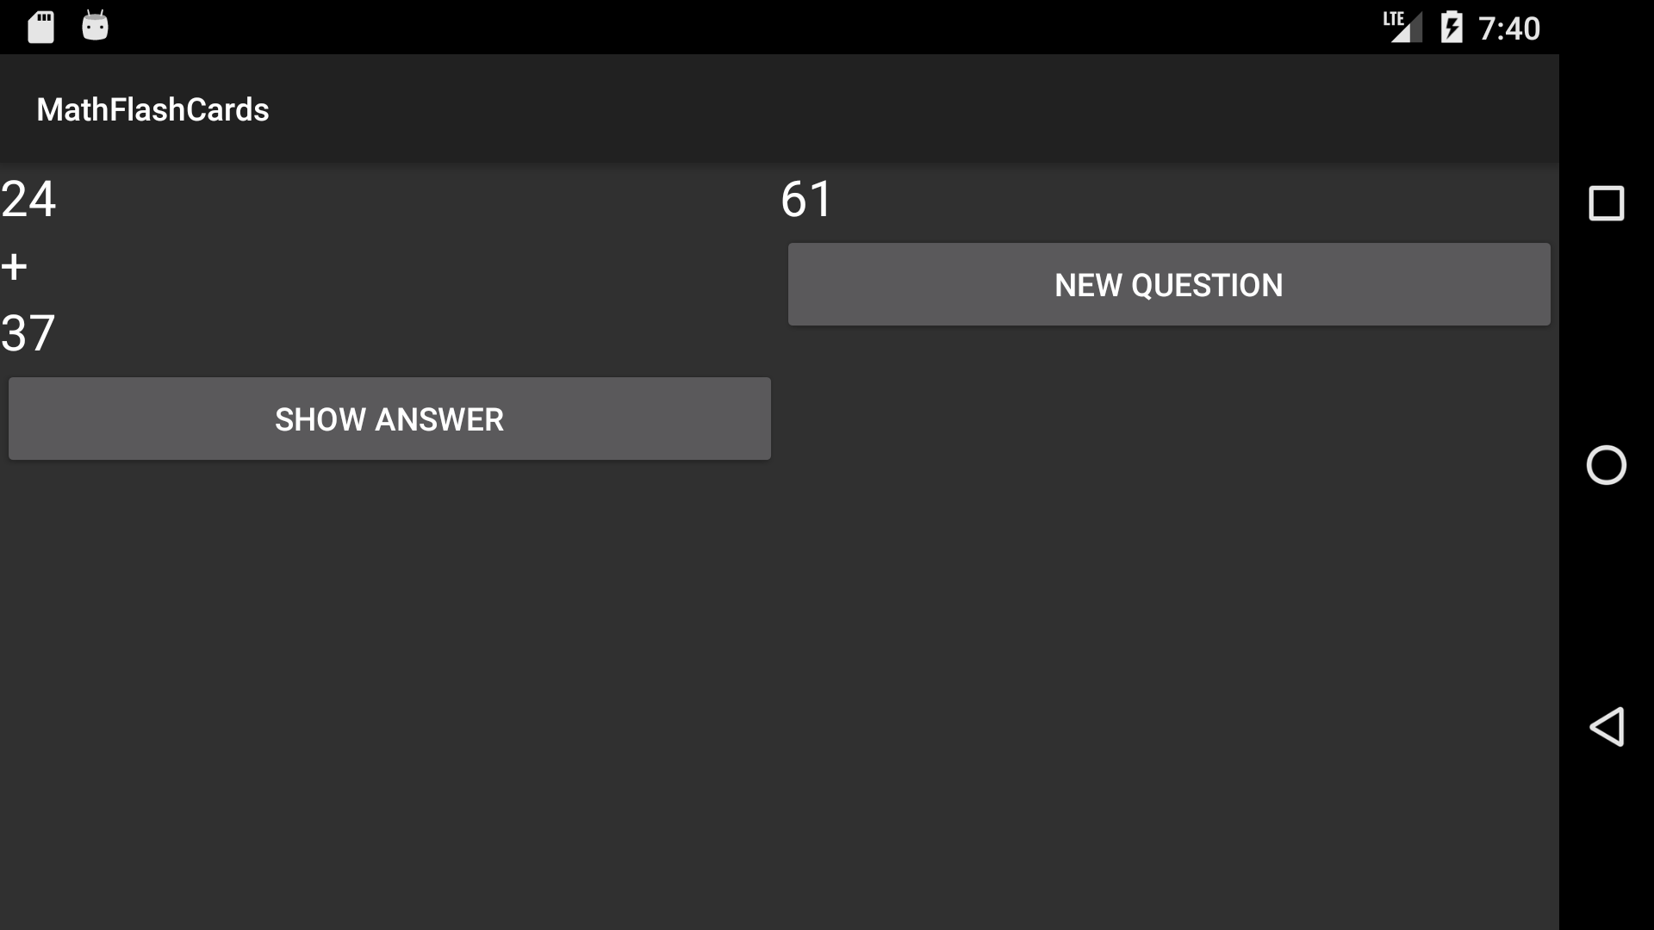
Large Screen

Slide 14
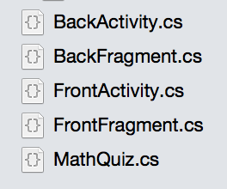
Activity and Fragment Classes

Slide 15
Activity Layout for Large Screen
<?xml version="1.0" encoding="utf-8"?> <LinearLayout xmlns:android="http://schemas.android.com/apk/res/android" android:orientation="vertical" android:layout_width="match_parent" android:layout_height="match_parent"> <fragment android:name="MathFlashCards.FrontFragment" android:id="@+id/frontFragment" android:layout_width="match_parent" android:layout_height="wrap_content" android:layout_weight="1"/> <fragment android:name="MathFlashCards.BackFragment" android:id="@+id/backFragment" android:layout_width="match_parent" android:layout_height="wrap_content" android:layout_weight="1"/> </LinearLayout>

Slide 16
Fragment Elements
<fragment android:name="MathFlashCards.FrontFragment" android:id="@+id/frontFragment" android:layout_width="match_parent" android:layout_height="wrap_content" android:layout_weight="1"/> <fragment android:name="MathFlashCards.BackFragment" android:id="@+id/backFragment" android:layout_width="match_parent" android:layout_height="wrap_content" android:layout_weight="1"/>

Slide 17
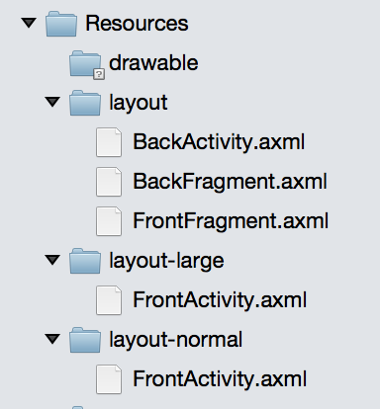
Activity and Fragment Layouts

Slide 18
Add Code to Detect Layout
// See if we're loading two fragments
bool isDualPane = false;
// Only the dual pane layout has a reset button var resetButton = FindViewById<Button>(Resource.Id.resetButton); if (resetButton != null) isDualPane = true;

Slide 19
Add Code for Dual-Pane Layout
In the dual-pane layout you need to do the things that would have been done by the second activity.
For MathFlashCards, you need to:
Handle the Show Answer button differently
Handle the Show Front button

Slide 20
Show Answer Button
showAnswerButton.Click += delegate { if(isDualPane) { answerTextView.Text = quiz.CalcSum().ToString(); } else { var back = new Intent(this, typeof(BackActivity)); back.PutExtra("Answer", quiz.CalcSum()); StartActivity(back); }
};

Slide 21
Show Front Button
Change the Button text to “New Problem”
if (resetButton != null { isDualPane = true; resetButton.Click += delegate { answerTextView.Text = ""; ShowNewQuestion(); }; }

Slide 22
Add a Landscape Layout
In the Resources Folder add:
layout-normal-land
layout-large-land
Put a copy of FrontActivity.axml in each folder
Change the orientation of the LinearLayout to horizontal
Change the width and height of the fragment elements. (reverse match_parent and wrap_content).

Slide 23
All Done!
Next topic: Loading fragments programmatically

